Slide 1
The Lightning Instrument Package Dataset
Presented by
Christopher J. Schultz
NASA/Marshall Space Flight Center
LIP Team:
Monte Bateman, Doug Mach, Sebastian Harkema, Timothy Lang, Michael Stewart, Scott Podgorny, David Corridor, Mason Quick, Rich Blakeslee, Patrick Duran
IMPACTS Data Science Team Meeting
26 October 2022

Slide 2
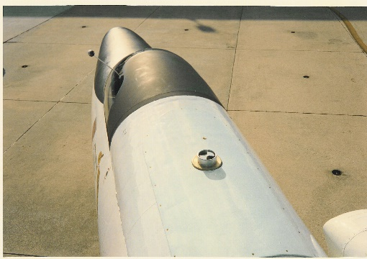
LIP Measurements
Instrumentation
Electric Field Mills (7)
Measurements
Vector components of the electric field ( E_{x} , E_{y} , E_{z} )
Aircraft Charge
Lightning statistics ( identified from electric field changes )
Storm electric currents (derived result )
Storm charge structure (derived result )
Measurement Range / Accuracy
Electric Field : 1 V/m to 512 kV/m within 5% accuracy

Slide 3
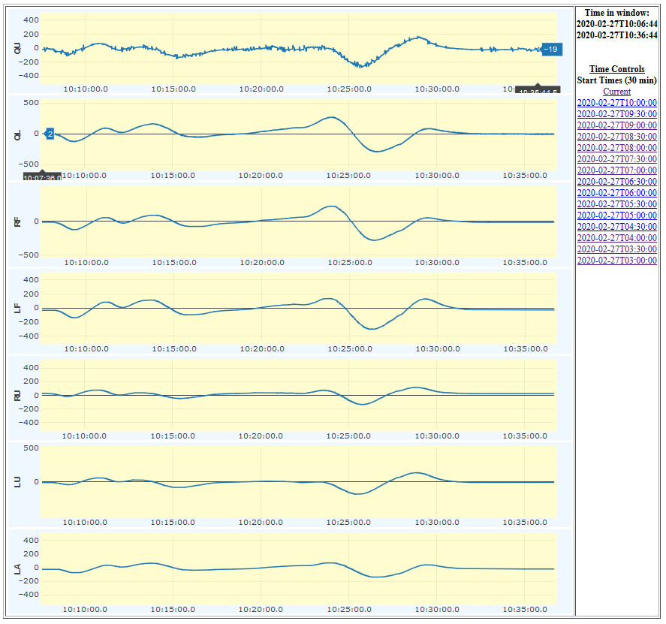
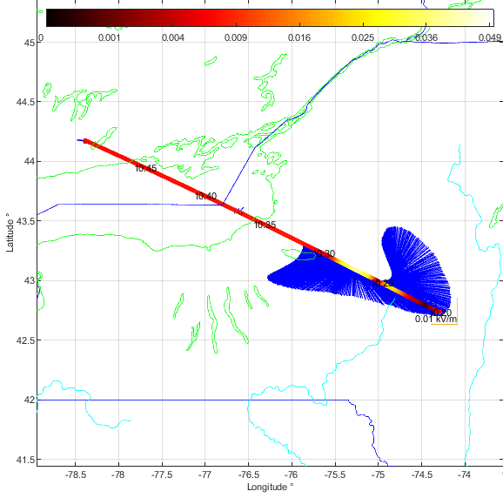
LIP Data Resolution and Products
Electric field components (Ex, Ey, and Ez) and aircraft self-charge
period: continuous record, entire flight
resolution: 0.1s (data are oversampled at 50 Hz)
comments: Total lightning (cloud-to-ground, intracloud) determined from electric field changes. Data also provides information on the electrical structure within and around the thunderstorms overflown.
B. Real-time monitoring
period: continuous, entire flight
resolution: 0.1s to a few seconds
comments: Electric fields will be monitored in real-time for mission situational awareness and guidance
Real-time electric field monitoring during the 27 February 2020 Flight.
Canada
NY
PA

Slide 4
Data Format
Time (UTC) Ex Ey Ez Eq (kV/m) roll pitch heading lat lon (degrees) altitude (km) En Ew Eu Em (kV/m)
Ascii format
10 samples per second
Ex, Ey, and Ez are the horizontal and vertical components of the electric field in the reference frame of the aircraft; Eq is the total electric field magnitude.
Ex is toward the nose, Ey is toward the left wing, and Ez is toward the top of the tail.
En, Ew, and Eu are the horizontal and vertical components relative to earth. Em is the total electric field magnitude.
En is north, Ew is West, and Eu is up.
***These are independent of aircraft orientation.***
https://ghrc.nsstc.nasa.gov/pub/fieldCampaigns/impacts/LIP/data/

Slide 5
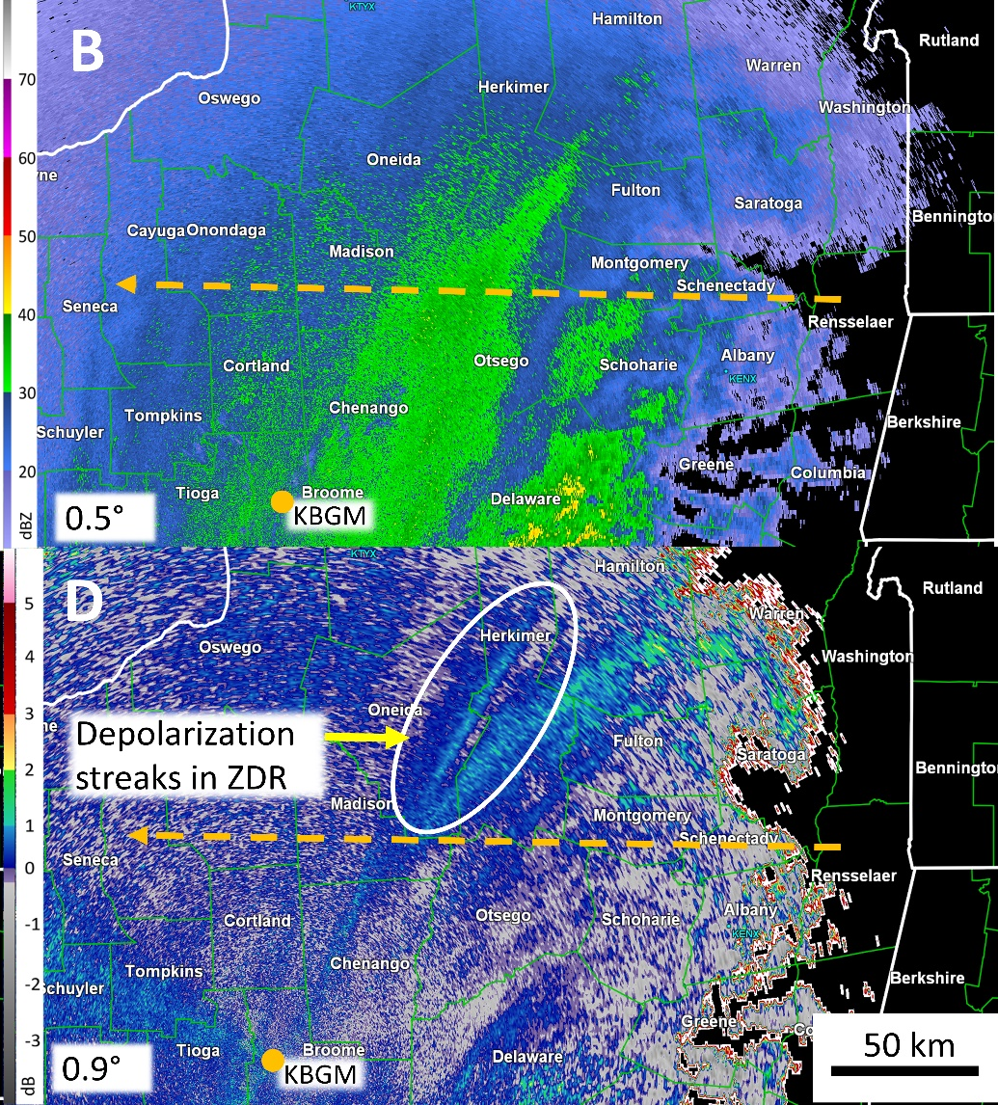
How have we used the data?
Schultz et al. 2021, JGR

Slide 6
How have we used the data?
Simulate electric fields within NASA’s Unified WRF and compare directly to the aircraft measurements
Dashed purple line LIP
Solid Purple line, NU-WRF with WRF-Elect
Courtesy Sebastian Harkema, will be presented at AMS

Slide 7
Questions? Ask one of us!
LIP Team POCs
Chris Schultz (christopher.j.schultz@nasa.gov)
Doug Mach (dmach@nasa.gov)
Monte Bateman (monte.bateman@nasa.gov)
Timothy Lang (timothy.j.lang@nasa.gov)
Mason Quick (mason.quick@nasa.gov)
GHRC DAAC POCs
Leigh Sinclair (slb0012@uah.edu)
Geoffrey Stano (gts0007@uah.edu)
https://agupubs.onlinelibrary.wiley.com/doi/epdf/10.1029/2021JD034704

