Slide 1
IMPACTS Ancillary Products
Stacy Brodzik
University of Washington
27 October 2022
Given by Joe Finlon
University of Washington

Slide 2
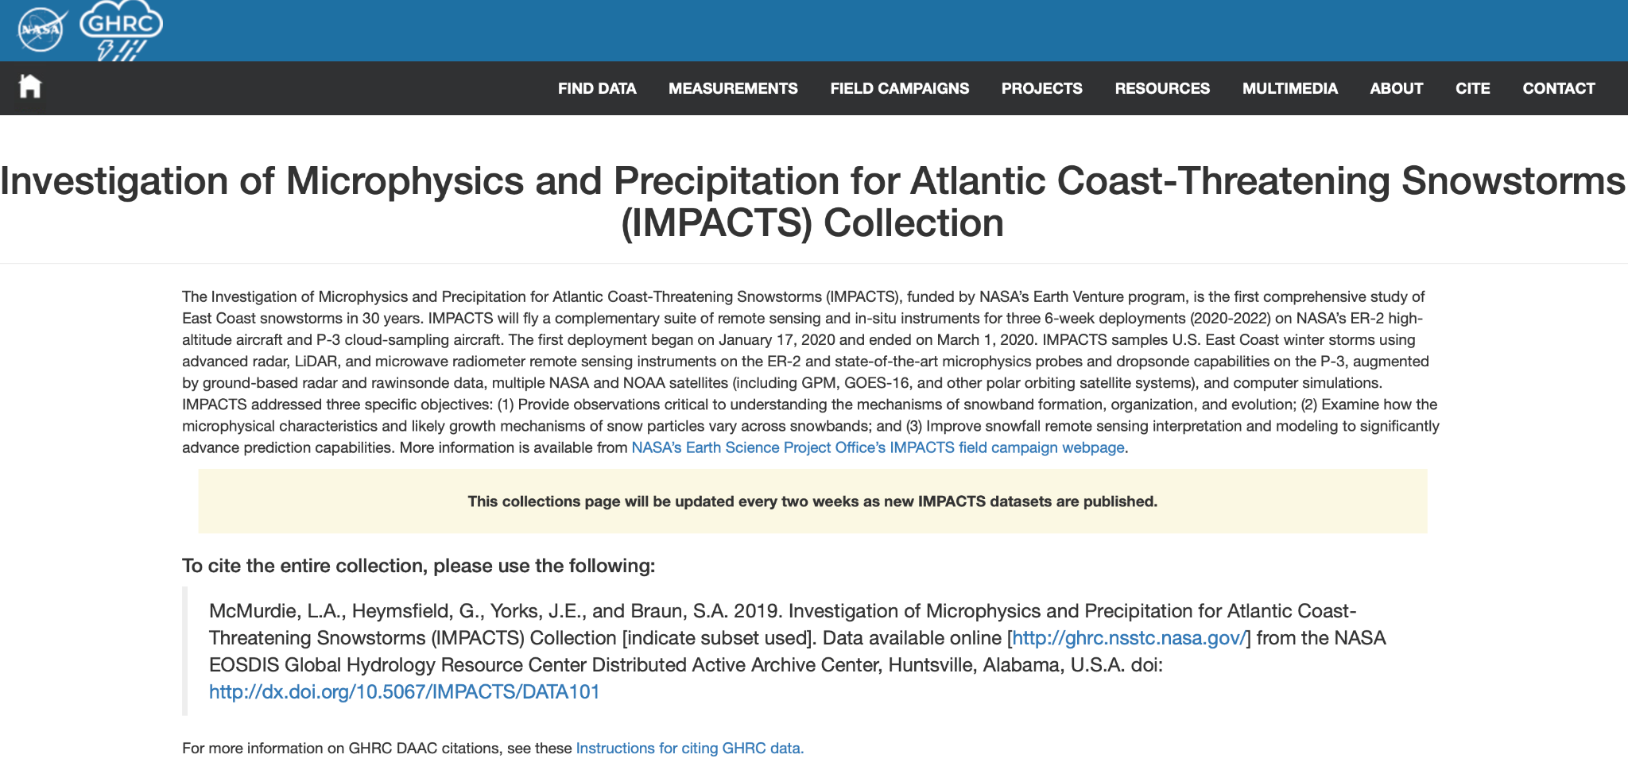
Location of Data
All data mentioned in this talk is available from the DAAC:
https://ghrc.nsstc.nasa.gov/uso/ds_details/collections/impactsC.html

Slide 3
Data sets
Satellite: GOES-16 (netcdf)
Channel 2 (visible)
Channel 8 (water vapor)
Channel 13 (infrared)
Lidar
Stonybrook Ceilometer (netcdf)
NY State Mesonet Lidar (from vendor only)
Model: Stonybrook WRF GFS (4, 12, 36km) (wrfout)

Slide 4
Data sets
Radar: MRMS (NEXRAD Composite) (netcdf)
Reflectivity (3D, 2D Composite)
KDP
RhoHV
Spectral Width
ZDR
Radar - Other (netcdf)
MRR (netcdf)
U of Albany
Stonybrook

Slide 5
Data sets
Surface (netcdf)
Automated Surface Observing Systems (ASOS) (netcdf)
NY State Mesonet (from vendor only)
https://www2.nysmesonet.org
GPM GV site at UConn provided by D. Wolff
Parsivel, Pluvio, PIP
Parsivel (netcdf)
U of Albany
Stonybrook Mobile Truck
Pluvio: Stonybrook (ascii csv)
Upper Air (netcdf)
NOAA Operational Soundings

Slide 6
Thank You
Questions or Comments??
srbrodzik@gmail.com

