Slide 1
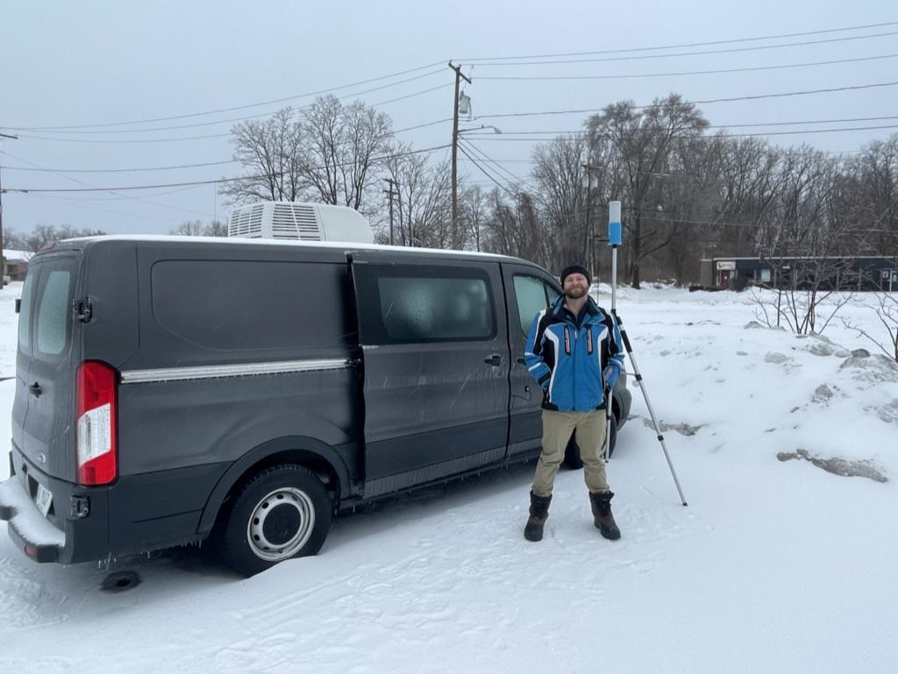
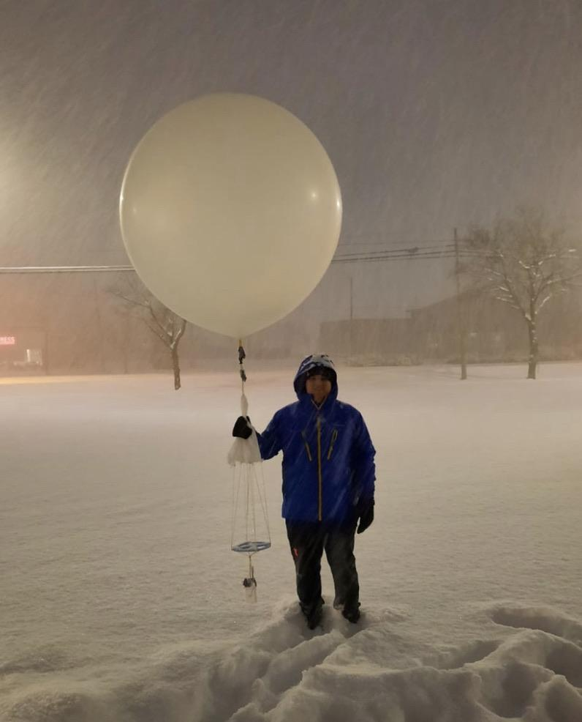
University of Illinois Mobile Rawinsonde Launches during the 2022 IMPACTS Field Campaign Deployment
Andrew Janiszeski¹, Troy J. Zaremba¹, and Robert M. Rauber¹
¹University of Illinois Urbana-Champaign
IMPACTS Science Team Meeting | Summer 2022

Slide 2
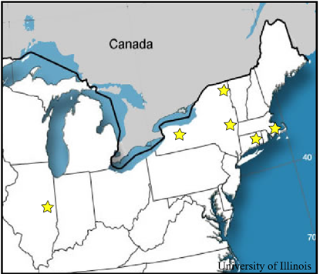
Location of Launches
Table 1: Launch Site locations IMPACTS 2022
Binghamton
Rawinsonde Launch Locations
Site | Latitude | Longitude | Sondes Launched
Geneseo, NY | 42.800 | -77.812 | 4
Plymouth, MA | 41.959 | -70.671 | 5
Albany, NY | 42.687 | -73.853 | 6
Vernon, CT | 41.824 | -72.502 | 4
Plattsburgh, NY | 44.695 | -73.500 | 3
Urbana, IL | 40.116 | -88.253 | 2
IMPACTS Science Team Meeting | Summer 2022

Slide 3
Quality Assessment
Sondes were checked prior to launch to verify that temperature, relative humidity, and pressure for the sonde were properly referencing surface conditions
Found one broken sonde and one sonde that was not recording relative humidity
Rawinsondes were iMet-4 Radiosondes that had an accuracy of ±0.2℃ for temperature, ±5% for relative humidity and ±0.2 m s⁻¹
IMPACTS Science Team Meeting | Summer 2022

Slide 4
Data Format
Field Name | Description | Data Type | Unit
TC | Temperature | float64 | ℃
RH | Relative Humidity | float64 | %
Time | Time in seconds past launch | timedelta64[ns] | ns
HAGL | Height above ground level | float64 | m
PRESS | Pressure | float64 | m s⁻¹
WINDSPD | Wind speed | float64 | mb
WINDDRN | Wind direction | float64 | °
LAT | Latitude | float64 | °
LON | Longitude | float64 | °
Soundings are available to download at: https://search.earthdata.nasa.gov/search?q=uiucsndimpacts/&ghrccloud/data/
Data is in netCDF4 format
Naming convention: IMPACTS_UIUC_Mobile_research_sounding_YYYYMMDD_hhmm.nc
Attribute information contained in each file includes latitude, longitude, start time, and starting altitude
IMPACTS Science Team Meeting | Summer 2022

Slide 5
How to View Soundings
Soundings are netCDF4 and do not require any specific software to read in
Can be easily read into and plotted using Python or Matlab
Also can be viewed using Panoply
Quick looks are available on the IMPACTS field catalog: http://catalog.eol.ucar.edu/impacts_2022 under Upper Air and then UIUC
IMPACTS Science Team Meeting | Summer 2022

Slide 6
Issues
There are no known issues or gaps in the data. The only issues we noticed occurred on January 29th
Jan 29th:
18z launch below ~ 800 mb T/T_{d} is likely inaccurate (bad communication)
20z launch has no lat/lon data
IMPACTS Science Team Meeting | Summer 2022

Slide 7
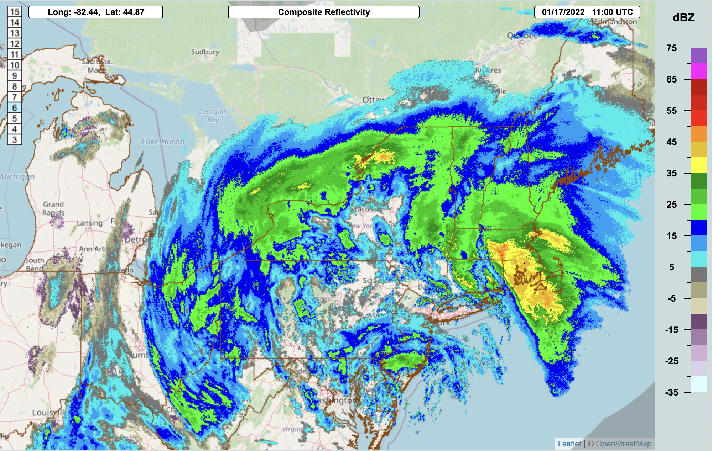
Geneseo, New York - January 17th
UIUC
IMPACTS Science Team Meeting | Summer 2022

Slide 8
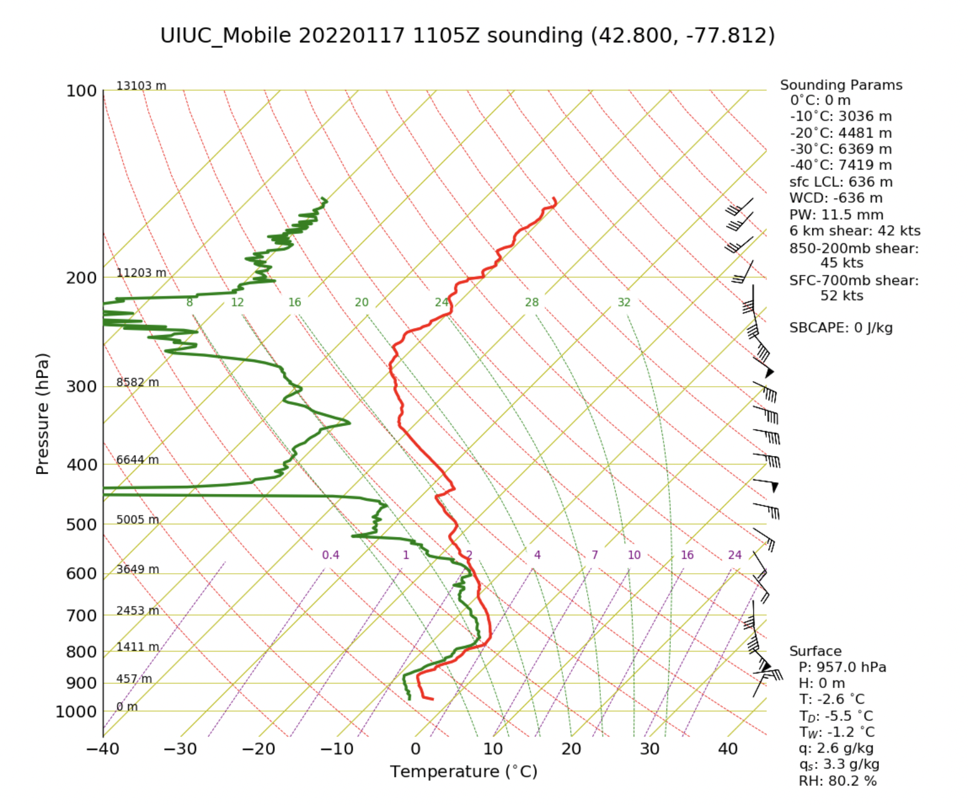
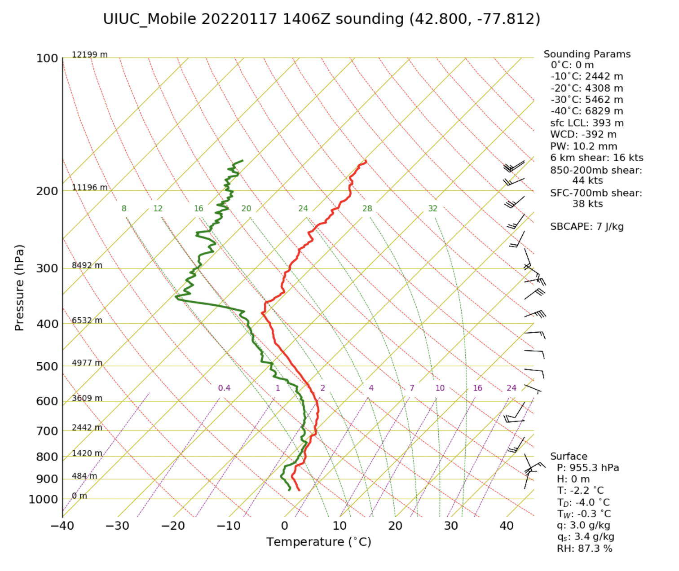
Geneseo, New York - January 17th
IMPACTS Science Team Meeting | Summer 2022

Slide 9
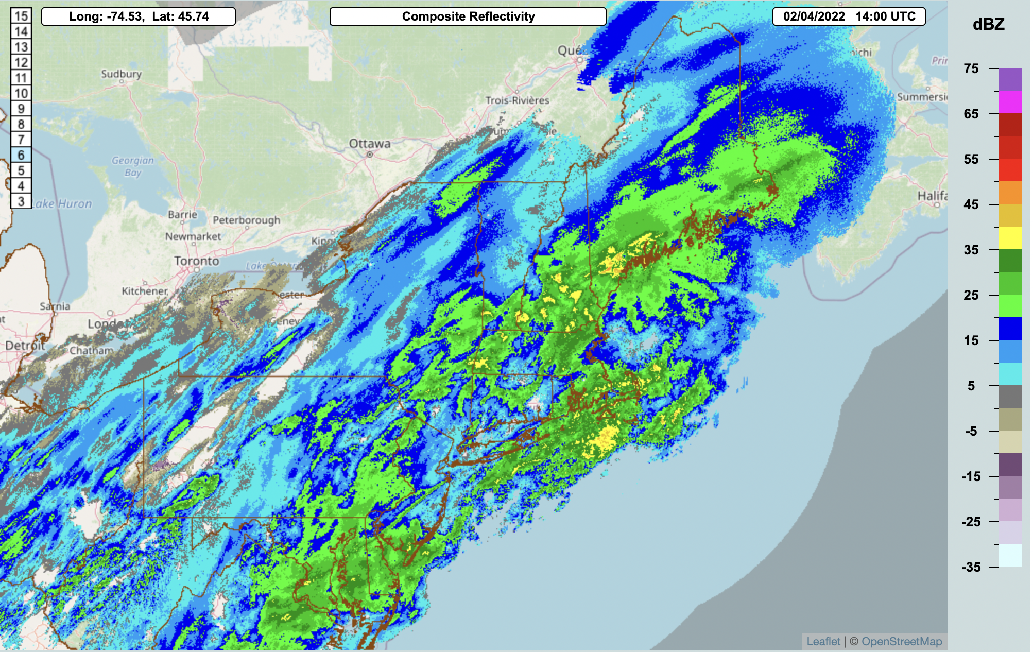
Albany, New York - February 4th
UIUC
IMPACTS Science Team Meeting | Summer 2022

Slide 10
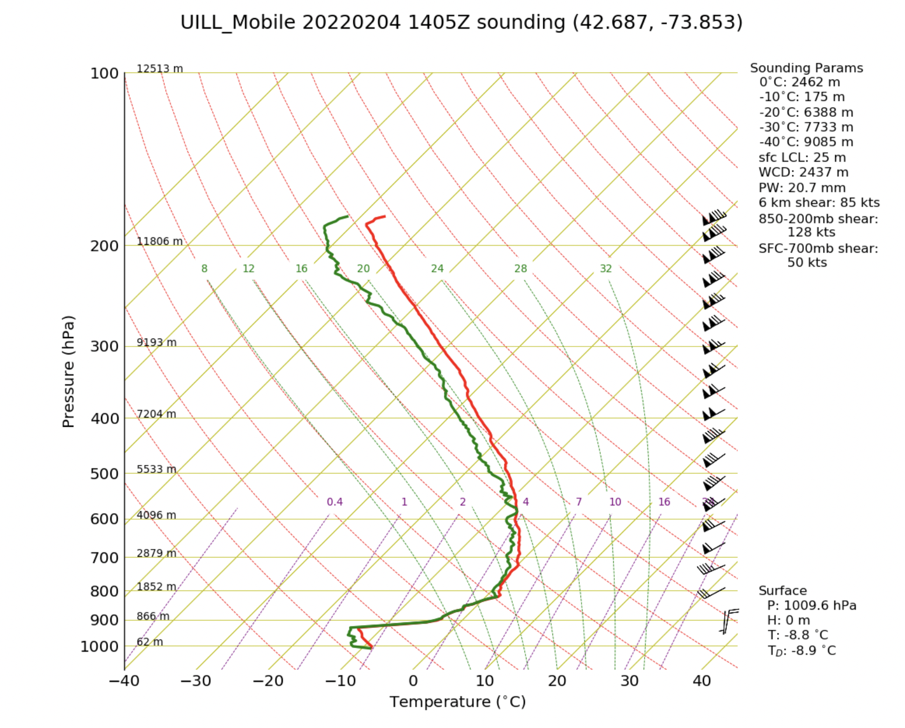
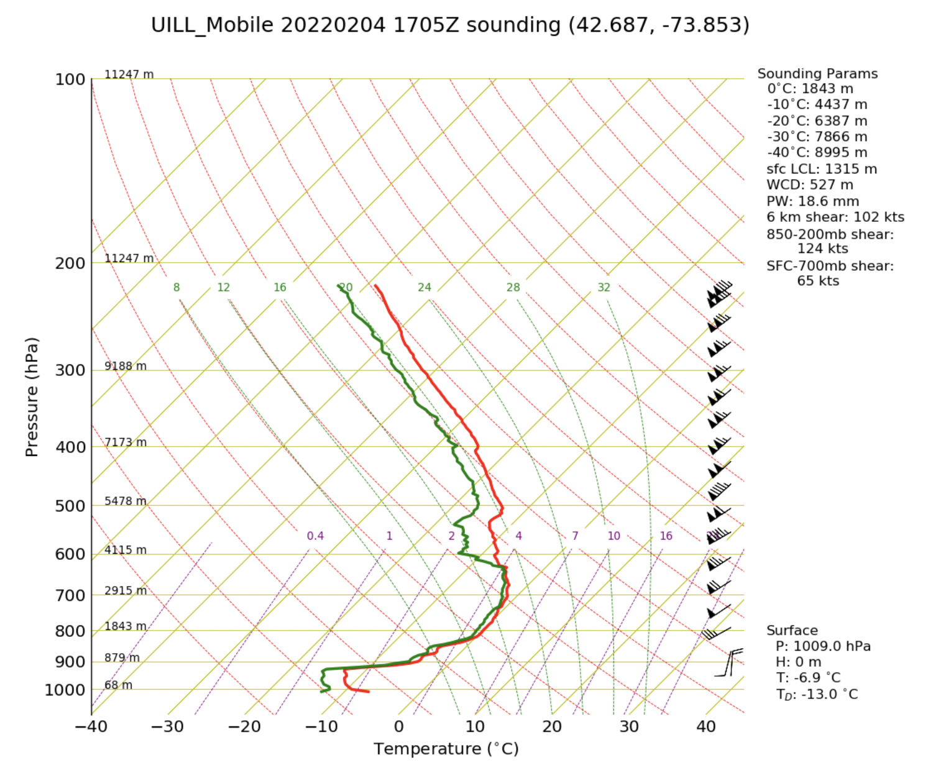
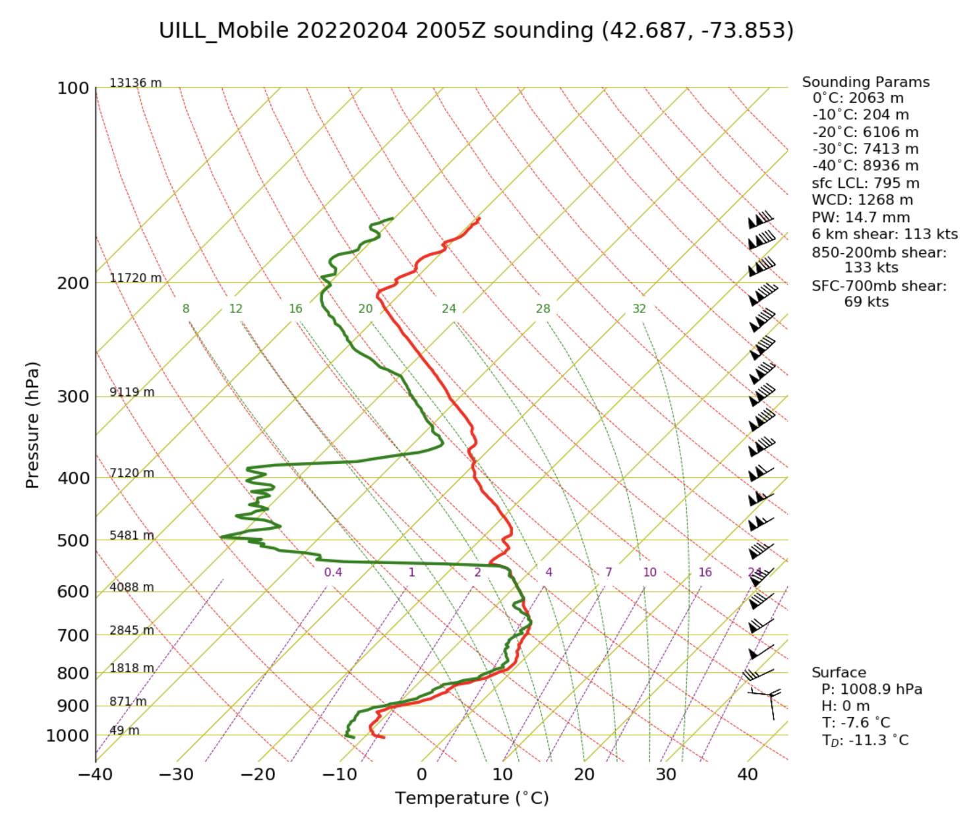
Albany, New York - February 4th
IMPACTS Science Team Meeting | Summer 2022

Slide 11
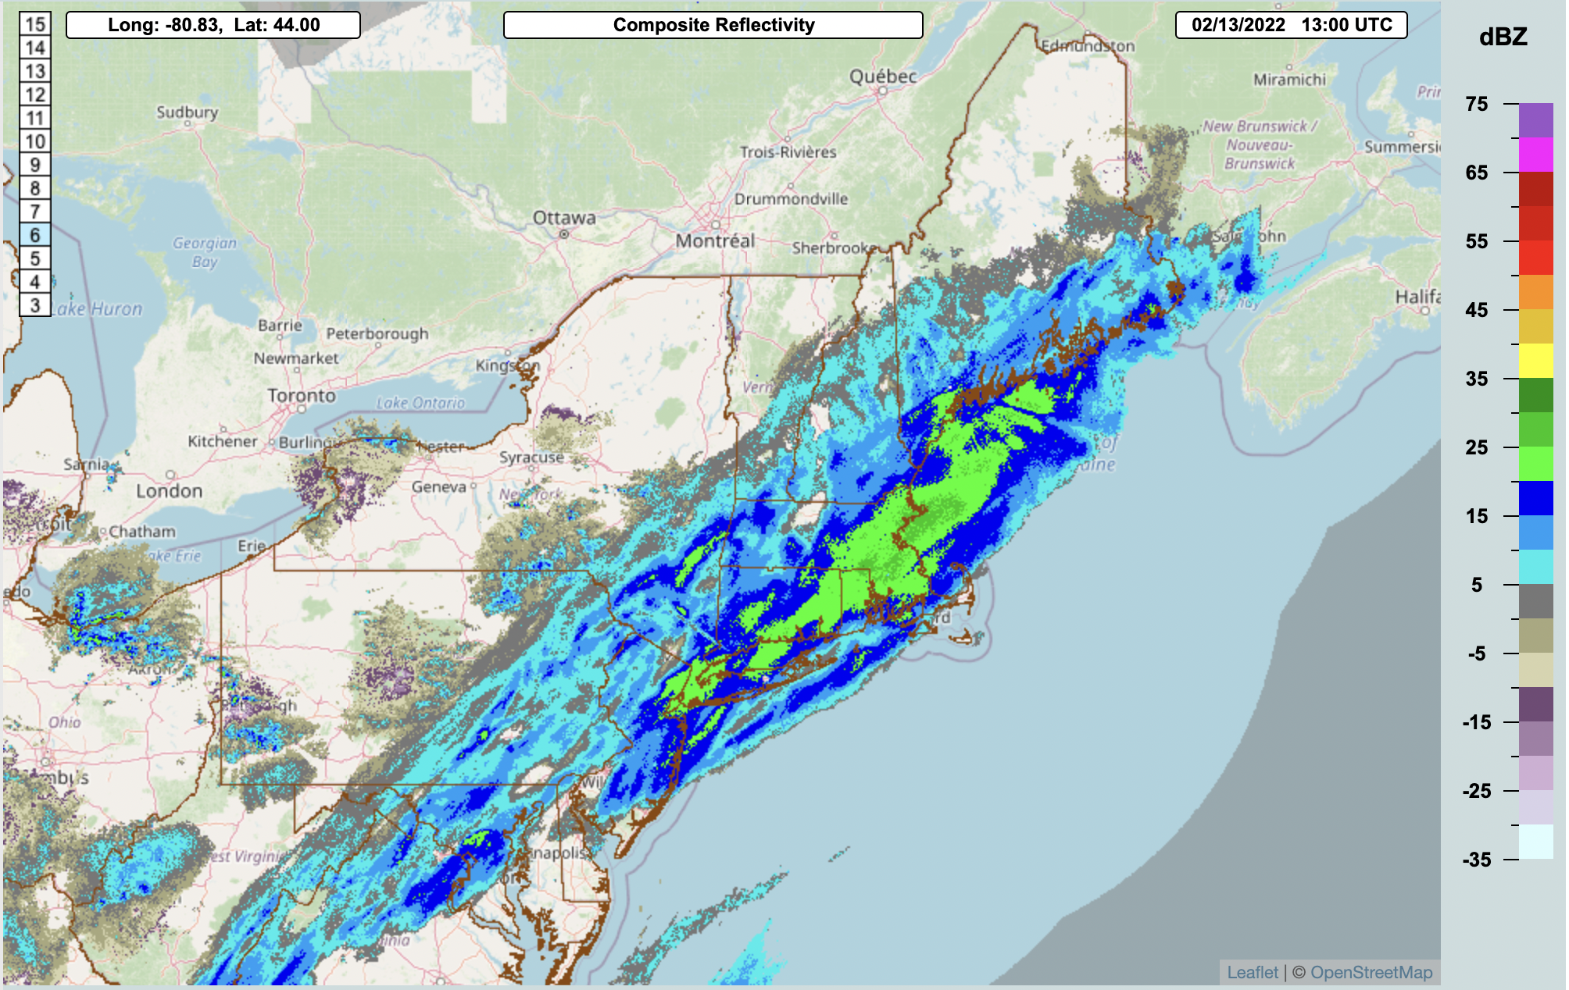
Hartford, Connecticut - February 13th
UIUC
IMPACTS Science Team Meeting | Summer 2022

Slide 12
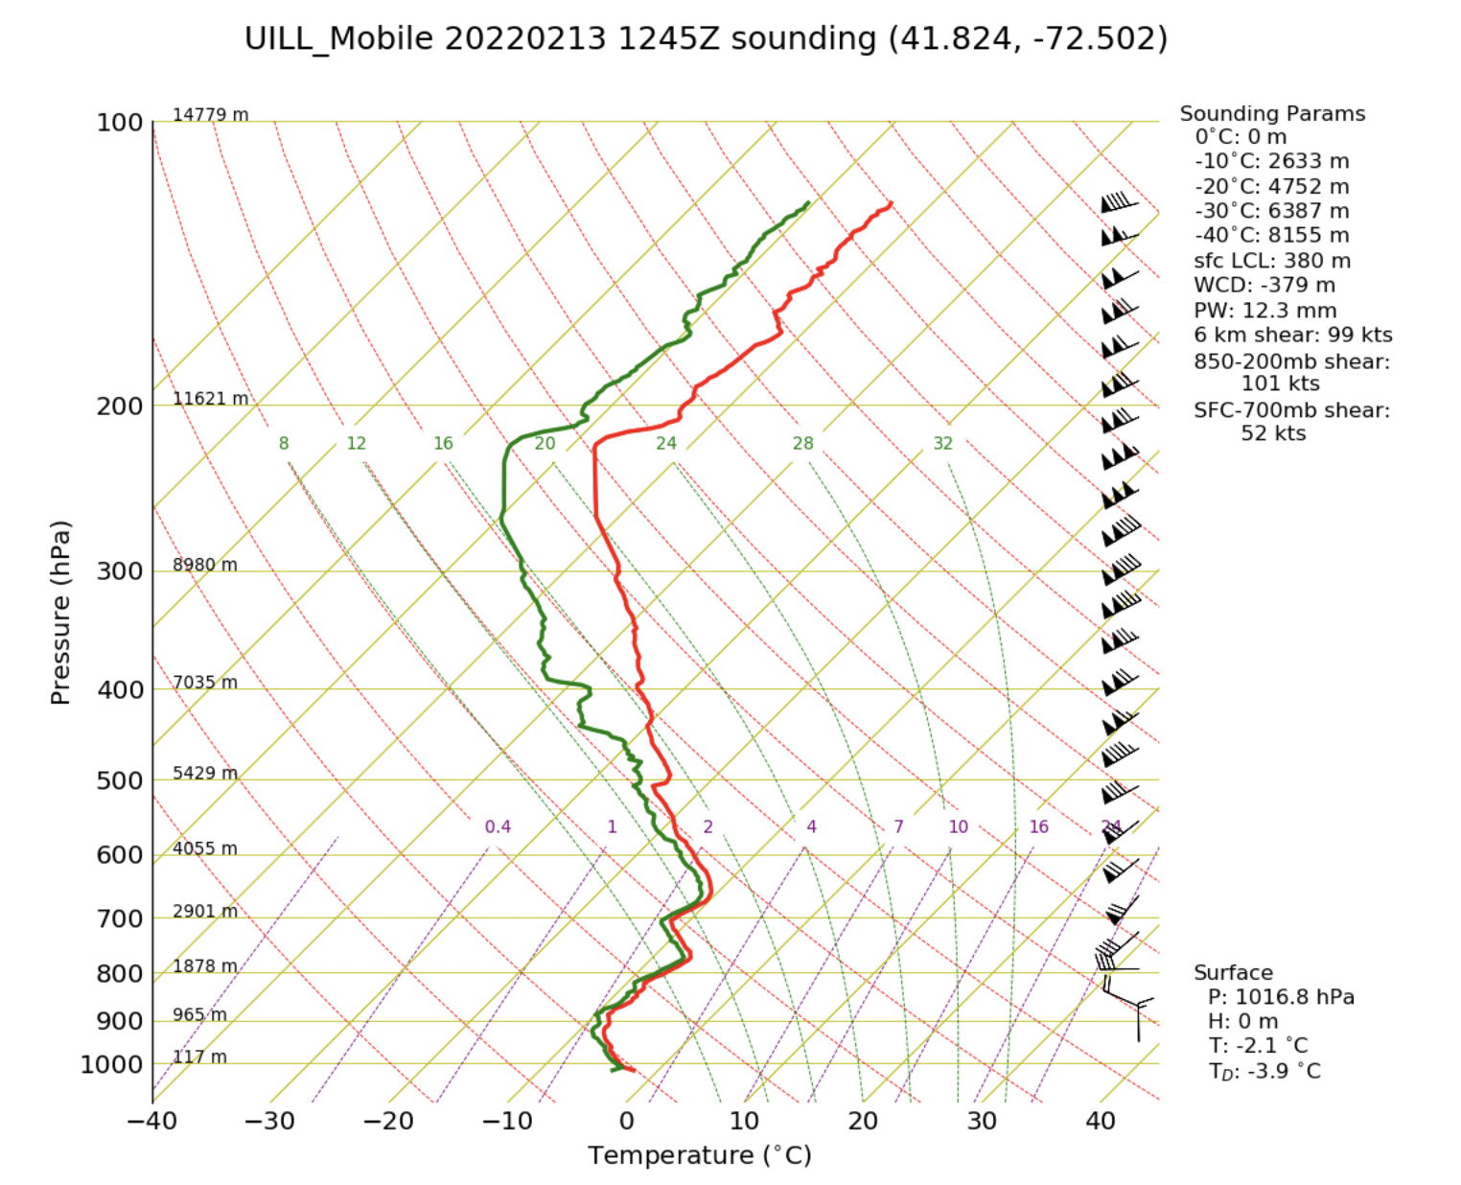
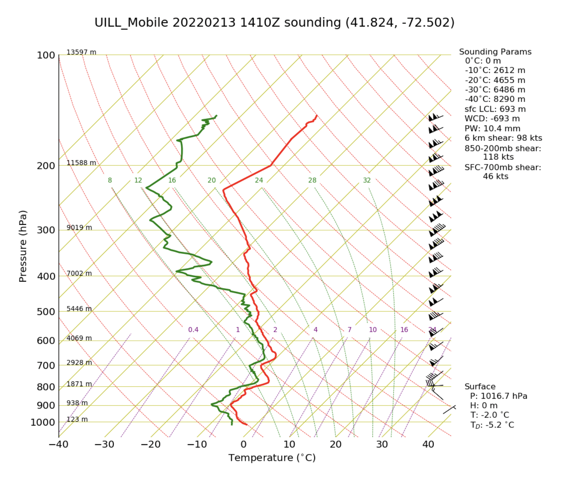
Hartford, Connecticut - February 13th
IMPACTS Science Team Meeting | Summer 2022

Slide 13
Summary
The UIUC rawinsonde crew had a successful deployment during the 2022 season
Sampled 7 storms, launching 25 weather balloons
Data is available in the IMPACTS field catalog and we hope people use it in their modeling and observational analysis.
IMPACTS Science Team Meeting | Summer 2022

Slide 14
This analysis implies that orographic cloud seeding effects
Questions?
Contact: janszsk2@illinois.edu, tzaremb2@illinois.edu, r-rauber@Illinois.edu
IMPACTS Science Team Meeting | Summer 2022

