Slide 1
John Yorks¹, Matthew McGill^{1,2}, Ed Nowottnick¹, Patrick Selmer³, Stephen Nicholls³, Kenny Christian⁴, Andrew Kupchock³, Natalie Midzak⁵
¹NASA GSFC, ²Univ. Of Iowa, ³SSAI, ⁴Univ. Of Maryland/ESSIC, ⁵Univ. North Dakota
IMPACTS Data Workshop 2022
26-27 October 2022
cpl.gsfc.nasa.gov john.e.yorks@nasa.gov

Slide 2
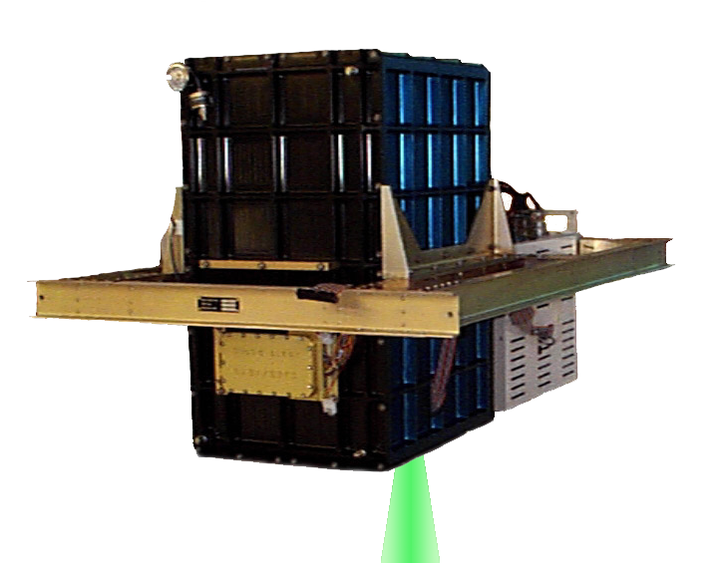
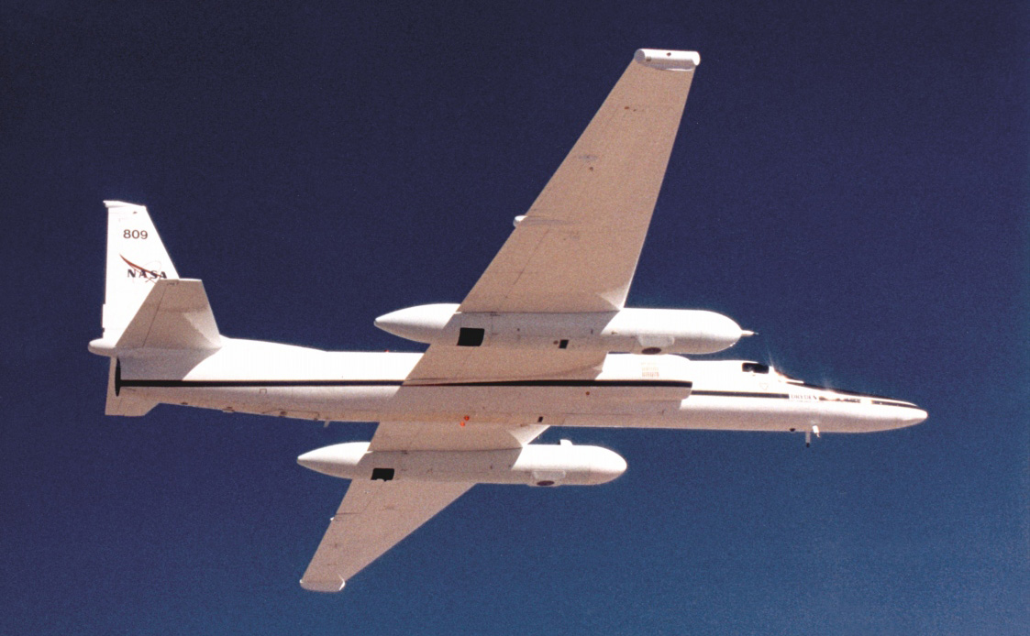
Instrument Overview
Instrument Characteristics:
3 Wavelengths: 1064, 532, and 355 nm
Depolarization using 1064 channel
Fully autonomous
Near nadir pointing
Small FOV minimizes multiple scattering
Resolution: 30 m (vert), 200 m (hor)
Wavelengths | 1064, 532, 355 nm
Laser type | solid state Nd:YVO4
Laser repetition rate | 5 kHz
Laser output energy | 50 μJ at 1064 nm
 | 25 μJ at 532 nm
 | 50 μJ at 355 nm
Telescope | 20 cm diameter
Telescope FOV | 100 uradians, full angle
Two duplicate instruments:
Built for high-altitude aircraft (ER-2)
Flight altitude of about 20‑km
Measure full extent of the troposphere
Deployed on low-flying aircraft
Primarily for aerosol/PBL on C-130
Being converted to ER-2 backup
IMPACTS Data Workshop, 26-27 October 2022, Virtual

Slide 3
CPL History
CPL first flew on the ER-2 in 2000 and has flown dozens of projects since on the ER-2, GlobalHawk, WB-57, and C-130.
Quick and easy integration in the ER-2 front wing pod
CPL data enables a wide-range of applications:
Cloud properties [McGill et al., 2004; Bucholtz et al., 2010; Yorks et al., 2011a; Alexandrov et al., 2015; etc]
Aerosol properties [McGill et al., 2003; Nowottnick et al., 2011; Di Noia et al., 2017; Midzak et al. 2022; etc.]
Satellite Validation [McGill et al., 2007; Yorks et al., 2011b; Hlavka et al., 2012; Yorks et al. 2016]
IMPACTS Data Workshop, 26-27 October 2022, Virtual

Slide 4
CPL Performance and Data
The instrument performed very well during the IMPACTS 2022 deployment
No loss of data and very good data quality
Final data products are available at GHRC for both deployments. Updates from in-field products:
Cloud Phase: Final data products include MERRA-2 meteorological data, which improves the cloud phase determination in the final data products since it is based on temperature.
Backscatter Calibration: We improved our instrument overlap function and backscatter calibration at all 3 wavelengths.
Reminder: available data products, parameters, resolutions, and wavelengths are on the right.
CPL is back at GSFC and should be ready for 2023.
Product | Parameter | Resolutions |  | Wavelengths
 |  | Vert. | Hor.
Level 1 | Attenuated Backscatter | 30 m | 200 m | 355, 532, 1064 nm
 | Depolarization Ratio | 30 m | 200 m | 1064 nm
Level 2 Layer | Cloud Layer Height | Layer | 1 km | NA
 | Cloud Phase | Layer | 1 km | NA
 | Cloud Optical Depth | Layer | 1 km | 532, 1064 nm
 | Ice Water Path | Layer | 1 km | 532, 1064 nm
Level 2 Profile | Extinction Coefficient | 30 m | 1 km | 532, 1064 nm
 | Ice Water Content | 30 m | 1 km | 532, 1064 nm
IMPACTS Data Workshop, 26-27 October 2022, Virtual

Slide 5
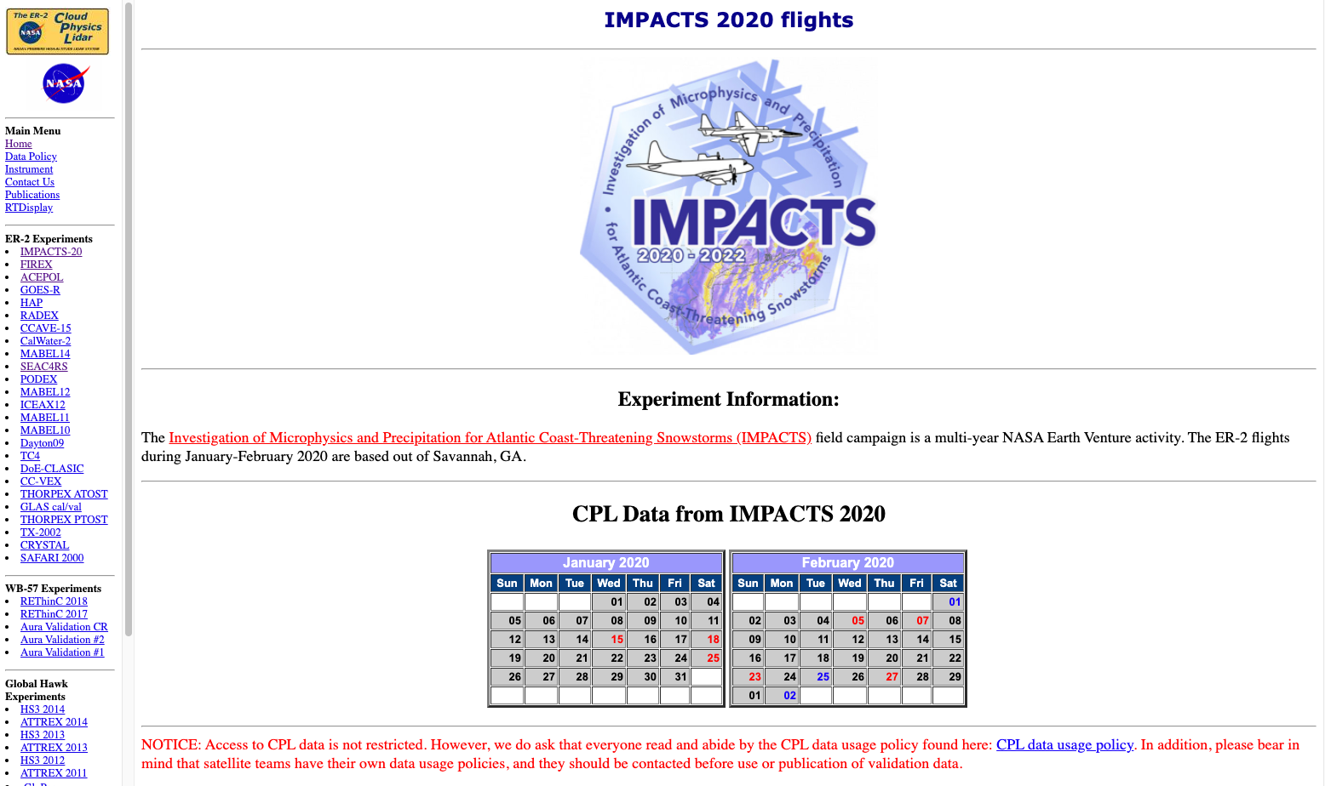
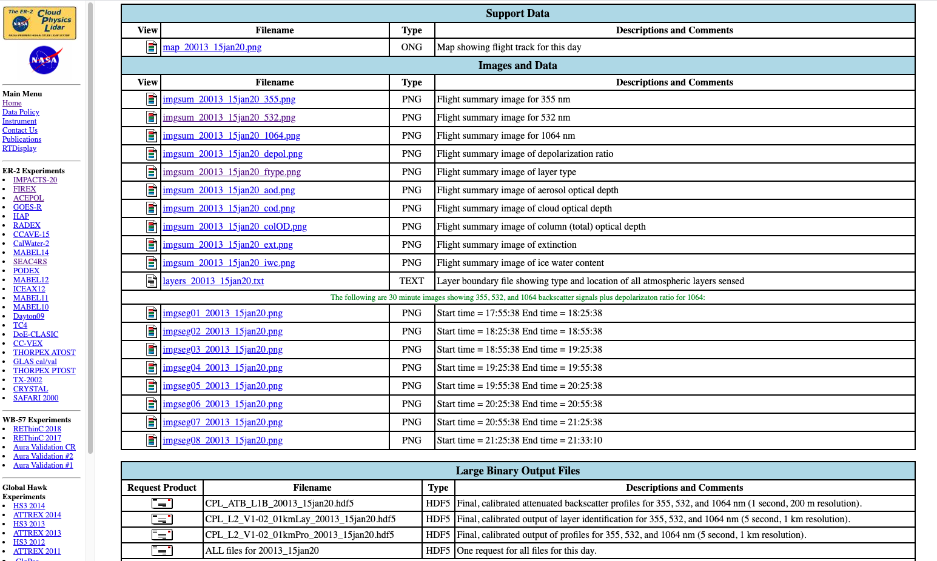
CPL Data Availability
Browse Images are available on the CPL website, as well as a link to request the data.
cpl.gsfc.nasa.gov
3 - Click on Browse Image
1 - Click on “IMPACTS-20” or
“IMPACTS-22”
2 - Pick a Flight
4 - Request Data Files
IMPACTS Data Workshop, 26-27 October 2022, Virtual

Slide 6
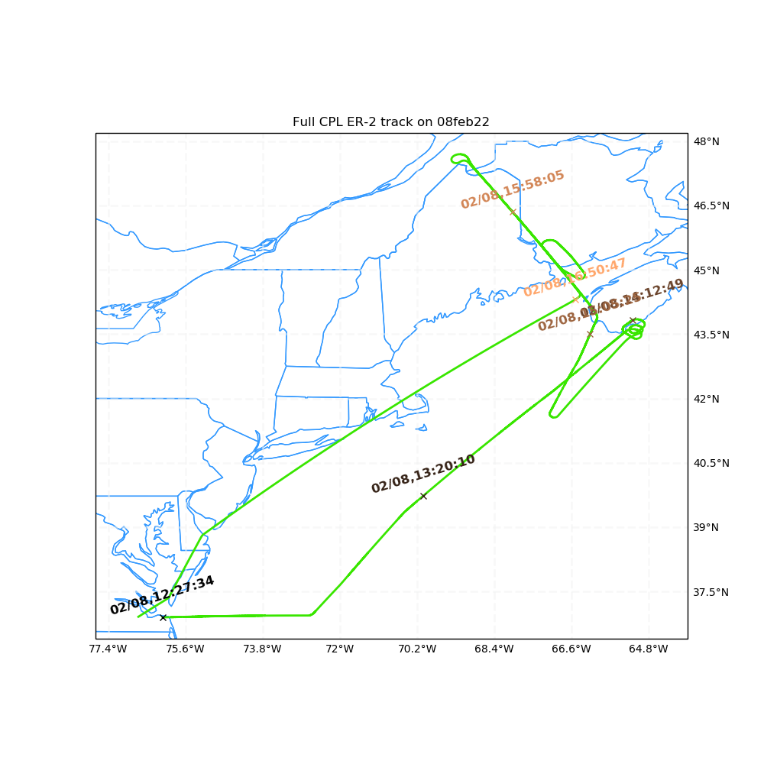
Data Example: 08 Feb. 2022
CPL observed some really interesting streaks in the upper-level clouds to the south of the Feb. 8th low off the coast of ME (GPM underflight).
Some of these streaks have low depolarization ratios (<0.15), suggesting they could be SCLW or mixed phase
Need to see what track the P-3 took and what altitude it flew at to transit to the rendezvous point.
CPL 532 nm Attenuated Backscatter: 08 February 2022
CPL Depolarization Ratio: 08 February 2022
12:27
12:38
12:49
13:00
13:10
13:21
13:32
IMPACTS Data Workshop, 26-27 October 2022, Virtual

Slide 7
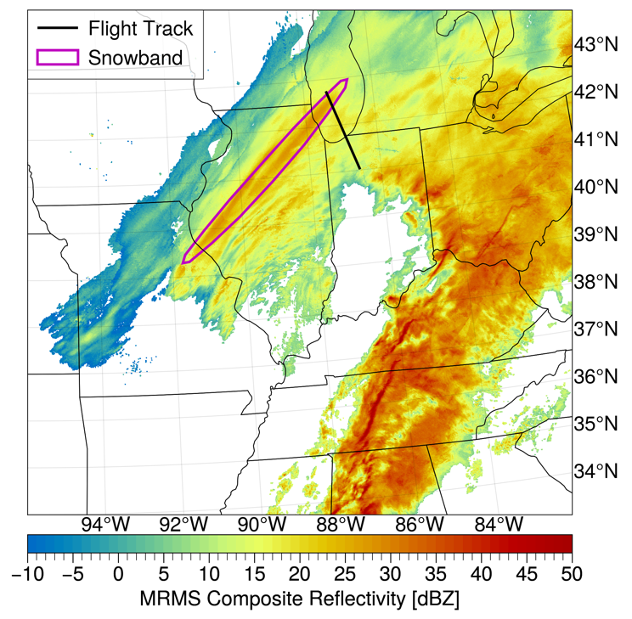
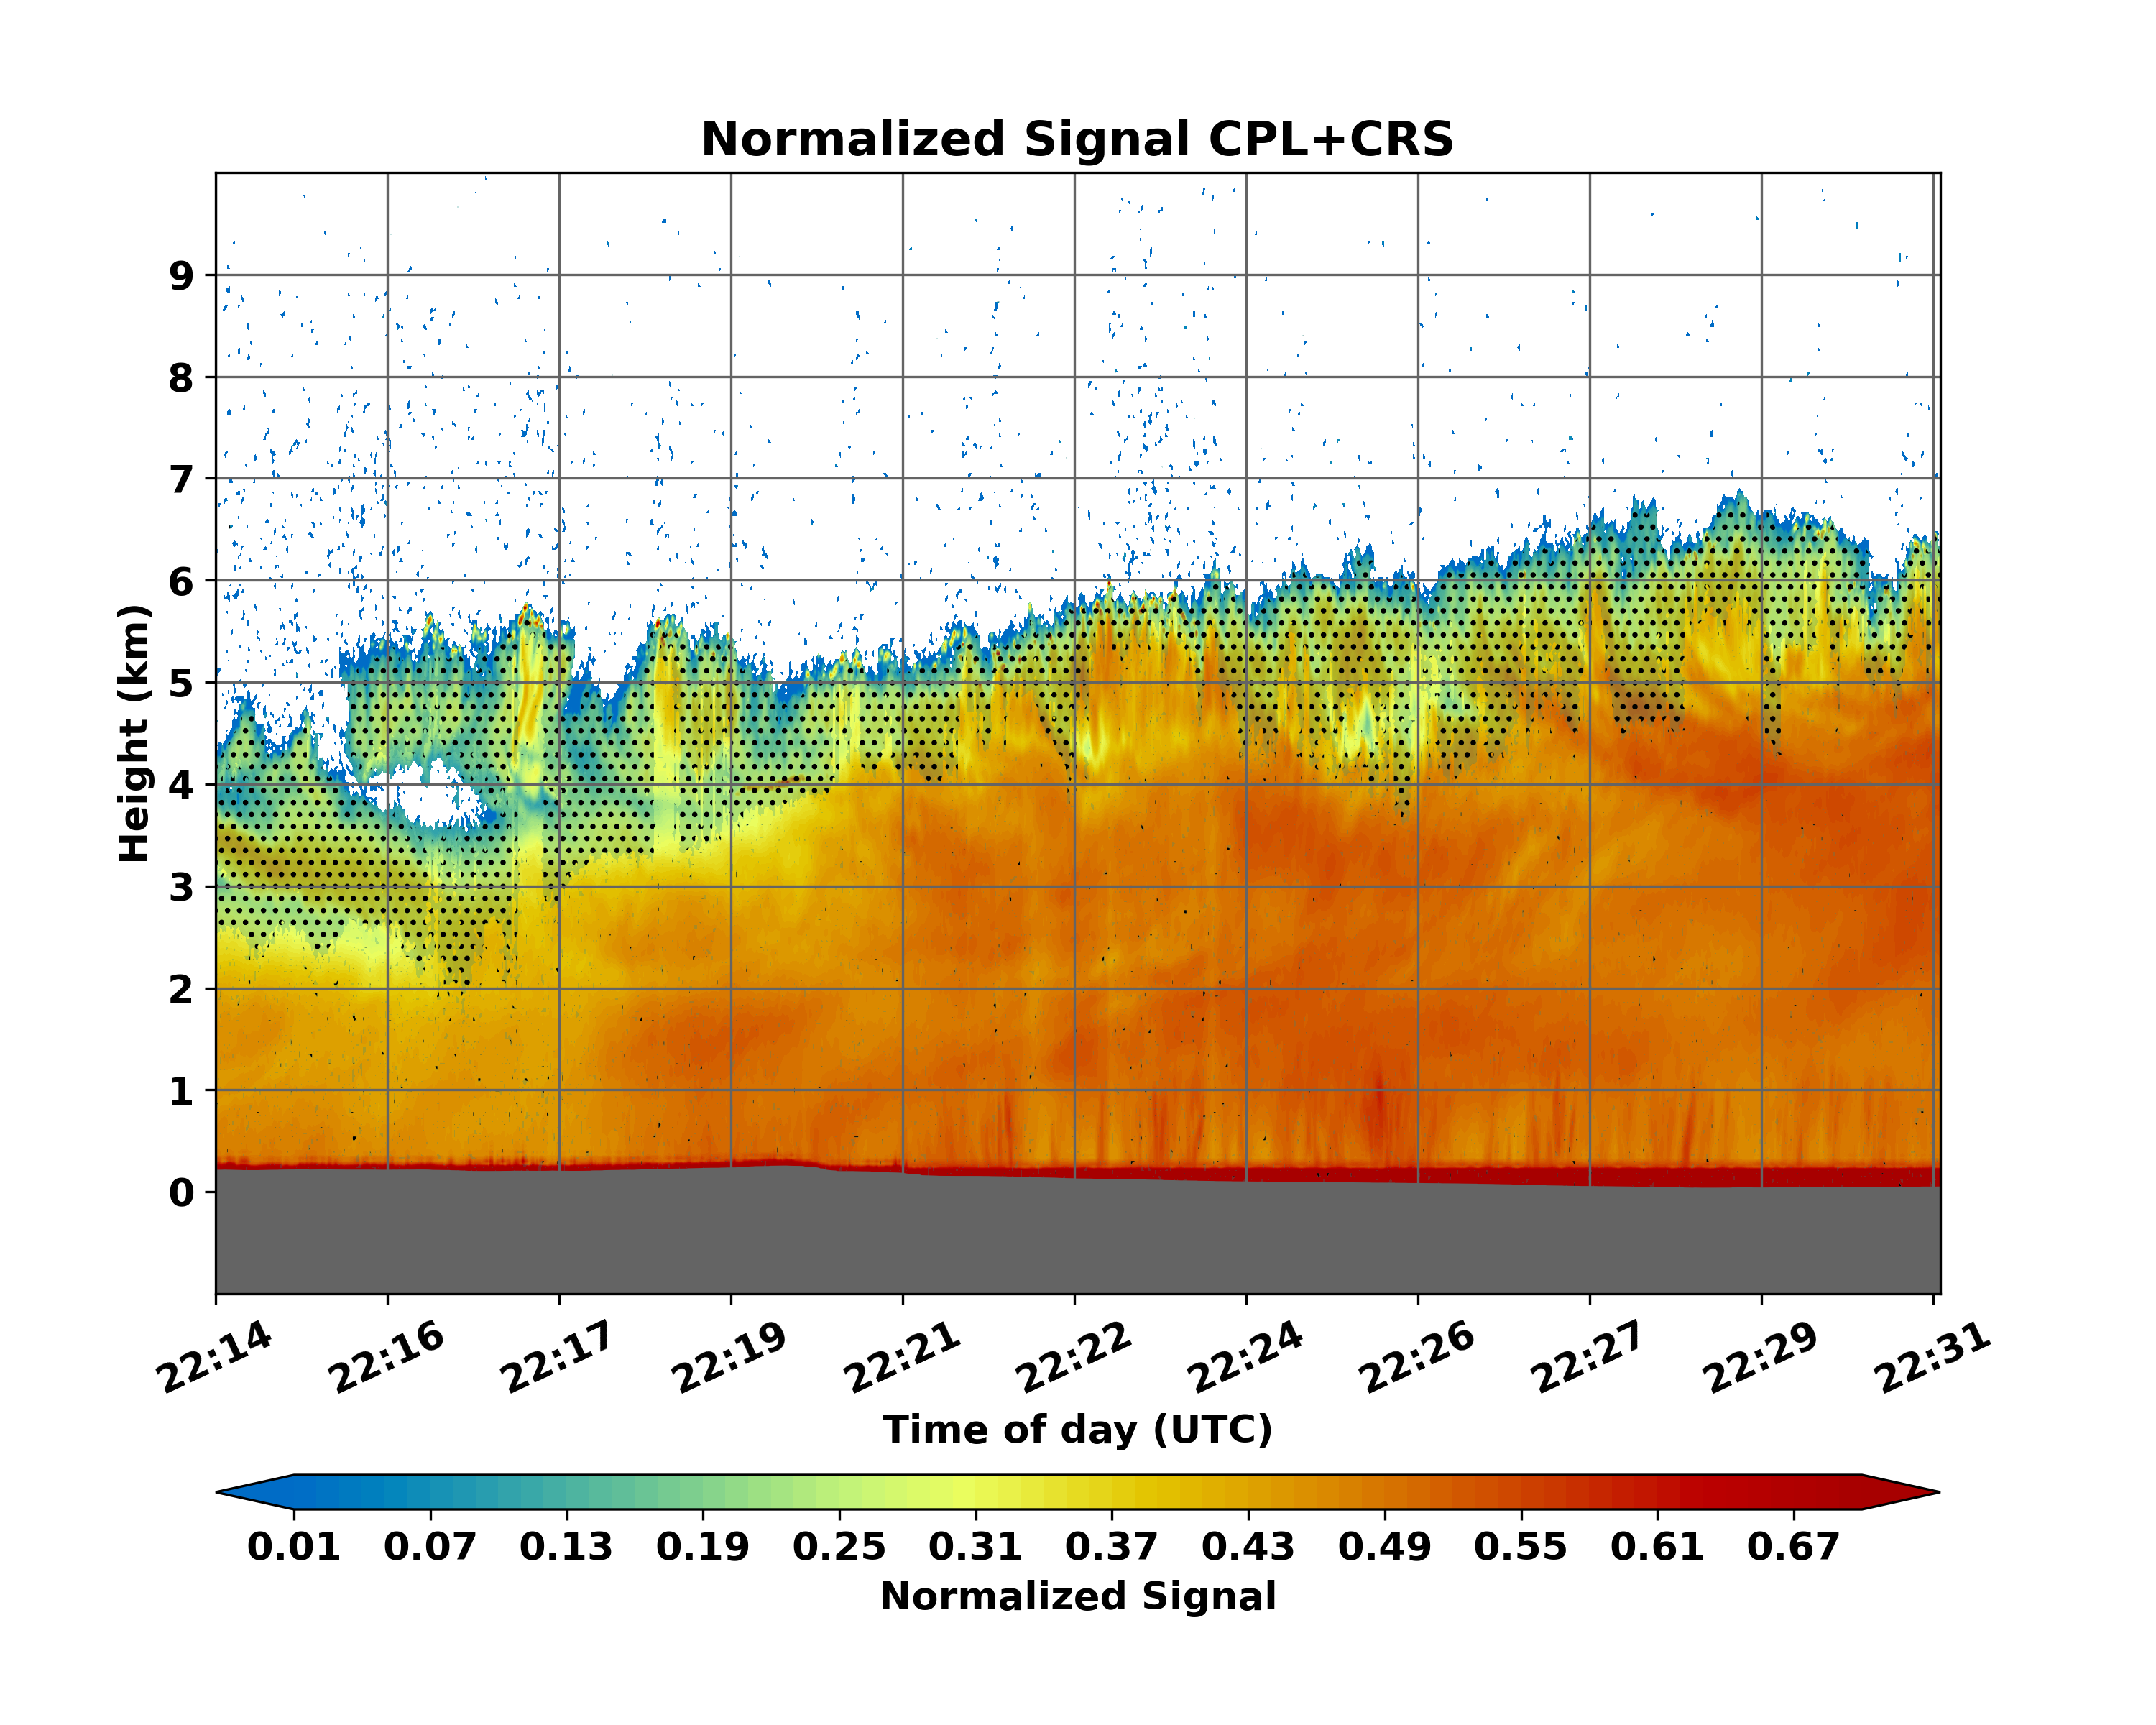
Data Example: 17 Feb. 2022
The location of the snowband at 170 km has the highest cloud tops (> 6.5 km) and the lidar is unable to penetrate very far into the clouds due attenuation by larger particles as sampled by the P-3.
In the region to the SE of the snowband (20 – 100 km), the CPL shows a lot of variability in the cloud top structure and penetration depth (CPL observed 2-4 km below cloud top in some parts of the system).
IMPACTS Data Workshop, 26-27 October 2022, Virtual

Slide 8
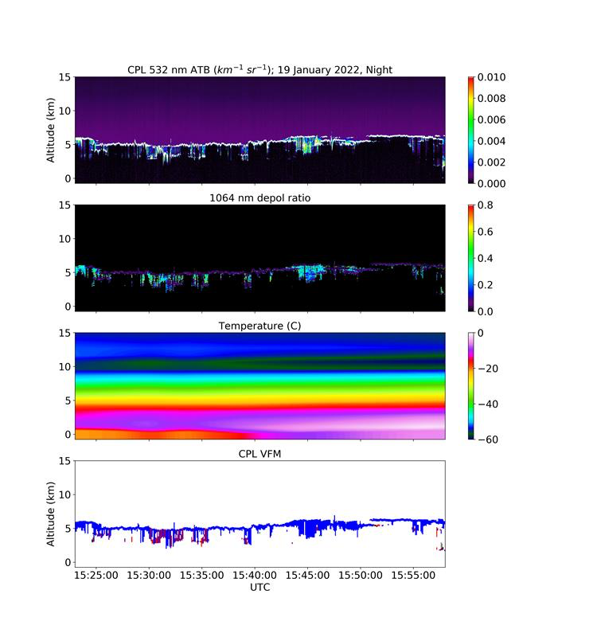
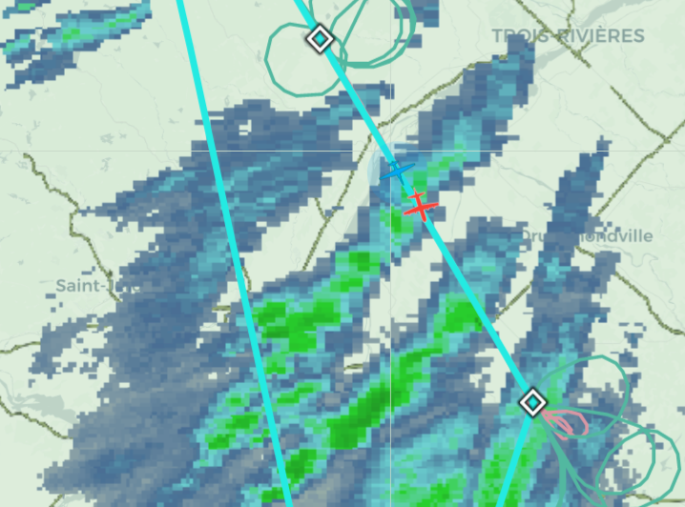
Data Example: 19 Jan. 2022
Supercooled Liquid Water in Lidar Data?!?!
6th and final leg of 19 Jan 2022 flight over Quebec
CPL observes high backscatter at the cloud tops, with low depolarization ratios (<0.10) and cold temps (-20 to -40 C)
Consistently through these bands there was supercooled liquid water in PHIPS data, with a very high amount of riming, especially on legs at 4-5 km.
Cold
Cloud Top Phase w/ Lidar
Mixed
Phase?
SCLW?
HOI?
Ice
Particles
Temp
Liquid
Water
Cloud
Dust
Aerosols
Warm
0.0
Depol
0.5
Check out Troy Zaremba’s poster on Wed.
IMPACTS Data Workshop, 26-27 October 2022, Virtual

