Slide 1
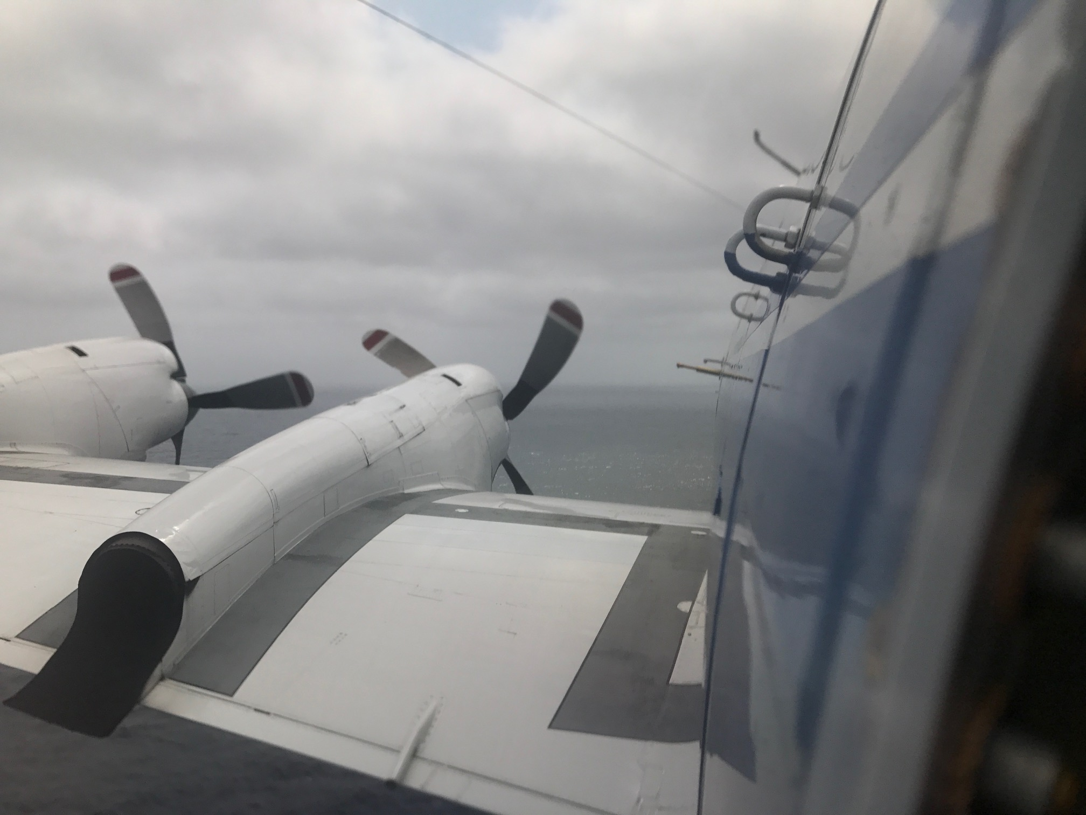
2022 TAMMS Instrument Status & Update
Lee Thornhill – Instrument PI
John Barrick
Claire Robinson
NASA Langley / SSAI
Contact Info:
Kenneth.l.Thornhill@nasa.gov
757 869-2109

Slide 2
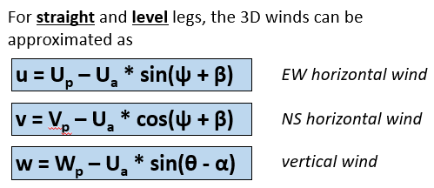
How do you compute the 3-D winds????
The ambient wind speed components are computed as the difference between two vectors:
Velocity of the aircraft with respect to the Earth (inertial)
Velocity of the air with respect to the aircraft (differential pressures & static P&T)
Important Notes:
These tend to be an order of magnitude higher than the resulting air speed (either horizontal or vertical)
True Airspeed (U_{a}) is a function of the Mach Number and the total air temperature
Mach Number is a function of static and impact pressure and is subject to how well the static pressure is calibrated
So at its most basic level its just geometry …

Slide 3
Measurements Overview
Additions since this figure was made:
The AOA 858 is heated
Valves are in place to flush out water and ice from the differential pressure lines
A new real-time data system from UEI is used
An Applanix 610 is used for the Inertial data (better accuracy and precision especially for Vertical Platform velocities)

Slide 4
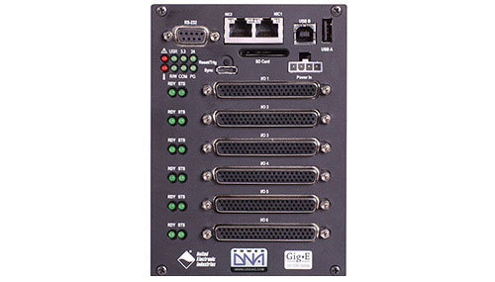
Real time Data System
New Data System
Manufactured by UEI (ueidaq.com)
Linux Based
Real-time
Rugged 50g shock, 3 g vibration
Small (4” x 4” x 6”)
Runs at powerup
24-bit 16 channel analog card (with separate timers on each channel)
8 channel ARINC-429 card (all receive) with independent timestamps for each incoming sample
More than 60 data streams are individually sampled at > 100 Hz
Entire setup takes up about ½ of a single bay rack
Other components include:
Analog / ARINC-429 breakout box
5 channel Ethernet switch
Applanix 610
UPS
Data is broadcast over Ethernet to be monitored remotely

Slide 5
Full vertical winds Equation (from Lenschow, 1986)
w = Wp – Ua/D *(t1c – tan(beta) * t2c – tan(alpha)*t3c) + L*t4c
Measurements Needed (and source) *** Data Recorded at at least 100 Hz ***
Wp = Aircraft vertical velocity (from Applanix)
Ua = True Airspeed (fn Pressure and Temperature)
Alpha & Beta (AOA and sideslip differential pressures)
D = sqrt(1 + tan²(alpha) + tan²(beta)) (differential pressures)
T1c = sin(Pitch) (from Applanix)
T2c = cos(Pitch) * sin(Roll) (from Applanix)
T3c = cos(Pitch) * cos(Roll) (from Applanix)
T4c = dPitch * sin(Pitch) (from Applanix)
L = separation distance (m) (pressure port to transducer)

Slide 6
Instrument and Data Status for late October 2022
A look back to earlier this year …
Final archive is in for 2022 (or is supposed to be …) in ICARTT text file format
System worked much better than in 2020 with regards to water and ice in the lines
Calibration flight analysis is done
First time with a new automated real-time data system and it worked great
Added my own Applanix 610 to the payload
No lost data due to data acquisition issues
Where are we as of today…
Just got the data system back from a software upgrade and its yearly NIST-traceable analog calibration
The 2020 data is done except for the vertical winds (getting there)
Prepping to integrate soon
Looking ahead to 2022 integration and 2023 field mission …
The rack is currently off the P-3 due to some rearranging efforts going on
Have to go back and revisit the 2020 data. Goal to have it done soon
Old PC-based data system is gone, but a backup real time system is ready since ACTIVATE is over
The 858Y probe for the sideslip was removed and will be put back on, but will need new calibration maneuvers to determine the heading offsets
Need to come up with the flight plan for the calibration flight for TAMMS

Slide 7
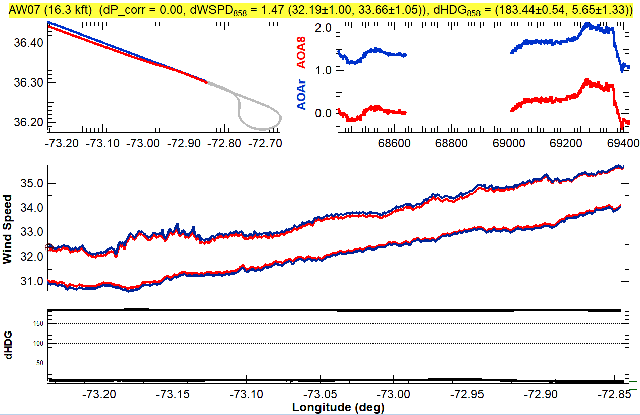
Example Data and Some Calibration Data
Alongwind Reverse Headings : Pressure Defect

Slide 8
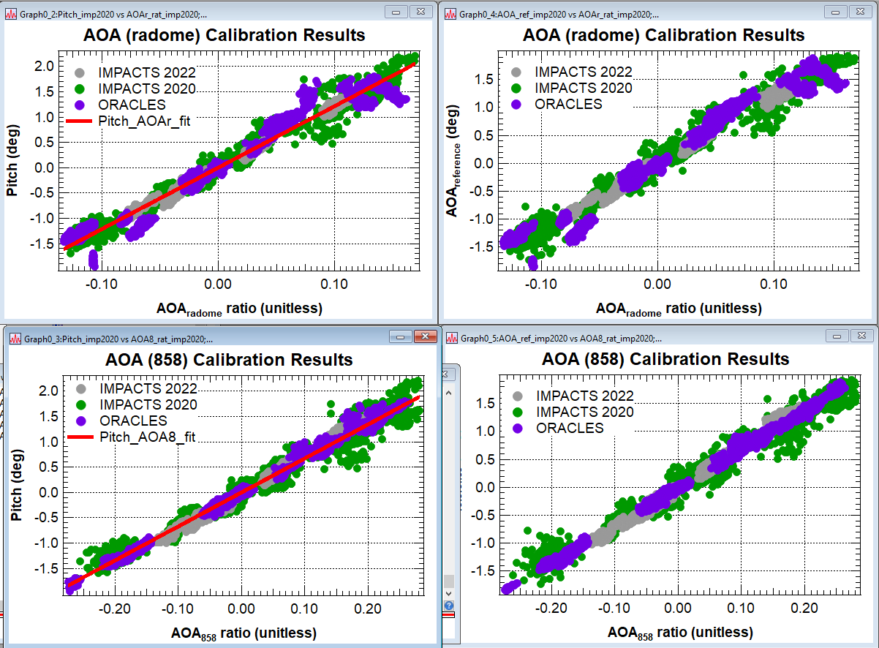
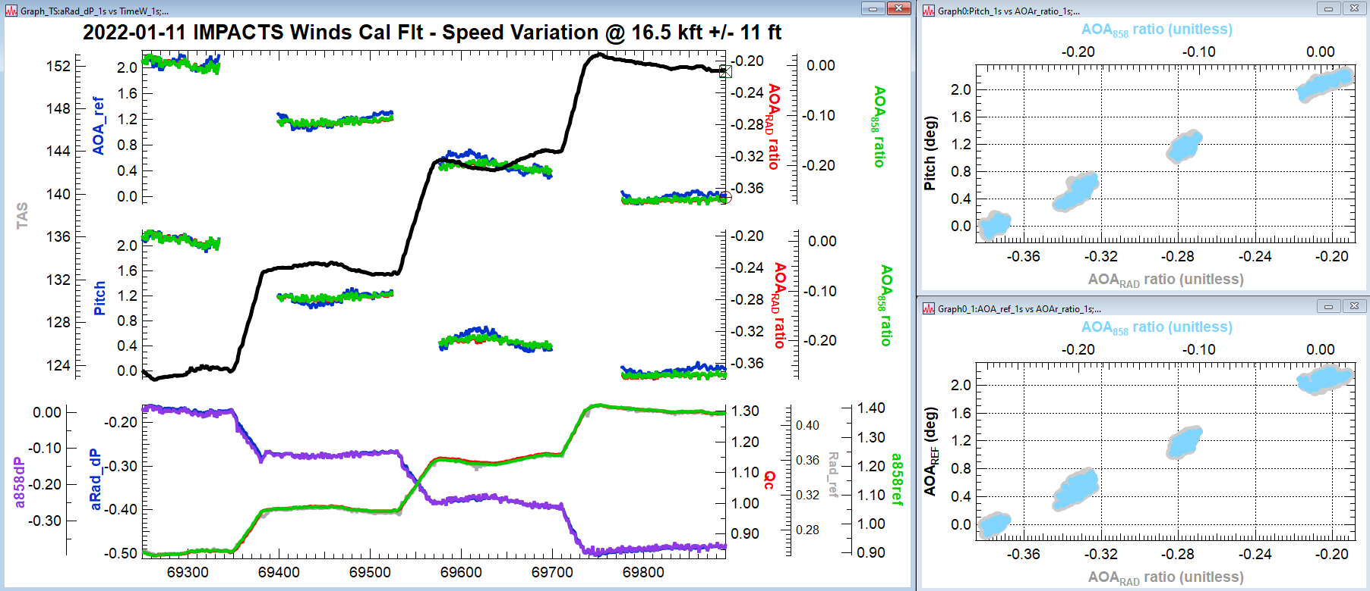
Example Data and Some Calibration Data
Speed Variations:
AOA Slope & Offset

