Slide 1
IMPACTS Data at the NASA GHRC DAAC
Leigh Sinclair
Geoffrey Stano

Slide 2
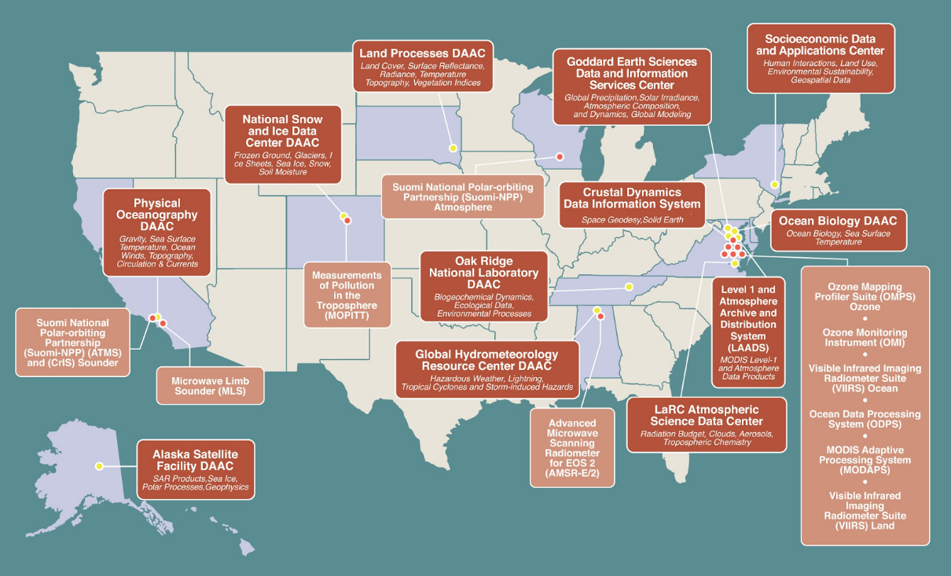
NASA’s Earth Science DAACs
Distributed Active Archive Center (DAAC)
Part of NASA’s Earth Observing System Data and Information System (EOSDIS)
Processes, archives, documents, and distributes data from NASA’s past and current Earth-observing satellites and field measurement programs
NASA Global Hydrometeorology Resource Center (GHRC) DAAC
Operates as a collaboration between NASA and the University of Alabama in Huntsville (UAH)
Also serves as a Science Investigator-led Processing System (SIPS) location creating data products working alongside project scientists

Slide 3
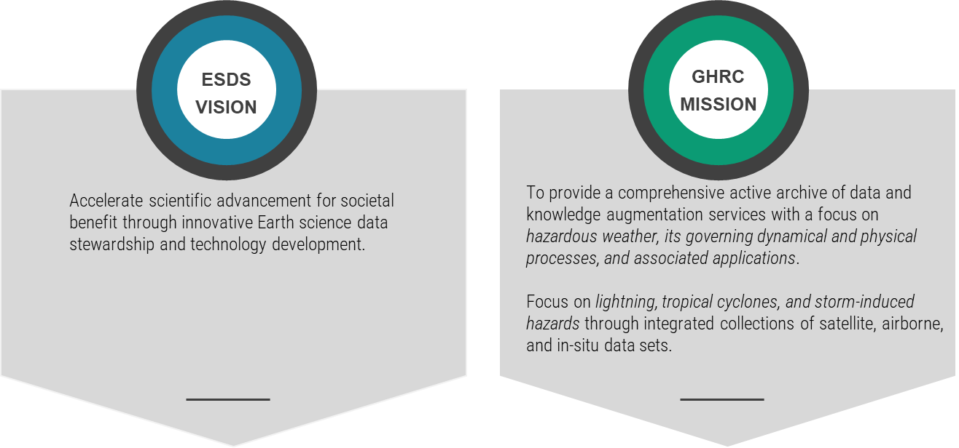
ESDS Vision & GHRC Mission

Slide 4
Type of Data GHRC Provides
Lightning, microwave, hurricane science, and field campaign data
Including IMPACTS
https://ghrc.nsstc.nasa.gov/home/field-campaigns/impacts

Slide 5
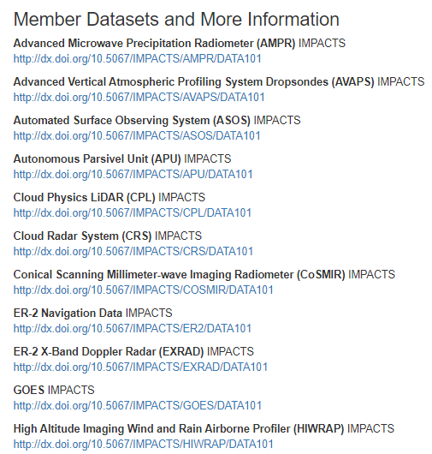
IMPACTS Data
Earthdata Search
https://search.earthdata.nasa.gov/portal/ghrc/search?fpj=IMPACTS
IMPACTS Collection DOI
http://dx.doi.org/10.5067/IMPACTS/DATA101

Slide 6
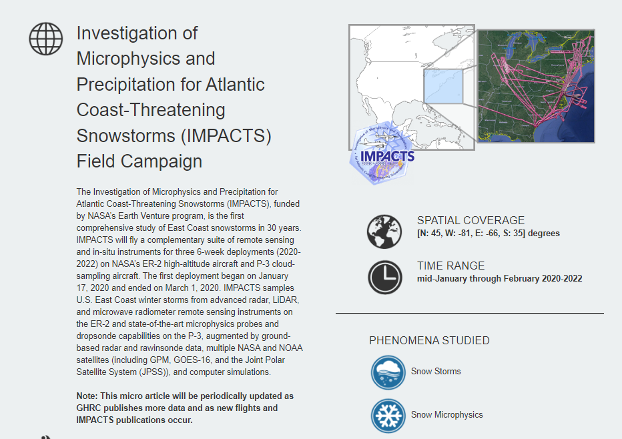
IMPACTS Micro Article
https://ghrc.nsstc.nasa.gov/home/micro-articles/investigation-microphysics-and-precipitation-atlantic-coast-threatening-snowstorms

Slide 7
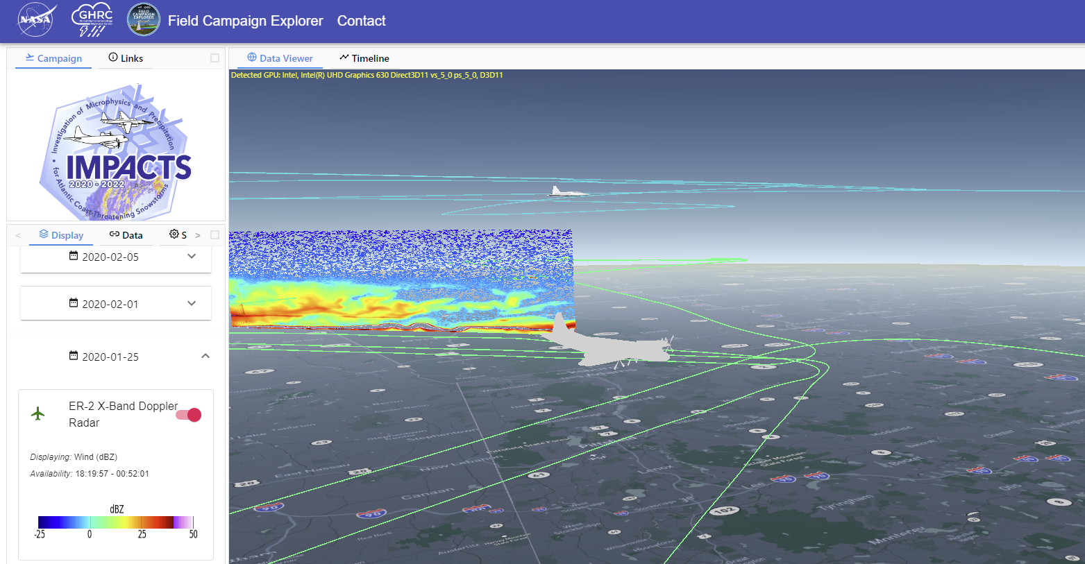
Field Campaign Explorer (FCX)
Cloud-based, three-dimensional data exploration for multiple datasets
Including IMPACTS data
Test it out!
https://ghrc.earthdata.nasa.gov/fcx/index.html

Slide 8
THANK YOU!
QUESTIONS?

