Slide 1
Conical Scanning Millimeter-wave Imaging Radiometer (CoSMIR)
Rachael Kroodsma^{1,2} and Matt Fritts²
¹ESSIC, Univ. of Maryland
²NASA Goddard Space Flight Center

Slide 2
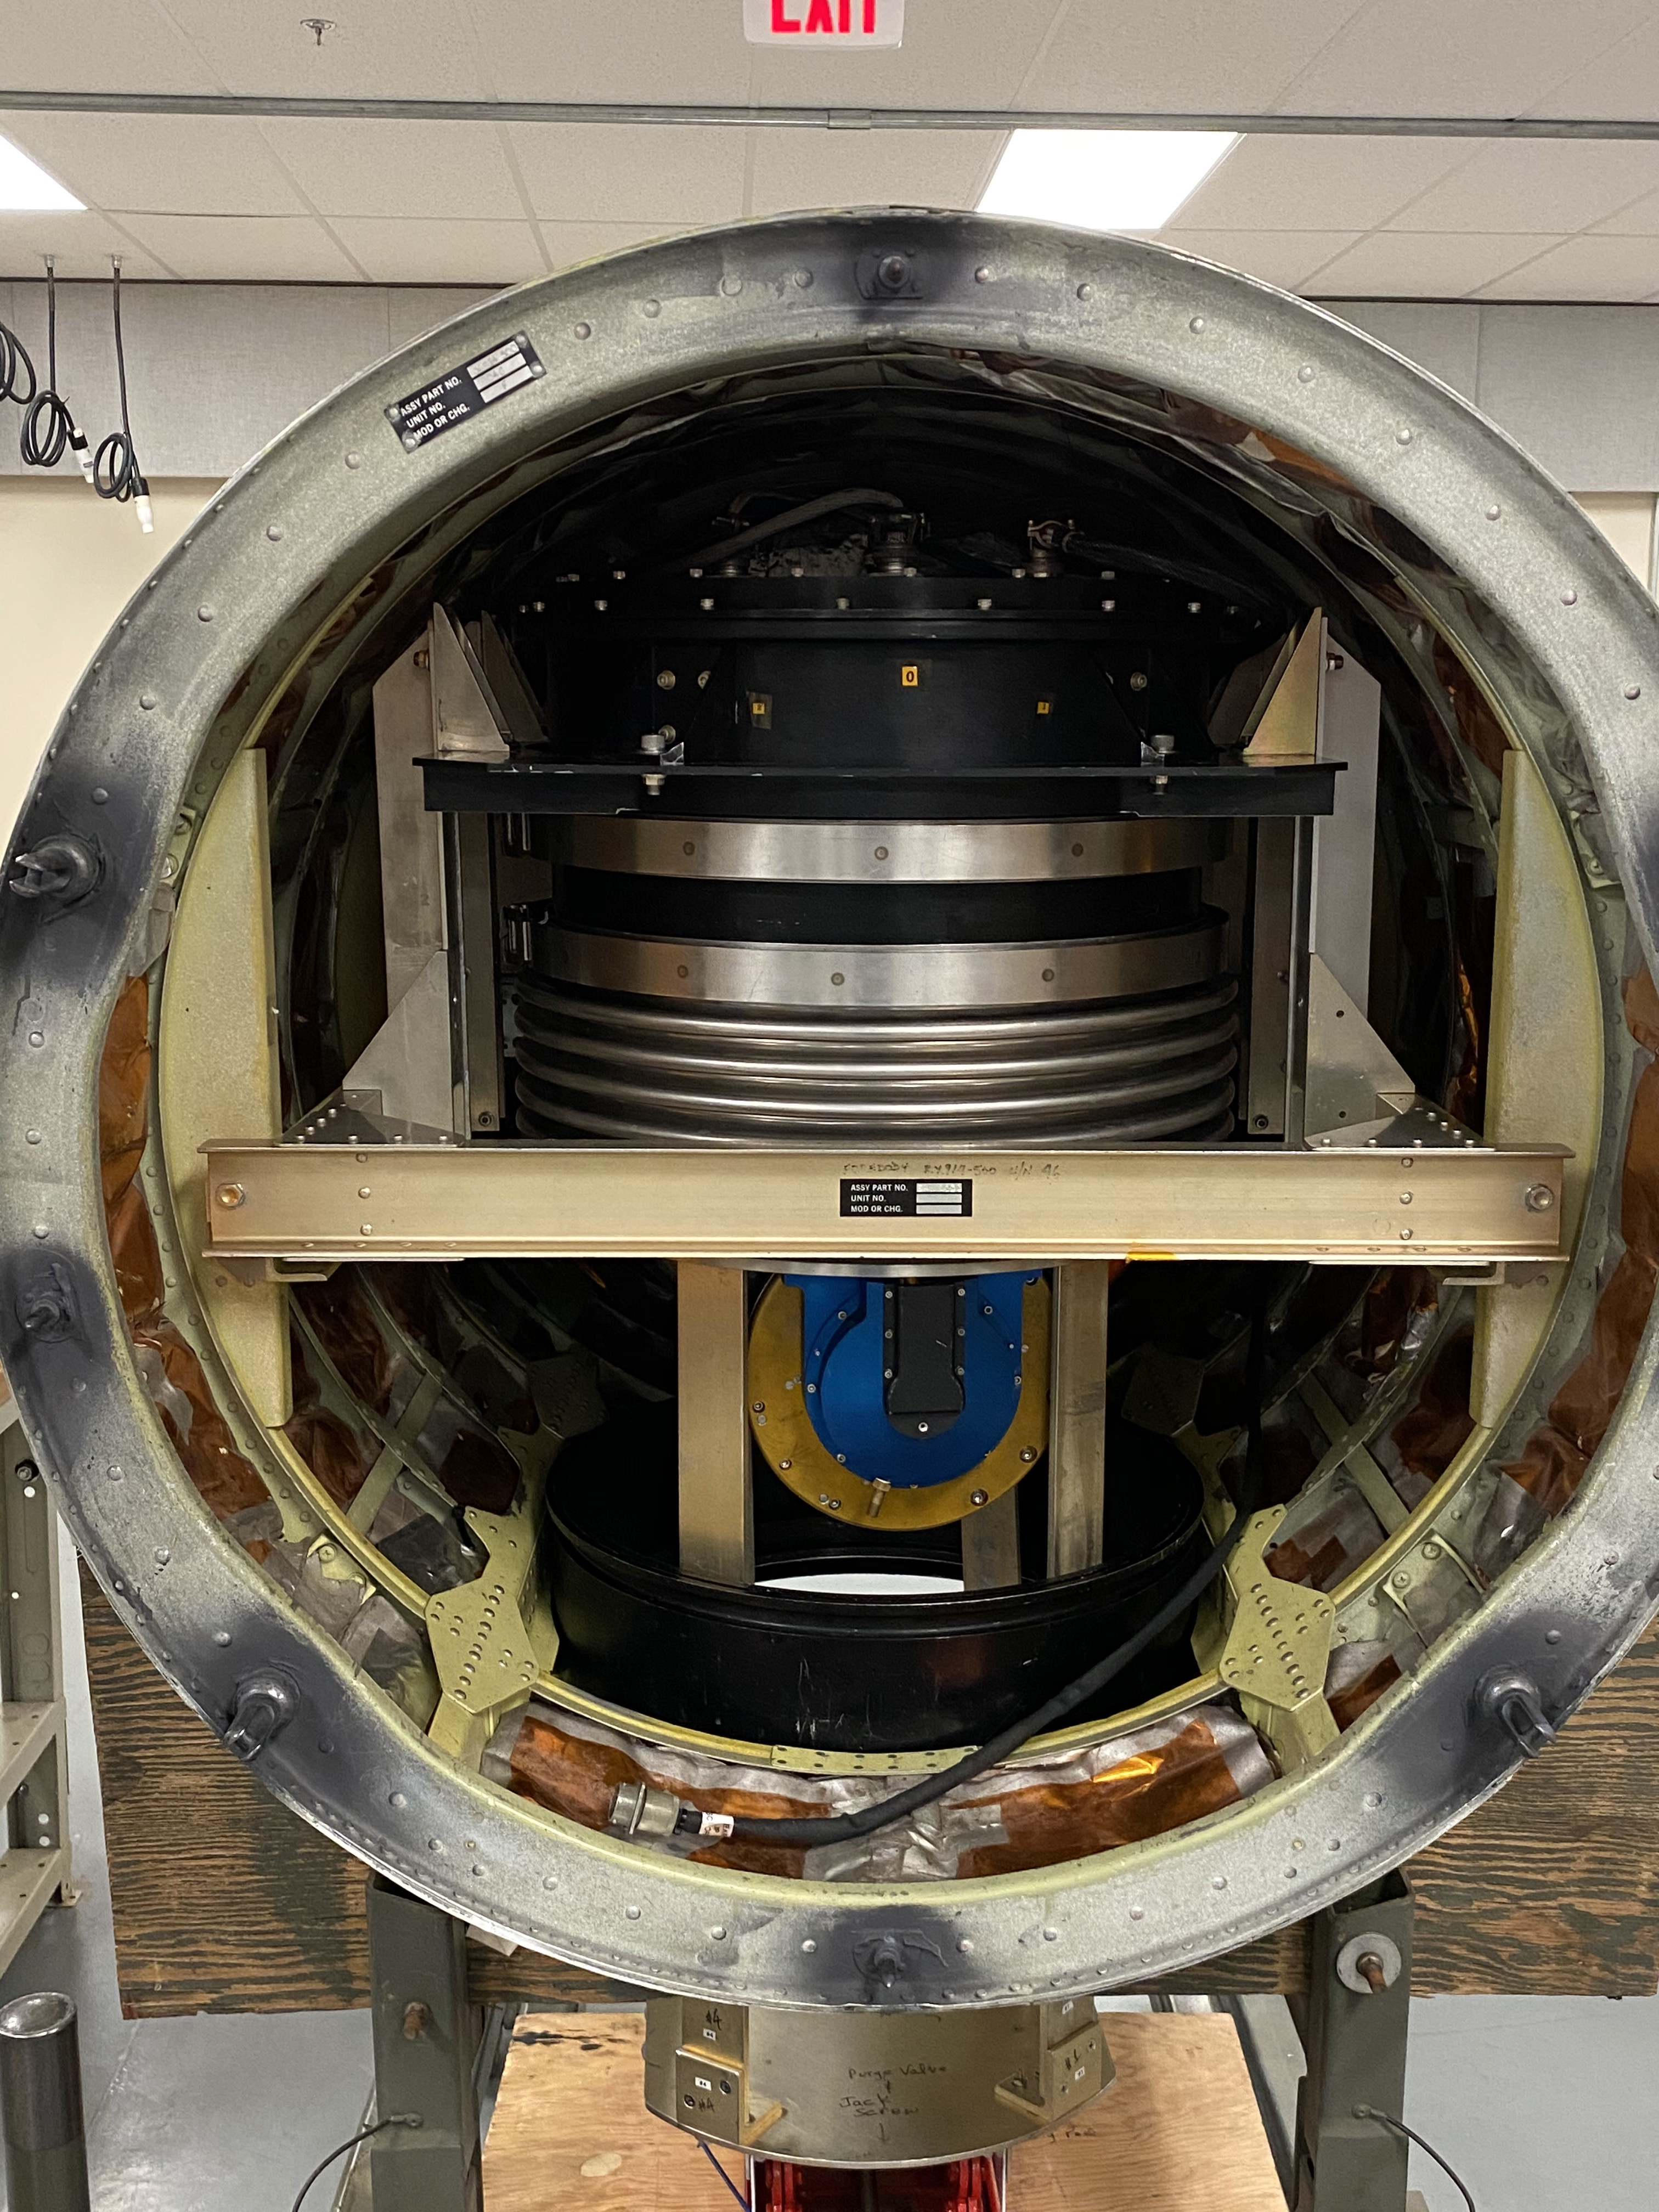
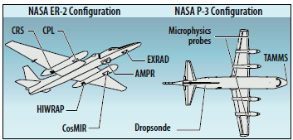
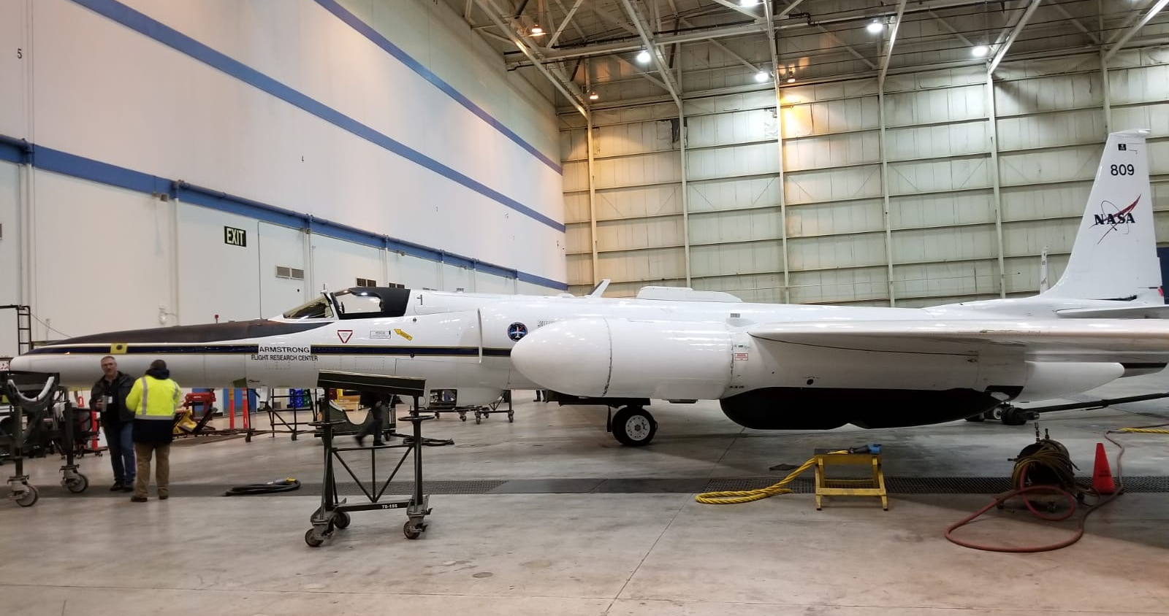
CoSMIR
Conical Scanning Millimeter-wave Imaging Radiometer
Programmable scanning airborne radiometer with channels similar to the GPM Microwave Imager (GMI)
CoSMIR | GMI
50.3h | --
52.8h | --
89.0v/h | 89.0v/h
165.5v/h | 166v/h
183.31±1h | --
183.31±3h | 183.31±3v
183.31±7h | 183.31±7v
CoSMIR flies in the left wing pod of the NASA ER-2
CoSMIR has the unique ability to scan in various modes: fore/aft conical and cross/along-track. IMPACTS utilizes this programmable feature of CoSMIR.
CoSMIR

Slide 3
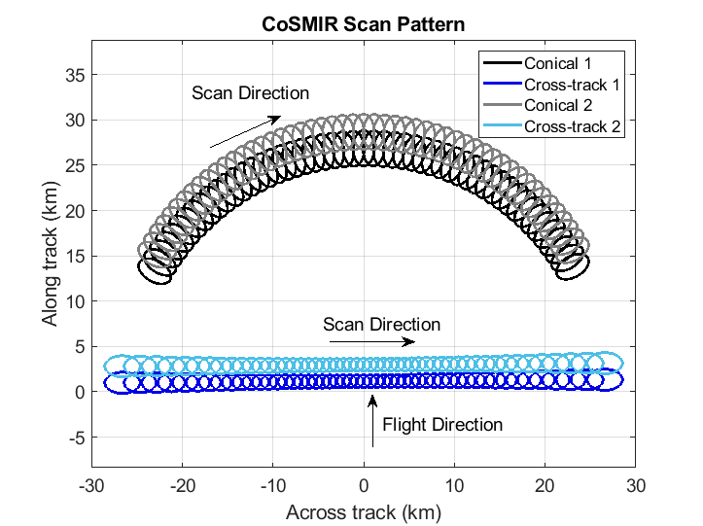
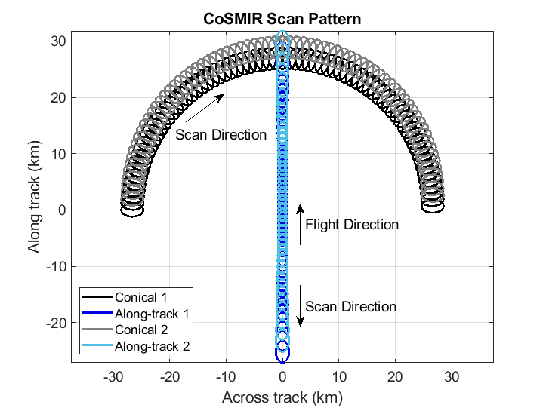
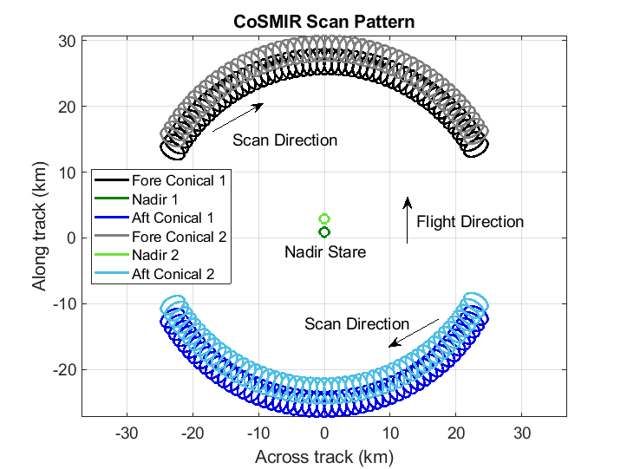
CoSMIR Scan Patterns
Fore conical / cross-track
(2020 only)
Fore conical / along-track
(2022 all flights)
Fore conical / aft conical
(2020 only)
Footprint size at 20 km altitude
Nadir: 1.4 x 1.4 km
49.2° off-nadir: 2.1 x 3.3 km

Slide 4
CoSMIR Performance Notes
CoSMIR had a successful deployment for first two years of IMPACTS
All channels operational with minimal data dropouts
Two significant data quality issues
(1) Ground-based RFI (Radio Frequency Interference)
Can be mostly detected and removed from data
Most evident in 183±3 and 183±7 channels
Removed observations from all channels if detected due to potential contamination
(2) Noise in 183±1
Occurs in most flights, to varying degrees, and in different parts of the scan
Portions of the scan are set to missing
Total time of CoSMIR data collected
2020: 40 hrs, 52 min
2022: 53 hrs, 33 min

Slide 5
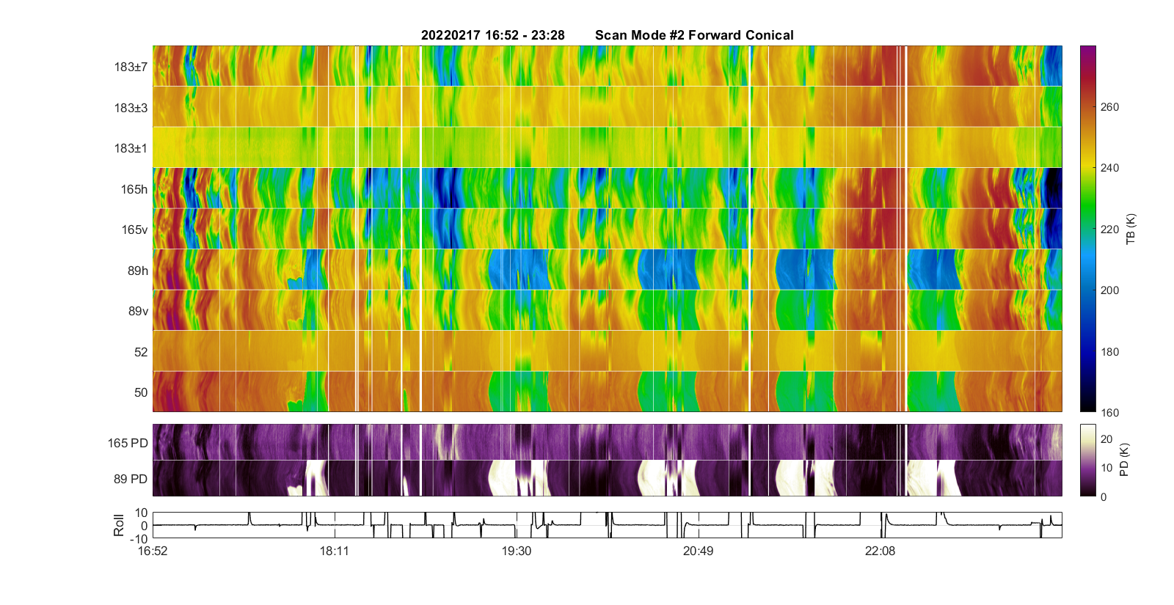
Quicklook Example

Slide 6
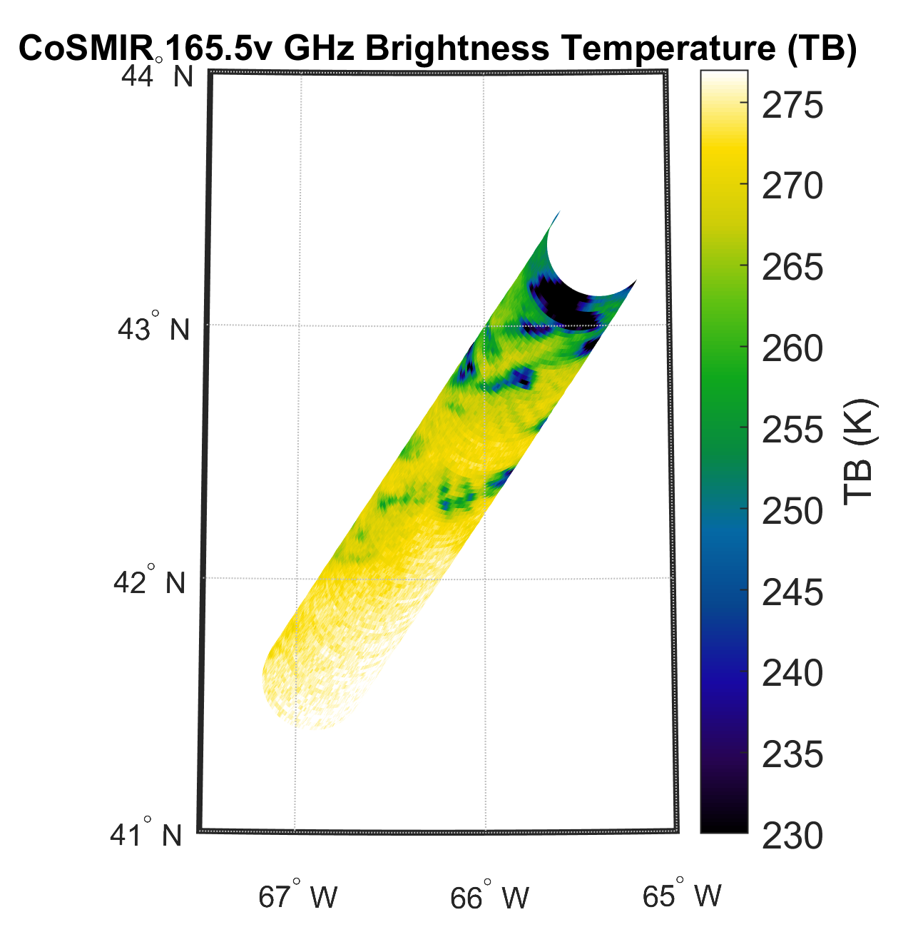
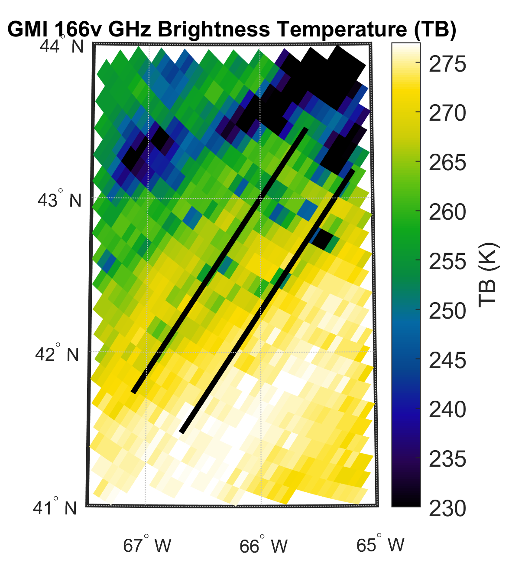
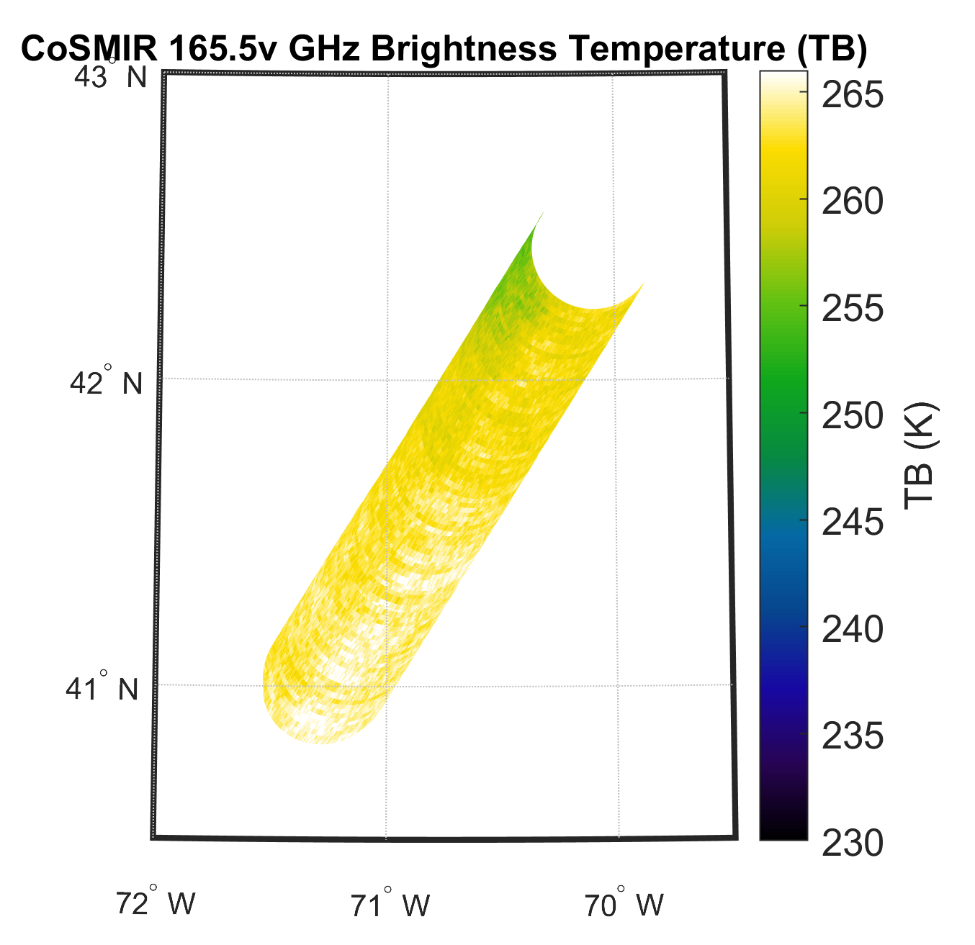
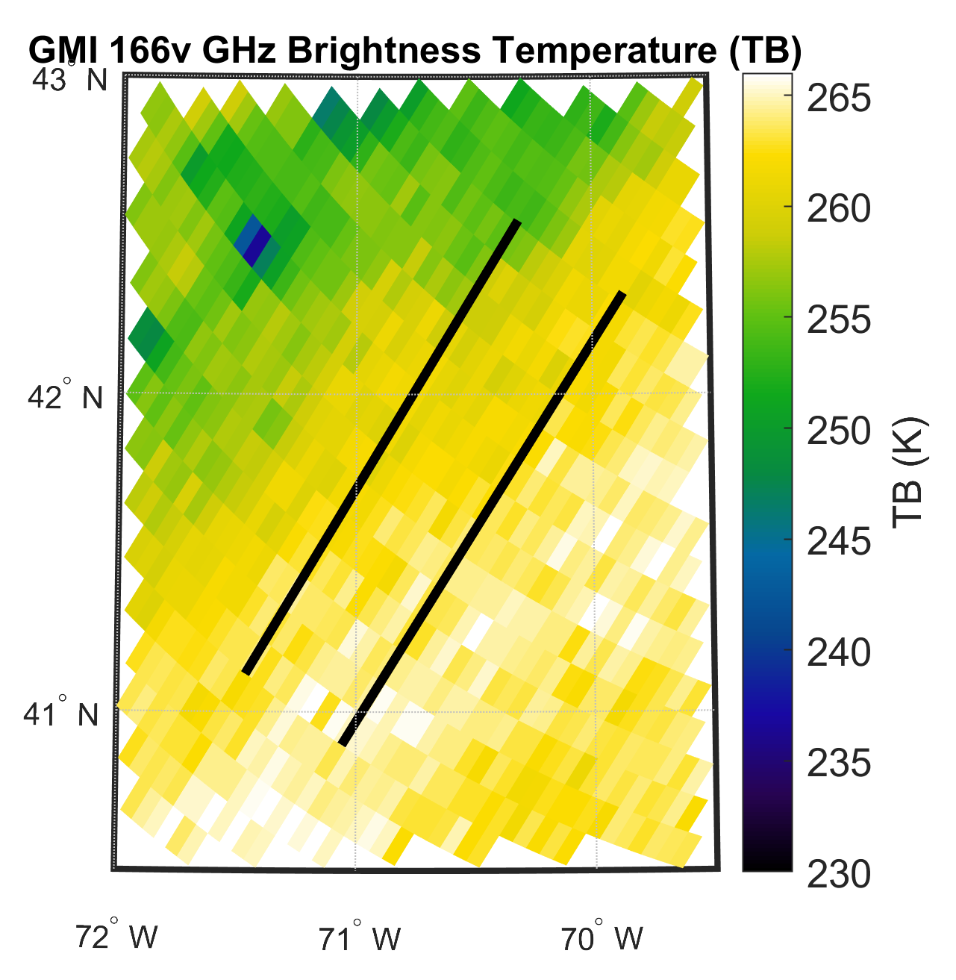
CoSMIR Observations: GPM Overpass
Two coordinated GPM overpass flights in 2022: 08 Feb at 14:37 UTC and 13 Feb at 13:23 UTC
CoSMIR 165.5v and GMI 166v TB comparisons
Similar features can be seen from both instruments, with differences mainly attributed to footprint size (CoSMIR footprint size: 2.1x3.3, GMI footprint size: 4.1x6.3 km) and that CoSMIR greatly oversamples, while GMI undersamples at 166 GHz.
08 Feb
13 Feb

Slide 7
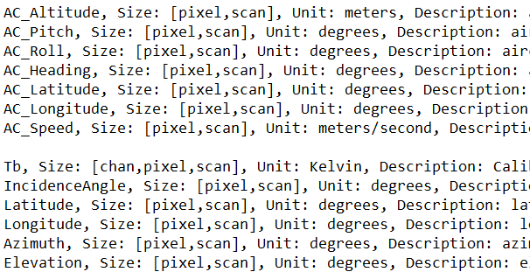
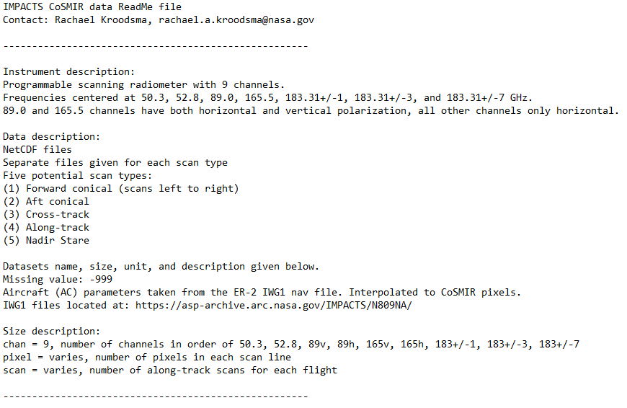
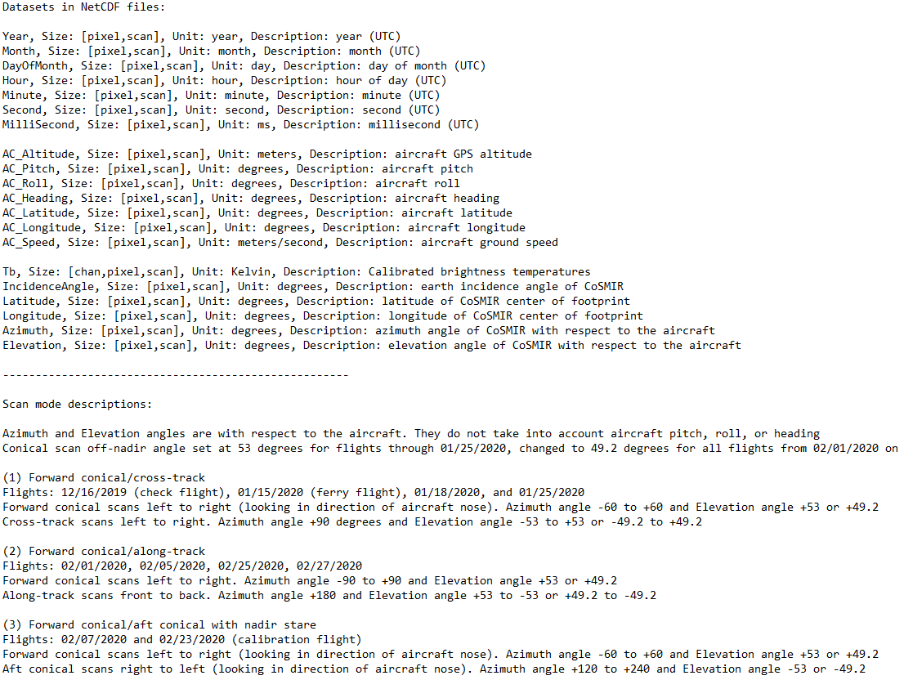
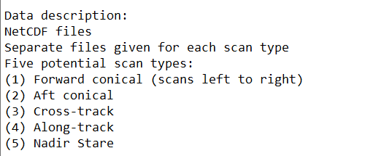
Data Product: NetCDF Files

Slide 8
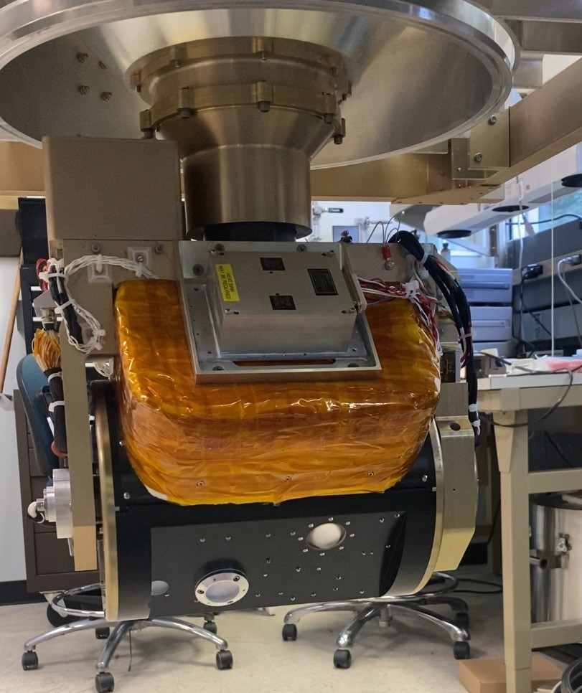
IMPACTS Year 3: CoSSIR
CoSSIR: Configurable Scanning Submillimeter-wave Instrument/Radiometer
CoSMIR |  |  | CoSSIR
Fc (GHz) | BW (GHz) | NEDT (K) | Fc (GHz) | BW (GHz) | NEDT (K)
50.3 h | 0.4 | 0.4
52.8 h | 0.4 | 0.4
89.0 v/h | 1.5 | 0.1/0.1
165.5 v/h | 1.5 | 0.5/0.6 | 170.5 v/h | 1.0 | 0.20
183.31±7 h | 1.5 | 0.2 | 177.31 v/h | 1.0 | 0.20
183.31±3 h | 1.2 | 0.3 | 180.31 v/h | 1.0 | 0.20
183.31±1 h | 0.6 | 0.4 | 182.31 v/h | 1.0 | 0.20
 |  |  | 325.15±11.5 v/h | 2.5 | <0.5
 |  |  | 325.15±3.4 v/h | 2.5 | <0.5
 |  |  | 325.15±0.9 v/h | 1.0 | <1.0
 |  |  | 684.0 v/h | 6.0 | ~1.0
CoSSIR is the submillimeter version of CoSMIR
Last flew in TC4 in 2007
Updated past couple years with new receivers
Fc: Center frequency v: Vertical polarization
BW: Bandwidth h: Horizontal polarization
NEDT: Noise Equivalent Delta Temperature
8

Slide 9
Summary
CoSMIR had a successful deployment for the first two years of IMPACTS
All channels operational with minimal data dropouts
2020 data available now on the DAAC, 2022 should be available very soon
Plan to fly CoSSIR during Year 3
Dual-polarized submillimeter-wave frequencies should provide interesting information on clouds
No critical observations lost by replacing CoSMIR with CoSSIR
AMPR provides 85 GHz, CoSSIR 170 GHz similar to CoSMIR 165 GHz
Questions/Comments?
Email: rachael.a.kroodsma@nasa.gov

