Slide 1
Advanced Microwave Precipitation Radiometer (AMPR): IMPACTS Data Users Workshop
Timothy J. Lang
NASA Marshall Space Flight Center

Slide 2
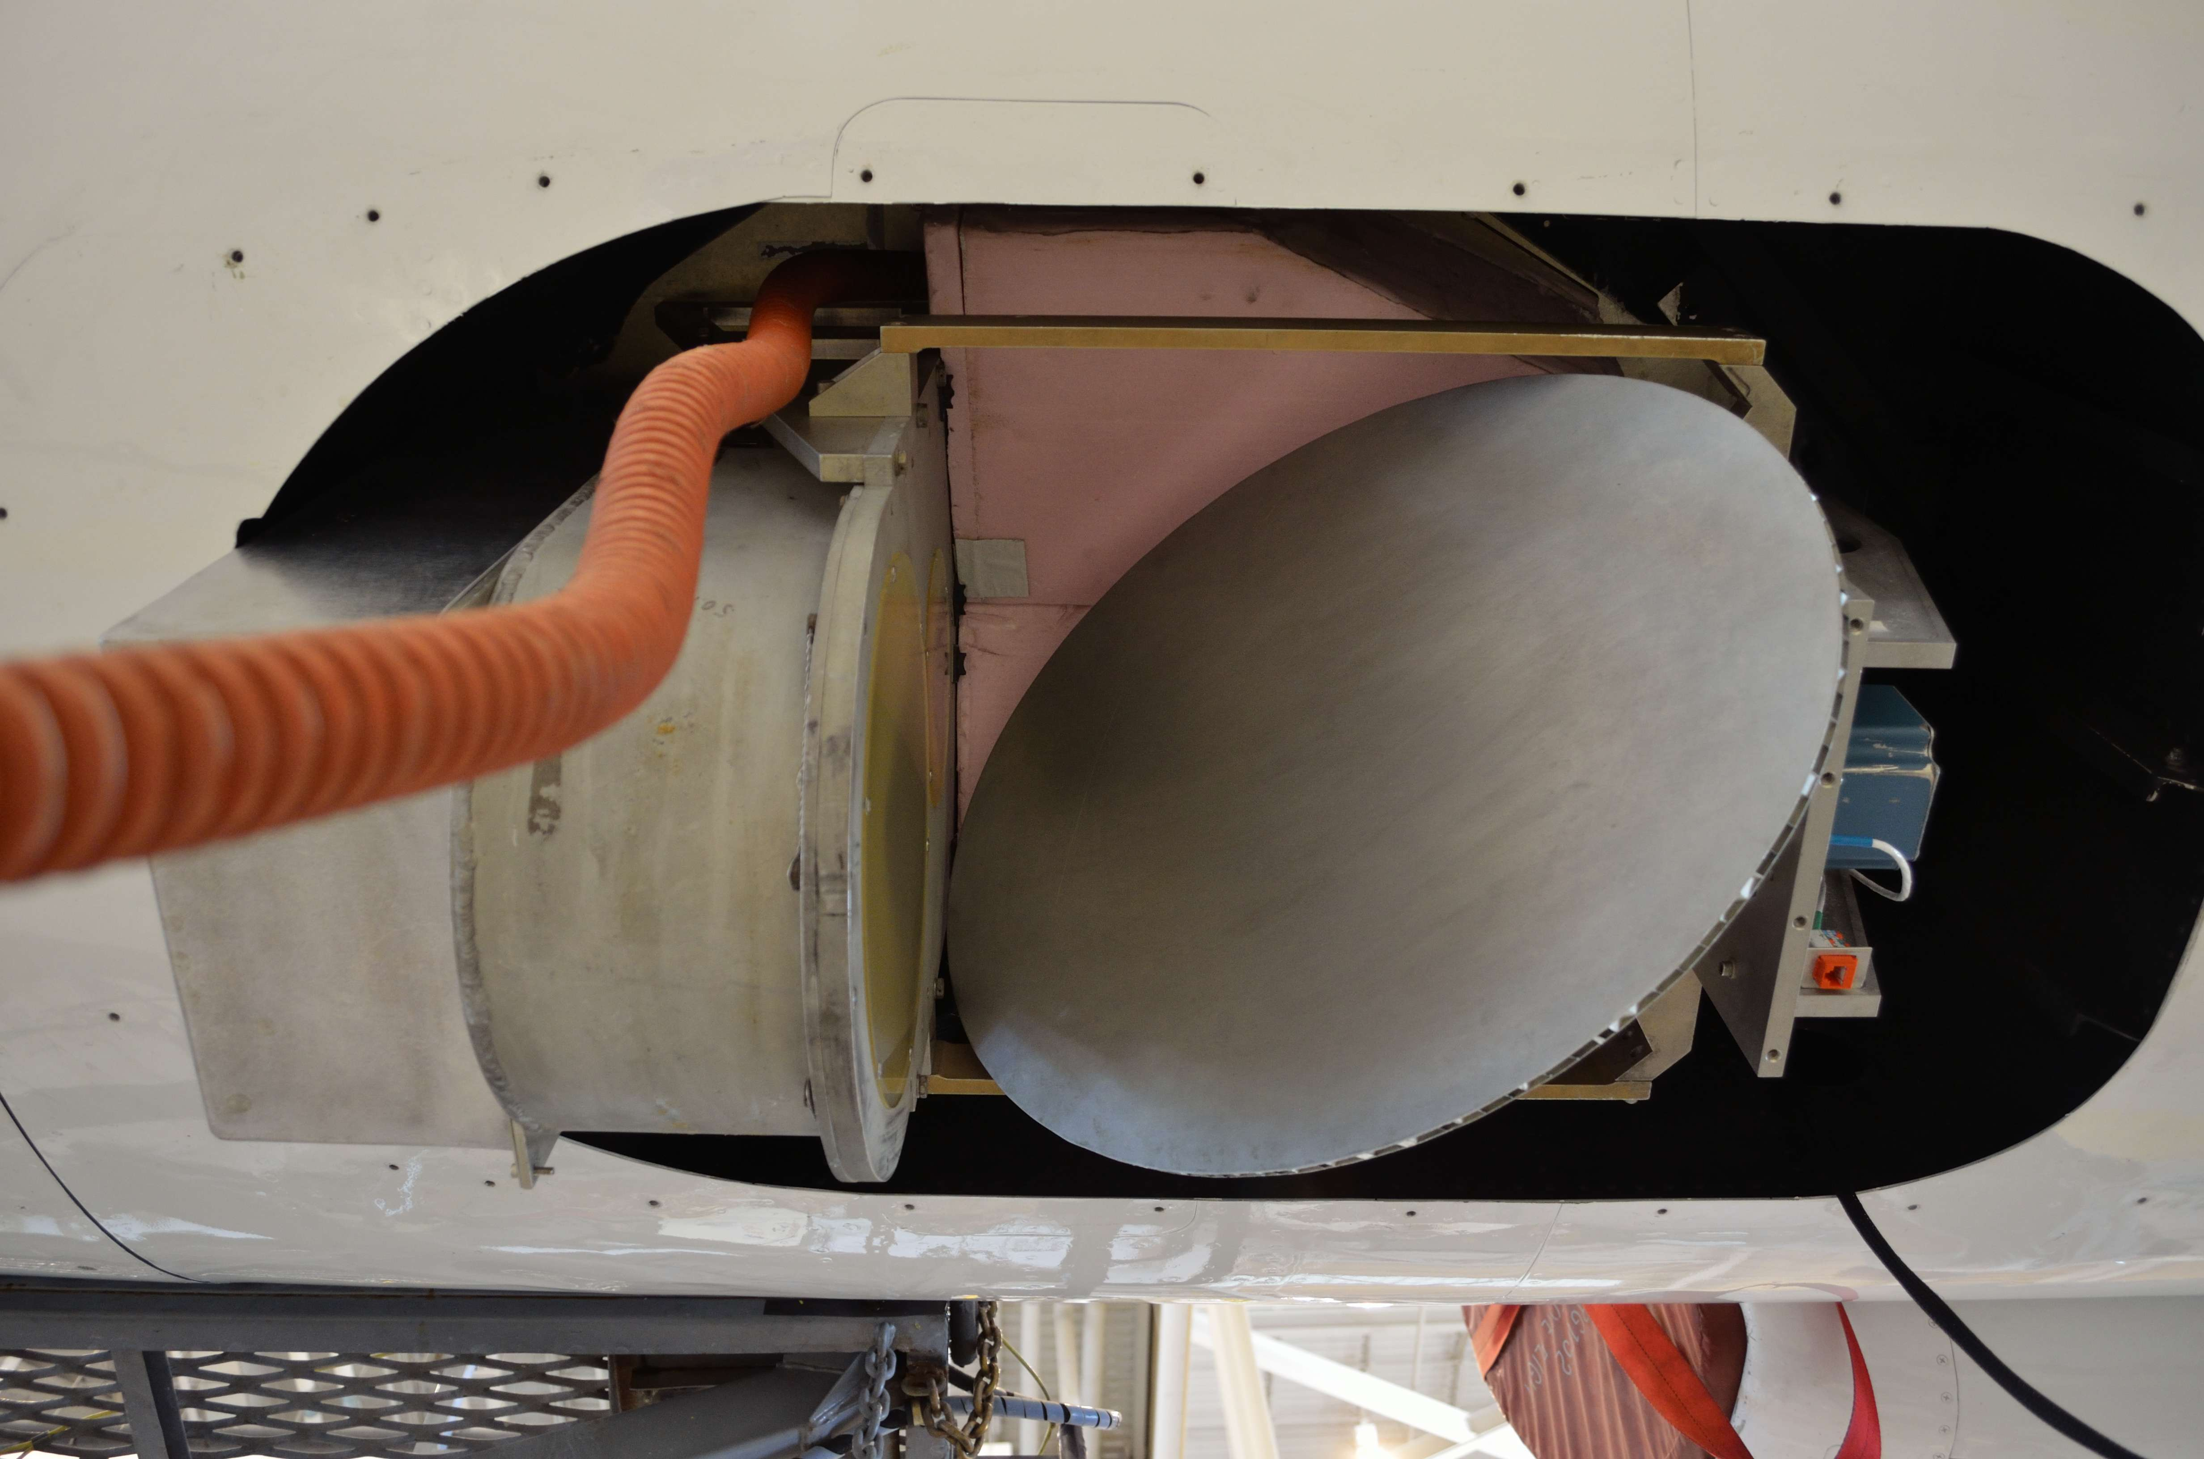
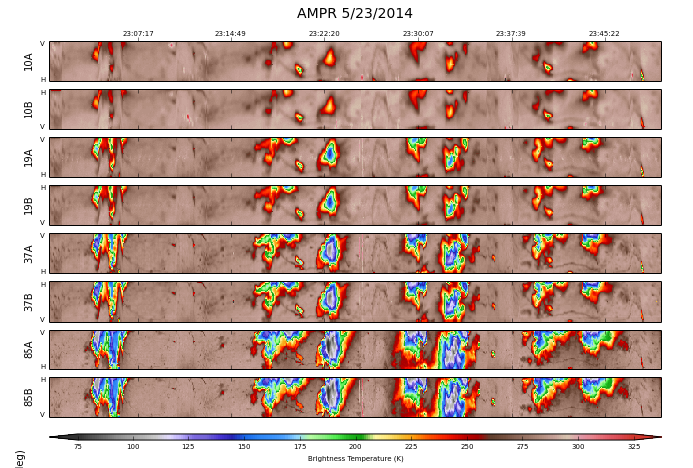
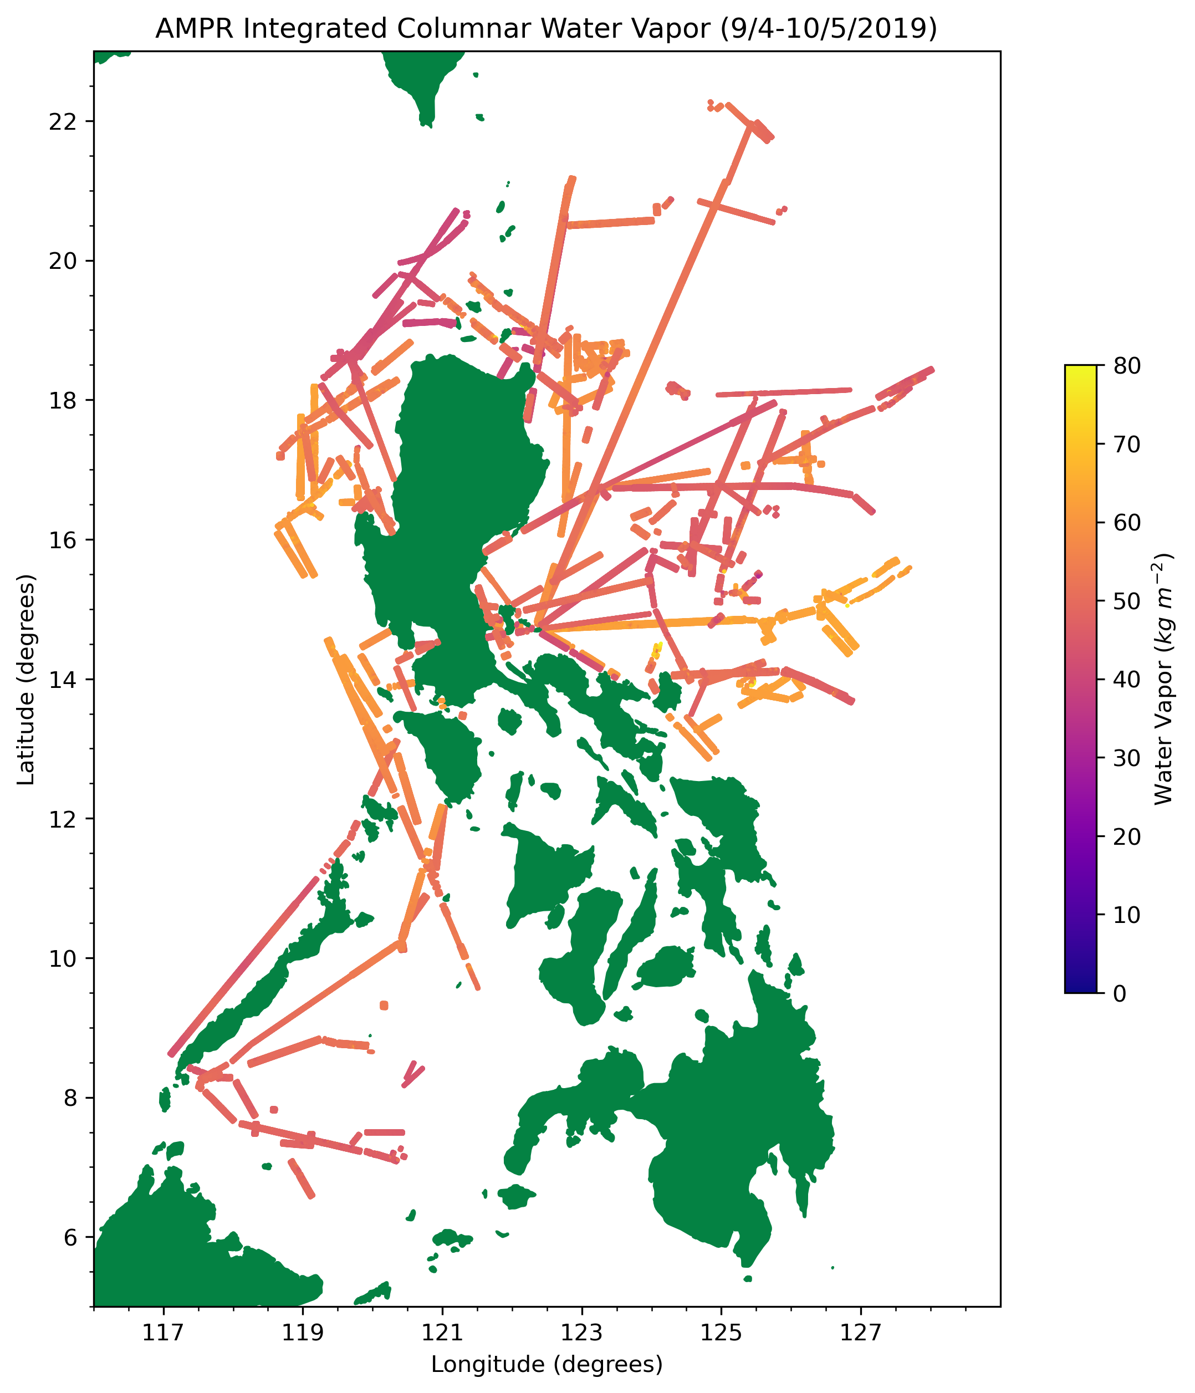
IMPACTS ER-2 Payload
Instrument name/team:
AMPR (Advanced Microwave Precipitation Radiometer)
Team: Timothy Lang (PI), Paul Meyer (PM), Eric Cantrell, Doug Huie, Julia Burton, Amanda Richter, Corey Amiot, Sayak Biswas, Sue O’Brien, Jonathan Hicks, Tom Phillips, Jacob Guthrie
1) What does AMPR measure?
Passive microwave radiometer – Retrieve surface emission, cloud liquid water, ice water path, water vapor, etc.
Four frequencies - 10.7, 19.35, 37.1, 85.5 GHz, with 2 variable polarization channels apiece (Channel A: V -> H and Channel B: H -> V)
Cross-track scanning or nadir staring
2) What science role is AMPR playing in IMPACTS?
Objective 1: Characterize the spatial/temporal scales/structures of snowbands - Precipitation horizontal structure
Together with CoSMIR, provide coverage of 10-183 GHz microwave range
Low frequencies provided by AMPR especially valuable over water

Slide 3
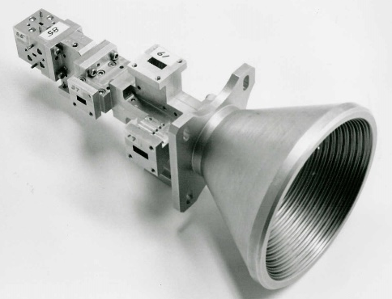
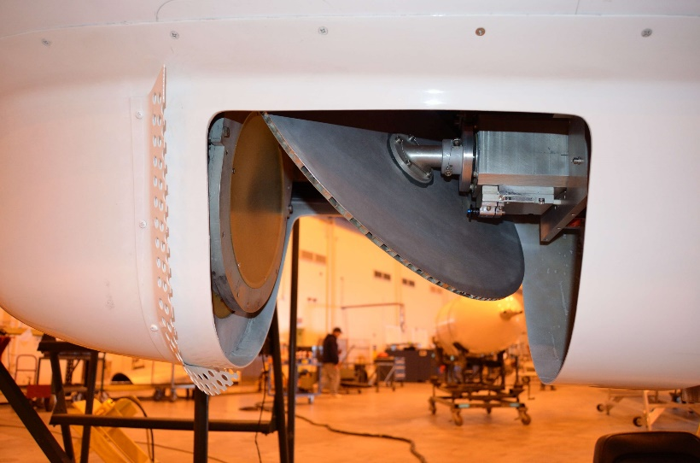
NASA ER-2
NASA ER-2
SSMI MFFH
NEdT = ±0.5 K
All channels
Mirror reflector
GTRI 10.7 GHz horn
Channel Center Frequency | 85.5GHz | 37.1GHz | 19.35GHz | 10.7GHz
Polarization | A/B | A/B | A/B | A/B
Pre-Detection Bandwidth (MHz) | 1400 | 900 | 240 | 100
Integration Time (ms) | 50 | 50 | 50 | 50
Horn Type | SSM/I | SSM/I | SSM/I | GTRI
Lens Diameter (inches) | 5.3 | 5.3 | 5.3 | 9.7
Beam width (degrees) | 1.8 | 4.2 | 8.0 | 8.0
Footprint (km) [@20 km ER-2 alt. 500kts] | 0.64 | 1.48 | 2.78 | 2.78

Slide 4
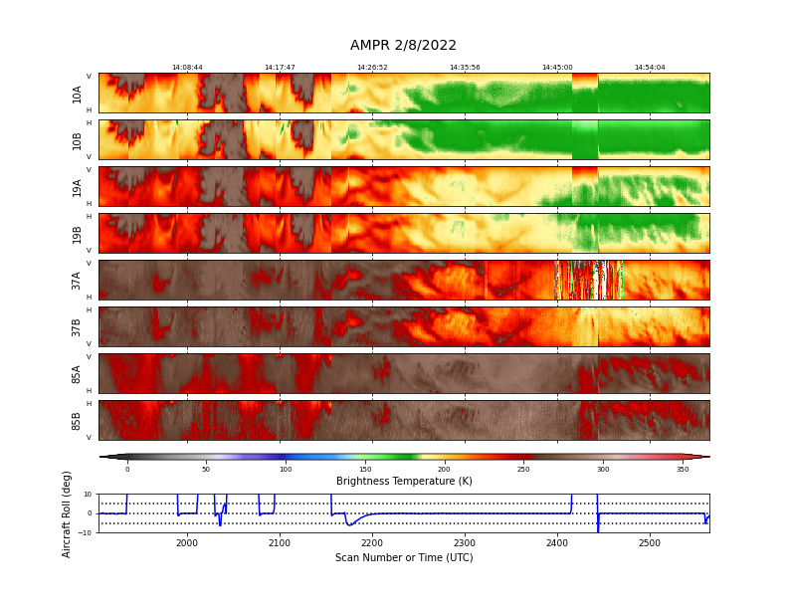
AMPR 2022 Science Highlights
GPM overpass of over-water precipitation system on 2/8/2022
Precipitation signal on all AMPR channels (10-85.5 GHz)

Slide 5
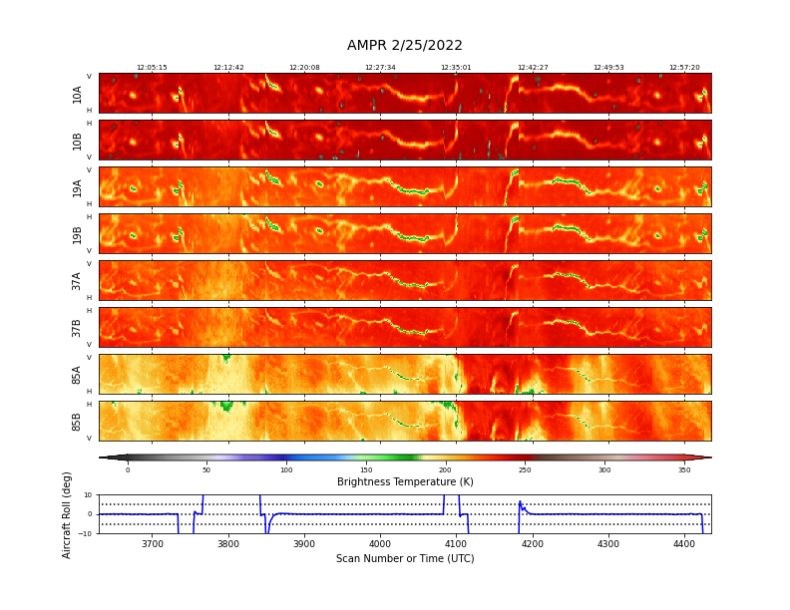
AMPR 2022 Science Highlights
Repeated overflights of heavy snow over Hudson River Valley on 2/25/2022
Mixture of surface features (e.g., Hudson River) with overlying snowstorm (esp. @ 85.5 GHz)

Slide 6
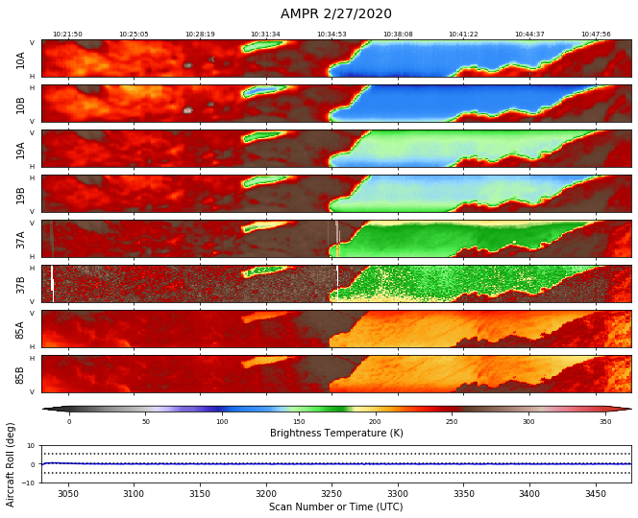
AMPR Data Plans
Data currently on GHRC provide brightness temperatures
An issue was recently discovered that identified potential miscalibration of the cold load temperature on most IMPACTS 2022 flights. This will be addressed in a new data version later this fall.
Improved noise filtering on 37B and 85B channels in 2020 and 2022 data will occur in a future data release.
Geophysical retrievals (e.g., CLW, WV, etc.) over water planned in a future data release.

Slide 7
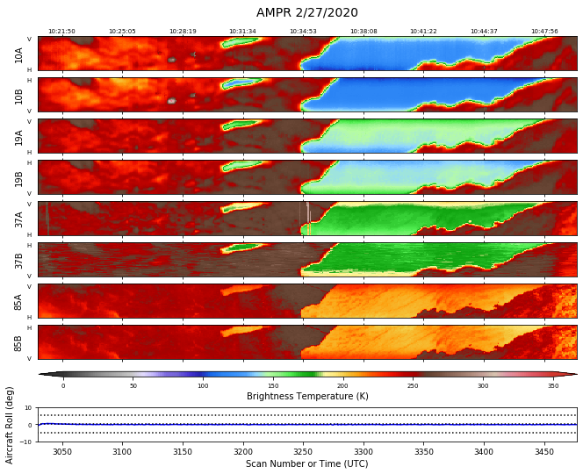
AMPR Data Plans
Data currently on GHRC provide brightness temperatures
An issue was recently discovered that identified potential miscalibration of the cold load temperature on most IMPACTS 2022 flights. This will be addressed in a new data version later this fall.
Improved noise filtering on 37B and 85B channels in 2020 and 2022 data will occur in a future data release.
Geophysical retrievals (e.g., CLW, WV, etc.) over water planned in a future data release.

Slide 8
AMPR Summary
AMPR observed precipitation signals on all nearly all IMPACTS 2020 and 2022 flights
85 GHz and some 37 GHz overflights are useful for precip over land; lower frequencies indicate mostly surface features
All frequencies sensitive to precipitation over water
Don’t use 37B or 85B channels if they appear noisy without consulting MSFC first
AMPR self-describing, CF-compliant netCDF4 data available from GHRC DAAC:
https://ghrc.nsstc.nasa.gov/home/
AMPR software here:
https://github.com/nasa/PyAMPR/
PI contact:
timothy.j.lang@nasa.gov

