Slide 1

Stony Brook University IMPACTS Ground Observations
Brian Colle¹, Pavlos Kollias^{1,2}, and Mariko Oue¹
Division of Atmospheric Sciences, Stony Brook University
Environmental and Climate Sciences Department, Brookhaven National Laboratory

Slide 2
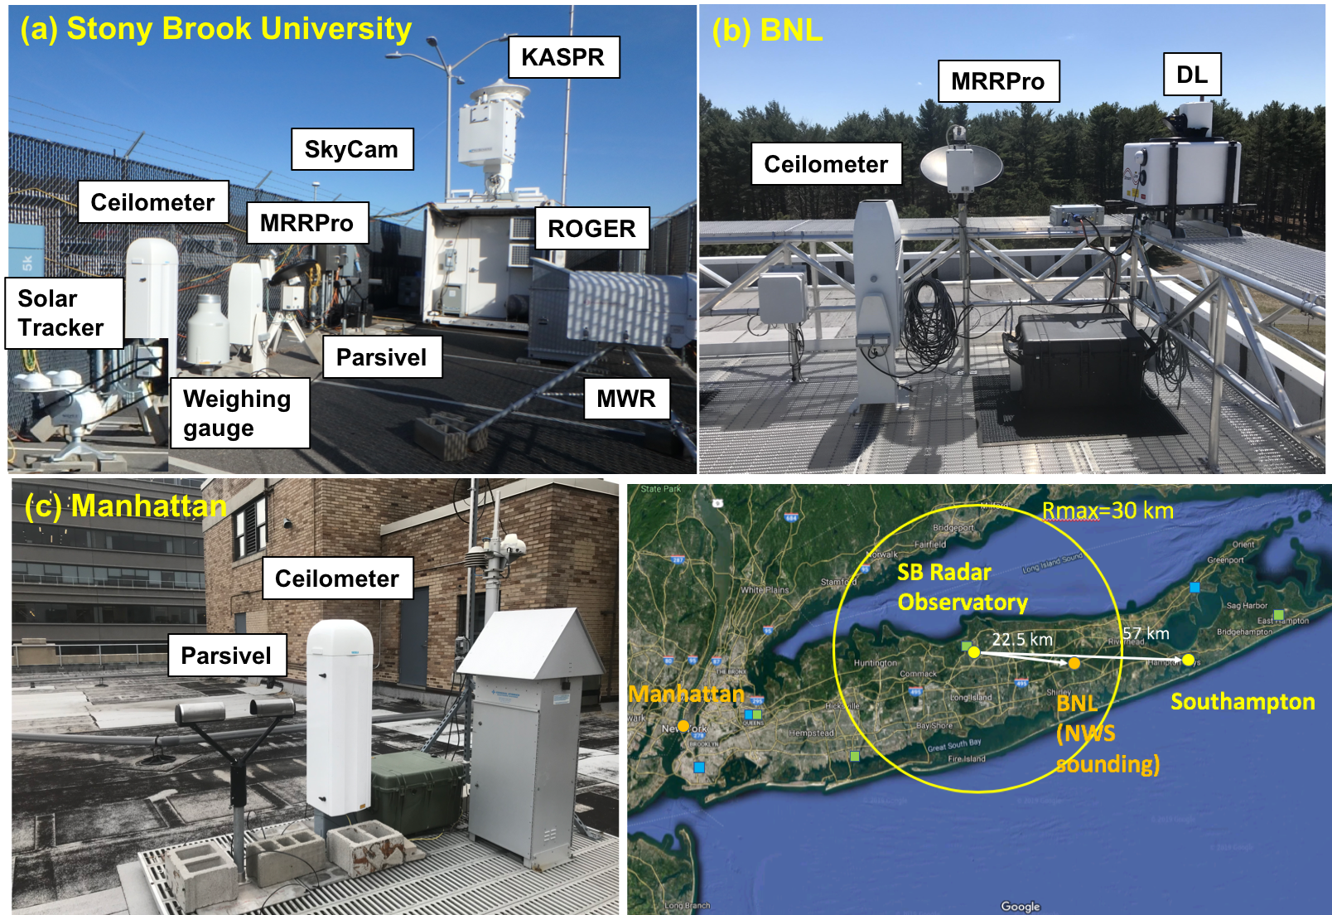
Stony Brook Ground Observations (2020)

Slide 3
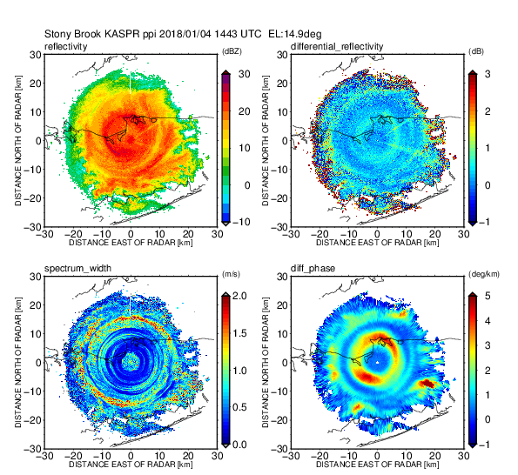
Ka-band Scanning Polarimetric Radar (KASPR)
Available 2019—2021, transmitter failure 2021 (now back in service)
** KASPR scan strategy: 1 or 2 PPIs– 2 RHIs –VPT– 3 RHIs, repeated every 7-8 min
For KASPR, Level 1 on DAAC, but for cases SBU dealiases DV, bias correction for Zdr, and adding Kdp. KASPR reflectivity is well calibrated, but reflectivity (and Zdr) may include attenuations

Slide 4
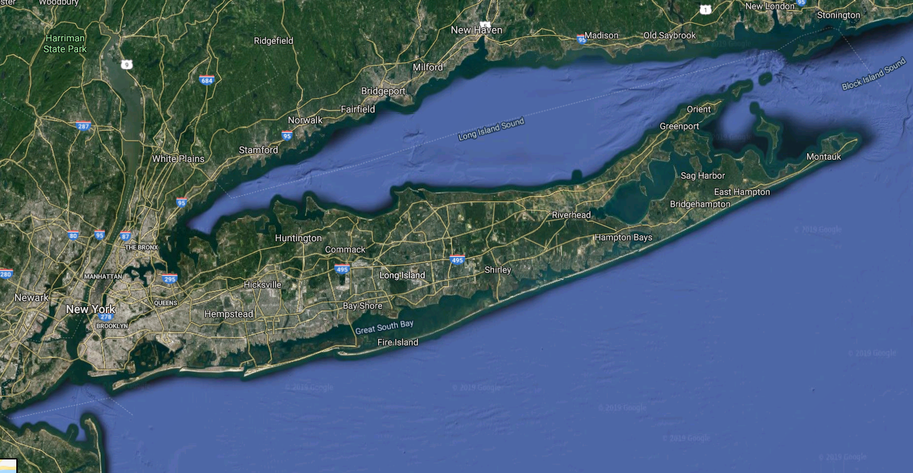
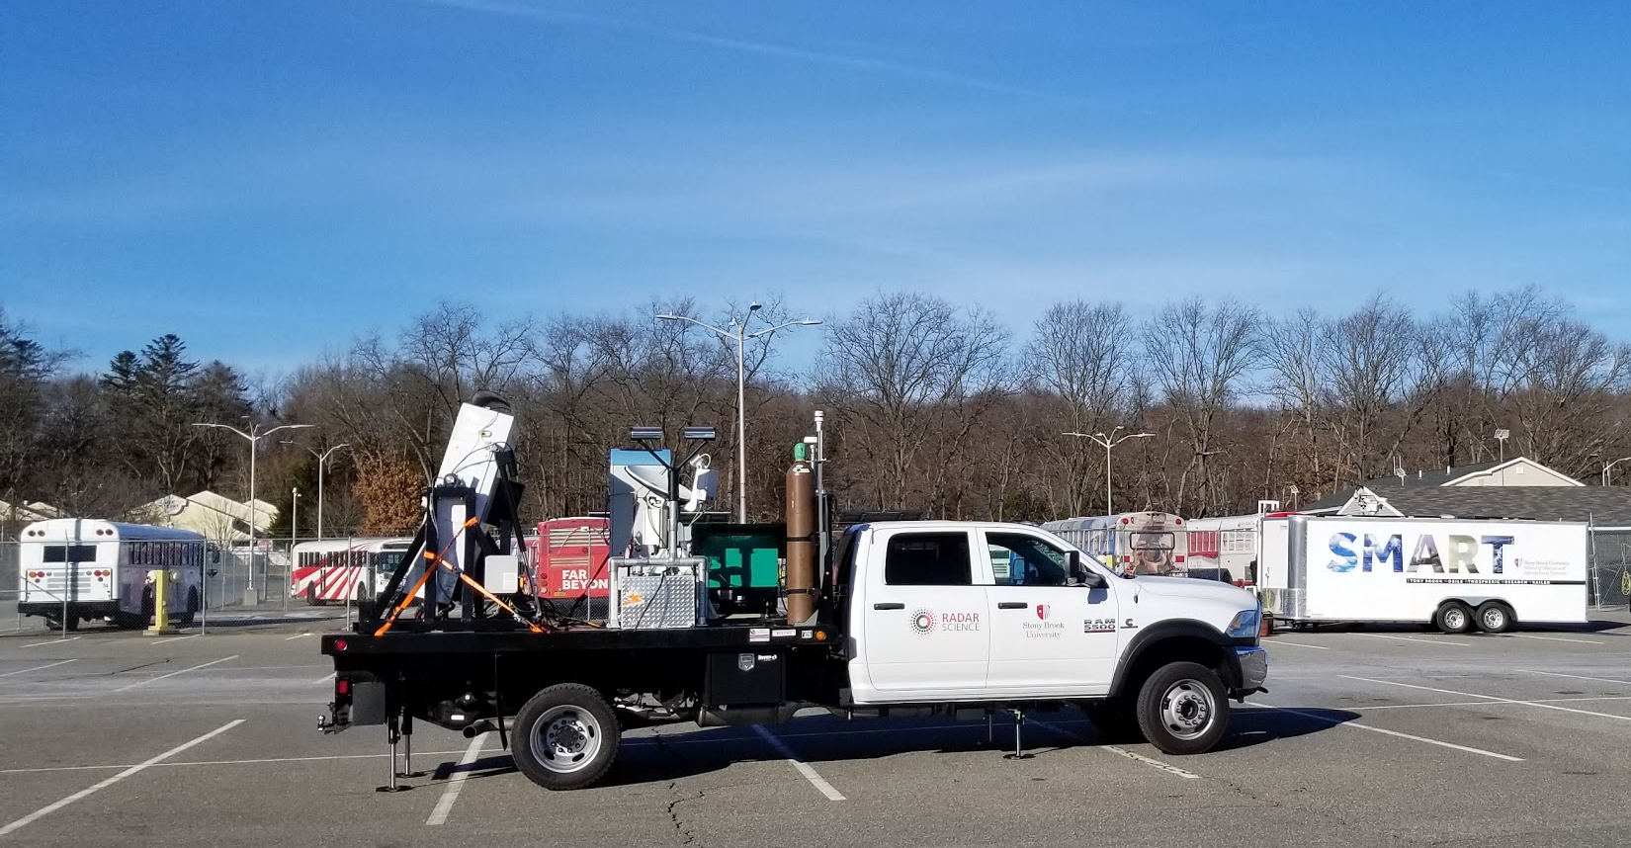
Stony Brook University Truck 2020
Met Station
Backscatter lidar
Graw Soundings
Parsivel2
MRRPro:
Micro Rain Radar
Cedar Beach
SKYLER-1: Dual-pol X-band phased-array radar
SBRO
KASPR 30-km range

Slide 5
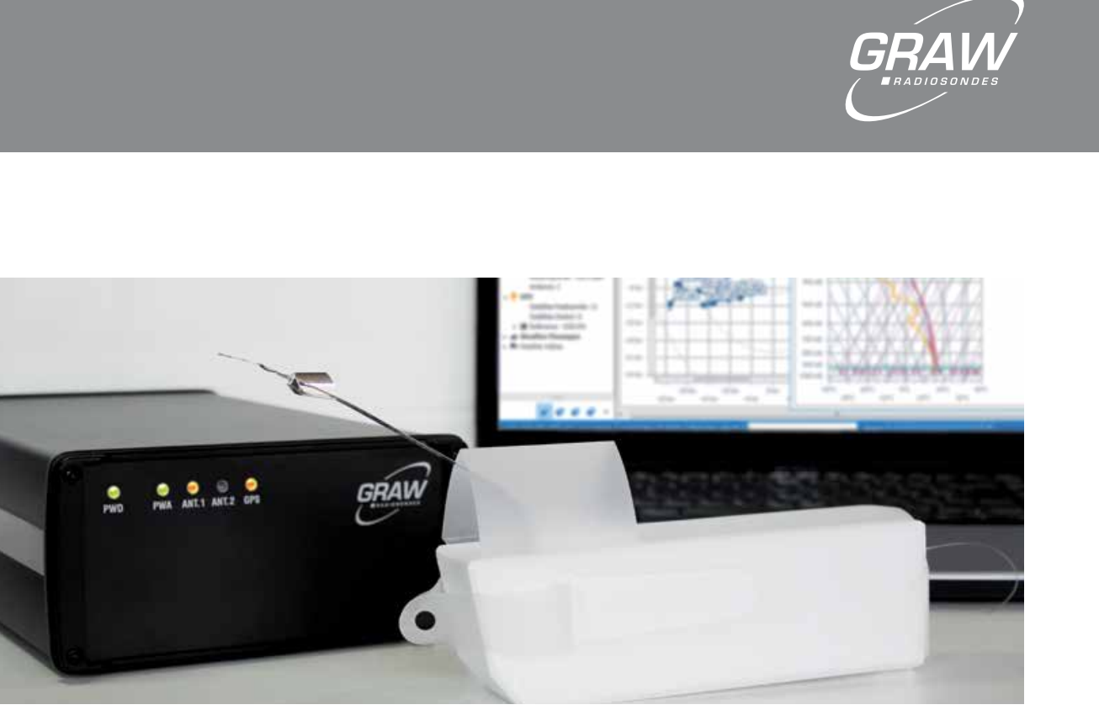
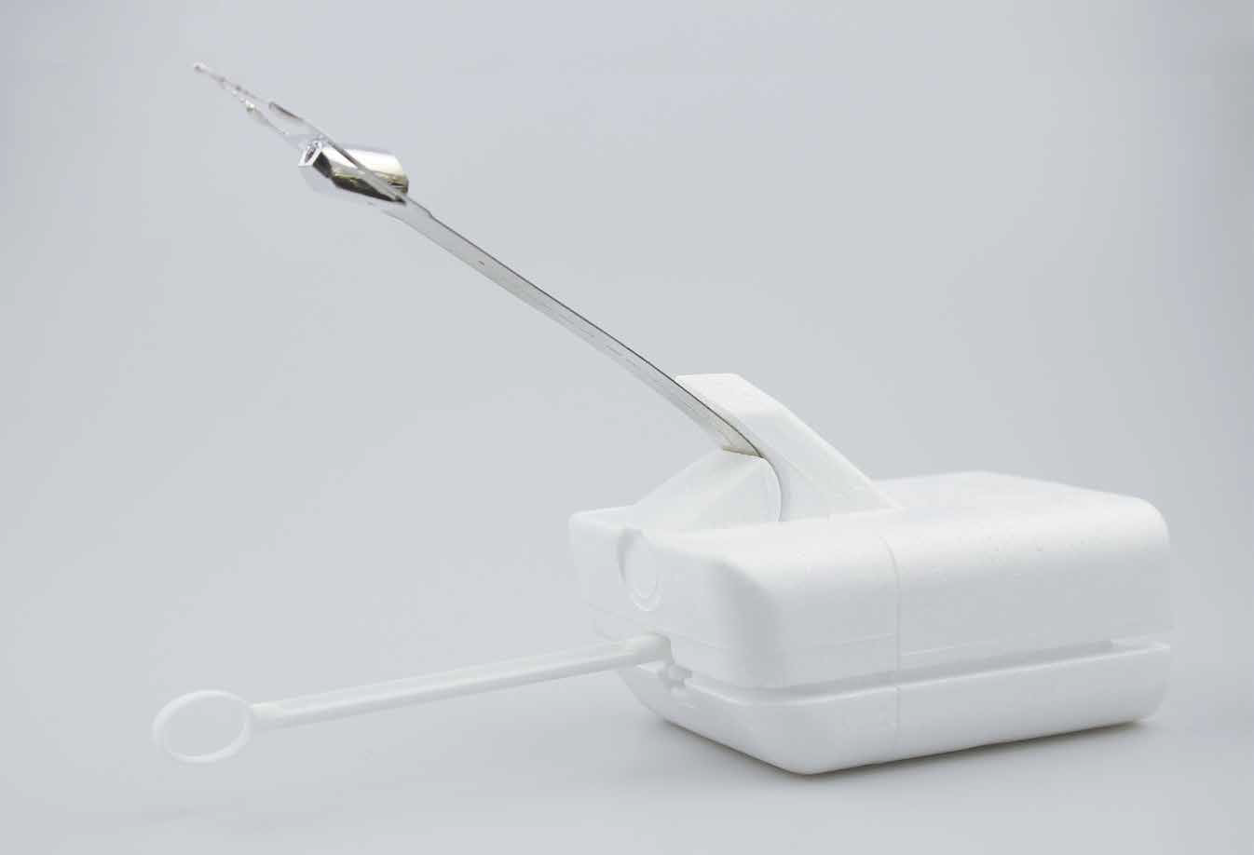
Stony Brook GRAW Sounding System
Technical Data | DFM-09 (2020) | DFM-17 (2022)
Weight | <90 g, ready to start | 63 g, ready to start
Size | 200 x 42 x 60 mm | 90 x 67 x 44 mm
Power supply | Lithium | 2 x Lithium CR123A, replaceable
Runtime integrated battery pack | >140 min | > 240 min
Wind finding | GPS (48 channel) | GNSS (GPS/GLONASS/BEIDOU)
Transmission-rate | One full dataset per second | One full data set per second
Bandwidth | < 10 kHz | < 12 kHz
Frequency range | +/- 3 kHz | 400 - 405.99 MHz
Modulation | FSK | GFSK
Output power telemetry | 100 mW, typical | < 100 mW
Error correction telemetry | Code-spreading, interleaving | Code-spreading, interleaving
Temperature resolution | 0.1°C | 0.01 °C (internal)
Temperature accuracy | < 0.2 °C | < 0.2 °C
Humidity resolution | 0.1 %rH | 0.1 %rH
Humidity uncertainty | < 4 %rH | < 4 %rH
Pressure uncertainty | < 0.3 hPa | Uncertainty > 100hPa< 1 hPa Uncertainty 100 - 10hPa< 0.2 hPa Uncertainty < 10hPa< 0.04 hPa
Geopotential height uncertainty | < 10 m | < 8 m
Wind speed uncertainty | <0.2 m/s | < 0.1 m/s

Slide 6
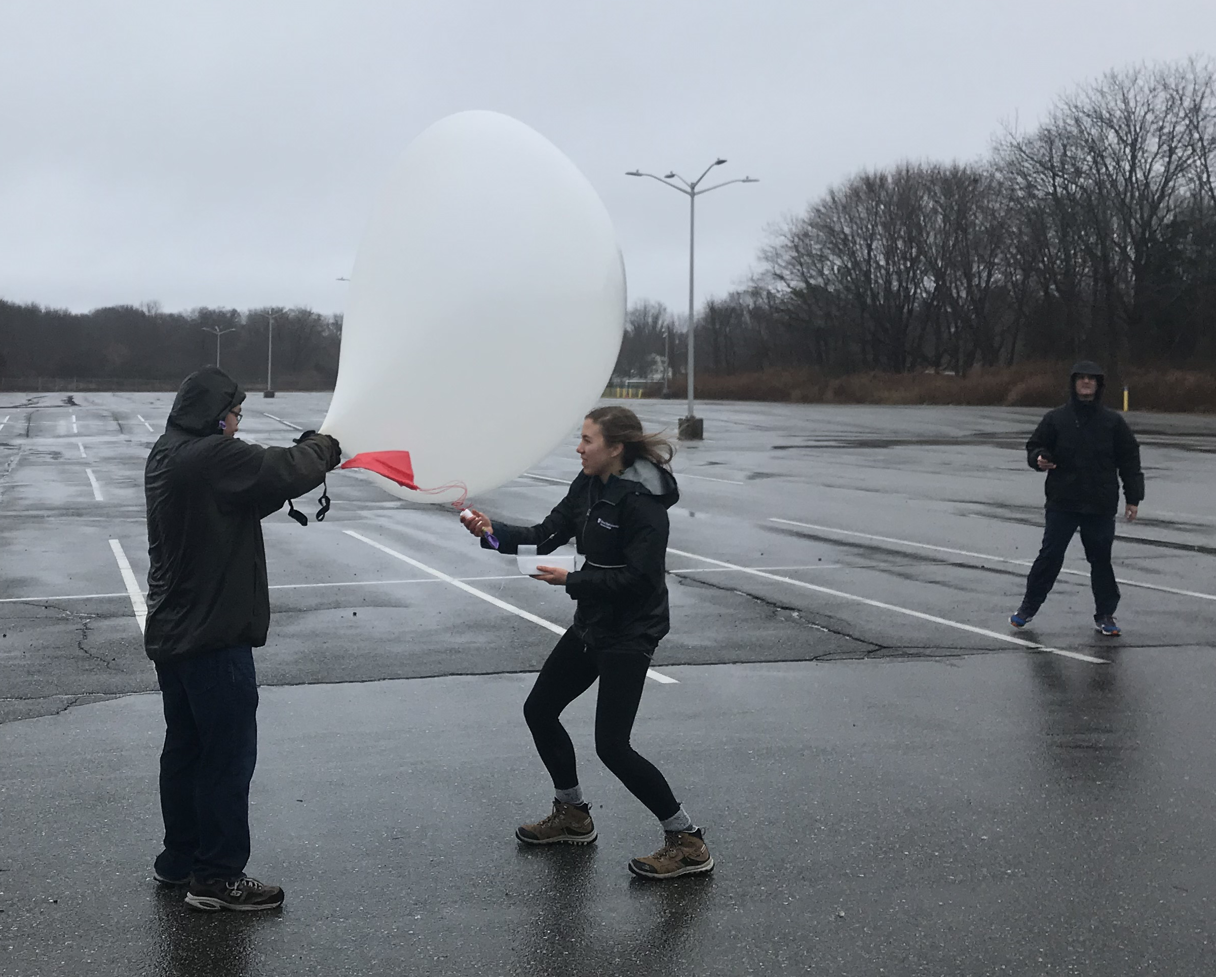
2020 Stony Brook Sounding Team Launches
 | Jan. 18-19 | Jan. 25 | Feb. 7 | Feb. 13 | Feb. 24-26 | Feb. 27
Location | Cedar Beach 40.965N, -73.030E | SBU 40.897N, -73.127E | SBU | Cedar Beach | SBU | SBU
Launch time (UTC) | Jan. 18 181323 Jan. 18 195323 Jan. 18 214620 Jan. 18 235935 Jan. 19 004158 | Jan. 25 175259 | Feb. 7 140738 Feb. 7 174314 | Feb. 13 021656 Feb. 13 050307 Feb. 13 055828 Feb. 13 081120 | Feb. 24 224844 Feb. 25 014604 Feb. 25 154414 | Feb. 27 050442 Feb. 27 081638
Data QC’d and uploaded to DAAC.

Slide 7
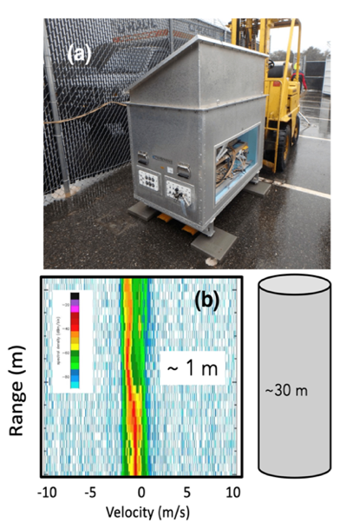
ROGER (W-band Profiling Radar)
We plan to upgrade the transceiver of the 94-GHz radar using quadratic phase coding (QPC) for high duty cycle operations (i.e., higher sensitivity without multiple-trip interference).
Use of wide bandwidth transmit waveforms to enable ultra-fine range resolution (~1 m), a 30-fold improvement over current instrument.
In addition, a high-performance digital receiver will be added to the radar system to improve its overall performance.
Upgraded in 2022 – now at BNL

Slide 8
Data Availability for IMPACTS Cases (2020)
 |  | Jan. 18-19 | Jan. 25 | Feb. 7 | Feb. 13 | Feb. 24-26 | Feb. 27
Radar Truck | Location | Cedar Beach 40.965N, -73.030E | SBU 40.897N, -73.127E | SBU | Cedar Beach | SBU | SBU
 | Sounding, Ceilometer, MRR, Parsivel, SKYLER, Weather Station [Sounding time] | ✓ [18/18z, 18/19z, 18/21z, 18/23z, 19/00] | ✓ [17z] | ✓ [14z 17z] | ✓ [02z, 05z, 06z, 08z] | ✓ [24/22z, 25/01z, 25/15z] | ✓ [05z, 08z]
SBU 40.897N, -73.127E | KASPR | ✓ | ✓ | ✓ | ✓ | ✓ | ✓
 | ROGER | ✓ | ✓ | ✓ | ✓ | ✓
 | Pluvio | ✓ | ✓ | ✓ | ✓ | ✓ | ✓
 | Parsivel |  |  | ✓ | ✓ | ✓ | ✓
 | MWR
BNL 40.879N, -72.874E | MRR, Ceilometer, Doppler Lidar | ✓ | ✓ | ✓ | ✓ | ✓ | ✓
Manhattan 40.728N, -74.007E. | MRR, Ceilometer, Parsivel, Weather station | ✓ | ✓ | ✓ | ✓ | ✓ | ✓
* All uploaded to DAAC: sounding, weather station, Pluvio, ceilometer have been QC’d.

Slide 9
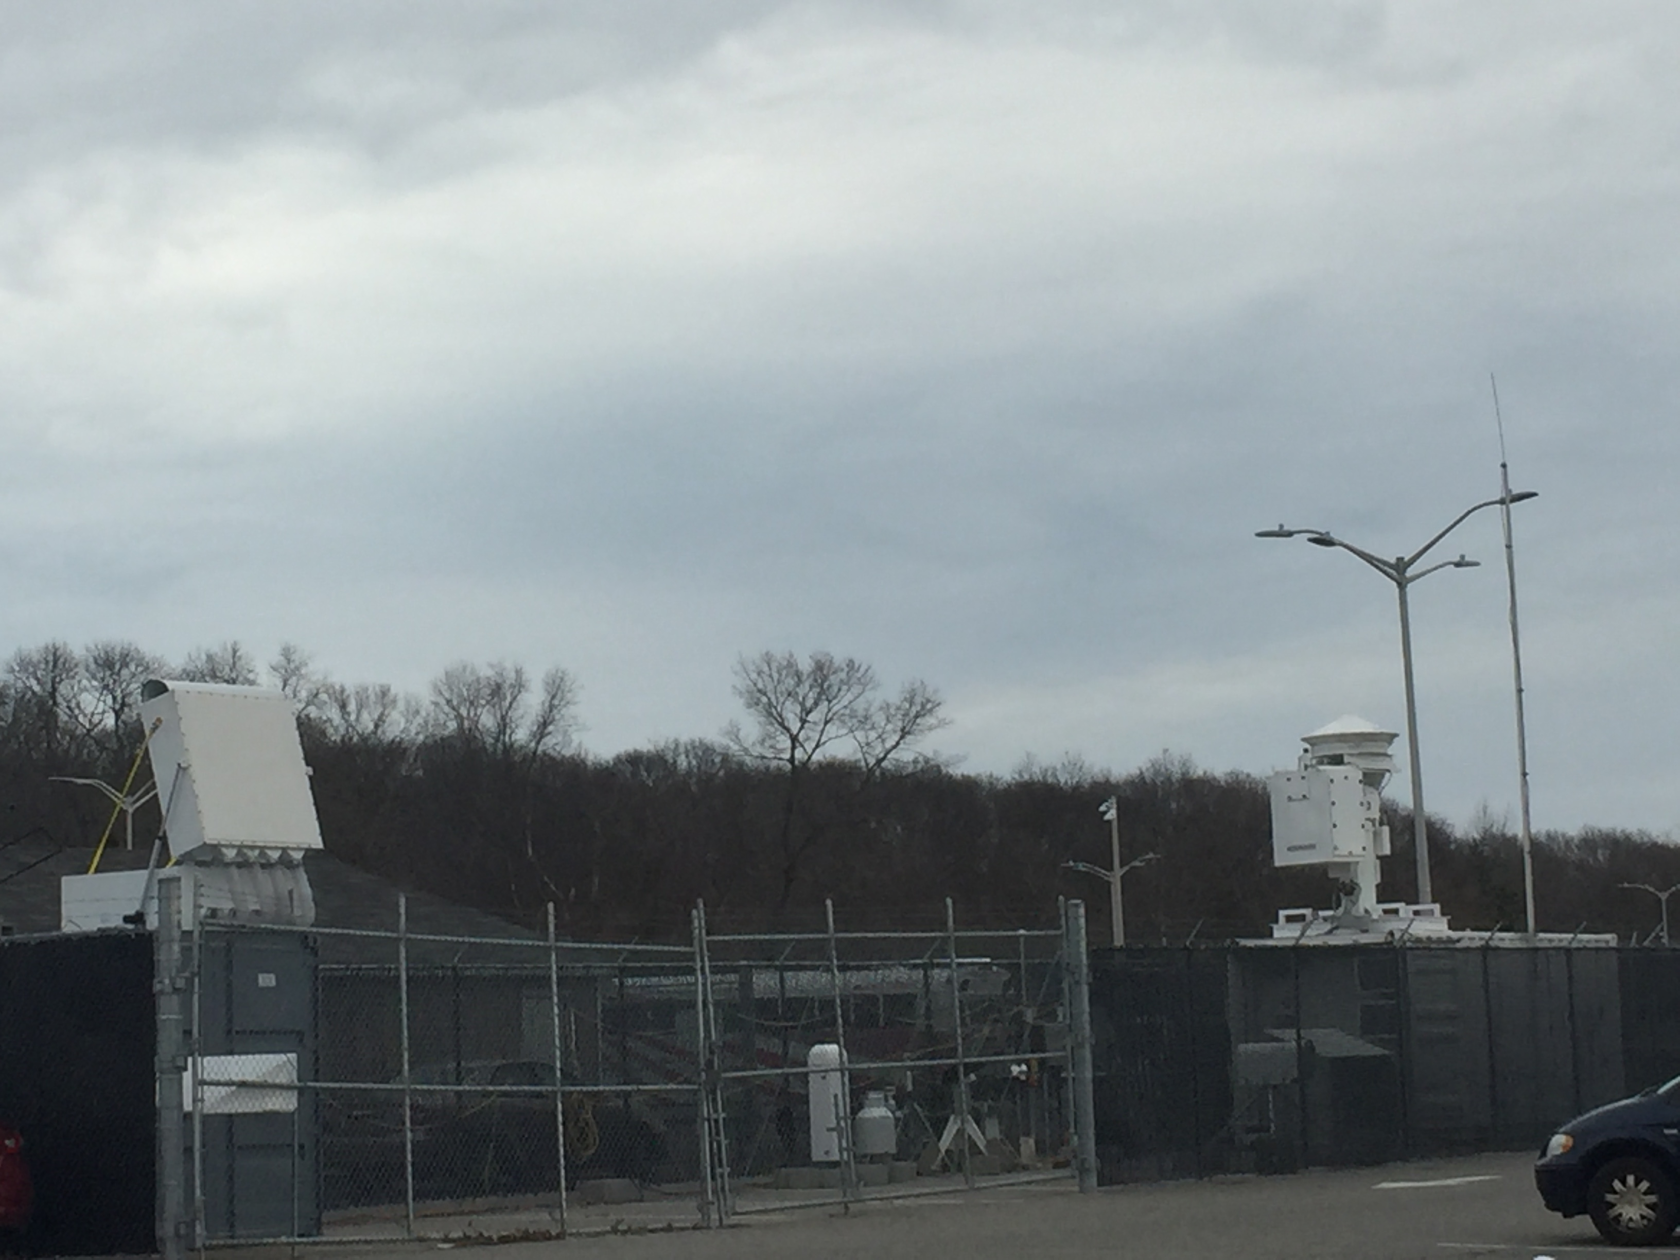
SKYLER-I was fixed at SBU for IMPACTS 2022
** KASPR not operational for IMPACTS 2022
Phased-array radar
KASPR

Slide 10
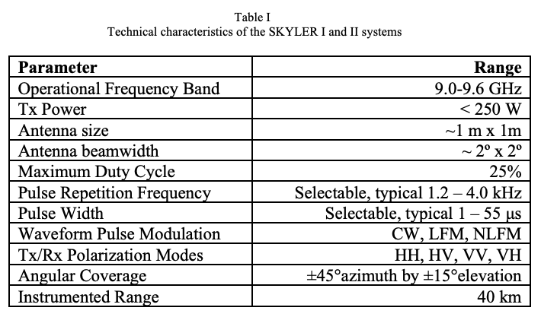
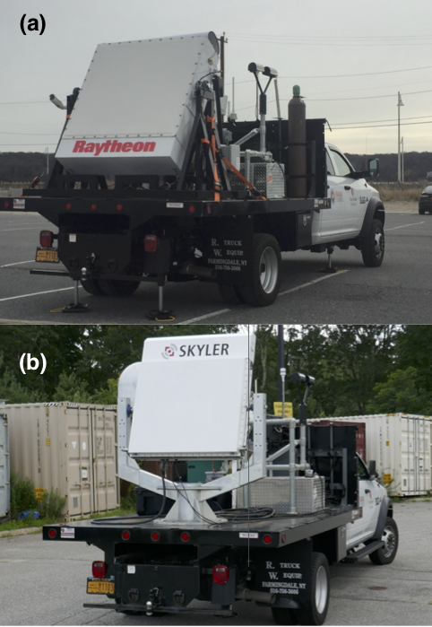
>= 2022: SKYLER-2 dual-polarization X-band phased array radar
Variables observed:
reflectivity,
Doppler velocity,
spectrum width,
differential reflectivity,
differential phase,
copolar correlation coefficient,
signal-to-noise ratio,
specific differential phase
Also on truck:
+Radiosonde
+Parsivel
+Met station
* Some data for 17 Jan 2022 (Elmira, NY case)
* Several technical issues have been resolved
Radar was successfully deployed in
Houston TX for ESCAPE/NSF

Slide 11
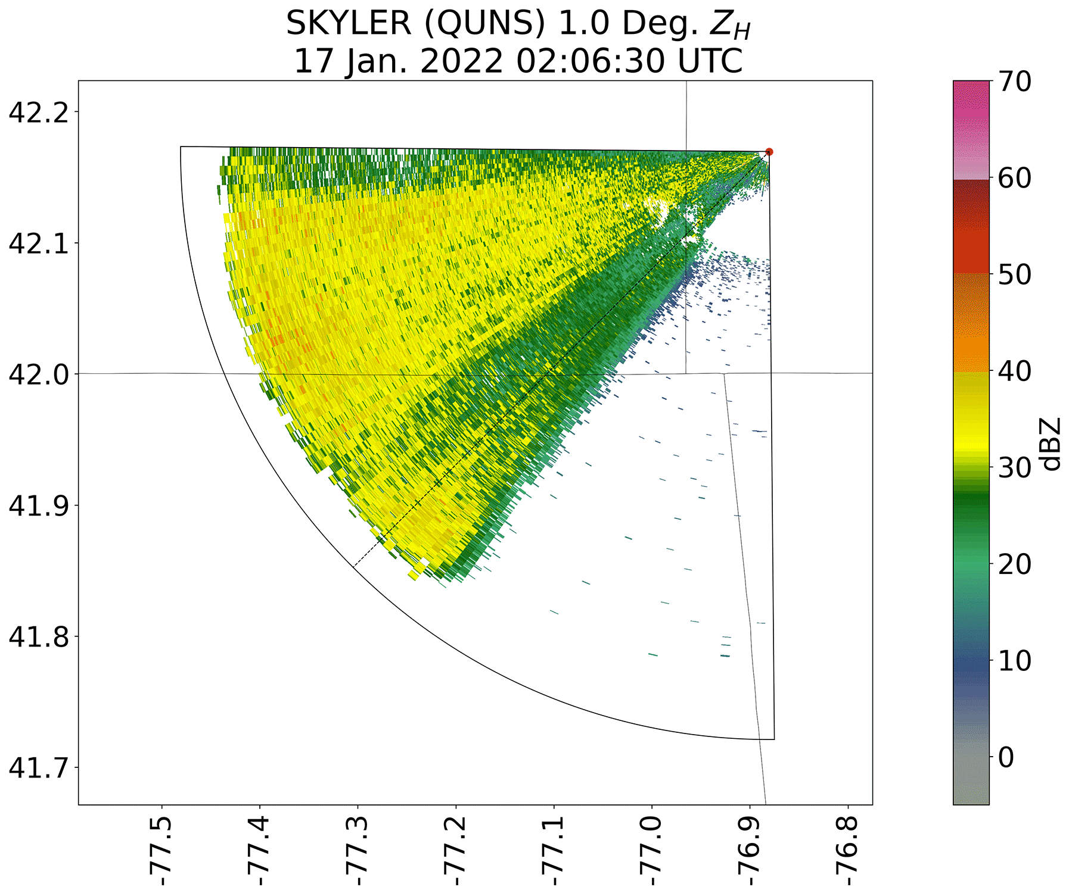
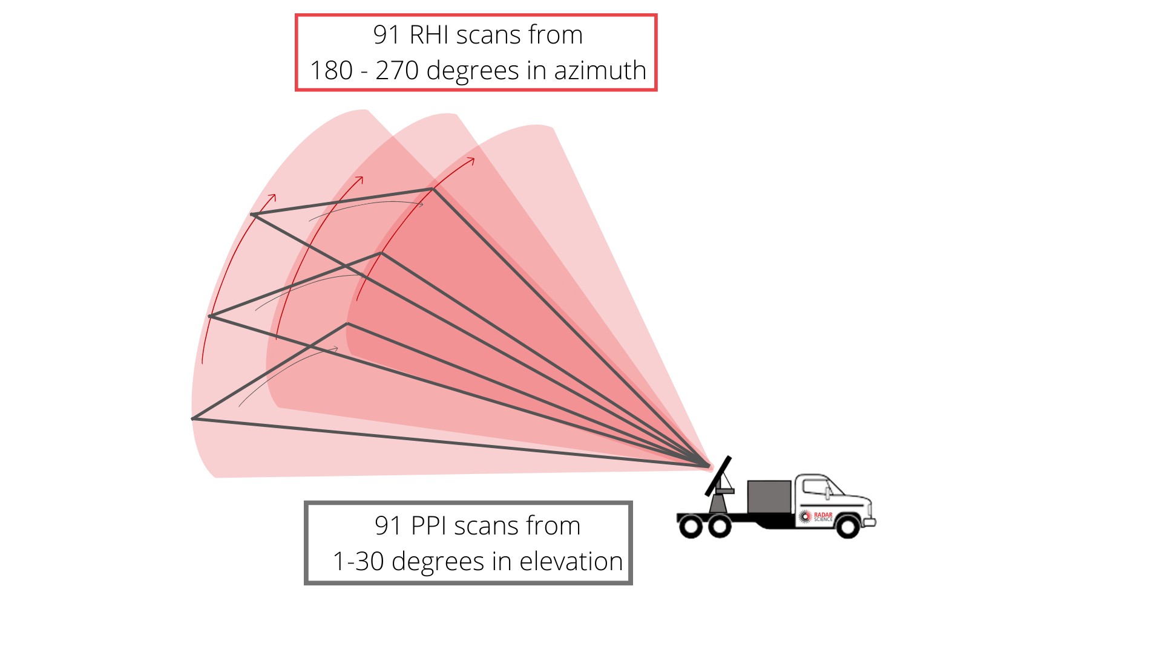
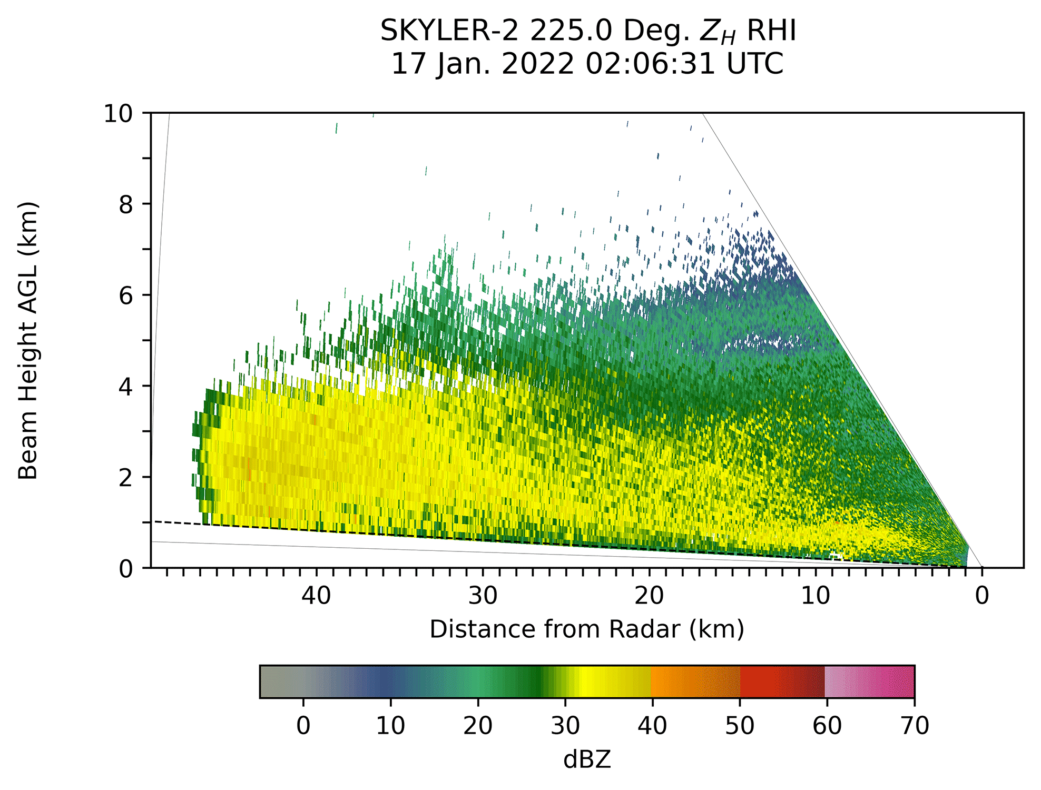
Skyler 3-D Volume Scans (using 91 PPI scans from 1-30 deg elevation)

Slide 12
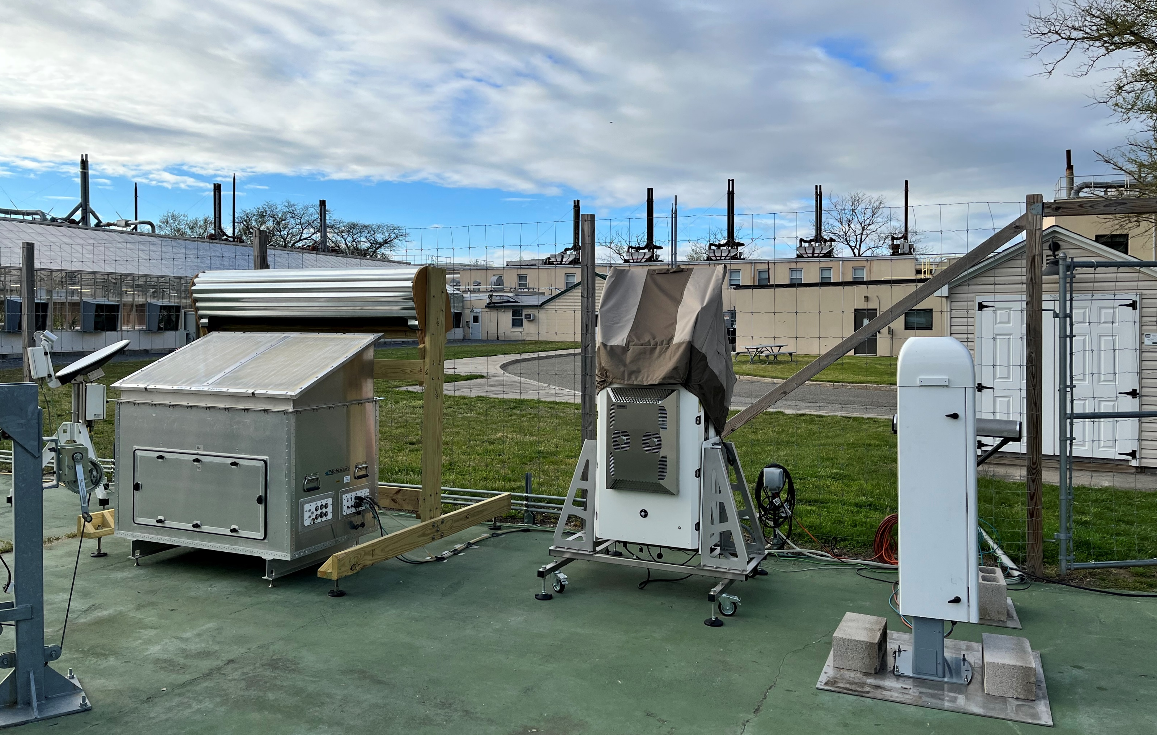
Current (mid-2022 to present – several obs moved BNL
CFMCW
W-band radar
Microrain Radar
HRL
Ceilometer
New ground site at Brookhaven National Laboratory
94-GHz, MRR-PRO, Parsivel, Pluvio, Ceilometer and HRL Supported by the BNL Center for Multiscale Applied Sensing.
KASPR and MASC located at Stony Brook
All other sensors at BNL
12

Slide 13
2022 Stony Brook Sounding Team Launches
 | Jan. 7 | Jan. 17 | Jan. 20 | Jan. 29 |  | Feb. 4 | Feb. 13 | Feb. 25
Location | SBU 40.897N, -73.127E | Elmira 42.1742 N -76.8719 E | SBU | SBU | Smith Point 40.7339 N -72.8615E | SBU | SBU | SBU | Fort Edward 43.246 N -73.559 E
Launch time (UTC) | 094323 131258 151019 | 033750 054634 | 124422 | 071954 090813 133618 152741 191951 212657 | 023055 035625 | 195915 | 144210 | 052500 094459 140436 | 061730 083107 150316

Slide 14
Deployments and Operations during IMPACTS 2022
 |  | Jan. 7 | Jan. 17 | Jan. 20 | Jan. 29 | Feb. 4 | Feb. 13 | Feb.25
Radar Truck | Location | SBU 40.897N, -73.127E | Elmira 42.1742 N -76.8719 E | SBU | Smith Point 40.7339 N -72.8615E | SBU | SBU | Fort Edward 43.246 N -73.559 E
 | Sounding, | ✓ | ✓ | ✓ | ✓ | ✓ | ✓ | ✓
 | Ceilometer | Removed
 | MRRPro | Removed
 | Parsivel | ✓ | ✓ | ✓ |  |  | ✓ | ✓
 | SKYLER2 |  | ✓ | ✓ |  |  | ✓ | ✓
 | Weather Station | ✓ | ✓ | ✓ | ✓ |  | ✓ | ✓
SBU 40.897N, -73.127E | KASPR
 | ROGER
 | SKYLER1 | ✓ | ✓ | ✓ |  | ✓ | ✓ | ✓
 | MRRPro | ✓ | ✓ | ✓ | ✓ | ✓ | ✓ | ✓
 | Ceilometer | ✓ | ✓ | ✓ | ✓ | ✓ | ✓ | ✓
 | Pluvio | ✓ | ✓ | ✓ | ✓ | ✓ | ✓ | ✓
 | Parsivel | ✓ | ✓ | ✓ | ✓ | ✓ | ✓ | ✓
 | MWR
All uploaded to DAAC: sounding data QC’d

Slide 15
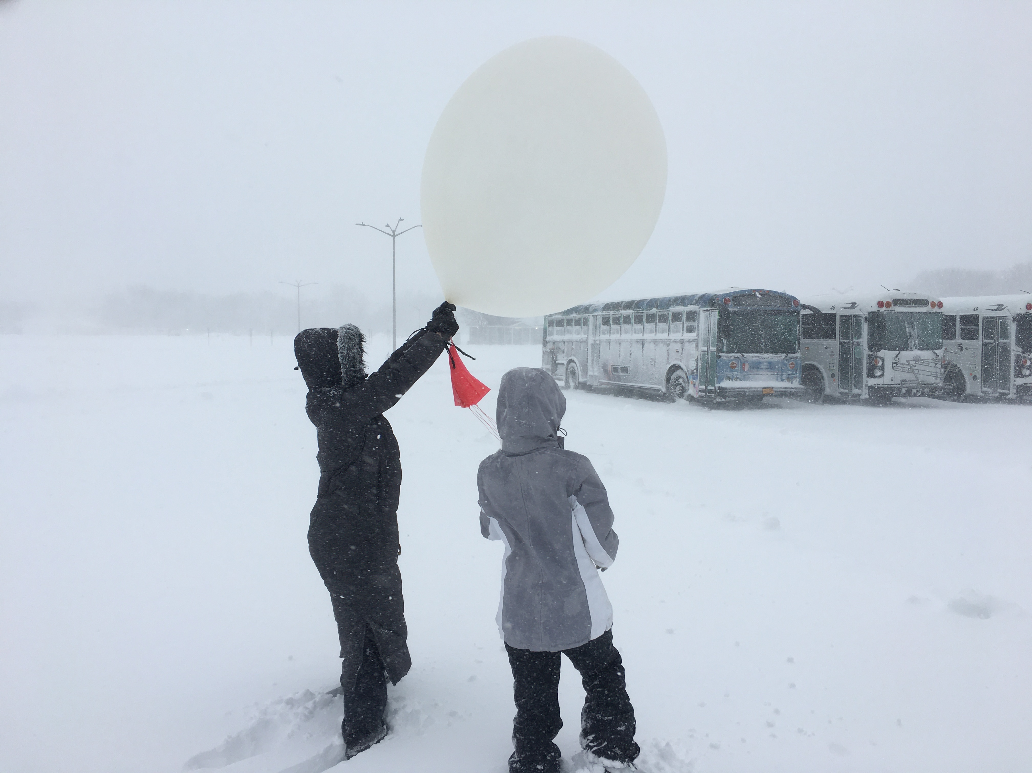
Questions?
Contact: brian.colle@stonybrook.edu
SBU Sounding Launch 31 Jan 2021

