Slide 1
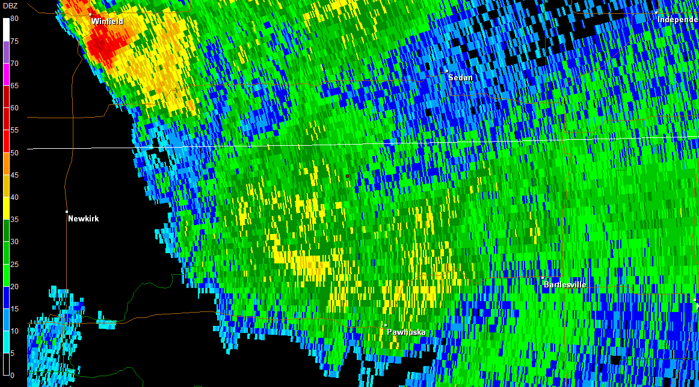
Spiral Pt. Echo-1 (FL 240 – FL40)

Slide 2
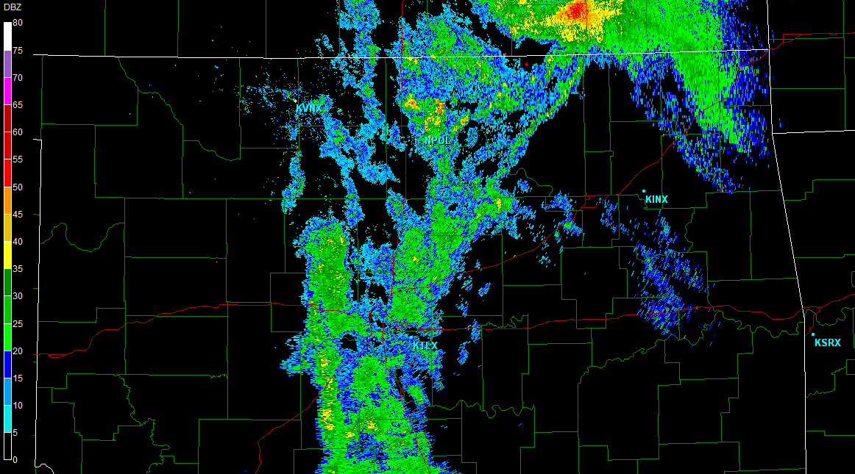
Porpoise Pt. Echo-1 – Pt. Echo-2 (FL 120- FL 140)

