Slide 1



NASA SPoRT’s Pseudo Geostationary Lightning Mapper (PGLM)
Geoffrey Stano
ENSCO, Inc./NASA Short-term Prediction Research and Transition Center, Huntsville, AL
Acknowledgments: Brian Carcione¹, Kristin Kuhlman², and Christopher Siewert³
¹ NOAA National Weather Service, Huntsville, AL
² University of Oklahoma – CIMMS / NSSL, Norman, OK
³ University of Oklahoma – CIMMS, Norman OK
GOES-R Science Week Meeting
19-23 September, 2011
Huntsville, Alabama
GLM Annual Science Meeting, 19-20 September 2011, Huntsville, Alabama

Slide 2

Outline
What is SPoRT?
Current Lightning and GLM Activities
What is the Pseudo GLM?
  Origin
  Why is it being used
  Operational examples
Conclusions and Future Work
GLM Annual Science Meeting, 19-20 September 2011, Huntsville, Alabama

Slide 3

The NASA SPoRT Program
Mission: Apply unique NASA Earth science research and observations to improve the accuracy of short-term (0-24 hr) weather prediction at the regional and local scale – work mainly with WFOs
SPoRT Paradigm
  Match observations/capabilities to forecast problems
  Develop / assess solution in “testbed”, transition to decision support system
  Conduct training,
  product assessment and impact
  Do not throw data “over the fence”
http://weather.msfc.nasa.gov/sport
http://weather.msfc.nasa.gov/sportblog
GLM Annual Science Meeting, 19-20 September 2011, Huntsville, Alabama

Slide 4
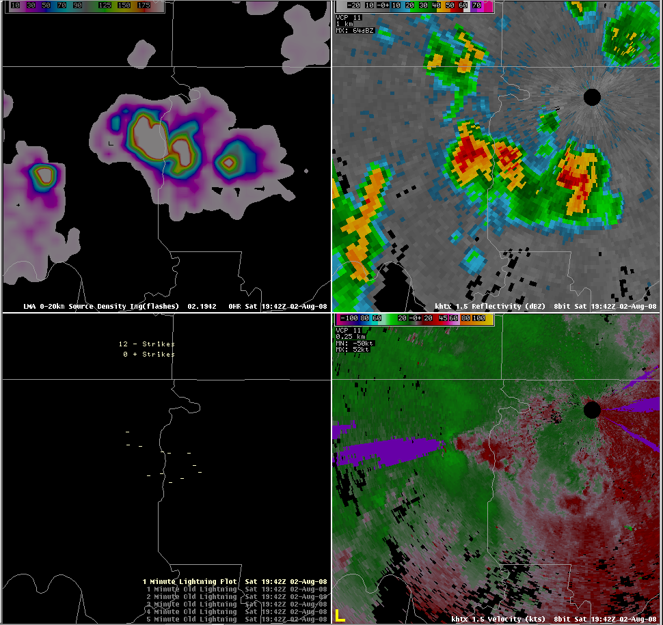
Current Lightning Work
Source Density
Reflectivity
  First transition in 2003
  North Alabama Network
  Now work with 5 WFOs
  Use three networks
  Producing new training modules
  Developing new visualizations
  Preparing for AWIPS II
NLDN
Velocity
GLM Annual Science Meeting, 19-20 September 2011, Huntsville, Alabama

Slide 5
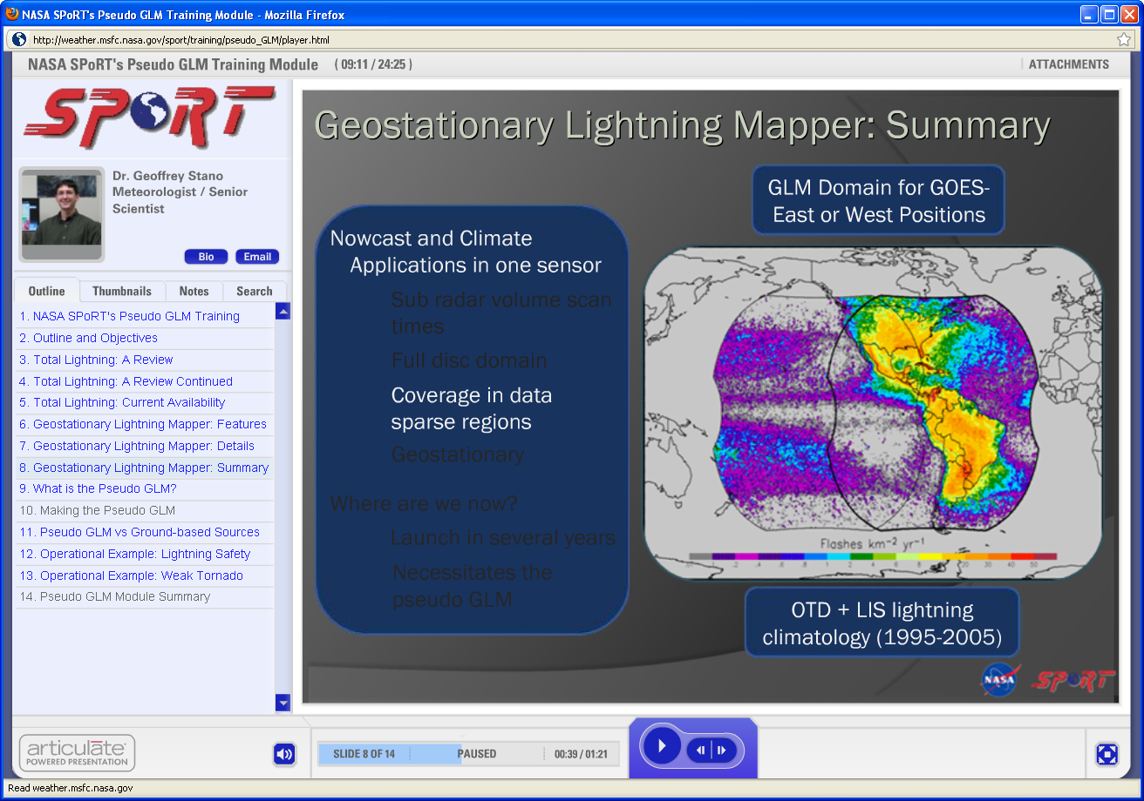
Current GLM Activities
  Funded as part of GOES-R Proving Ground and Risk Reduction
  Spring Program Participant
  Prepare forecasters for GLM
  Start with Pseudo-GLM (PGLM)
  Providing data
  Providing training
  Eventually GLM proxy
Training Module Used for the Spring Program
GLM Annual Science Meeting, 19-20 September 2011, Huntsville, Alabama

Slide 6
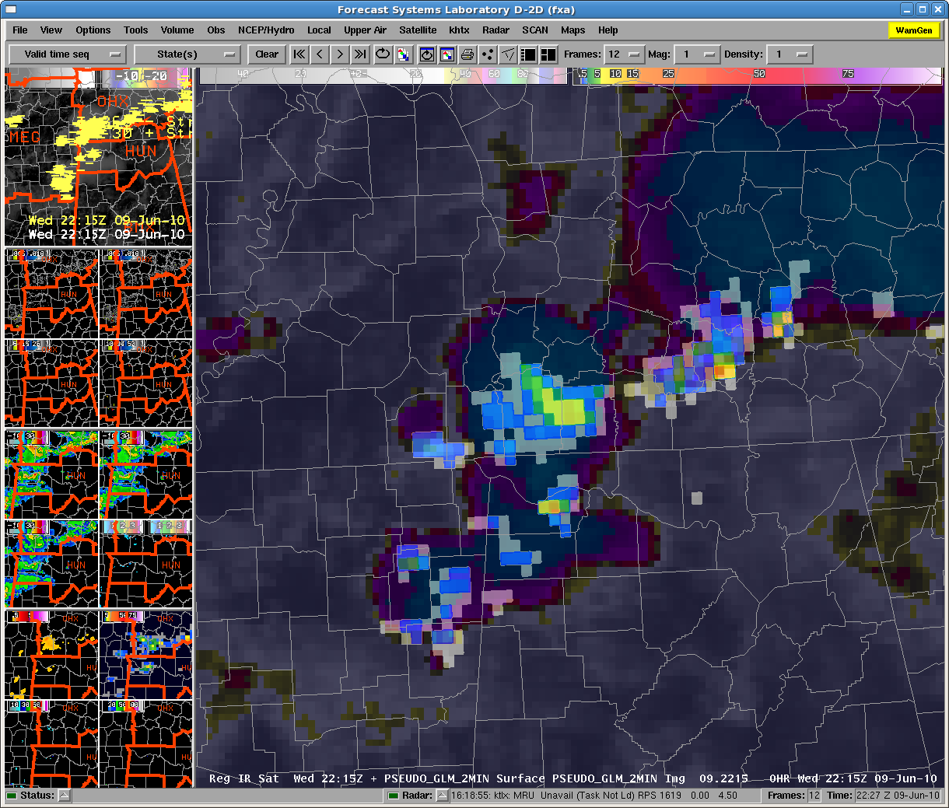
Origin of the Pseudo GLM
  Came from 2009 Spring Program
  No viable product to demonstrate
  Used “smeared” source density
  Or standard source density
  AWG proxy not available
  Needed 3 things
  Flash-based product
  GLM resolution
  Make for all ground networks
First PGLM use at Spring Program (2010) and overlaid on IR image
GLM Annual Science Meeting, 19-20 September 2011, Huntsville, Alabama

Slide 7
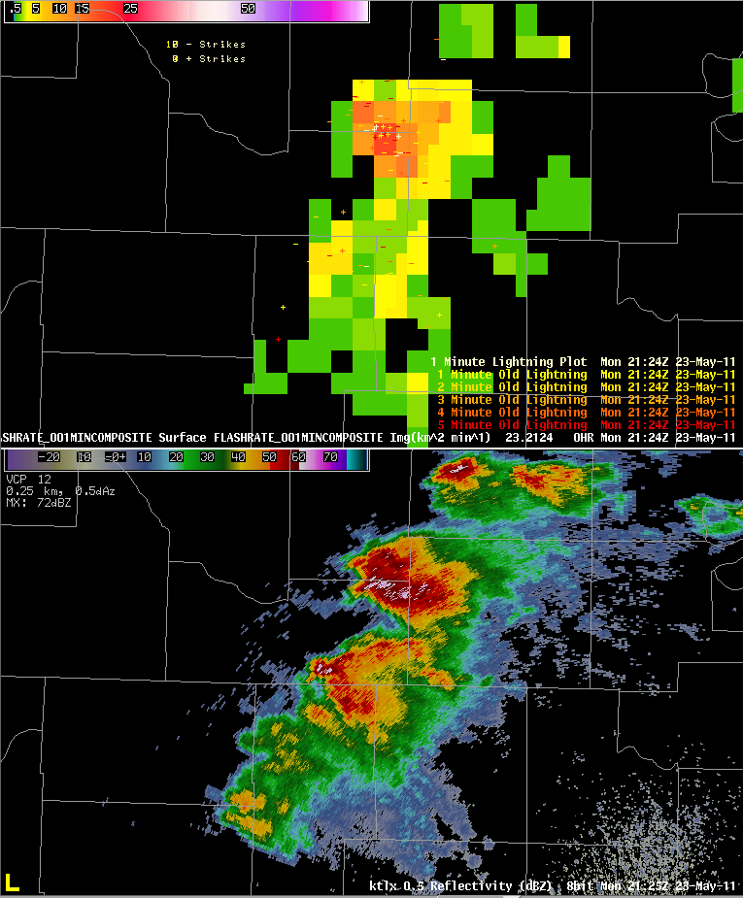
What Is the Pseudo GLM?
PGLM
Uses only ground-based data
  GLM is optical based
  PGLM not trained with LIS
Flash extent density
  Uses GLM resolution
  GLM flash output
  Used in 2010 and 2011
Collaboration with NSSL
  SPoRT sends raw data
  NSSL processes locally
Endorsed/funded by Proving Ground
Reflectivity
GLM Annual Science Meeting, 19-20 September 2011, Huntsville, Alabama

Slide 8
Making the PGLM
Start with raw sources
Algorithm recreates flashes
  First find initiation points
  Match sources to flashes
Place flashes on a grid
  Count how many flashes in each 8 km box
  Flash only counted once per box
Final product is the Pseudo GLM flash extent density
y
x
No Flash
2 Flashes
1 Flash
3 Flashes
Notes:
The pseudo GLM will only focus on demonstrating flash densities, which are just one of the three future GLM observations. To create the pseudo GLM flash extent density product, the raw VHF observations, or sources, from the ground-based networks are used. To the left is a display of raw sources in the x-y plane from several flashes. In order to create the pseudo GLM flash extent density, an algorithm is used to recombine all of the sources into flashes. First, the initiation points for the flashes are found, as shown by the three colored circles on to the left. From there, using temporal and spatial criteria, each source is matched to a specific flash. Once created, these flashes are placed on a grid with 8 km spacing where each grid box sums how many flashes entered the grid box for this time period. Based on thunderstorm charging mechanisms, we expect to find the greatest densities near the core of the storm with the greatest updrafts. However, as can be seen, the flashes can extend many kilometers away from the storm. Because advection redistributes the charged hydrometeors within the storm, lightning can extend through regions where there is no local updraft. The resulting pseudo flash extent density provides a good overview of the spatial extent of lightning activity in the storm. Please note that while a flash is composed of many sources, each grid box counts each flash only once, even if two separate branches of the same flash enter the grid box. Now, we can remove the original ground-based data and we are left with the final pseudo GLM flash extent density. A variant of this product can be produced that only sums the flash initiation points called the pseudo GLM flash origin density.

Slide 9
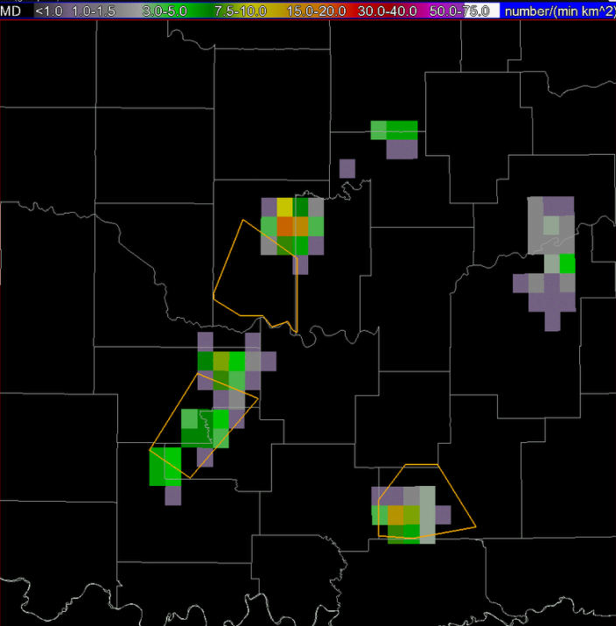
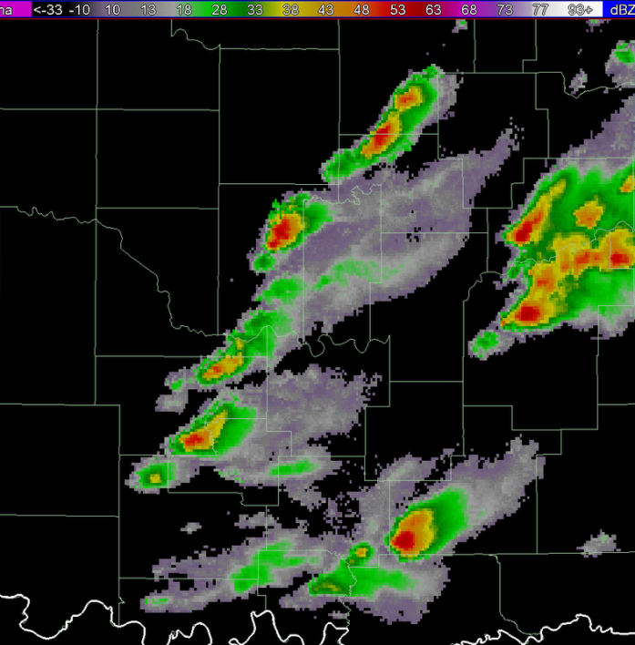
Why Use the PGLM?
PGLM used for warning in Spring Program
  PGLM is NOT a GLM proxy
  What is the point then?
  Demonstration tool
  Work with select end users
  Total lightning and GLM learning
  Easy to implement
  Focus of discussion
  How to use lower resolution
  Develop operational plans
  SPoRT can produce this 24/7
GLM Annual Science Meeting, 19-20 September 2011, Huntsville, Alabama

Slide 10
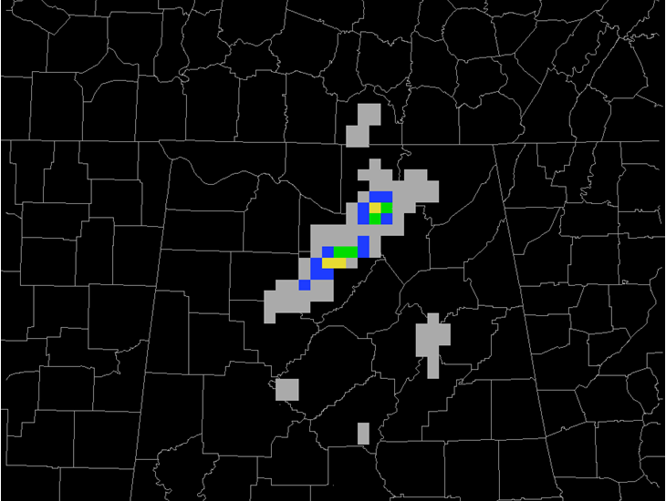
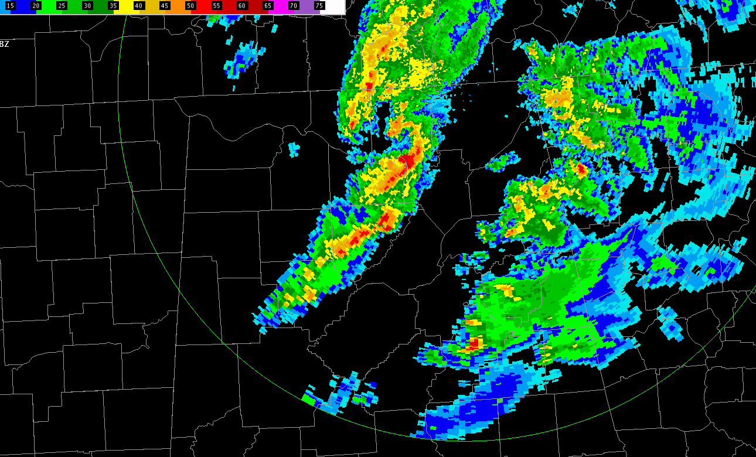
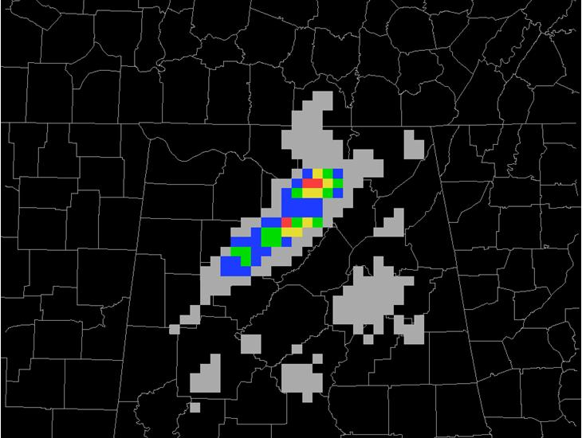

Example Maximum Flash Density
0038 UTC
0039 UTC
PGLM
Reflectivity
  Compare PGLM to MFD
    What has changed?
  MFD shows lightning cores
  Shows spatial extent
    Lightning safety
0008 –
0036 UTC
MFD

Slide 11
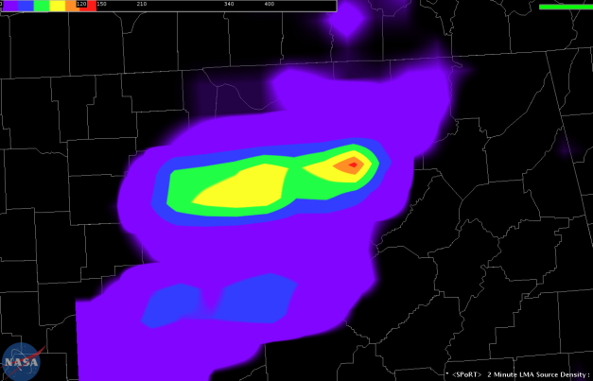
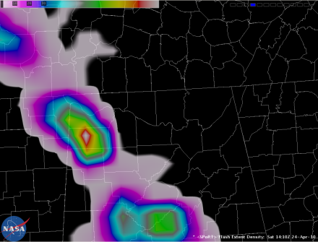
Other PGLM Uses
  Tool for new visualizations
  Integrate with other tools
  New products
    Max density
    Flash initiation density
    Others?
  Transitioned to AWIPS II
    Future decision support
    Aid with AWG proxy
Max PGLM
(AWIPS II)
Both 24 April 2010
PGLM
(AWIPS II)
GLM Annual Science Meeting, 19-20 September 2011, Huntsville, Alabama

Slide 12
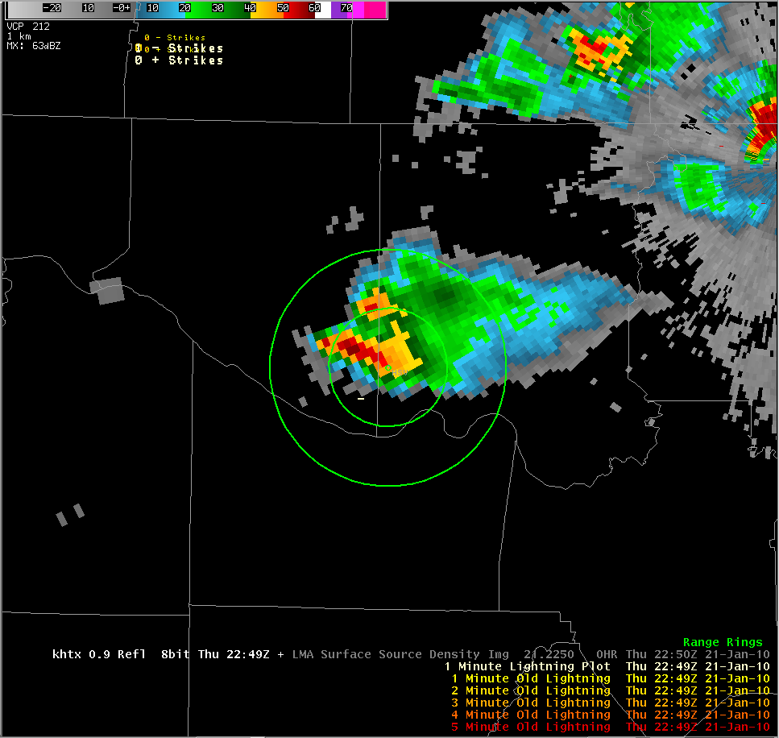
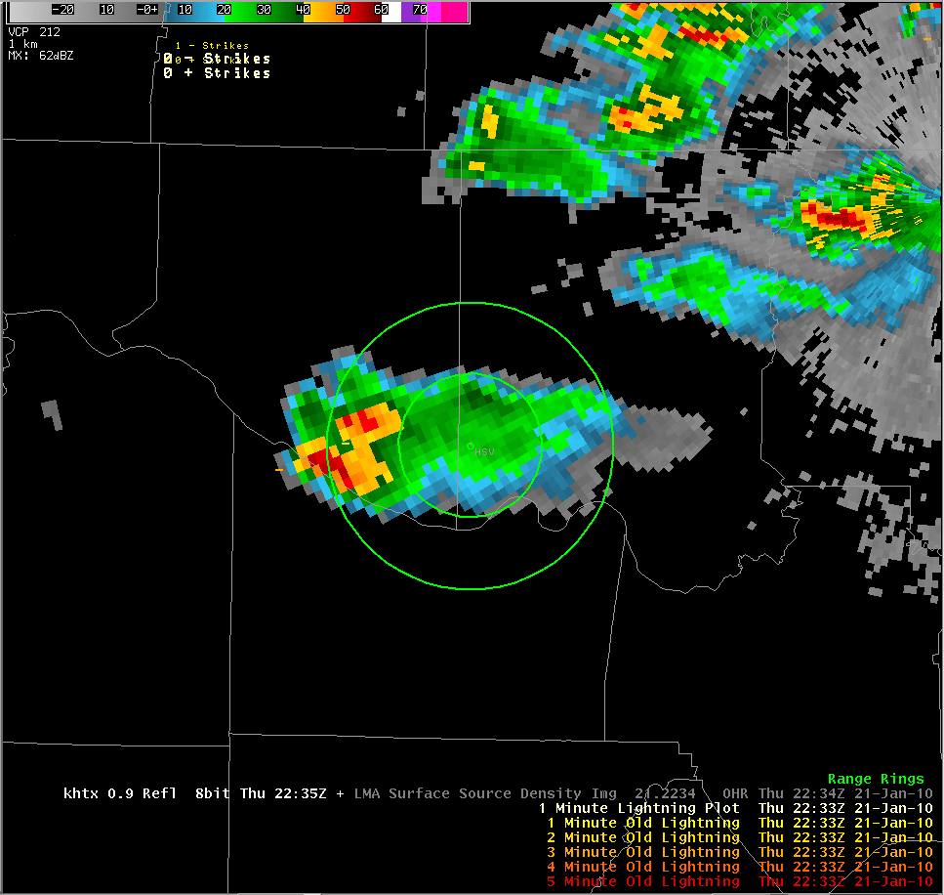
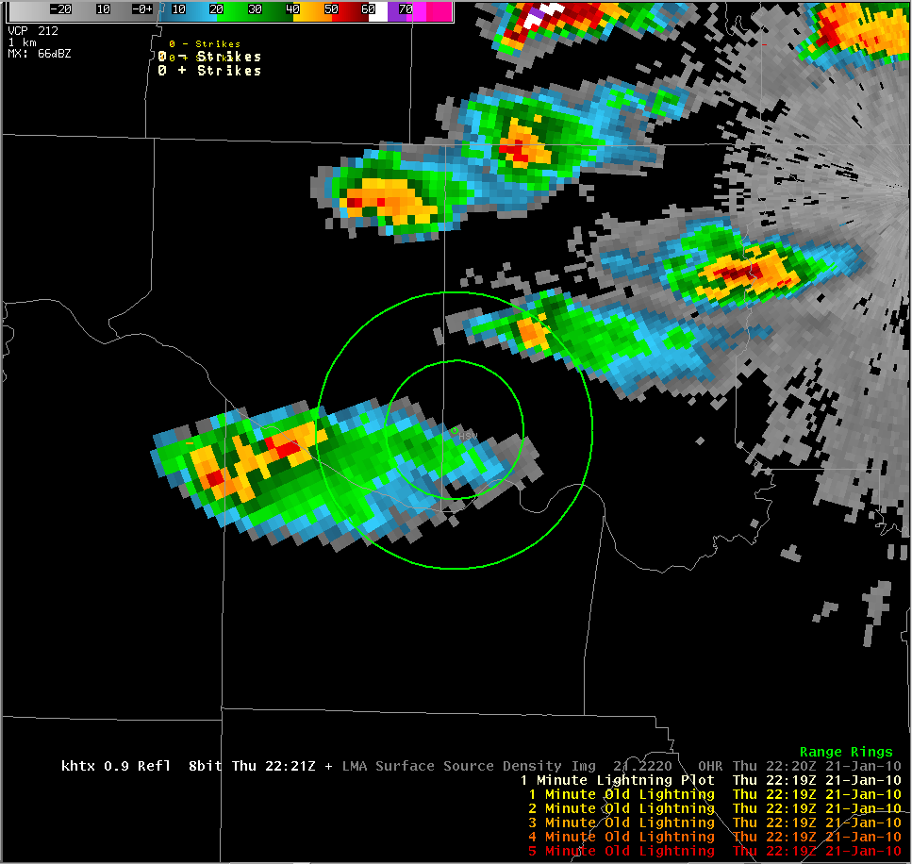
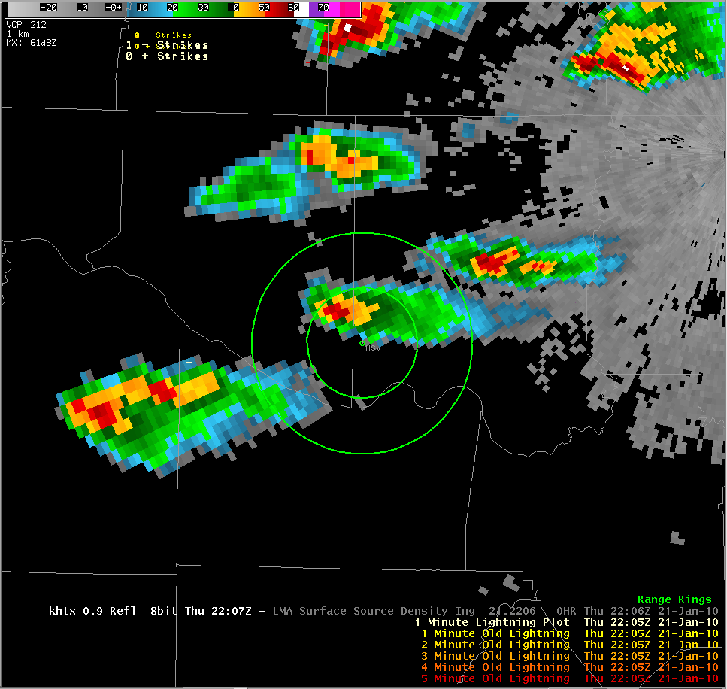
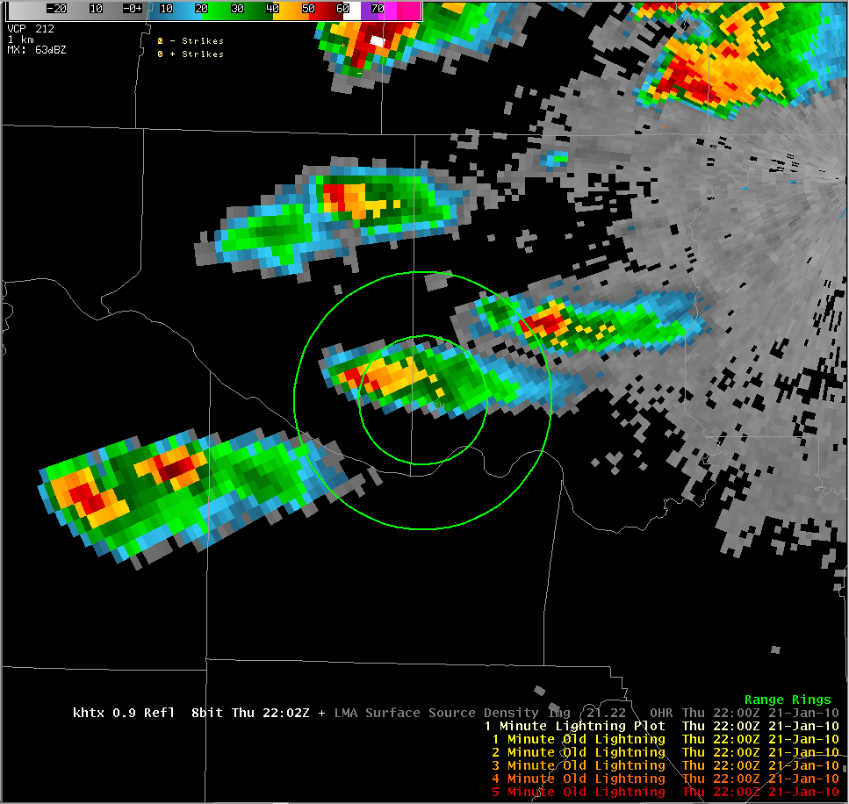
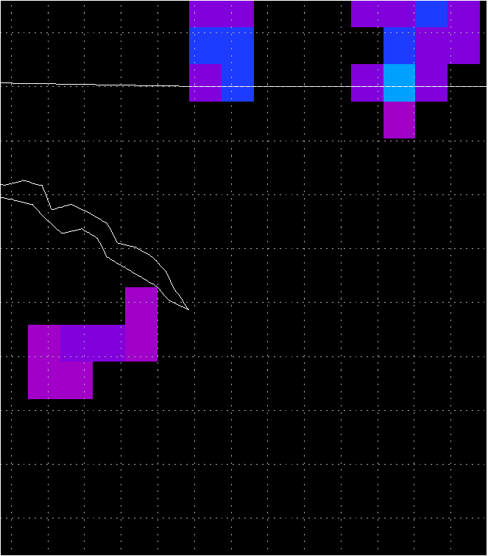
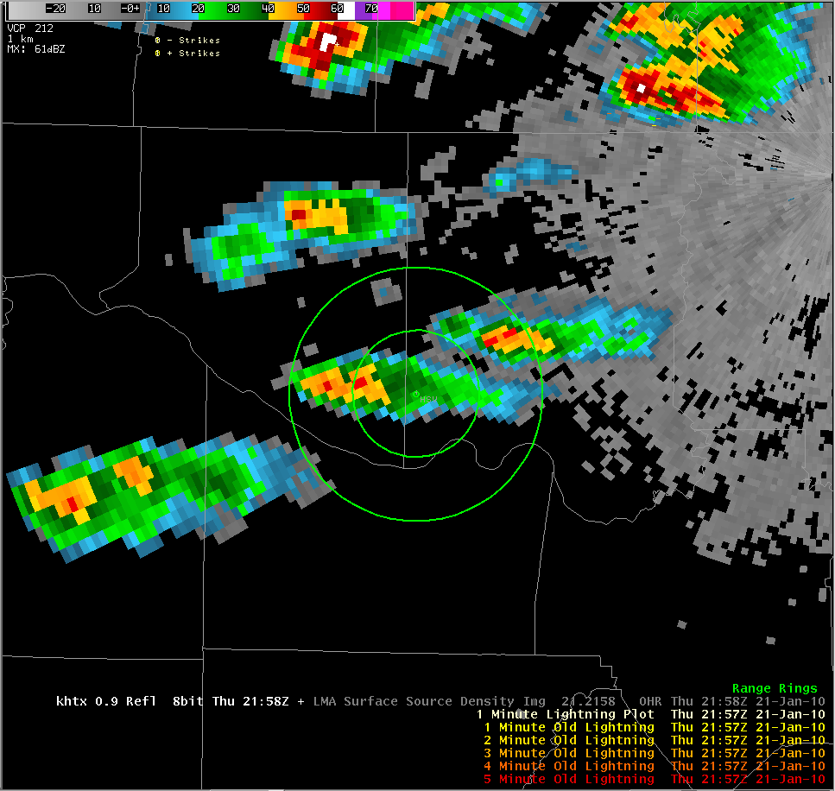
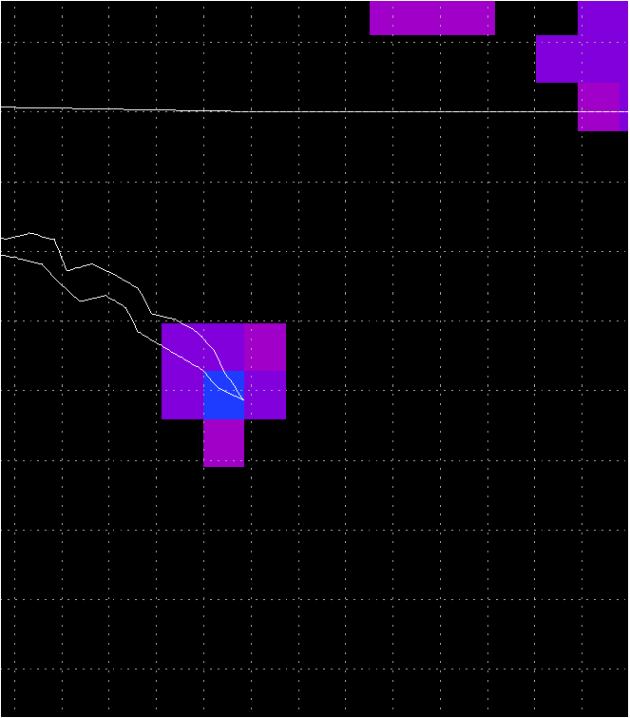
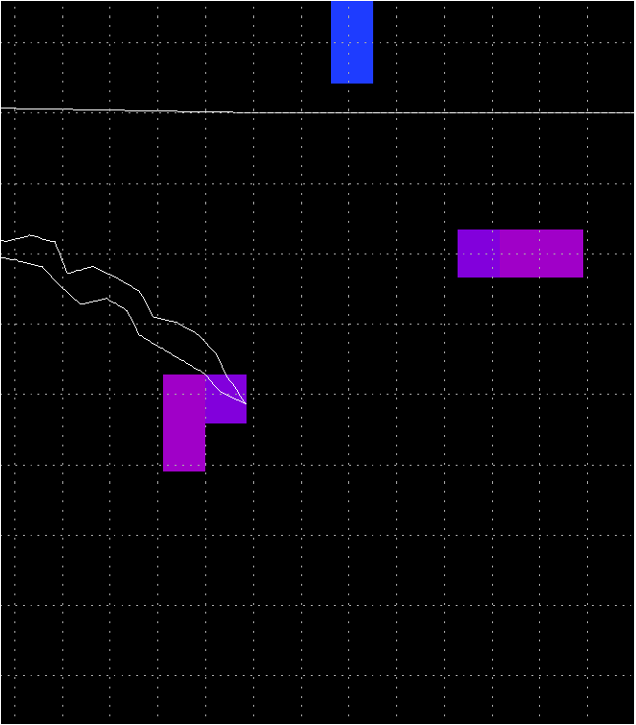
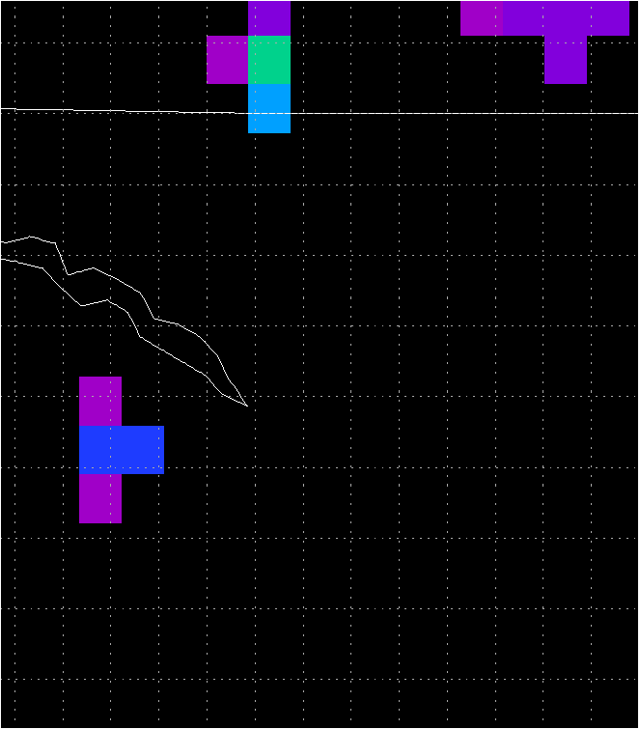
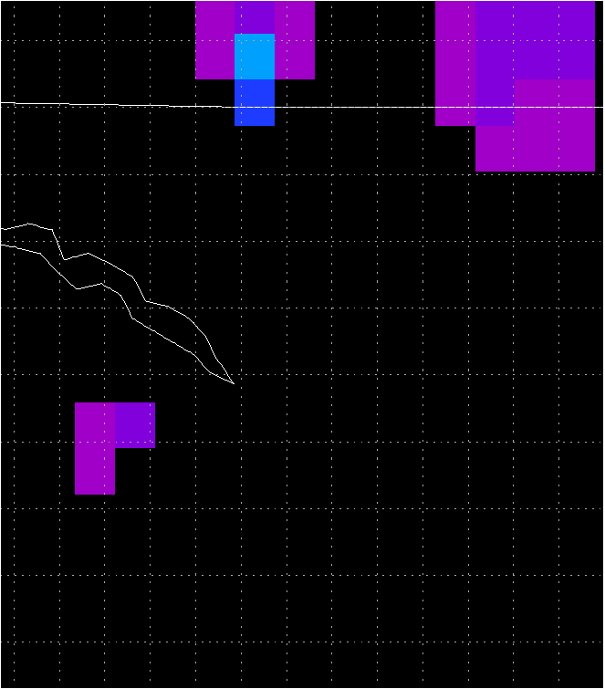
Operational Example
First CG within 10 nm
First CG
Airport Weather Warning Issued for KHSV
First CG within 5 nm
2221 UTC
2235 UTC
2249 UTC
2200 UTC
2202 UTC
2207 UTC
Notes:
No training would be complete without operational examples of the product. Two examples have been produced as part of a post-event analysis. This example highlights the situational awareness aspect of the pseudo GLM to help issue an airport weather warning and to show the lead time on the first cloud-to-ground lightning strike. This example comes from the Huntsville, Alabama Weather Forecast Office. On the left is the 8 km pseudo GLM flash extent density product. The image to the right is the corresponding 0.5 degree radar reflectivity observations from the Hytop radar with the coincident 1 minute summary of NLDN cloud-to-ground lightning strike locations. The concentric rings represent 5 and 10 nm from the Huntsville airport. At 2200 UTC, the radar indicates a strong convective cell southwest of the airport that has been maintaining a rough northeasterly course. The NLDN observations indicate no lightning activity. However, at 2200 UTC the pseudo GLM observes that this storm is, in fact, electrically active and the threat for cloud-to-ground lightning already exists. As we step forward 2 minutes to 2202 UTC we see that the pseudo GLM observations indicate a small increase in total lightning activity. Seeing that the storm was intensifying, both with lightning and radar observations, and given its direction of movement, forecasters issued an Airport Weather Warning for the Huntsville airport. With this warning issued, ground operations ceased and work crews began moving inside to take shelter. Five minutes later at 2207, the storm has maintained its course and the spatial extent of total lightning has increased. More importantly, the NLDN registers the first cloud-to-ground strike with this storm, which occurred at 2205 UTC. The pseudo GLM provided a 5 minute lead time ahead of this first cloud-to-ground strike. We now skip ahead 14 minutes as the storm has steadily moved to the northeast towards the airport. At this time the pseudo GLM flash extent density product indicates lightning activity and the threat of a ground strike within 10 nm of the airport. By 2235 UTC, the storm has moved within 10 nm of the Huntsville airport and the pseudo GLM has once again indicated an increase in total lightning activity. Most importantly, the NLDN registered the first cloud-to-ground strike within 10 nm of the airport at 2232 UTC, 11 minutes after the pseudo GLM flash extent indicated lightning activity. Additionally, total lightning activity is now occurring within 5 nm of the airport. Finally, at 2249 UTC, as the storm is directly over the airport, the NLDN records the first cloud-to-ground strike within 5 nm of the Huntsville airport. For this example, the pseudo GLM flash extent density allowed forecasters to issue an Airport Weather Warning 47 minutes in advance of cloud-to-ground activity within 5 nm of the Huntsville airport. The pseudo GLM product was able to continuously provide forecasters a greater knowledge of the extent of the lightning threat compared to the single point NLDN data.

Slide 13
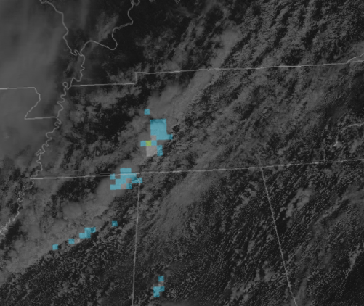
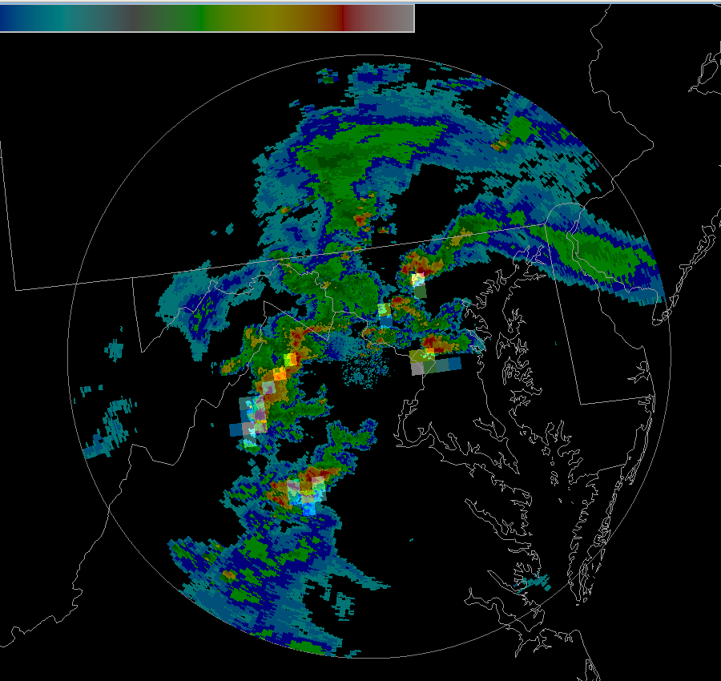
Looking Forward
PGLM & 1 km MODIS visible
  The PGLM is a Demonstration tool
  Stop-gap until AWG proxy
  Available for any network
  Train about total lightning
  Train about the GLM
  Discussion for development
  Led to maximum density product
  Technical aid
  AWIPS II development
  Operational procedures
  Spring Program feedback positive
PGLM Flash Initiation and Reflectivity
GLM Annual Science Meeting, 19-20 September 2011, Huntsville, Alabama

Slide 14
Questions
  E-mail
  geoffrey.stano@nasa.gov
  SPoRT Webpage
  weather.nasa.gov/sport
GLM Annual Science Meeting, 19-20 September 2011, Huntsville, Alabama

Slide 15
Outline
GLM Annual Science Meeting, 19-20 September 2011, Huntsville, Alabama

