Slide 1
Meteosat Third Generation (MTG) with focus on the
Lightning Imager (MTG-LI)
Status and Activities
Jochen Grandell, Marcel Dobber, Rolf Stuhlmann
GLM Science Team
19-20 September 2011
Huntsville, Alabama
EUM/MTG/VWG/11/0515
September 2011
GLM Science Team, Huntsville

Slide 2
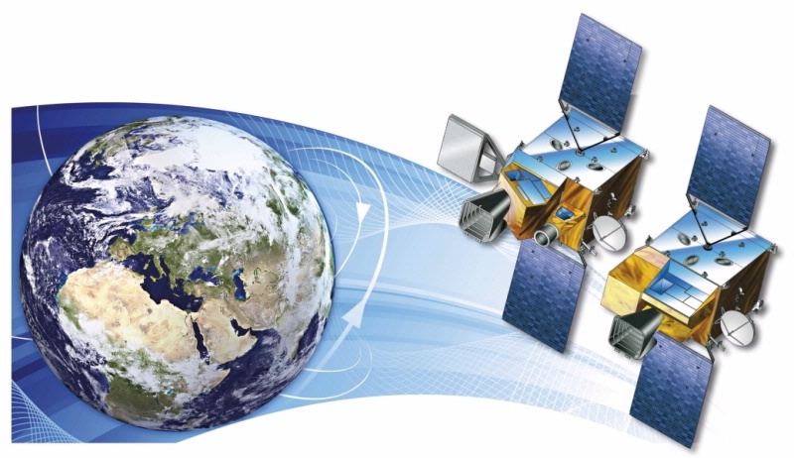


Short Introduction to the MTG Programme
MTG-I; 4 satellites
MTG-S; 2 satellites
Courtesy of

Slide 3
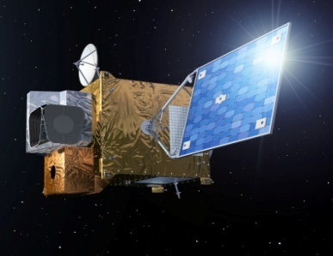
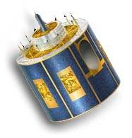
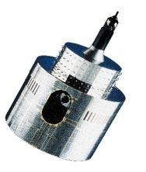
MTG to Secure Continuity and Evolution of EUMETSAT Services
1977
2002
2017 and 2019
MOP/MTP
MSG
MOP/MTP
MSG
MTG-I and MTG-S
Observation missions:
- Flex.Comb. Imager: 16 channels
- Infra-Red Sounder
Lightning Imager
UVN
3-axis stabilised satellites
Twin Sat configuration
Class 3-ton
Observation missions:
- SEVIRI: 12 channels
GERB
Spinning satellite
Class 2-ton
Observation mission:
MVIRI: 3 channels
Spinning satellite
Class 800 kg
Implementation of the EUMETSAT Mandate
for the Geostationary Programme
Atmospheric Chemistry Mission (UVN-S4):
via GMES Sentinel 4

Slide 4
MTG - Five Missions to Satisfy User Needs
Full Disk High Spectral resolution Imagery (FDHSI), global scales (Full Disk) over a BRC = 10 min, with 16 channels at spatial resolution of 1 km (8 solar channels) and 2 km (8 thermal channels)
High spatial Resolution Fast Imagery (HRFI), local scales (1/4th of Full Disk) over a BRC = 2.5 min with 4 channels at high spatial resolution 0.5 km (2 solar channels), and 1.0 km (2 thermal channels)
InfraRed Sounding (IRS), global scales (Full Disk) over a BRC = 60 min at spatial resolution of 4 km, providing hyperspectral soundings at 0.625 cm⁻¹ sampling in two bands: Long-Wave-IR (LWIR: 700 – 1210 cm⁻¹ ~ 820 spectral samples) Mid-Wave-IR (MWIR: 1600 – 2175 cm⁻¹ ~ 920 spectral sample )
Lightning Imagery (LI), global scales (80% of Full Disk) detecting and mapping continuously the optical emission of cloud-to-cloud and cloud-ground discharges. Detection efficiency between DE=90% (night) and DE=40% (overhead sun)
UVN Sounding, implemented as GMES Sentinel 4 Instruments provided by ESA

Slide 5
MTG Implementing Arrangements
EUMETSAT - ESA Programmes
MTG implemented as result of EUMETSAT and ESA Programmes:
ESA develops the MTG-I and MTG-S protoflight satellites as part of the ESA MTG Programme.
      Space segment requirements established by ESA, in agreement with EUMETSAT. Fixed financial contribution by EUMETSAT to the ESA Programme.
Scope of the EUMETSAT MTG Programme encompasses:
  Overall system and interface to the Users
  Procurement via ESA of the four recurrent satellites and fixed financial contribution to the ESA MTG Programme;
  Launch and LEOP services for all six MTG satellites;
  Establishment of the MTG Ground Segment to support the in orbit operations;
  At least twenty years of routine operations of the imagery mission, and fifteen and half years of routine operations of the sounding mission;
  SAFs: Ten years of continuous development and operations (CDOP).

Slide 6
System Engineering Status - Phase C0
The System Requirement Review Part 2 (SRR-2) took place end of 2010 baselining the MTG System Requirement Document.
The MTG System Preliminary Design Review (PDR) took place from May (release of documents) to end of June 2011 (Collocation, Board and Steering Committee meetings) and included a System-, a Ground Segment- and a Science Panel.

Slide 7
Space Segment Status - Phase B2
ESA
Space Segment Development & Procurement
EUMETSAT
Overall MTG System Responsibility (space, ground & services)
Space Segment - System & Co-ordination TAS
  + other MTG-I Payloads:
    Lightning Imager (LI) Mission Role AST-F;
    Search & Rescue (GEOSAR)
    Data Collection Service (DCS)
  + other MTG-S Payload:
    Sentinel 4 (UVN) - CFI

Slide 8
Space Segment Status - Phase B2
Technical aspects for starting Space Segment Phase B2 activities including the development of the Flexible Combined Imager (FCI) and the InfraRed Sounder (IRS)* were negotiated in summer 2010.
The related Space Segment activities of Phase B2 were kicked off with ThalesAlenia Space (TAS)* as overall prime on 18 November 2010
The Space Segment System Requirement Review (SRR)* took place between February and April 2011. Majority of residual open items will be closed out by November 2011 with a Baseline Definition Review (BDR)*.
The Space Segment Preliminary Design Review (PDR)* closing Phase B2 is scheduled for 2nd Quarter 2012, after the PDRs of Platform, FCI and IRS.
(* Lightning Imager (LI) is on separate schedules – for LI see next slide)

Slide 9
Status: Lightning Imager (LI) – Phase A
Currently no consolidated LI instrument design, because the instrument is among the items still to be procured in competition; (40% of MTG development procured via Best Practice)
(Astrium Toulouse (ASF) and TAS are performing phase-A trade-off studies)
ITT released begin October 2011.
Interested parties will get 8 weeks to respond to the ITT (proposals expected December 2011)
Proposal evaluation by ESA/EUMETSAT until end December 2011.
Consolidated LI industrial consortium by end of 2011 – LI PDR expected 2013.
LI main characteristics:
Coverage about equal to visible disc (instantaneous view).
Continuous measurements of triggered events / lightning triggered events.
Continuous measurements of background images, typically one every minute.
Data rate <30 Mbps; Mass < 70Kg; Power < 320W.
Ground pixel size required < 10 km at 45 degrees latitude
Measurements at 777.4 nm with 1.0-1.5 nm spectral bandpass filter.

Slide 10
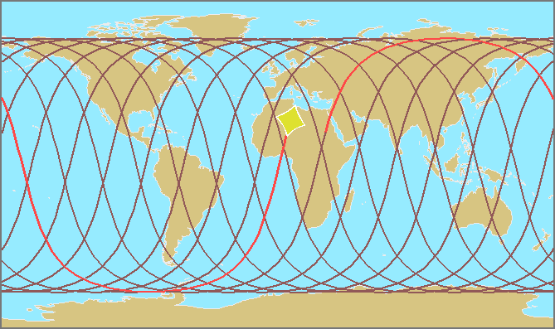
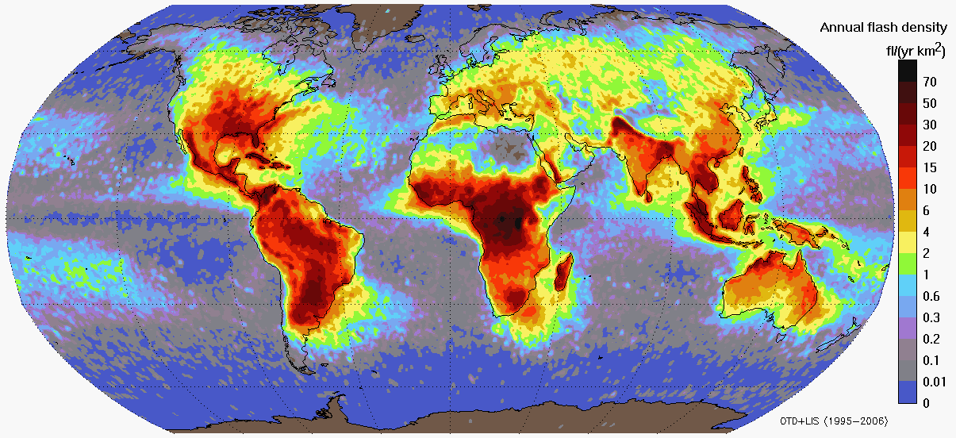
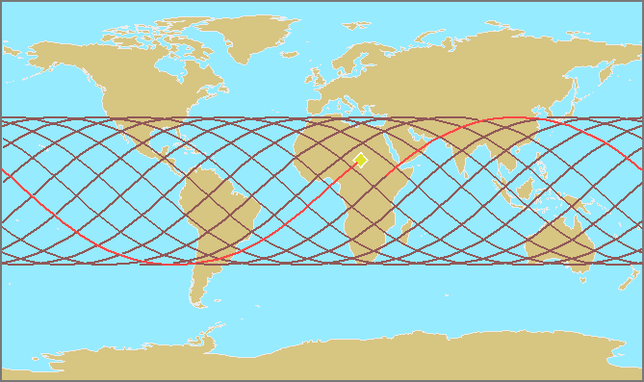
MTG-LI Capitalises on US Activities on Lightning Detection from Space
Feasibility of lightning detection from space by optical sensors has been proven by NASA instruments since 1995 on low earth orbits (LEO)
OTD (1995-2000)
Results from LIS/OTD: Global lightning distribution
Annual flash density
LIS (1997-present)

Slide 11
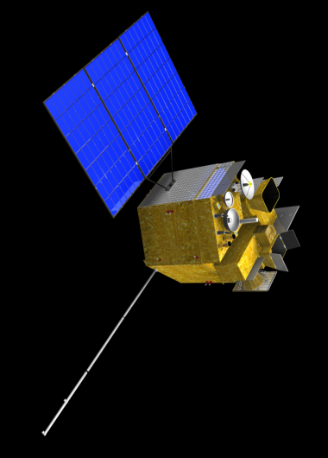
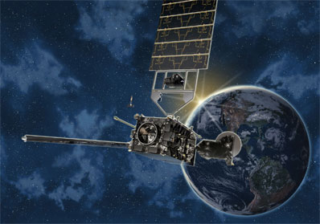
Lightning Detection from Space – from LEO to GEO
GEO lightning missions in preparation by several agencies
(in USA, Europe, China) for this decade...
...all of these are building on LIS/OTD heritage
Geostationary Lightning Mapper (GLM)
on GOES-R (USA)
Lightning Imager (LI) on MTG (Europe)
Geostationary Lightning Imager (GLI) on FY-4 (China)
2015 ⇒
2018 ⇒
2014 ?
EUM/MTG/VWG/11/0504
September 2011
EUMETSAT Conference, Oslo
EUM/MTG/VWG/11/0515
September 2011
GLM Science Team, Huntsville

Slide 12
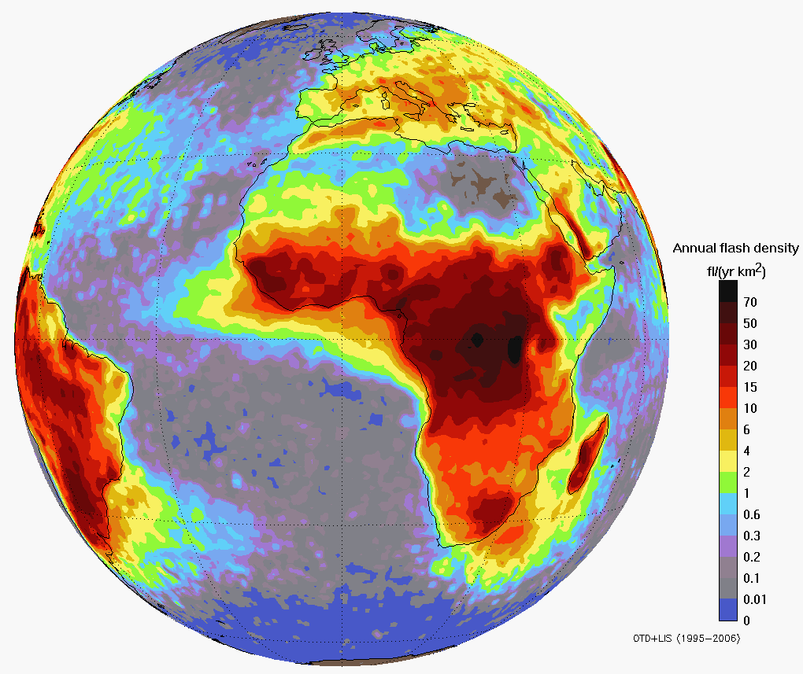
MTG-LI – Requirements and Objectives
The LI on MTG measures Total Lightning:
Cloud-to-Cloud Lightning (IC) and Cloud-to-Ground Lightning (CG)
Main benefit from GEO observations:
homogeneous and continuous observations delivering information on location and strength of lightning flashes to the users with a timeliness of 30 seconds
Main objectives are:
detect, monitor, track and extrapolate in time
Development (Intensity/Location) of active convective areas
Monitoring of storm lifecycle
As well as...
Lightning climatology
Chemistry (NOx production)
LIS/OTD flash density in
the MTG LI field of view

Slide 13
MTG LI – Main Mission Requirements
Wavelength
    777.4 nm
Sensitivity
  pulses as small as 100 km² with energies down to 4 µJ/(m²sr) should be detected
Spatial sampling
  Less or equal to 10 km at 45ºN for the sub-satellite longitude
Detection Efficiency
  70% in average, 90% over central Europe, 40% as a minimum over EUMETSAT member states
False Alarm Rate
  2.5 false flashes/s
Background images
  every 60 seconds
EUM/MTG/VWG/11/0504
September 2011
EUMETSAT Conference, Oslo
EUM/MTG/VWG/11/0515
September 2011
GLM Science Team, Huntsville

Slide 14
From a Lightning Optical Signal to MTG LI Events
MTG LI Events: L0 -> L1b processing
Detection of events in a nutshell:
Output (=events) of the Lightning Imager at L0 is two-fold:
Background scene tracking and removal
Thresholding
Event
detection
True lightning events (triggered by a lightning optical signal)
False events (not related to lightning)
    False event filtering needed in L0 -> L1b processing
EUM/MTG/VWG/11/0504
September 2011
EUMETSAT Conference, Oslo
EUM/MTG/VWG/11/0515
September 2011
GLM Science Team, Huntsville

Slide 15
Challenge for L1b processing: “False Events”
False events are typically caused by:
    High energy particle collisions
    Noise (instrument, spacecraft etc)
    Solar glint
    Spacecraft motion (“jitter”)
Specific filters are required for each case:
→ Radiation filter
→ Shot noise/coherency filter
→ Solar glint filter
Contrast filter
Rough order of severity (based on GLM analysis):
Spacecraft motion, Photon/electronics noise, Solar glint, Radiation
EUM/MTG/VWG/11/0504
September 2011
EUMETSAT Conference, Oslo
EUM/MTG/VWG/11/0515
September 2011
GLM Science Team, Huntsville

Slide 16
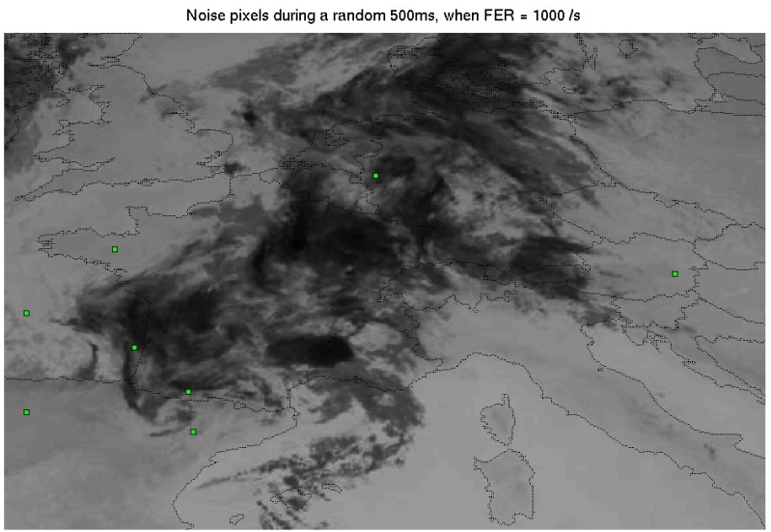
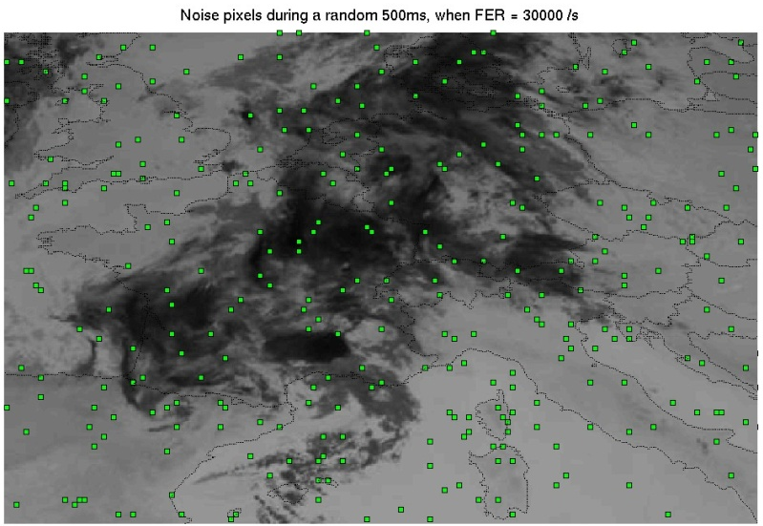
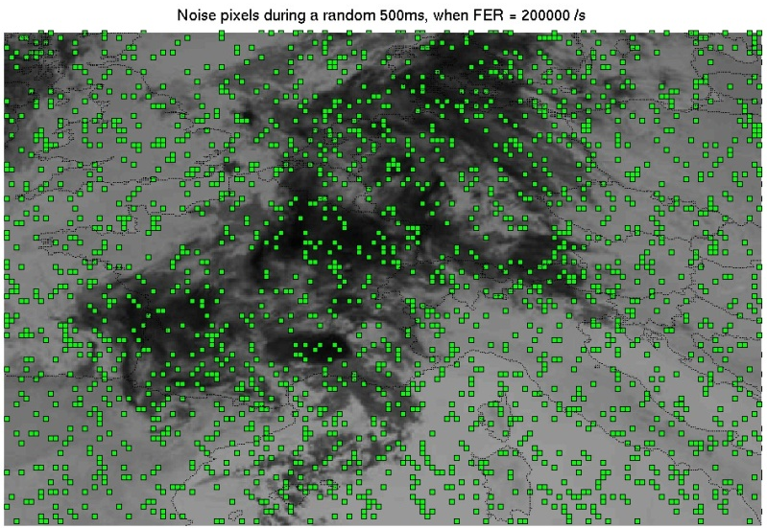
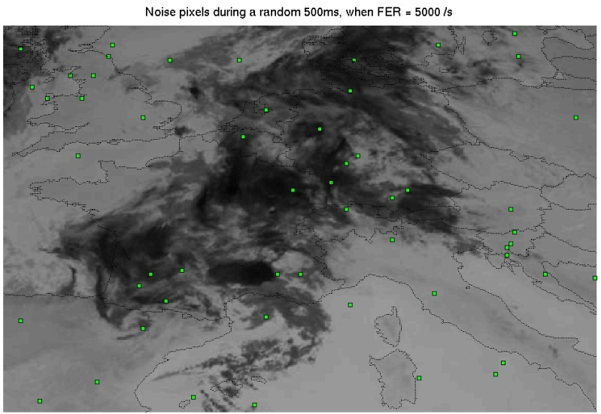
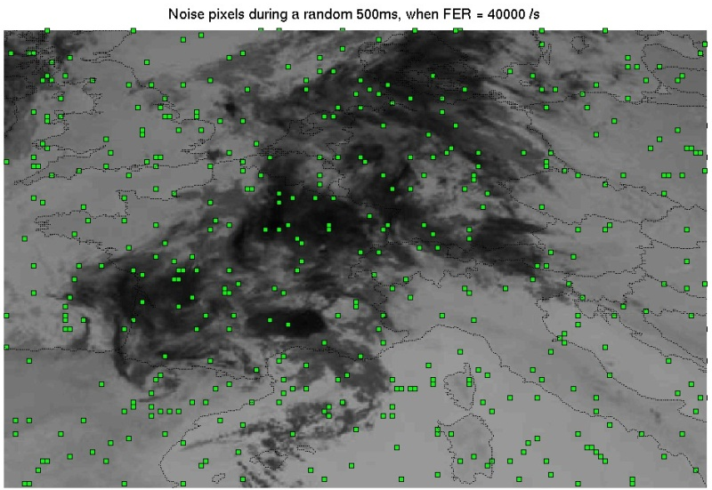
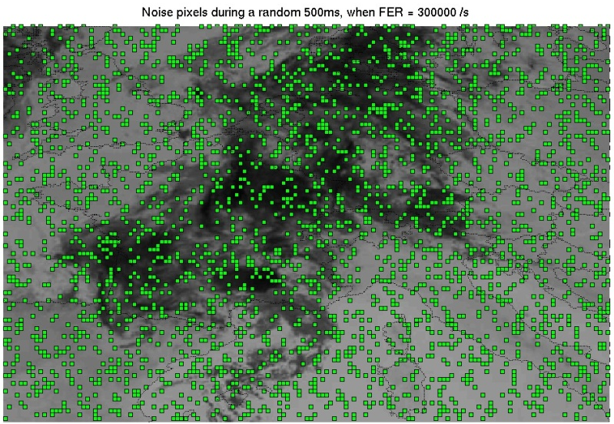
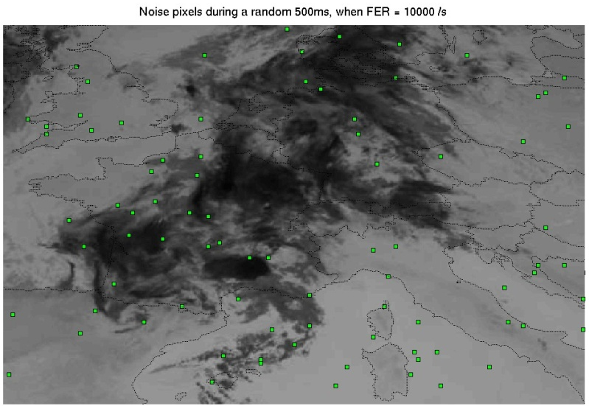
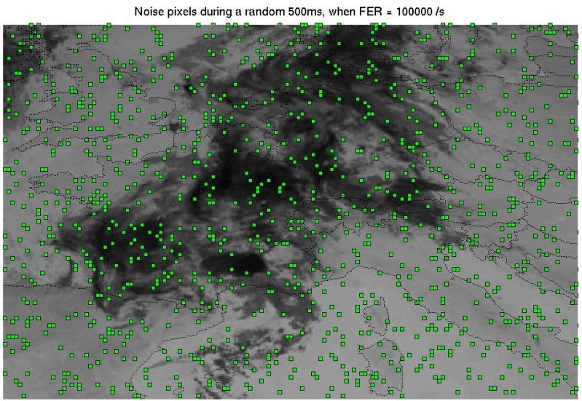

How noise looks like on a 0.5s period
FER = 1 000 /s
FER = 30 000 /s
FER = 200 000 /s
All noise events in 500 milliseconds!
FER = 5 000 /s
FER = 40 000 /s
FER = 300 000 /s
FER = 10 000 /s
FER = 100 000 /s
FER = 400 000 /s

Slide 17
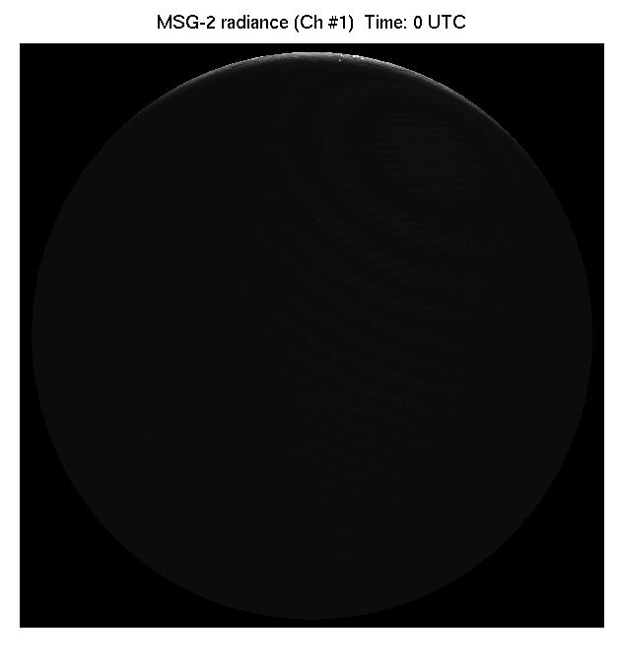
Background radiance: Solar reflection on clouds and ground surfaces
Background radiation from clouds determines the signal to noise ratio for detection of transient lightning signals
Challenges:
  Day-night contrast in FOV
  Microvibrations (fast changing background)
  Sun glint
0 UTC 12 UTC 22 UTC
EUM/MTG/VWG/11/0504
September 2011
EUMETSAT Conference, Oslo
EUM/MTG/VWG/11/0515
September 2011
GLM Science Team, Huntsville

Slide 18
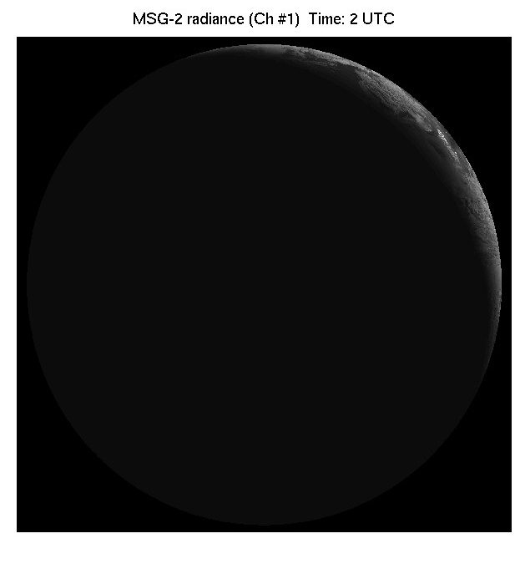
Background radiance: Solar reflection on clouds and ground surfaces
Background radiation from clouds determines the signal to noise ratio for detection of transient lightning signals
Challenges:
  Day-night contrast in FOV
  Microvibrations (fast changing background)
  Sun glint
0 UTC 12 UTC 22 UTC
EUM/MTG/VWG/11/0504
September 2011
EUMETSAT Conference, Oslo
EUM/MTG/VWG/11/0515
September 2011
GLM Science Team, Huntsville

Slide 19
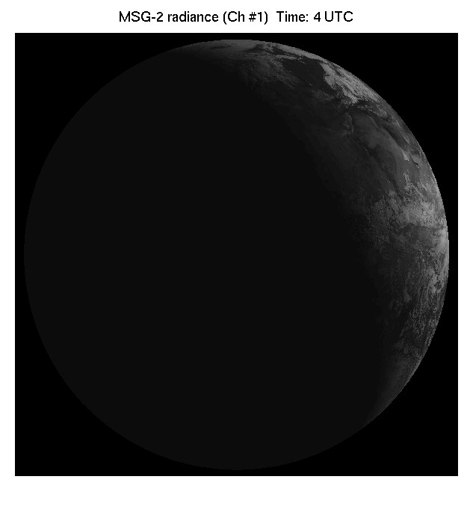
Background radiance: Solar reflection on clouds and ground surfaces
Background radiation from clouds determines the signal to noise ratio for detection of transient lightning signals
Challenges:
  Day-night contrast in FOV
  Microvibrations (fast changing background)
  Sun glint
0 UTC 12 UTC 22 UTC
EUM/MTG/VWG/11/0504
September 2011
EUMETSAT Conference, Oslo
EUM/MTG/VWG/11/0515
September 2011
GLM Science Team, Huntsville

Slide 20
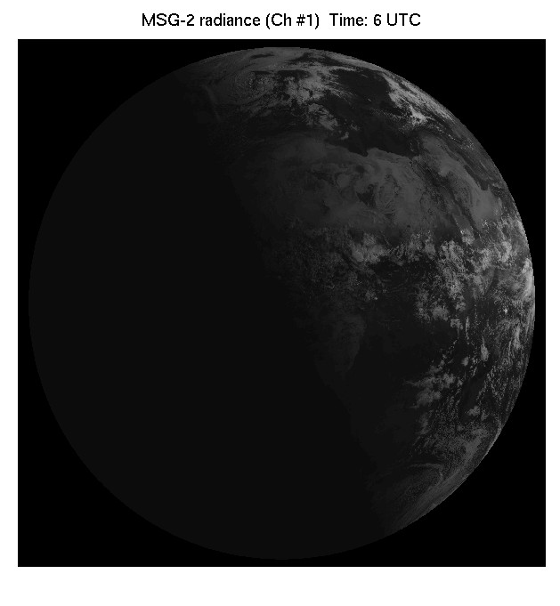
Background radiance: Solar reflection on clouds and ground surfaces
Background radiation from clouds determines the signal to noise ratio for detection of transient lightning signals
Challenges:
  Day-night contrast in FOV
  Microvibrations (fast changing background)
  Sun glint
0 UTC 12 UTC 22 UTC
EUM/MTG/VWG/11/0504
September 2011
EUMETSAT Conference, Oslo
EUM/MTG/VWG/11/0515
September 2011
GLM Science Team, Huntsville

Slide 21
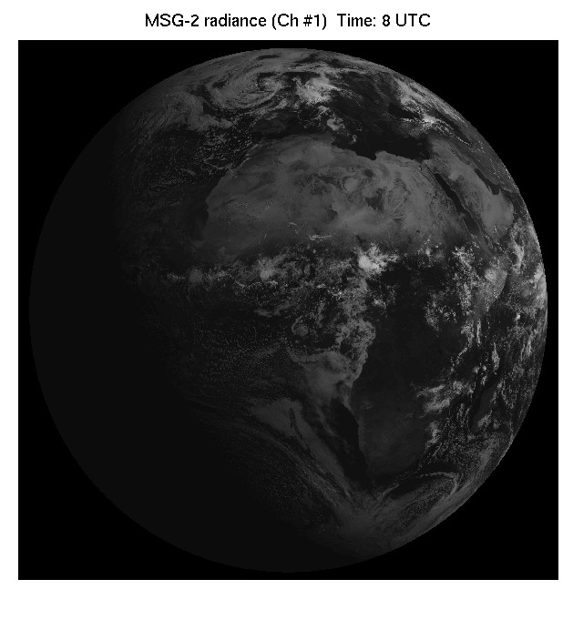
Background radiance: Solar reflection on clouds and ground surfaces
Background radiation from clouds determines the signal to noise ratio for detection of transient lightning signals
Challenges:
  Day-night contrast in FOV
  Microvibrations (fast changing background)
  Sun glint
0 UTC 12 UTC 22 UTC
EUM/MTG/VWG/11/0504
September 2011
EUMETSAT Conference, Oslo
EUM/MTG/VWG/11/0515
September 2011
GLM Science Team, Huntsville

Slide 22
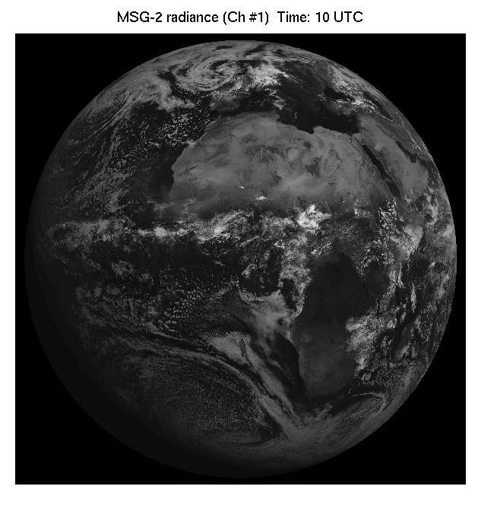
Background radiance: Solar reflection on clouds and ground surfaces
Background radiation from clouds determines the signal to noise ratio for detection of transient lightning signals
Challenges:
  Day-night contrast in FOV
  Microvibrations (fast changing background)
  Sun glint
0 UTC 12 UTC 22 UTC
EUM/MTG/VWG/11/0504
September 2011
EUMETSAT Conference, Oslo
EUM/MTG/VWG/11/0515
September 2011
GLM Science Team, Huntsville

Slide 23
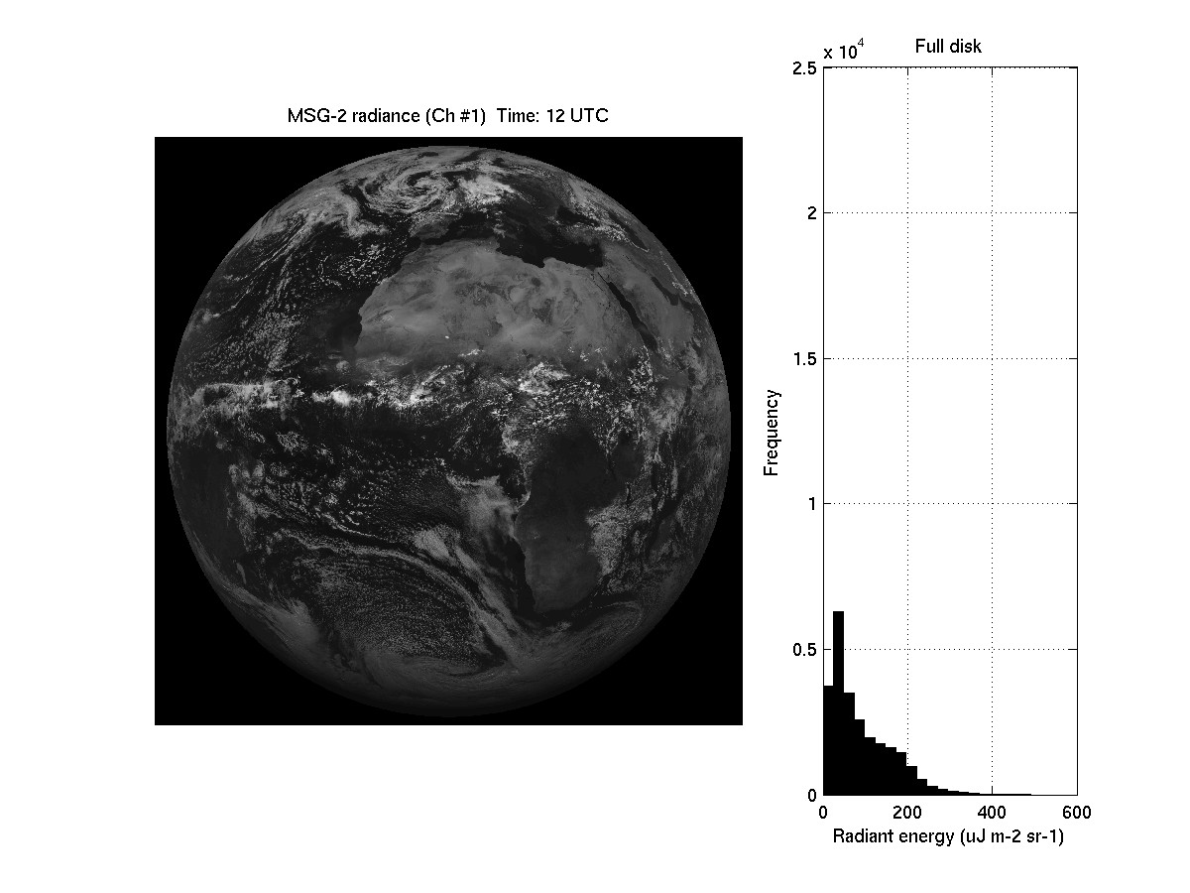
Background radiance: Solar reflection on clouds and ground surfaces
Background radiation from clouds determines the signal to noise ratio for detection of transient lightning signals
Challenges:
  Day-night contrast in FOV
  Microvibrations (fast changing background)
  Sun glint
0 UTC 12 UTC 22 UTC
EUM/MTG/VWG/11/0504
September 2011
EUMETSAT Conference, Oslo
EUM/MTG/VWG/11/0515
September 2011
GLM Science Team, Huntsville

Slide 24

Background radiance: Solar reflection on clouds and ground surfaces
Background radiation from clouds determines the signal to noise ratio for detection of transient lightning signals
Challenges:
  Day-night contrast in FOV
  Microvibrations (fast changing background)
  Sun glint
0 UTC 12 UTC 22 UTC
EUM/MTG/VWG/11/0504
September 2011
EUMETSAT Conference, Oslo
EUM/MTG/VWG/11/0515
September 2011
GLM Science Team, Huntsville

Slide 25
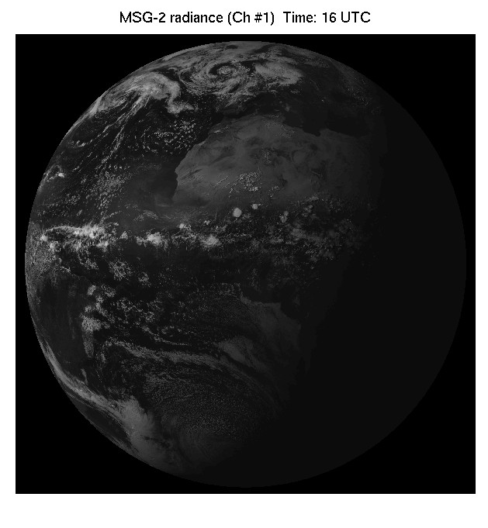
Background radiance: Solar reflection on clouds and ground surfaces
Background radiation from clouds determines the signal to noise ratio for detection of transient lightning signals
Challenges:
  Day-night contrast in FOV
  Microvibrations (fast changing background)
  Sun glint
0 UTC 12 UTC 22 UTC
EUM/MTG/VWG/11/0504
September 2011
EUMETSAT Conference, Oslo
EUM/MTG/VWG/11/0515
September 2011
GLM Science Team, Huntsville

Slide 26
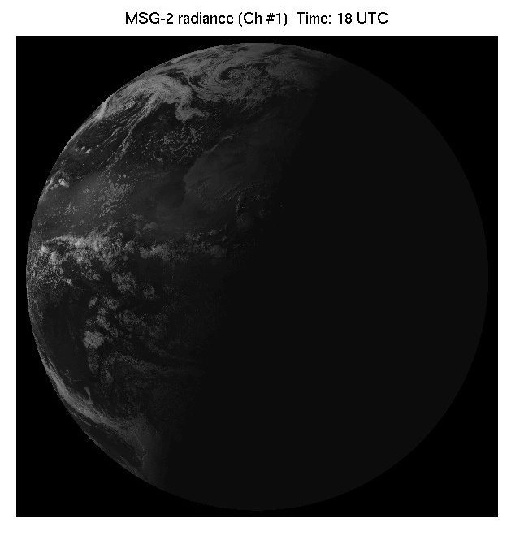
Background radiance: Solar reflection on clouds and ground surfaces
Background radiation from clouds determines the signal to noise ratio for detection of transient lightning signals
Challenges:
  Day-night contrast in FOV
  Microvibrations (fast changing background)
  Sun glint
0 UTC 12 UTC 22 UTC
EUM/MTG/VWG/11/0504
September 2011
EUMETSAT Conference, Oslo
EUM/MTG/VWG/11/0515
September 2011
GLM Science Team, Huntsville

Slide 27
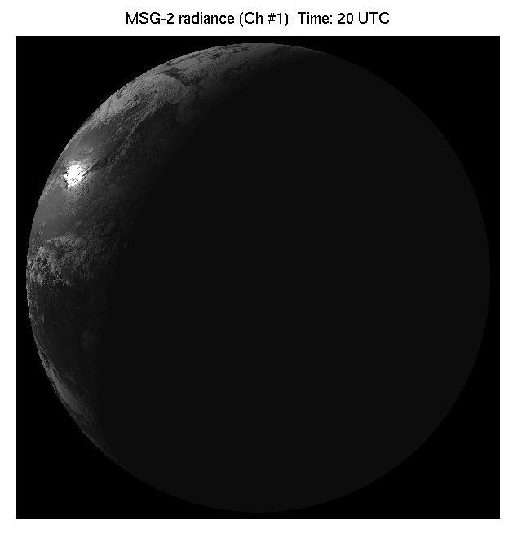
Background radiance: Solar reflection on clouds and ground surfaces
Background radiation from clouds determines the signal to noise ratio for detection of transient lightning signals
Challenges:
  Day-night contrast in FOV
  Microvibrations (fast changing background)
  Sun glint
0 UTC 12 UTC 22 UTC
EUM/MTG/VWG/11/0504
September 2011
EUMETSAT Conference, Oslo
EUM/MTG/VWG/11/0515
September 2011
GLM Science Team, Huntsville

Slide 28
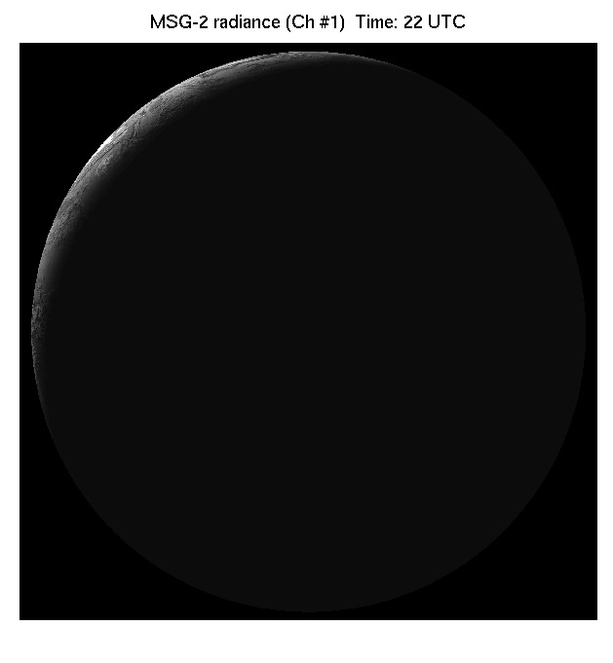
Background radiance: Solar reflection on clouds and ground surfaces
Background radiation from clouds determines the signal to noise ratio for detection of transient lightning signals
Challenges:
  Day-night contrast in FOV
  Microvibrations (fast changing background)
  Sun glint
0 UTC 12 UTC 22 UTC
EUM/MTG/VWG/11/0504
September 2011
EUMETSAT Conference, Oslo
EUM/MTG/VWG/11/0515
September 2011
GLM Science Team, Huntsville

Slide 29
Effect of Microvibrations (“jitter”) on Lightning Detection
Assuming that this is what the
Lightning Imager is looking at...
Background
energy
Cloud
Distance
Darker (ocean)
background
Cloud
Darker (ocean)
background
EUM/MTG/VWG/11/0504
September 2011
EUMETSAT Conference, Oslo
EUM/MTG/VWG/11/0515
September 2011
GLM Science Team, Huntsville

Slide 30
Microvibrations (“jitter”) – False Events
What if the instrument (satellite) moves slightly between integration frames...?
Background
energy
Background removal
(Frame #2 – Frame #1)
But this is
not lightning!
Frame #1
Cloud
Frame #2
Distance
Distance
Darker (ocean)
background

Slide 31
MTG-LI Products: L1b -> L2 processing
The following products are resulting from the L1b processing:
  Events with geolocation, UTC time stamp and calibrated radiance
  background images, supporting navigation, quality asessment
The baseline L2 product, as result of clustering of events in time and space:
  Groups (representing lightning strokes)
  Flashes (main product for most users)
  Events quality indicator added
Example L2
Sequence:
“Events”
“Groups”
“Flashes”
EUM/MTG/VWG/11/0504
September 2011
EUMETSAT Conference, Oslo
EUM/MTG/VWG/11/0515
September 2011
GLM Science Team, Huntsville

Slide 32
MTG Lightning Imager Science Team (LIST)
EUM/MTG/VWG/11/0515
September 2011
GLM Science Team, Huntsville
The MTG LI Science Team currently consists of the following members:
  Alec Bennett (MetOffice – UK)
  Daniele Biron (USAM – Italy)
  Eric Defer (LERMA – France)
  Ullrich Finke (U. Hannover – Germany)
  Hartmut Höller (DLR – Germany)
  Philippe Lopez (ECMWF)
  Douglas Mach (NASA – USA)
  Antti Mäkelä (FMI – Finland)
  Serge Soula (Laboratoire d'Aerologie – France)
In addition, invited experts contributing in individual meetings.

Slide 33
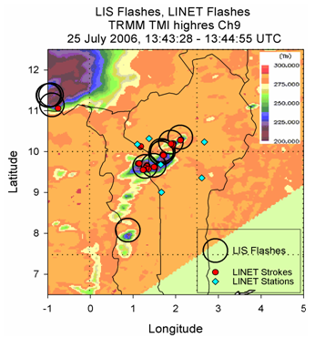
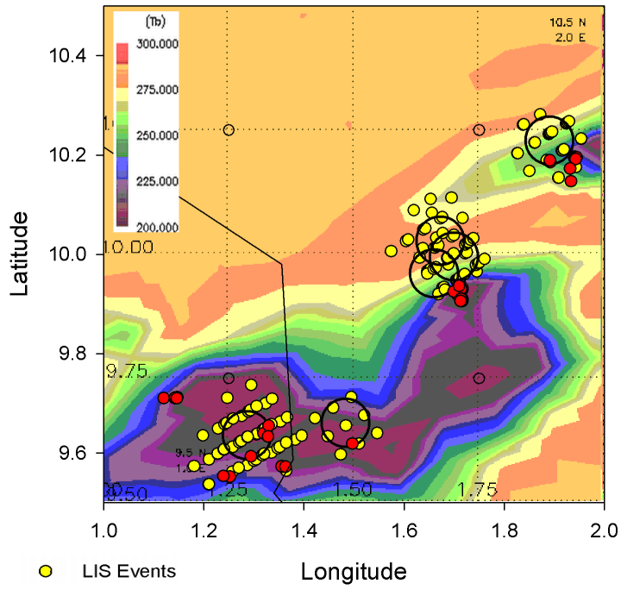
LIProxy -> LIS-LINET Transfer Function: Comparison 25 July 2006

Slide 34
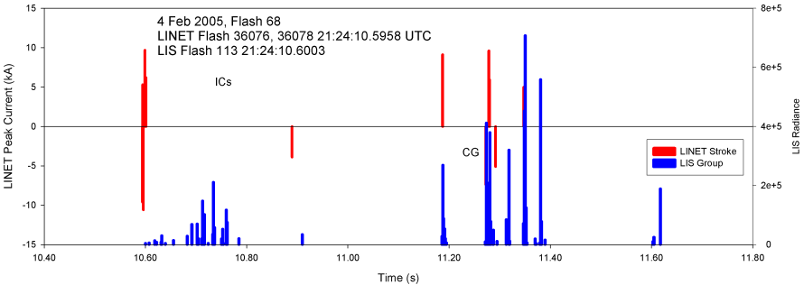
LIProxy -> LIS-LINET Transfer Function: Inter stroke activity Large variability
  The inter-stroke optical activity is of a much more irregular nature, thus statistical representation will be adequate (post-stroke and pre-stroke predominantly optical or sometimes RF activity)
  But: often post-stoke optical groups occur within 100 ms

Slide 35
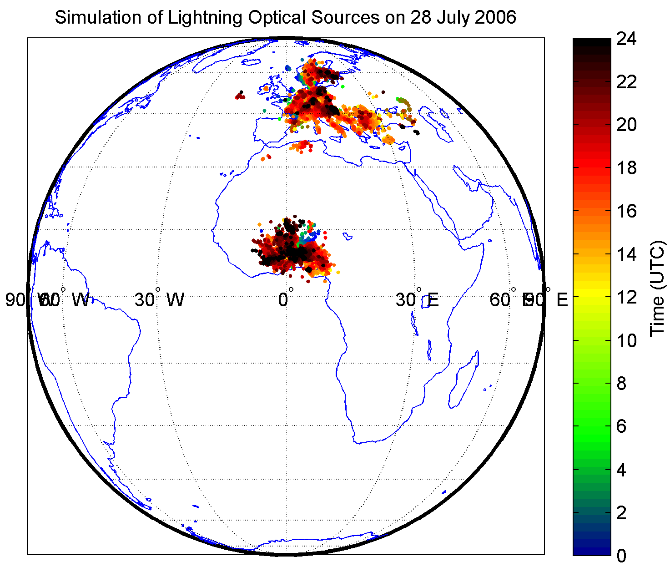
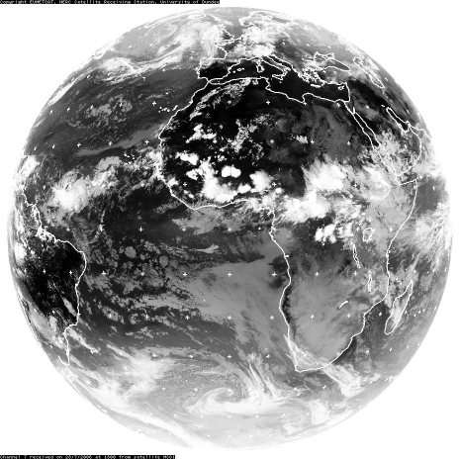
Case Studies - W-Africa + Europe, 28 July 2006
Optical Pulses - simulation for W-Africa and Europe on 28 July 2006

Slide 36
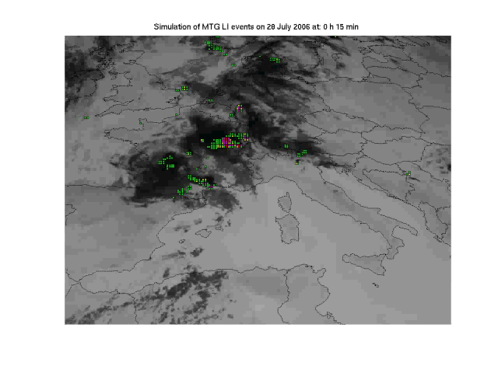
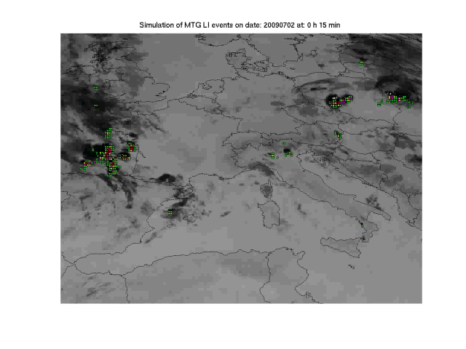
Proxy data development – example
Based on LINET
ground-based
data over Europe
Colour code indicates the
MTG-LI “event” density

Slide 37
Conclusion on MTG Missions
MTG Mission are well defined
to ensure continuation and improvement of existing services
to enable new services expected for 2017 – 2037
breakthrough expected exploiting the MTG information on evolution of convective systems from cradle to grave

Slide 38
Thank you!
EUM/MTG/VWG/11/0504
September 2011
EUMETSAT Conference, Oslo
EUM/MTG/VWG/11/0515
September 2011
GLM Science Team, Huntsville

