Slide 1
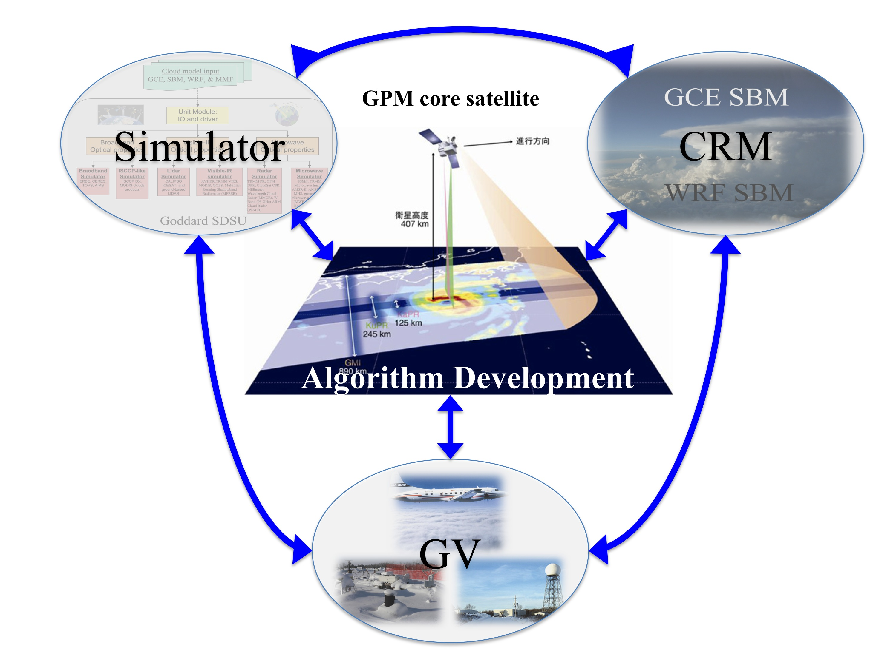
Development of the Synthetic GPM Simulator upon the MC3E measurements
Synthetic GPM Simulator team:
Toshihisa Matsui, Takamichi Iguchi, Xiaowen Li, and Wei-Kuo Tao
GPM GV team:
W. Petersen, A. Heymsfield, A. Tokay, D. Wolff, and A. Hou

Slide 2
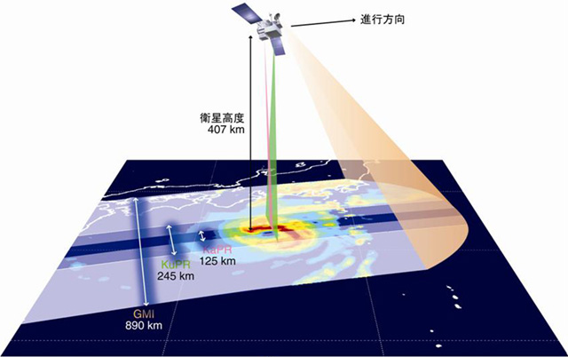
Input for forward models
Forward
Models
CRM
Algorithm Testbed
GV-constrained
CRM database
Algorithm Development
Non-spherical particle
Constrain
Microphysics
Value-added GV data (Density, PSD, Vt)
GV
C3VP, LPVEx, MC3E

Slide 3
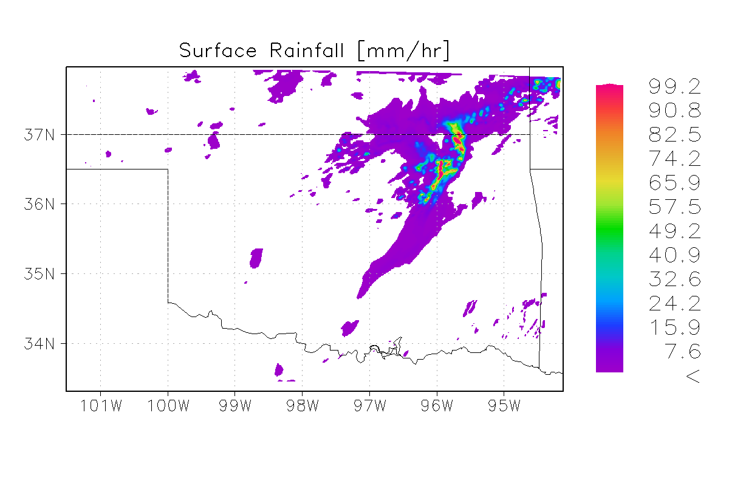
WRF SBM
CRM
Weather Research Forecasting model V3.1. coupled with HUCM spectral bin microphysics (WRF-SBM).
Model Setup:
WRF Setup for LPVEx
Domains: 2-nesting, Domain 2: 652x498x60 (x-y-z)
Grid: finest dx=dy=1km, dz=50~250m, dt=3sec
Microphysics: HUCM Spectra-Bin Microphysics 43bin (SBM43) scheme [Khain et al. 2011].
Other Physics Options: Goddard radiation, NOAH LSM scheme, MYJ-PBL scheme
Boundary/Initial conditions: NAM
Computational specs:
Model output size: ~30Gb (mostly PSD data) per output (at every 1hour for 24hr).
CPUs: ~4000CPUs, and it takes <24hr to simulate one-day WRF-SBM simulations in NASA Pleiades machine.
WRF-SBM MC3E domain

Slide 4
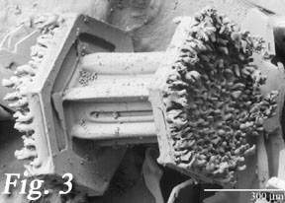
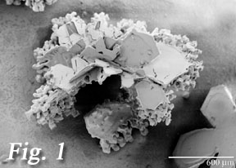
Spectra-Bin Microphysics
# conc
Prognostic parameter
Species
Liquid
Ice column
Ice plate
Ice dendride
Snow aggregate
Graupel
Hail
Bin #
mass
m1 m2 m3 … … m43
Explicit bin-by-bin melt fraction
density
ρ1 ρ2 ρ3 … … ρ43
v1 v2 v3 … ... v43
New upgrade 2
Terminal
velocity
33bin → 43bin to represent huge drops in MCS.
(→ 55dBZ in convective core)
radius
r1 r2 r3 … ... r43
New upgrade 1
Explicit bin-by-bin rimed fraction on snow aggregate
that affect density and terminal velocity bin by bin.
Khain, A., D. Rosenfeld, A. Pokrovsky, U. Blahak, A. Ryzhkov, (2011), The role of CCN in precipitation and hail in a mid-latitude storm as seen in simulations using a spectral (bin) microphysics model in a 2D dynamic frame, Atmospheric Research, 99, 129–146

Slide 5
GV simulator
# conc
SBM PSD for species
How can SBM be compared with GV?
GV simulator translates SBM PSDs into bulk PSDs or bulk water content compatible to aircraft 2D measurements and/or ground Parsivel measurements
For unit particle
Bin #
Sphere radius
r1 r2 r3 … ... r33
D_{max}
×7 SBM species
Aircraft or Parsivel
Measurable
Bulk PSD
Instrument-measureable Bulk PSD
D_{max} Bin
D_{max} bins are defined
By Aircraft 2D or Parsivel
D1
D2
D3
D4 D5 D6
D22 D23~32
~10% diff

Slide 6
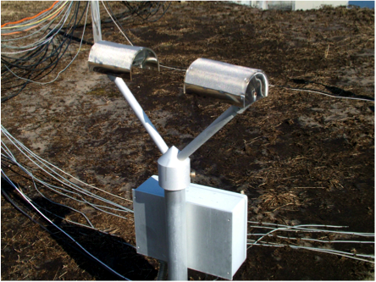
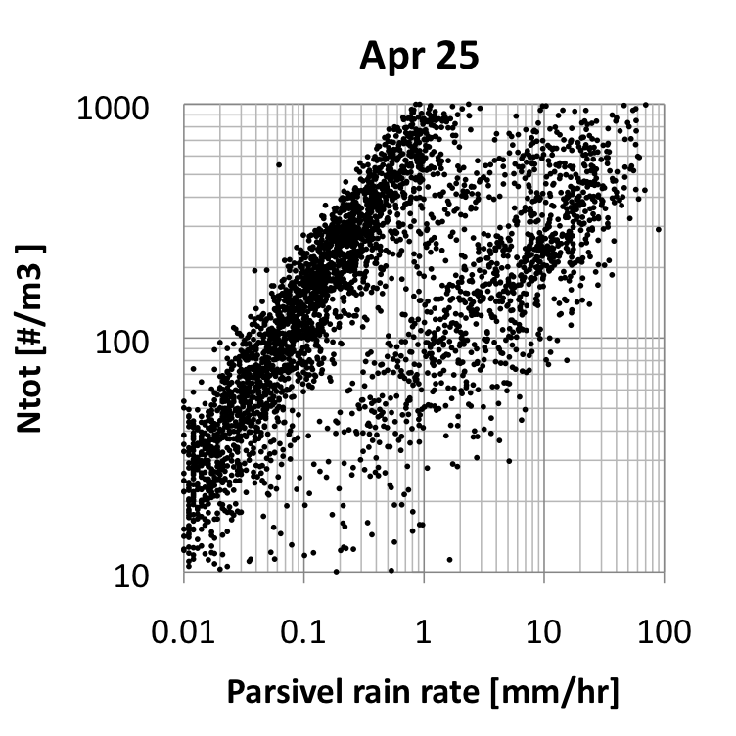
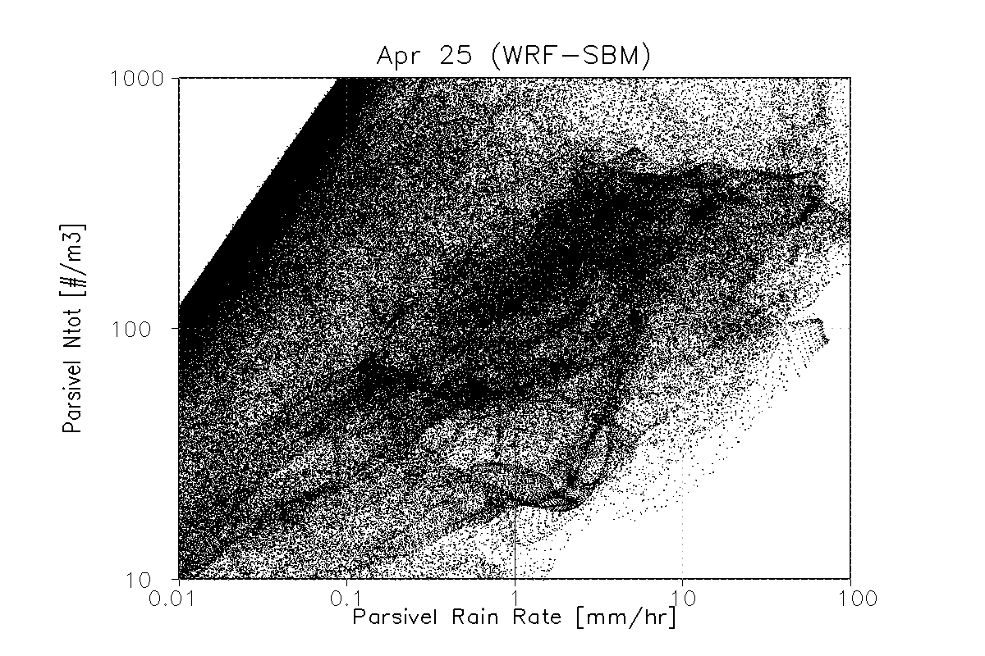
Parsivel Composites I (Ntot-Rain)
Parsivel data provided by A. Tokay.
Parsivel
WRF-SBM
Convective
Convective
Stratiform
Stratiform
All Parsivel 17 units around SGP site are integrated for 24hr periods.

Slide 7
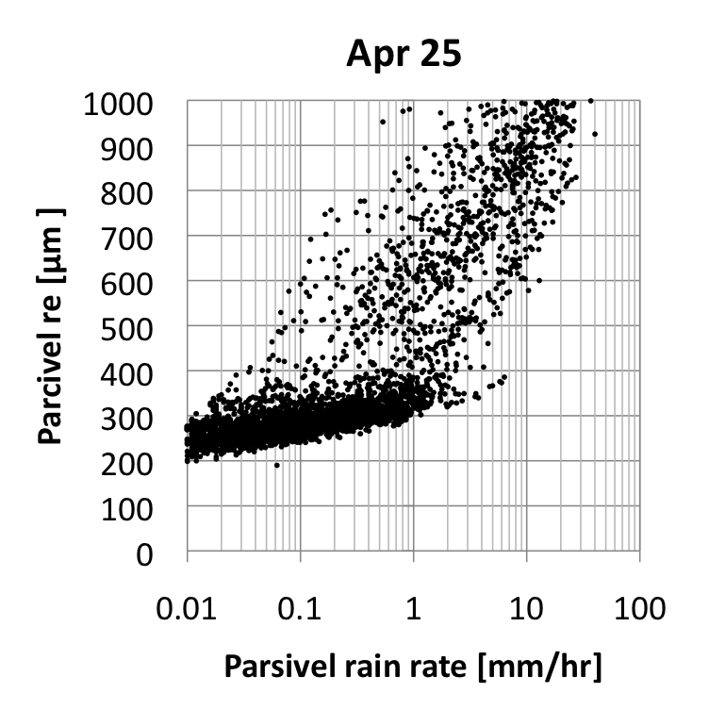
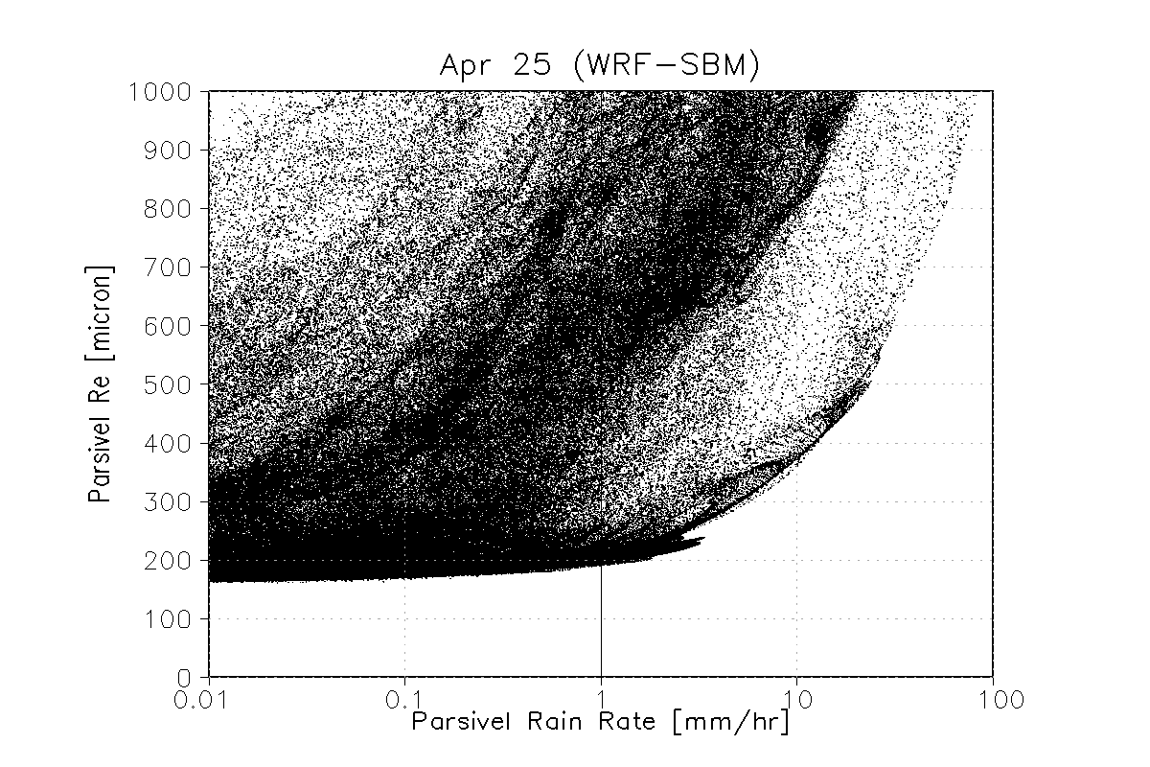
Parsivel Composites II (Re-Rain)
Parsivel data provided by A. Tokay.
Parsivel
WRF-SBM
Convective
Convective
Stratiform
Stratiform

Slide 8
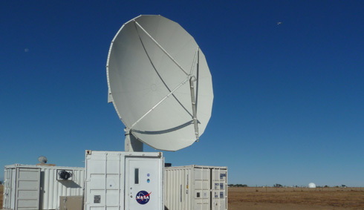
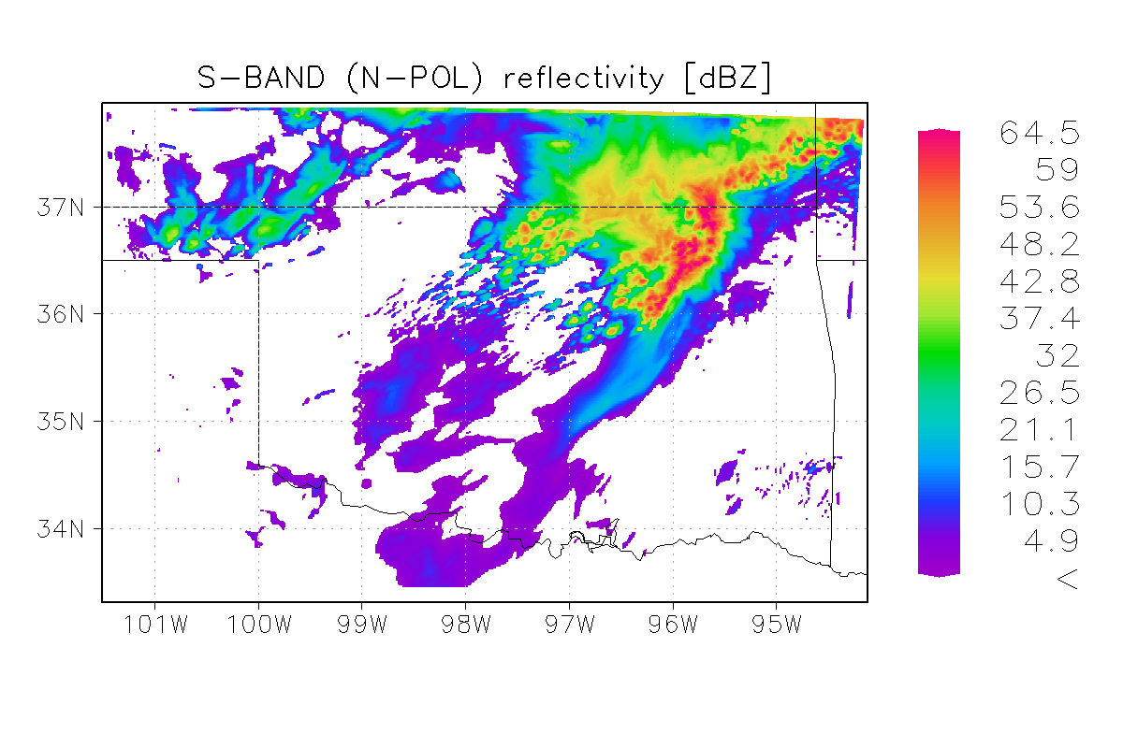
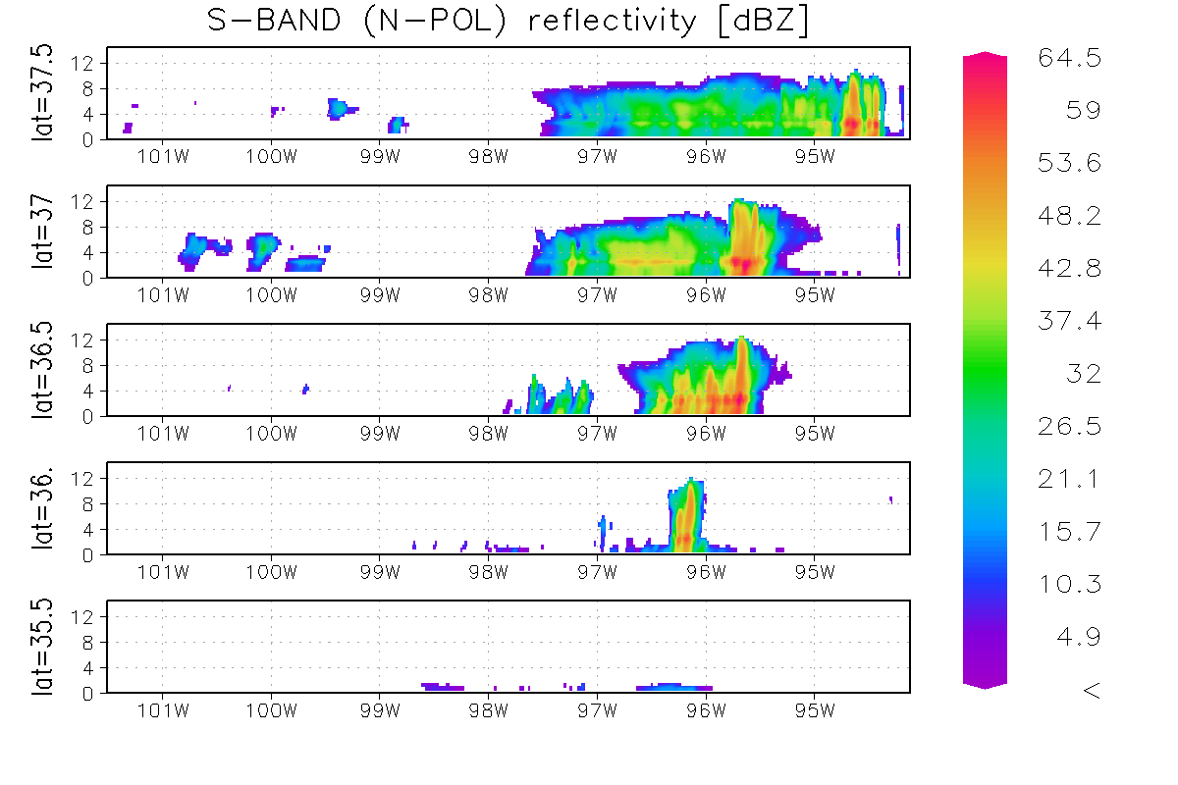
N-POL simulation from WRF-SBM
WRF SBM output
at 12:00Z, Apr 25

Slide 9
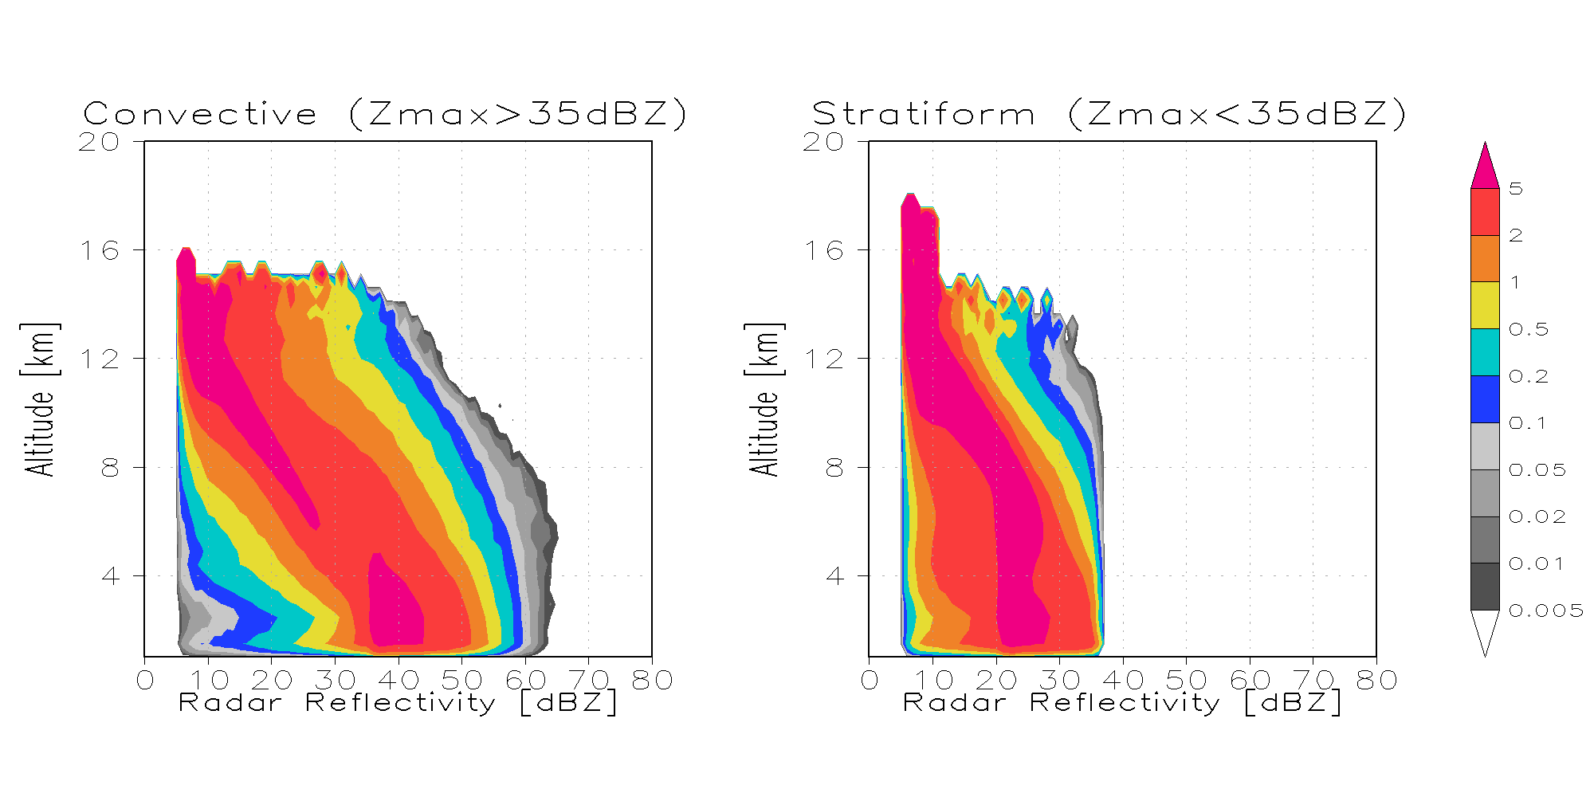
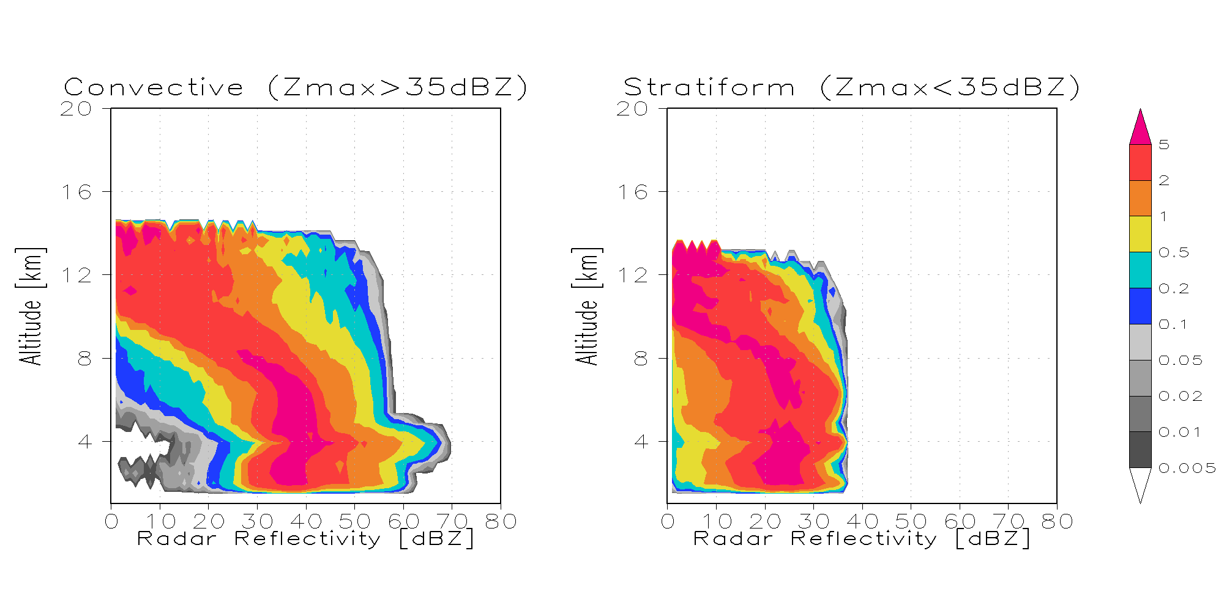
N-POL comparison
N-POL data provided by D. Wolff
Observation
(200km, 24hr )
WRF-SBM
(D2, 12Z)

Slide 10
Input for forward models
Forward
Models
CRM
Algorithm Testbed
GV-constrained
CRM database
Algorithm Development
Non-spherical particle
Constrain
Microphysics
Value-added GV data (Density, PSD, Vt plots)
GV
C3VP, LPVEx, MC3E

Slide 11
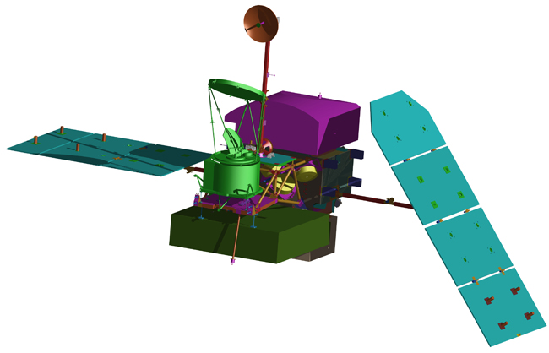
GMI Forward Simulator V_{β}
32rpm
Radiative Transfer specs:
Model: 1D Delta-Eddington
Path: 2-way slant
Single Scattering: MG/DDA
Emissivity: NESDIS model
IFOV gain function: Gaussian
Orbit specs:
Inclination angle = 65°
semi-major axis = 6776.14km
Sensor Specs:
Rotation: 32rpm
Off-nadir angle: 48.5° & 45.36°
Imager channels (10~89GHz)
Sounder channels (166~183Ghz)
CRM specs:
Model: WRF or GCE
Horizontal grid spacing: 1km
Vertical grid: 50m~1km (60lyr)
Microphysics: Bin-resolving
LSM: NOAH
GMI S2
(166~183GHz)
Off-nadir = 45.36°
GMI S1
(10~89GHz)
Off-nadir = 48.5°
EFOV sample
WRF/GCE domain

Slide 12
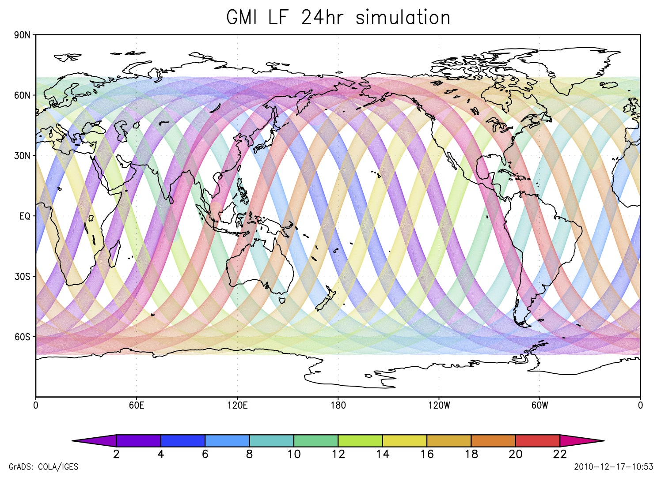
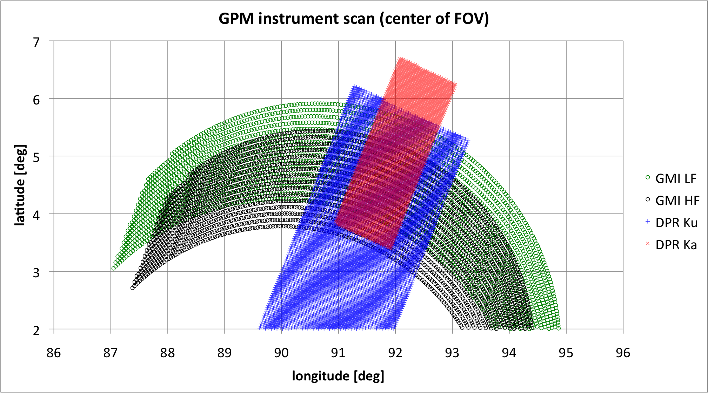
GPM Sensor Orbit-Scan Module
GPM Satellite orbit is Keplerian with Kozai’s 1st order perturbation theory. Inclination angle will be 65deg, and semi-major axis will be 6776.14km.
DPR is a cross-track scanning radar instrument.
Maximum off-nadir angles are 17.395° for Ku band and 8.52° for Ka band. Sampling bin angle is set as 0.71°. Scan speed is 1/0.6 [scan per sec].
GMI is a conically scanning microwave radiometer.
Off-nadir angles are set as 48.5° for low-frequency channels (10~89GHz) and 45.36° for high-frequency channels (166~183GHz).
Earth-viewing sector of sampling scan is 140°.
Rotation speed is 32 [rpm], and sampling interval is 3.6 [ms] for all channels.
a)
Satellite track
Regime III
Regime I
Regime IV
Regime II
≈ 122km
≈ 250km
≈ 797km
≈ 898km
b)
Figure 1:
a) 24hr simulation of GMI LF sensor coverage. Color shading represents time progression [hr].
b) Simulated center-of-FOV position on ellipsoid of GMI LF (O), GMI HF (O), DPR Ku (O), DPR Ka (O) sensors. Note that, for presentation purposes, the simulation intervals (time) are uniquely adjusted for the four types of channels.

Slide 13
2-way Slant-Path RT Driver
V_{mirror}
Optical properties are re-sampled along the 2-way slant path to represent 1-order 3D effect.
V_{GPM}
Downwelling Tb
Upwelling Tb
Terrain
V_{bottom}
250m
1km
V_{EFOV} at reference ellipsoid
V (x,y,z) in ECEF coordinate.
Tb is computed at every single CRM grid.

Slide 14
Antenna Gain Pattern: Effective Field of View (EFOV)
N sample
N+1 sample
N sample
N+1 sample
CRM grid
1km×1km
CRM grid
1km×1km
89GHz
BW_{3dB}=0.4°
DT:7.3km
CT:4.3km
IFOV center
EFOV center
36.5GHz
BW_{3dB}=0.9°
DT:14.4km
CT:8.6km
EFOV center
Tb difference between IFOV and EFOV is up to 8K at 36.5G along the coast line.
IFOV
dt=3.6ms
dt=3.6ms
EFOV
~5.76km
Integrate IFOV Antenna Gain function during sampling interval.
IFOV Antenna Gain function: Gaussian

Slide 15
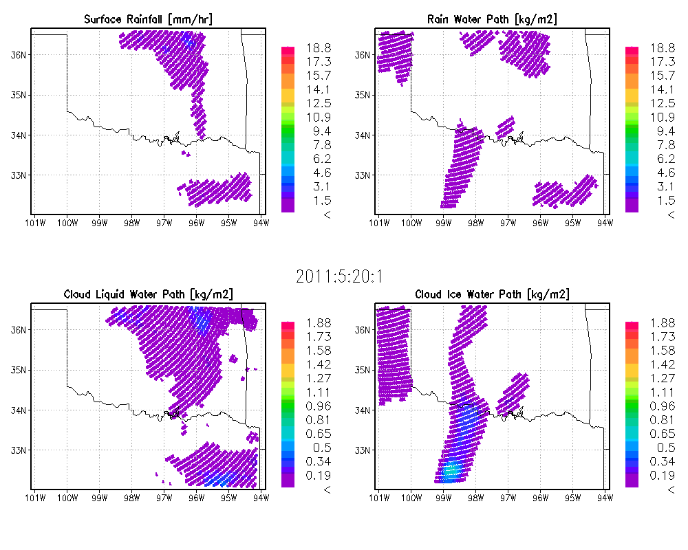
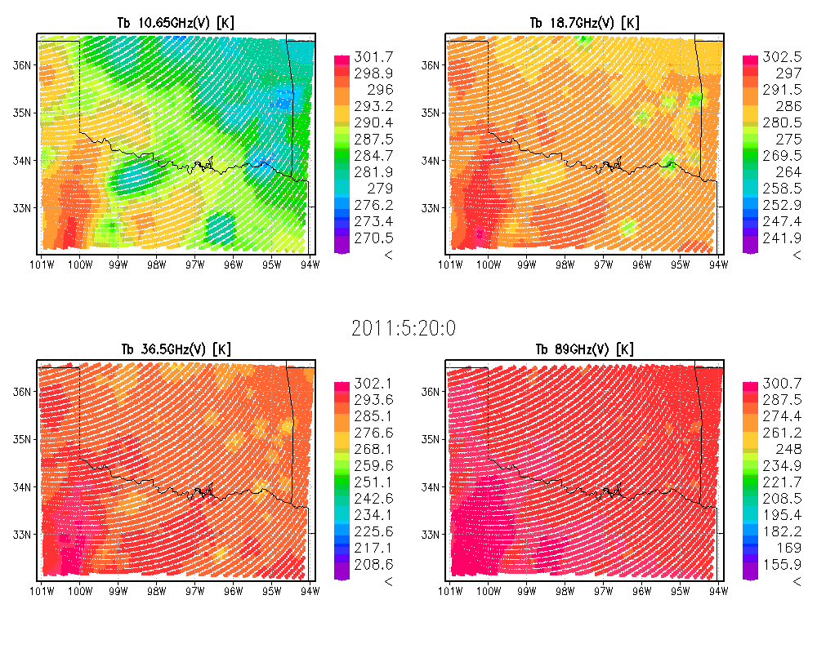
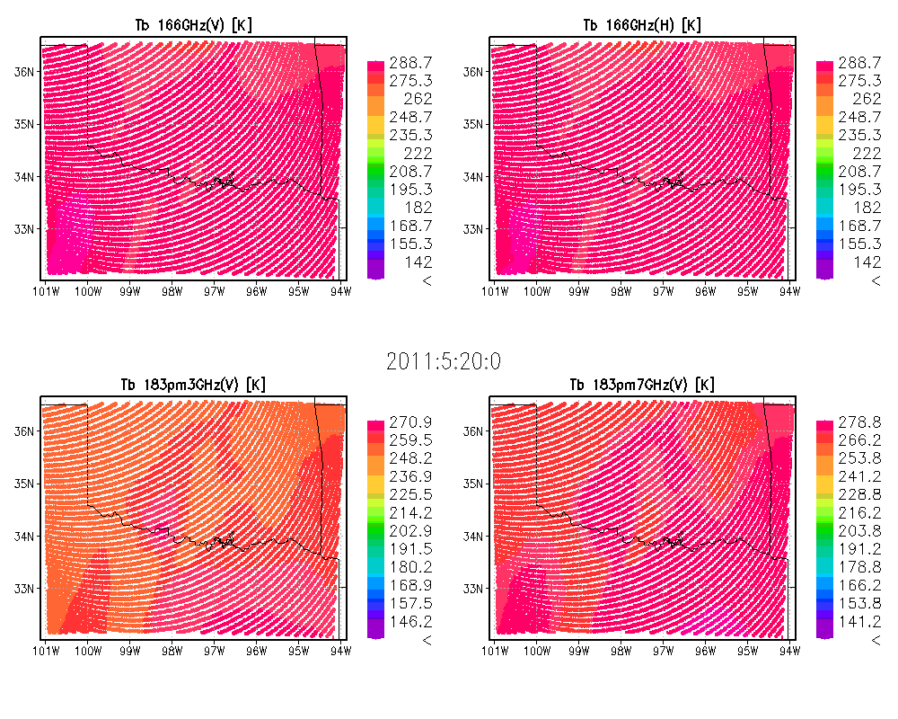
Simulated GMI L1B/L2 signals
GV case: MC3E
Date: May 20, 2011 (Golden case scenario)
Details of rainfall events: Sever thunderstorm with convective-stratiform rain.
Comments
Large depression of high frequency channels.
Surface lake create constant patch of Tb depression in low-frequency channels.
GMI L2 GPROF
GMI L1 S1
GMI L1 S2

Slide 16
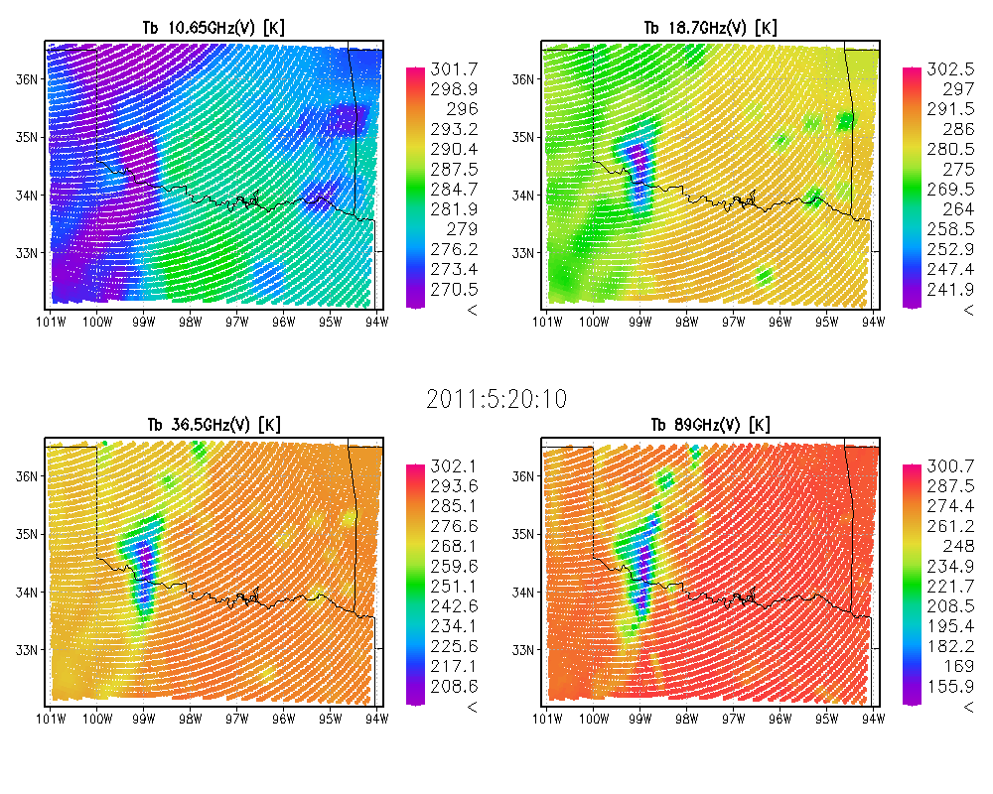
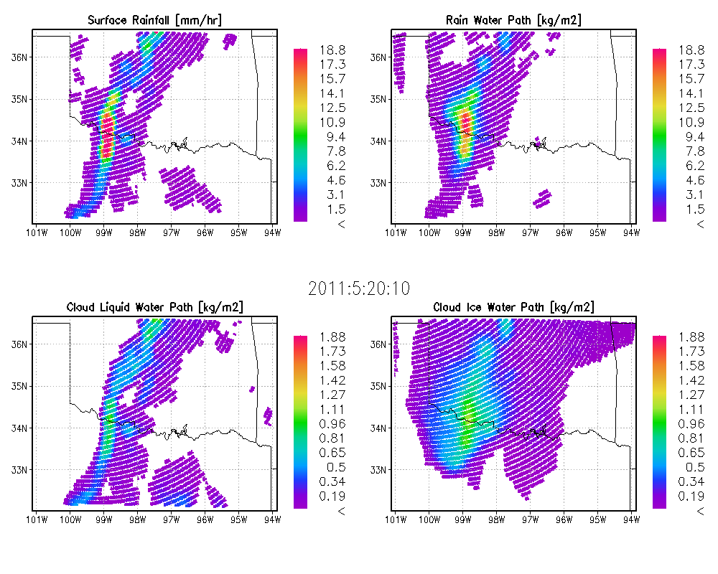
Algorithm Testing in PPS
GPM L1B orbital data
GV-constrained
CRM Simulations
(MC3E, LPVEx, C3VP
HMT, TWP)
Simulated Tb & Z
At-Launch GPM Algorithm (GMI, DPR, combined)
GPM L2 orbital data
Consistent?
Rainfall
Rain water path
Cloud water path
Ice water path
etc….
CRM rainfall convolved within antenna gain pattern
Rainfall estimated from algorithm through simulated Tb & Z
GPM L2 orbital data

Slide 17
Summary
Synthetic GPM simulator is built upon the GPM Ground Validation Program.
→ GV will give reality on the CRM simulations.
GPM forward model can generate GMI L1/L2 orbital data from CRM-SBM database to validate pre-/at-launch algorithms.
MC3E WRF-SBM simulation will be validated and improved in next 6 month using more and more QCed-GV observations.

Slide 18
Backups

Slide 19
module_simulator.F
Main module of Goddard SDSU
Manage user options, global parameters, and memory allocation
input data (GCE, WRF, MMF)
Microphysics (GCE one-moment, RAMS 1/2-moment, HUCM Spectra-bin)
module_mpi.F
MPI module
MPI control for file or domain decomposition
main_SDSU.F
Main driver of SDSU
Procedure control
Single-Scatter Table Development
Common SS-PSD framework (L. Liao)
SCATDB ice crystal database [G. Liu 2008]
SnowFake-DDSCAT database
(K.-S. Kuo and B. Johnson)
module_opt_micro.F
Microwave Single-Scattering 3D Integration Module
Integrating optical properties into 3D field
[Kummerow 1993, Bauer 2001]
module_GV.F
GV in-situ simulator
Re-sample CRM microphysics, and translate into observable parameters from GV instruments.
simulator_DPR.F
DPR L1B Simulator
Sensor specifications of DPR
(Meneghini group)
Radar sigma database (Meneghini group and Tanelli)
module_scan.F
Instrumental Scanning Module
Re-sample optical path along GMI/DPR scanning pattern
[Matsui 2011]
Land-Surface Characterization WG
(R. Ferraro, C. Peters-Lidard, G. Jackson)
AMSU-based TELSEM (C. Prigent )
NESDIS Microwave Land-Surface Emissivity model [Weng et al. 2001]
Others/TBD (Turk, Mohr, Boukabara, Petty, etc)
simulator_micro.F
Passive microwave simulator
Delta-edington two-stream
[Kummerow 1993]
[Olson and Kummerow 1996]
simulator_radar.F
L2 Radar simulator
Single Scattering Backscatter
[Masunaga and Kummerow 2005]

Slide 20
Orbital Database
Simulated GMI1B
Swath Parameters: Satellite navigations, geolocations, S1/S2 Tbs, surface skin temperature, emissivity, and etc.
Simulated GMI GPROF
Swath Parameters: Satellite navigations, geolocations, surface rainfall, cloud/ice/rain water paths, surface skin temperature, vegetation cover, land fraction, surface wind speed, snow depth, and etc.
Note:
Closely follow ATBD GMI1B, GPM GPROF, but some parameters are missing.
Current format is HDF5, but format may be changed as GMI ATBD.
Due to limited CRM domains, most of Tbs are undefined.
Each CRM case can generate x 24 (for all CRM hourly output) x 2 (ascending/descending paths). Thus, 8 cases of CRM simulations will generate total 384 orbital testbed data.
Red-colored parameters are special parameters for simulated swath data.

Slide 21
CRM Database in Pleiades
Beta - no validation. Val1 - first validation. Val2 - second validation.
Each CRM case can generate x24 (for all CRM hourly output) x2 (ascending/descending paths). Thus, 8 cases of CRM simulations will generate total 384 orbital testbed data.

Slide 22
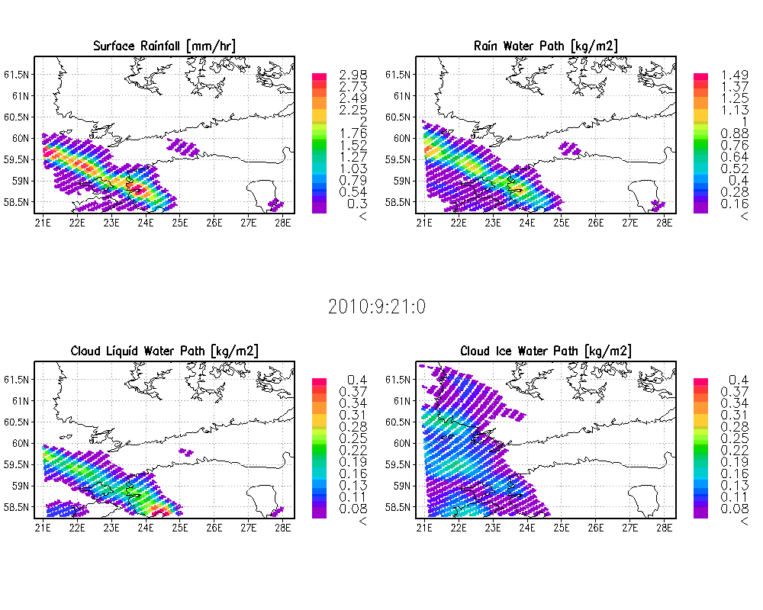
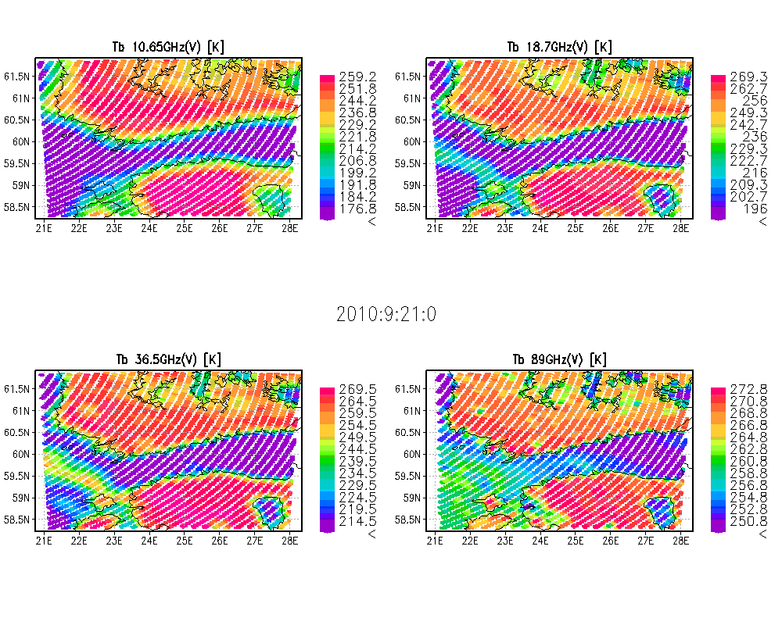
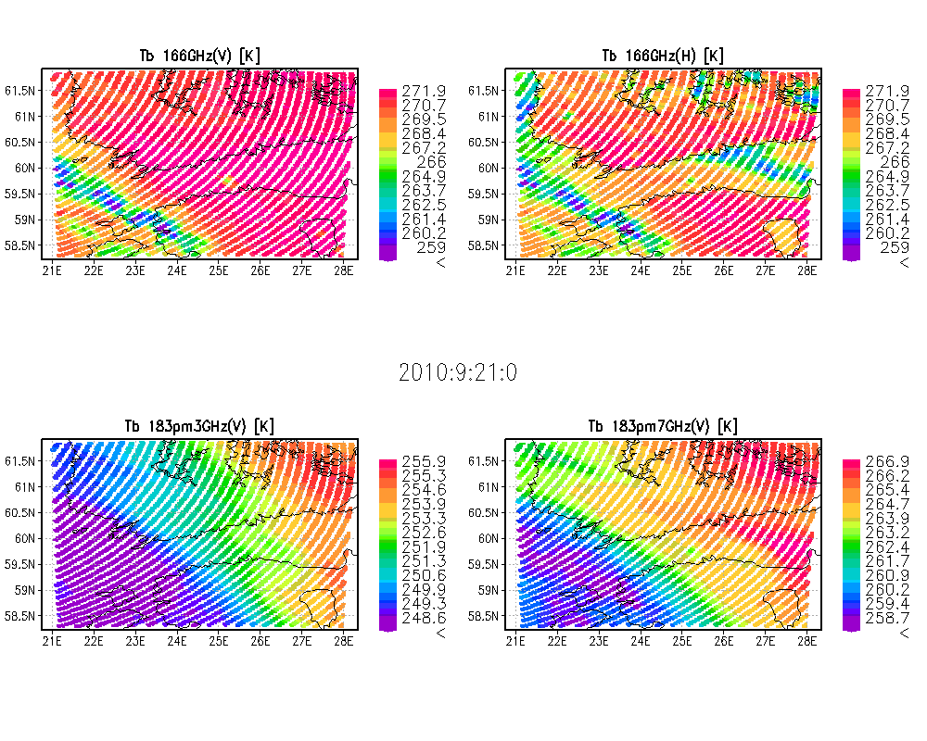
Simulated GMI L1B/L2 signals
GV case: LPVEx
Date: Sep 21 (Golden case scenario)
Details of rainfall events: large-scale mixed-phase rainfall with relatively high (2400m) melting band.
Comments
89GHz~166GHz channels capture rainfall signals well.
183GHz channel is saturated by ice water path.
GMI L2 GPROF
GMI L1 S1
GMI L1 S2

Slide 23
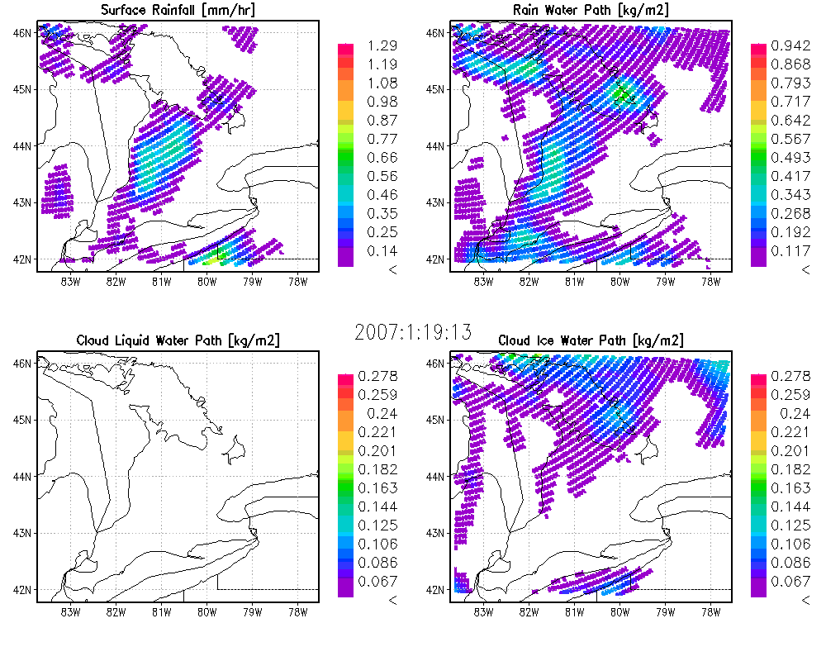
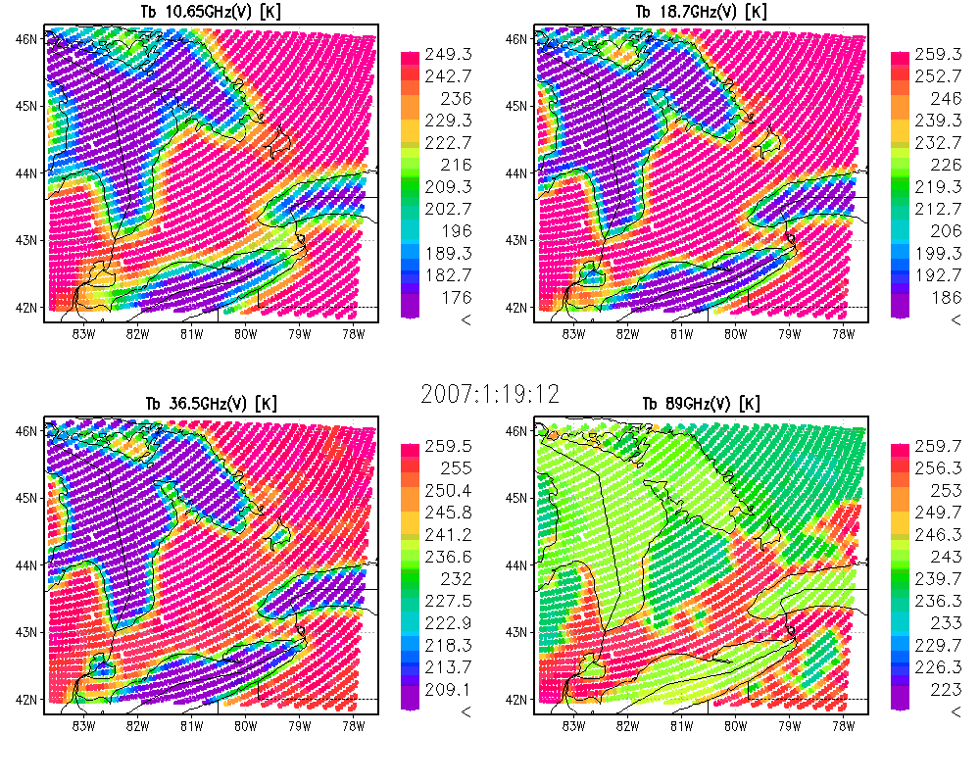
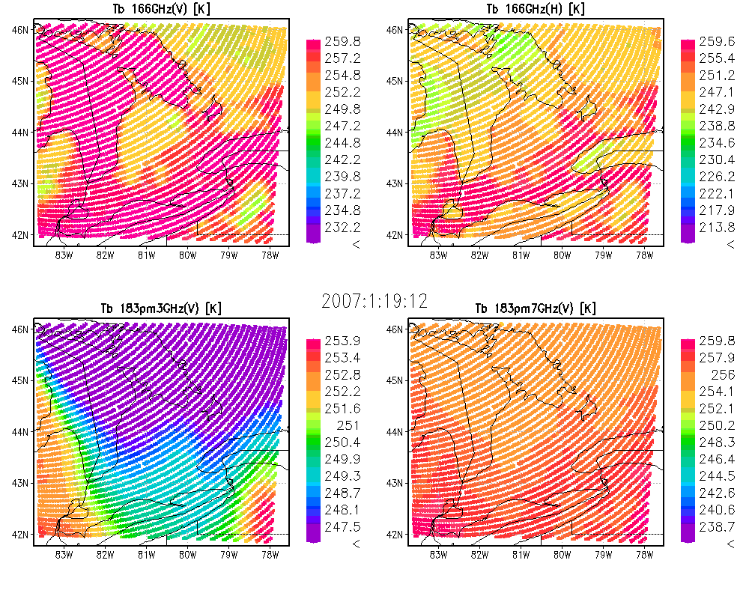
Simulated GMI L1B/L2 signals
GV case: C3VP
Date: Jan 19, 2007
Details of rainfall events: Lake-effect snow storm extended from Great Lake. Narrow and shallow snow band.
Comments
Strong moisture gradient dominate the signals of shallow snow storm in 183GHz.
GMI L2 GPROF
GMI L1 S1
GMI L1 S2

