Slide 1
HAMSR during CPEX-AW
Retrievals and Variables
Mathias Schreier
Bjorn Lambrigtsen, Shannon Brown, Sun Wong

Slide 2
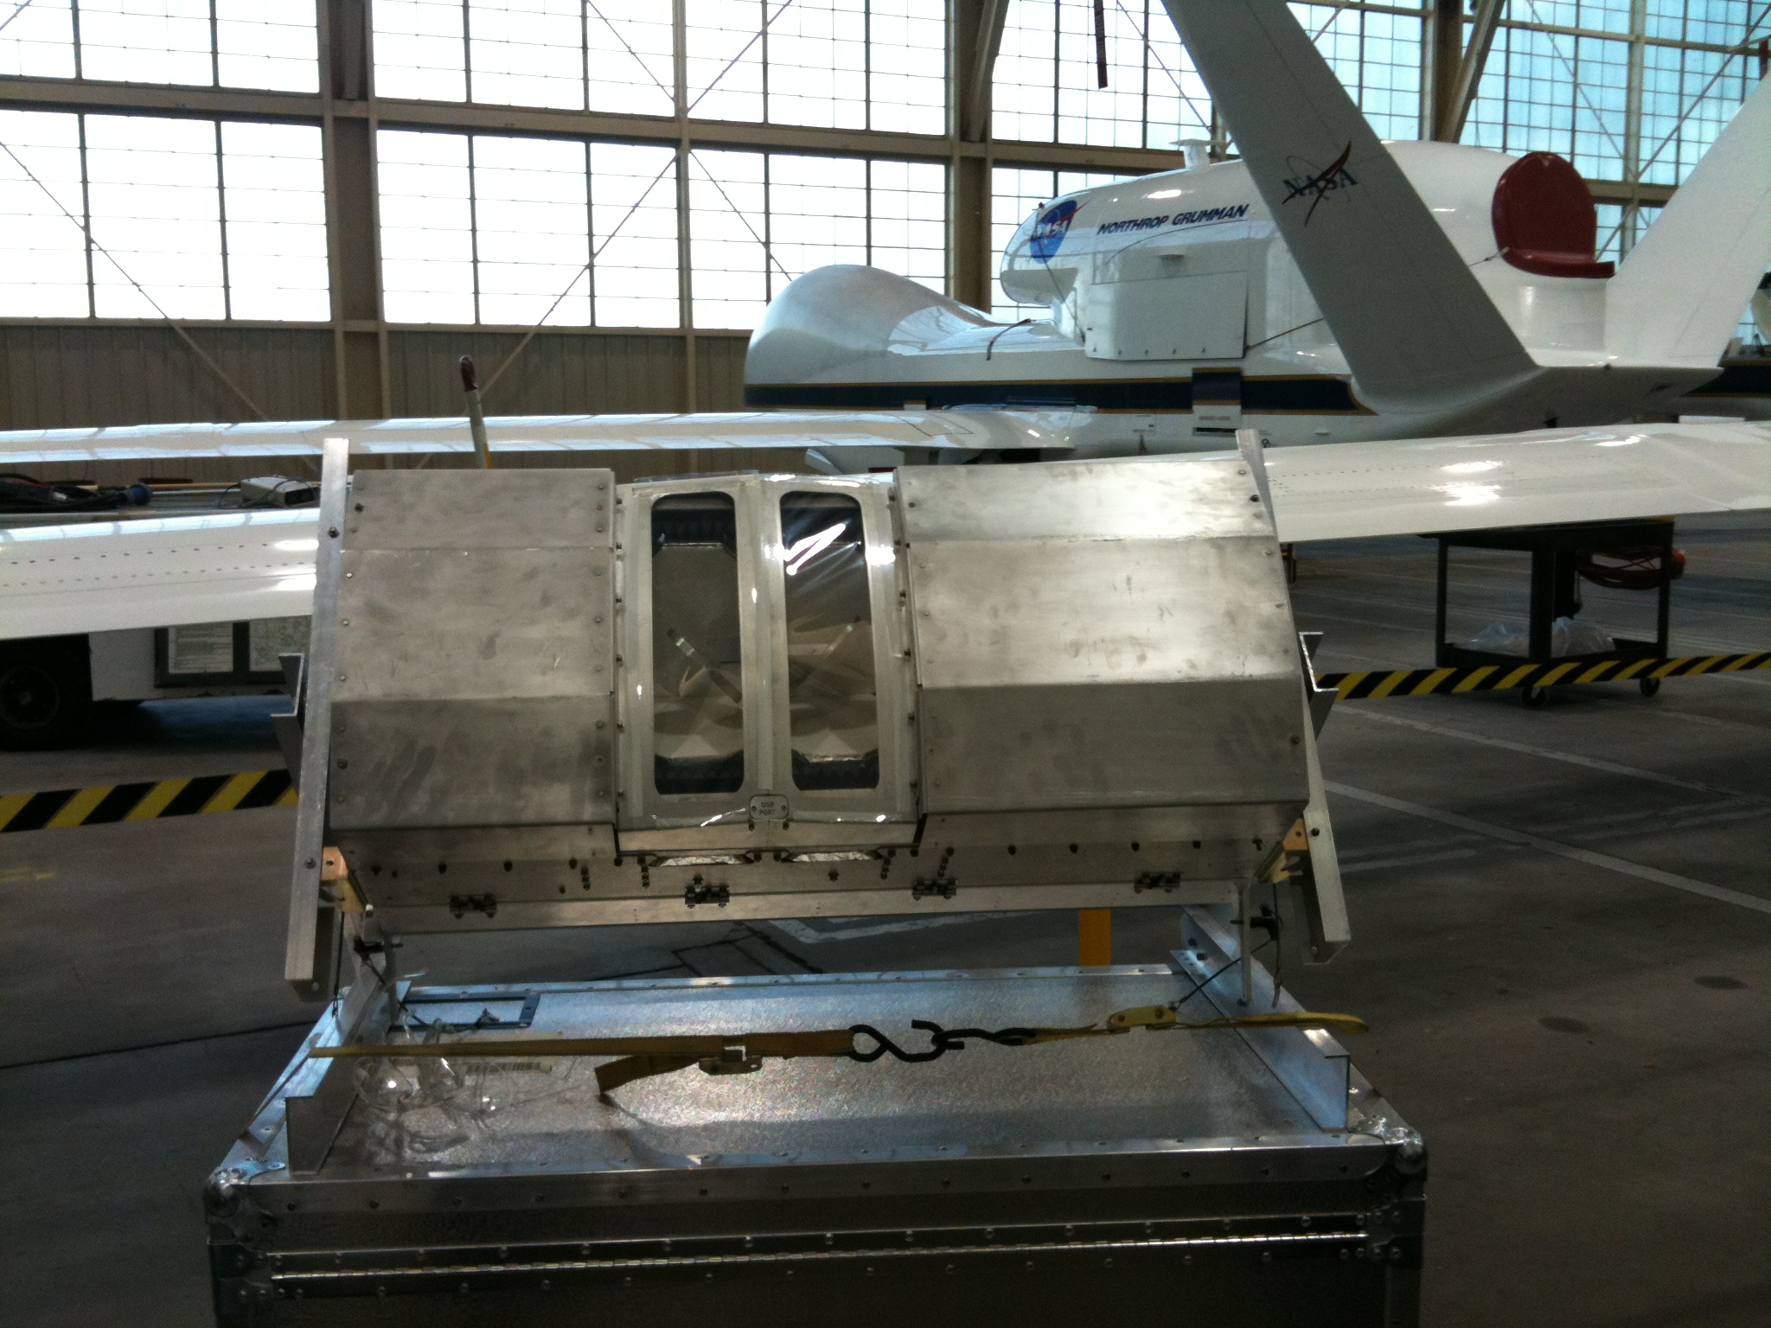


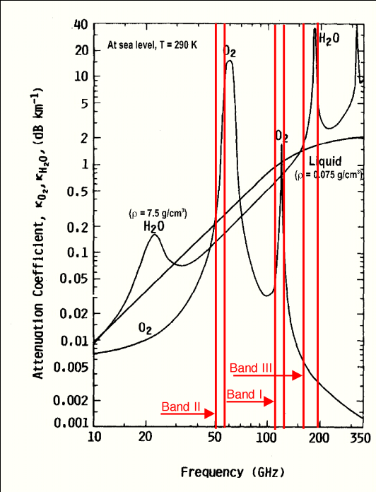
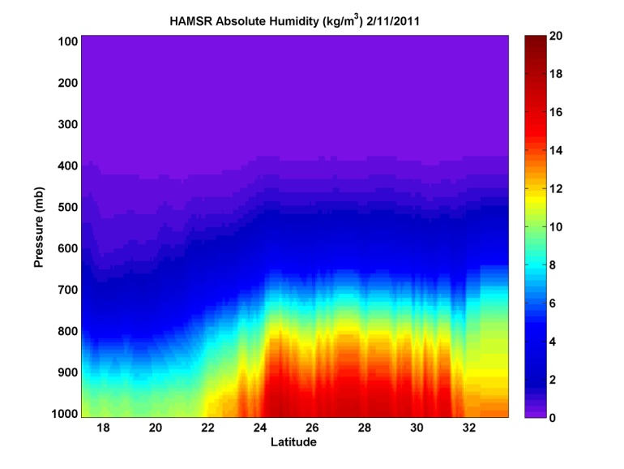
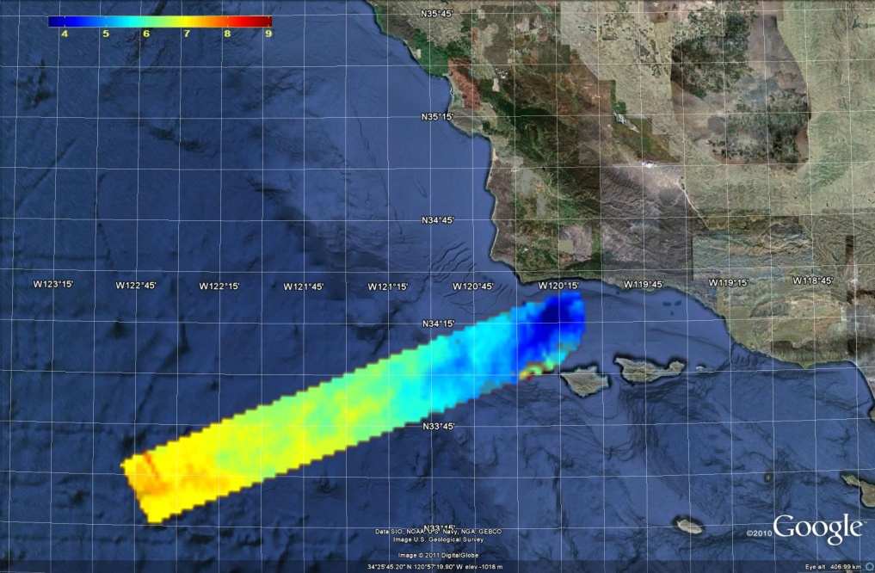
JPL High Altitude MMIC Sounding Radiometer (HAMSR)
JPL High Altitude MMIC Sounding Radiometer (HAMSR)
  Microwave radiometer for 3-D all-weather temperature and water vapor sounding, similar to AMSU
  25 sounding channels in three bands:
  50-60 GHz, 118 GHz, 183 GHz
Cross track scanning
  + 60º off nadir
  20 km swath
  1 km resolution
6
8
10
13 mm
HAMSR PWV

Slide 3
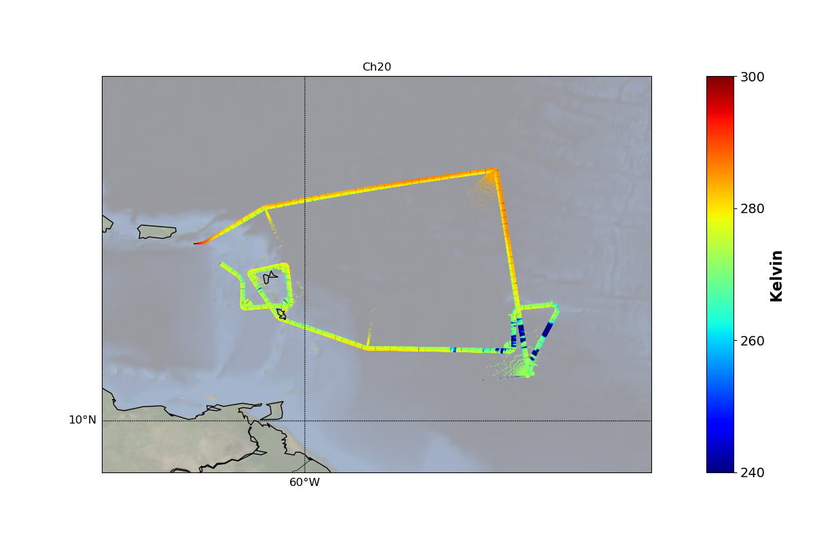
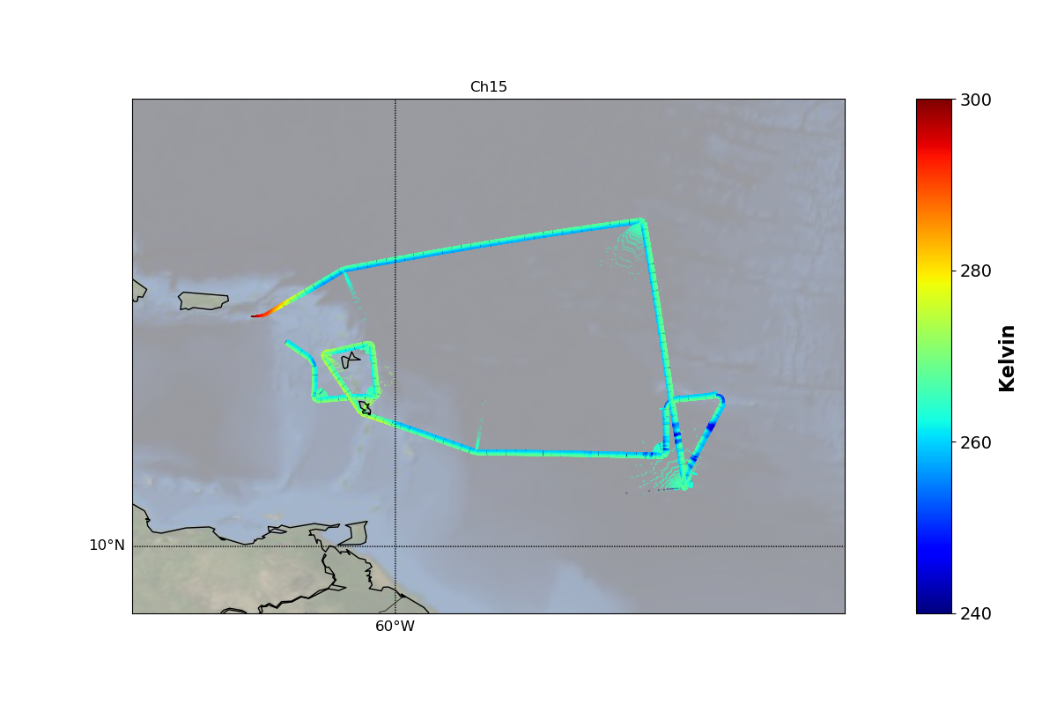
Measurement
L1B data - What does HAMSR measure:
  Brightness Temperatures at specific frequencies
  Oxygen and Water vapor emissions at different levels
  25 Channels:
    Channels like Ch 20 measure water vapor near the surface
    Channels like Ch 15 measure temperature close to the airplane
  Measurement of whole swath, not just below the airplane
The “swath” during CPEX and CPEX-AW

Slide 4
Retrieval
2 Approaches
A Neural Network algorithm was implemented during the campaign Netcdf-files, already available on google drive Retrievals include temperature profiles, relative humidity, rain flags, …
A Optimal Estimation Algorithm Currently postprocessing Will also be Netcdf-files Retrievals include temperature profiles, relative humidity, rain flags, …
Why 2 Algorithms ?

Slide 5
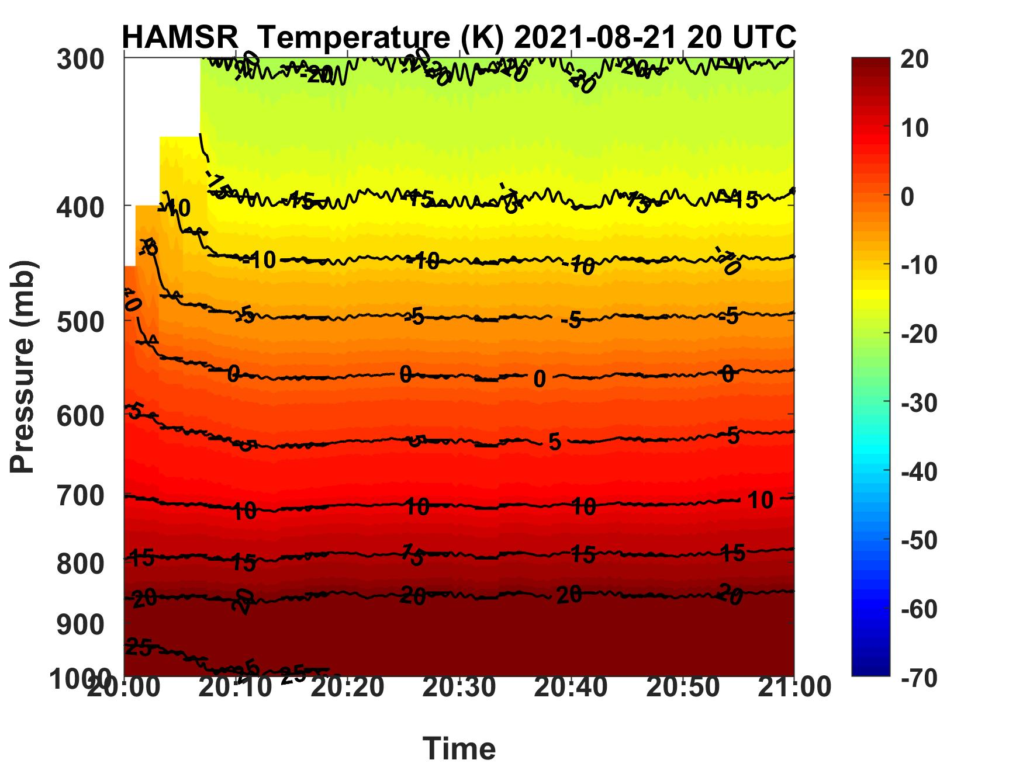
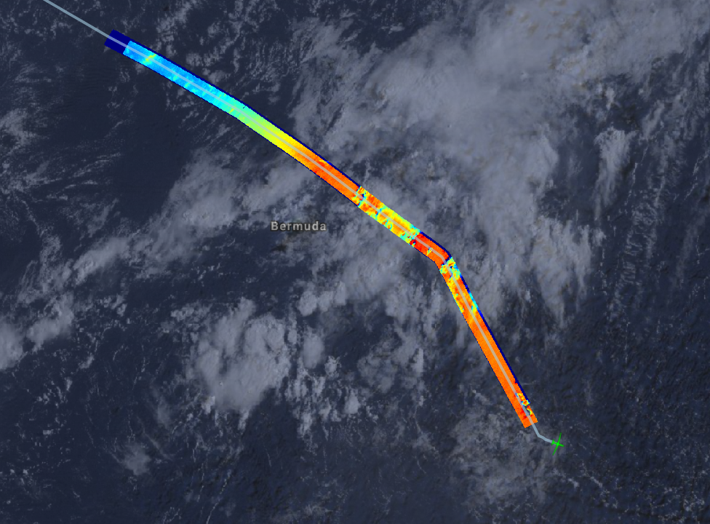
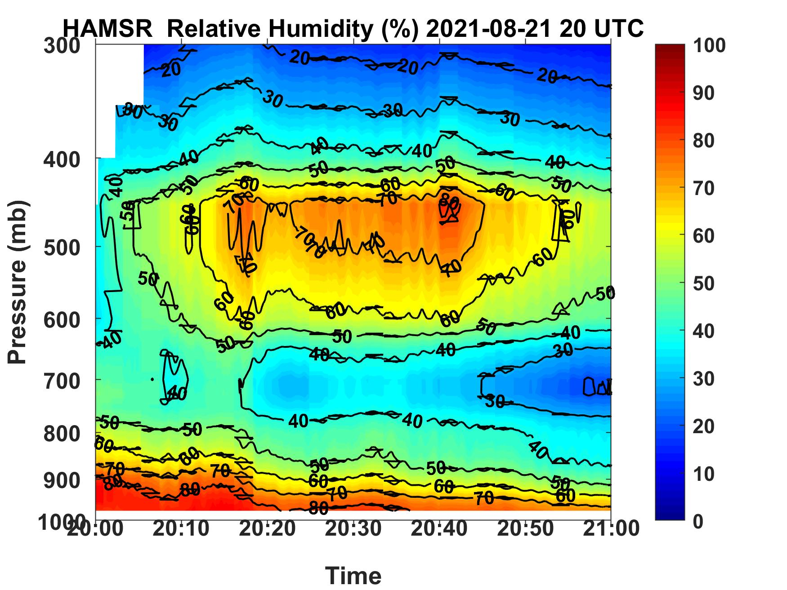
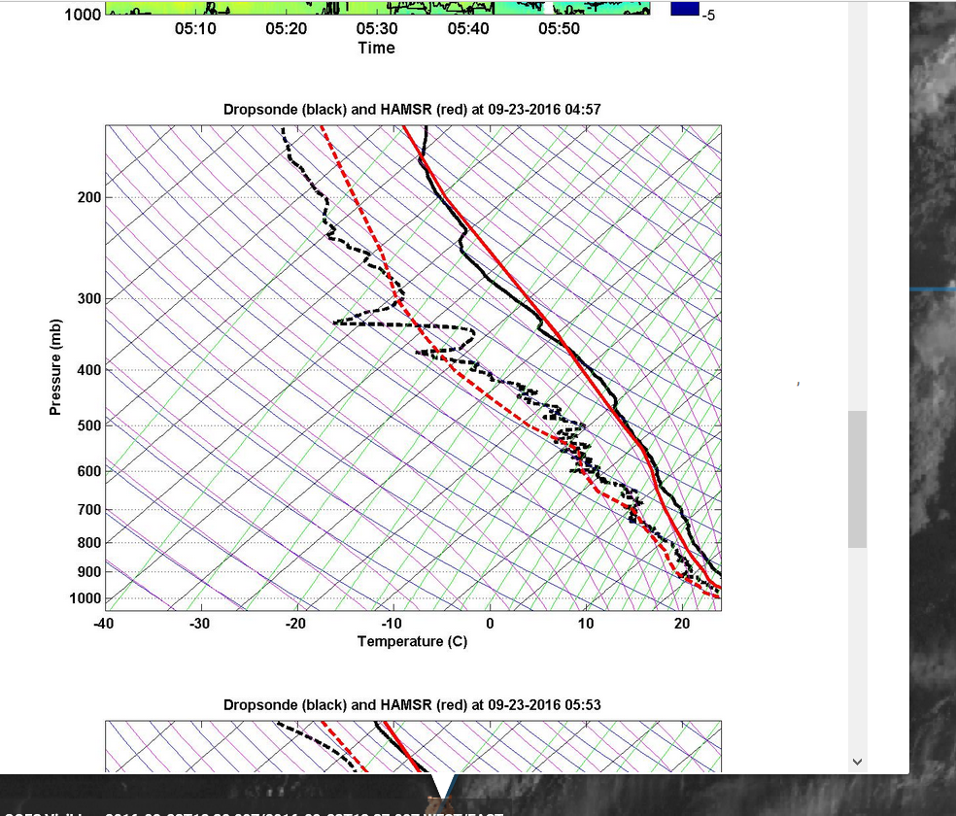
Neural Network Retrieval
Neural Network Approach
Large Amount of Data: Observation is continuously Retrieval is almost real time ~1km resolution
Main Observables: Temperature at different levels Water vapor at different levels Relative Humidity at different levels Total precipitable water cloud water Rain flag | ham_airT ham_airQ ham_airRH TPW CLW rain_flag
Perfect for Fast Analysis and Validation: Nadir quick-looks Overlay with GOES satellite data Rain flag, columns water, observed T_{b}, … SkewT-plots for comparisons

Slide 6
Neural Network Retrieval
NN - Advantages
Available Observation is continuously
Has All Main Observables: Temperature at different levels Water vapor at different levels Relative Humidity at different levels Total precipitable water Rain flag
Perfect for Fast Analysis and Validation: Nadir quick-looks Rain flag for unusable data Bias corrected
NN - Caveats
Validity tested only close to nadir Not corrected for high scan angles Watch for scan angle variable “inc” (+/- 10)
Precipitation creates problems Filtering needed based on rain Watch for rain flag indicator
Not easy to assimilate No real quality flags No real error estimates

Slide 7
Ratatouille - Optimal Estimation Retrieval
Simple Approach:
No tweaking
No tuning
System is mainly based on available components
Goal :
Optimal Estimation : “all at once”
Provide Quality Flags and Error Estimates
Provide Averaging Kernels
Allow multiple input sources to compare impacts and reduce uncertainty
Include regression approaches and Scattering to allow partly rainy retrievals
Type
Language | Fortran 2003 (some bash/python)
Instruments | ATMS (h5), ATMS-SIPS (nc), AMSU-A/B, MHS (binary) HAMSR (nc)
RTA | CRTM RTTOVS
Background | “Standard” ECMWF, MERRA-2, WRF
“Addable” information | CYGNSS-wind (adapted)
Covariance Matrices | Various, based on PCA
Solver Approach | Optimal Estimation , Adjoints/Jacobians from RTA (LMBM-Minimiz.: N. Karmitsa)
Error analysis | X², Quality Flags, Error covariances, Averaging Kernels

Slide 8
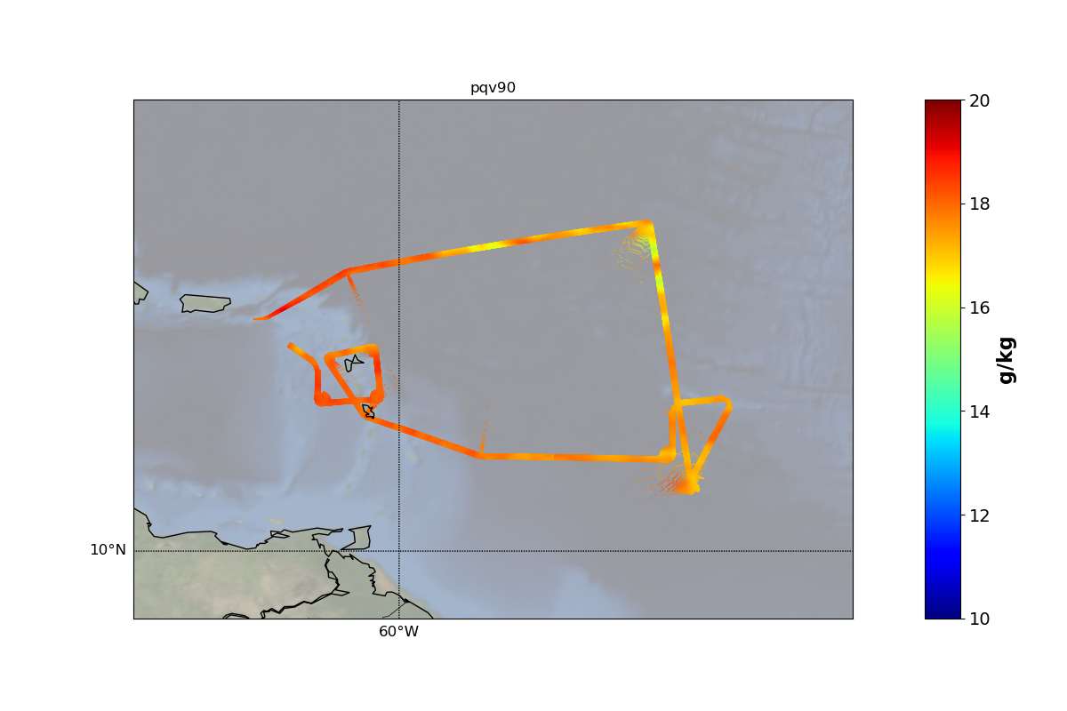
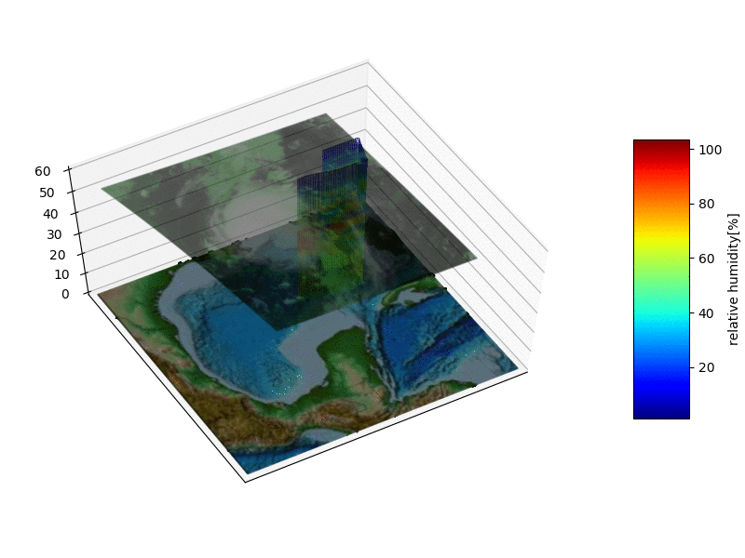
Example : Flight on 2021/08/21
2nd Reasearch Flight durin CPEX Campaign :
Flight on August 21/22 2021
Duration was ~8 hours: Arrival and Departure from St. Croix
Uppe plot shows the retrieved water vapor at a level of ~900 hP
Lower animation shows retrieved relative humidity at nadir
Its actually from CPEX 2017, I just like the animation….

Slide 9
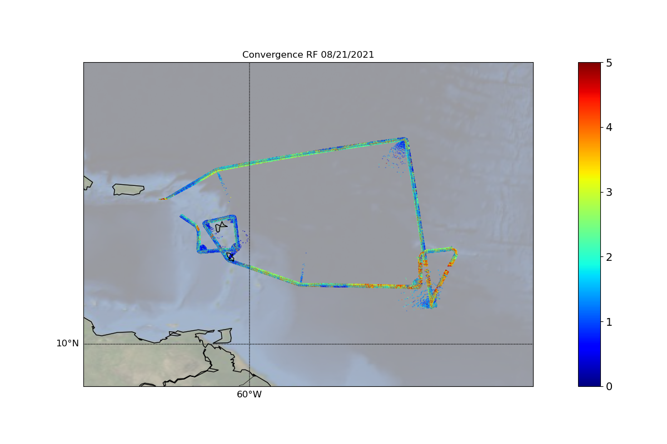
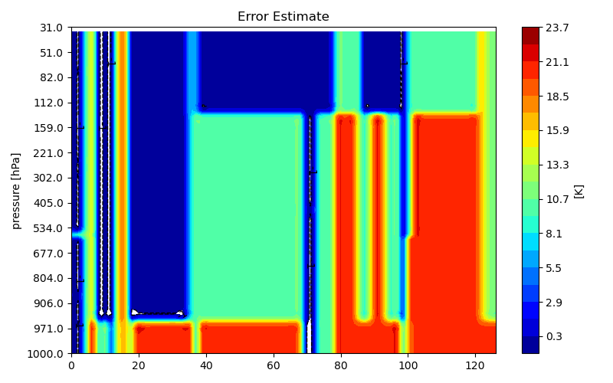
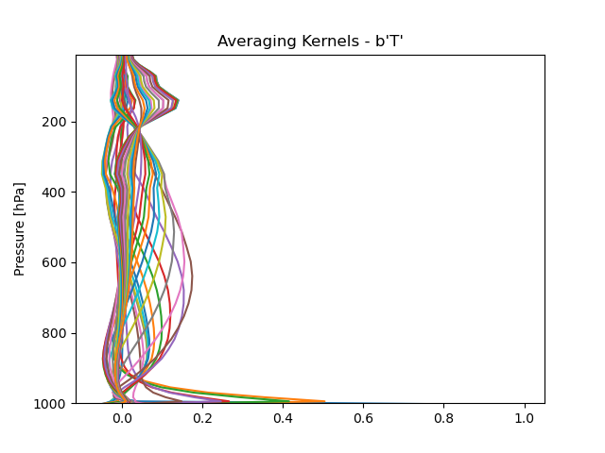
Error Estimates
Options:
Convergence
Name in file: ERROR_VALUE
Gives a good estimate for bad areas in general:
Bad convergence means avoid all variables
Quality Flag and Error Estimate
X_LEVEL_QUALITY_ESTIMATE,
X _ACCURACY_ESTIMATE
Can be derived from a combination of the error covariance and the channel dependent convergence
Level dependent
QUALITY : 0 is best, 1 is good, 2: bad
Averaging Kernels
No in file, but can be provided
E.g, rain changes the sensitivity of specific channels
Convergence
blue: good, red no convergence
Convergence
blue: good, red no convergence
Error Estimate for T
Good vs bad scan
Kernel Information T
no rain vs high precipitation
Available on request

Slide 10
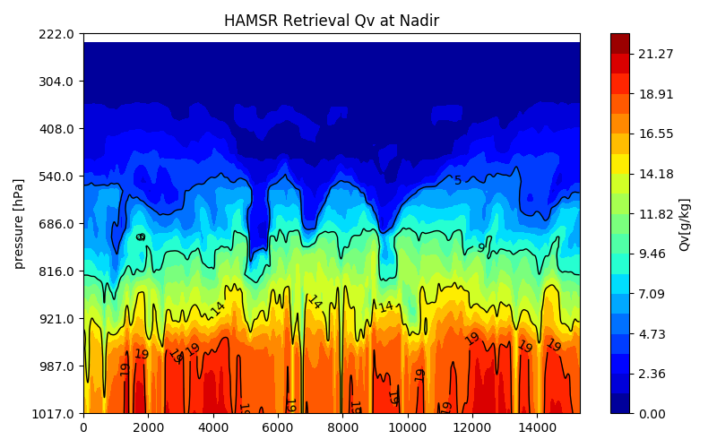
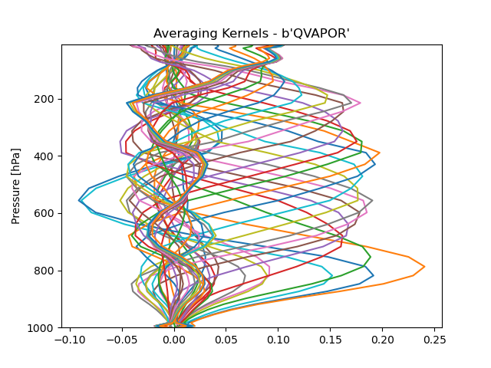
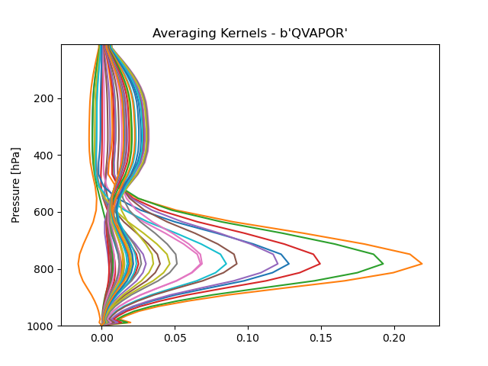
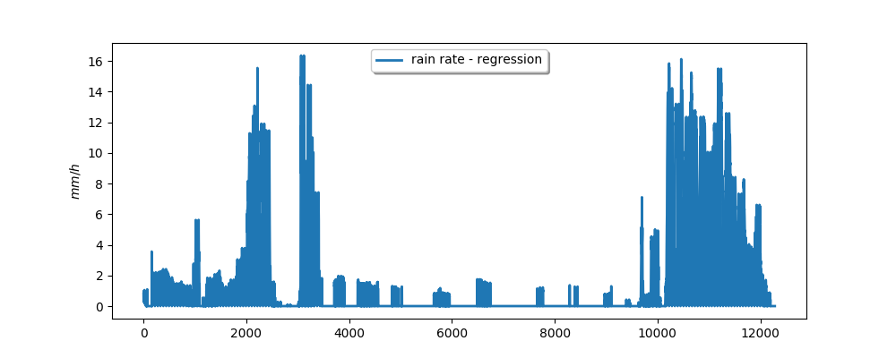
Scattering: Surface and Rainy Retrievals
Filtering
Kernel Information Qv
Scattering can affect MW observations
  Ocean waves can cause unwanted effects, especially in the boundary layer regions
  Rain, hail or snow can affect retrievals in regions interesting for convection
  Information content significantly reduced
  However, these areas and scenes are often the most significant
Options:
Surface: We use wind information and FASTEM calculations to calculate emissivity and reflectivity of the ocean surface
Rain: We added scattering to retrieval
  Needs good guess of particle mix
  Averaging Kernels change a lot
no rain
~ 5 degrees of Freedom
good vertical information
rain of ~ 10 mm/h
~ 2degrees of Freedom
weak vertical information

Slide 11
Summary
Neural Network Approach
Available Now: Available on google drive for all flights (RF) Hourly NC-files: RF -> HAMSR -> L2-NN Quicklooks: RF -> HAMSR -> Quicklooks-NN
Main Observables: Temperature at different levels Water vapor at different levels Relative Humidity at different levels Total precipitable water cloud water Rain flag | ham_airT ham_airQ ham_airRH TPW CLW rain_flag
Dangers: Validity tested only close to nadir Not corrected for high scan angles (“inc” +/- 10) Precipitation creates problems Watch for rain flag indicator Not easy to assimilate No real quality flags or error estimates
Post processing Approach
Partly available: RF01 available for testing on google drive Hourly NC-files: RF01 -> HAMSR -> L2-OD Remaining flights available soon
Main Observables: Temperature Water vapor Surface temperature cloud water Rain flag Quality flag Error estimate …. | T QVAPOR T_SURFACE QCLOUD PRECIP_RainRate2 X_LEVEL_QUALITY_ESTIMATE X_LEVEL_ERROR_ESTIMATE
Dangers: Some areas with scattering can be unusual cold: In case you want to use T_SURFACE Data comes in sigma levels PRESSURE variable provides the levels

Slide 12
Thank you for you attention

