Slide 1
WB-57 navigation data
GRIP flights 1-2 Sept 2010 (Earl) and 16 Sept 2010 (Karl)
Figures by Tim Miller

Slide 2
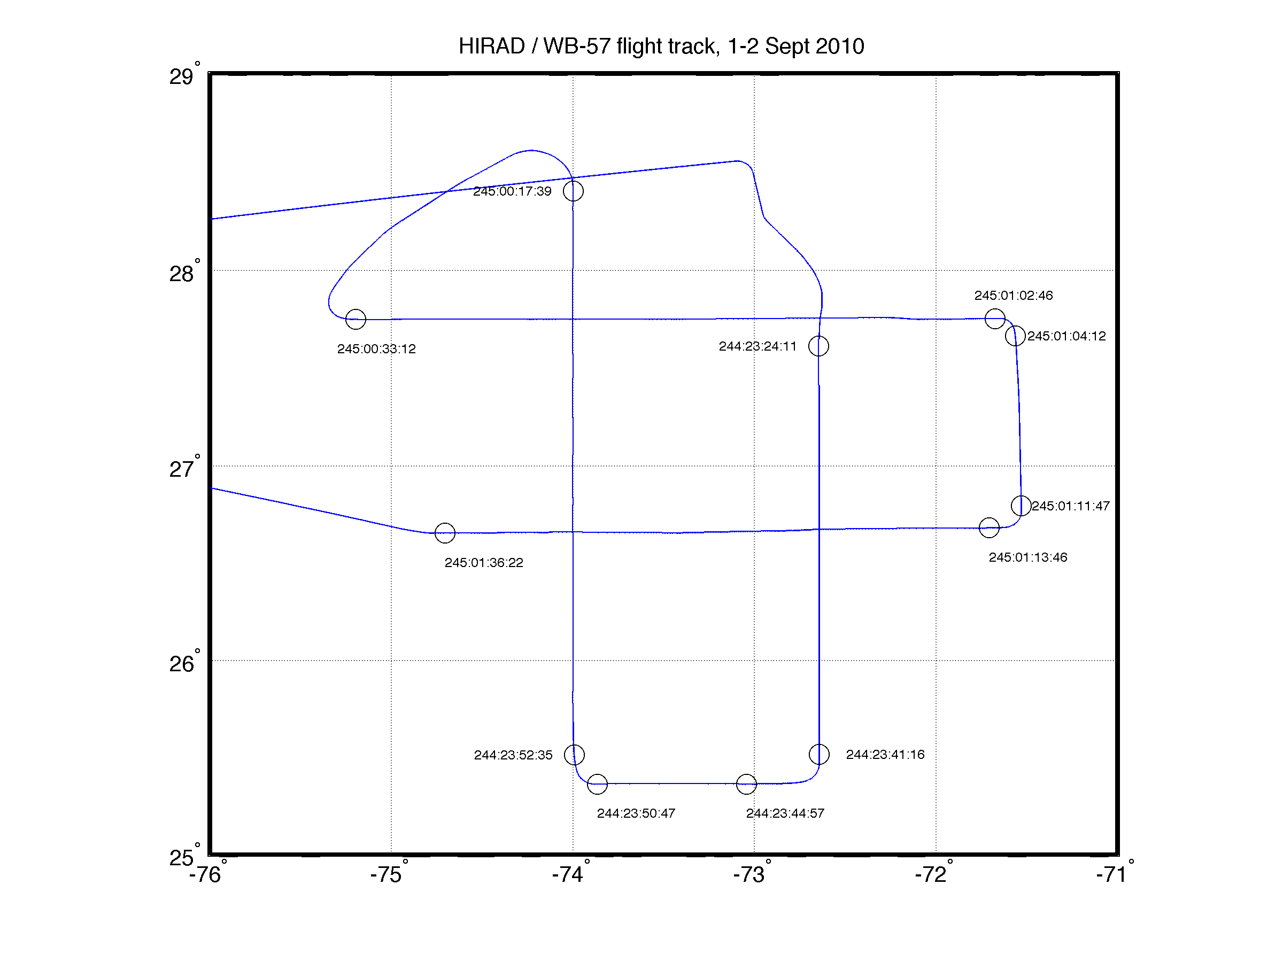
Earl Flight Track with Times of Start and Finish of Data Provided on GRIP Data Facility (v0)

Slide 3
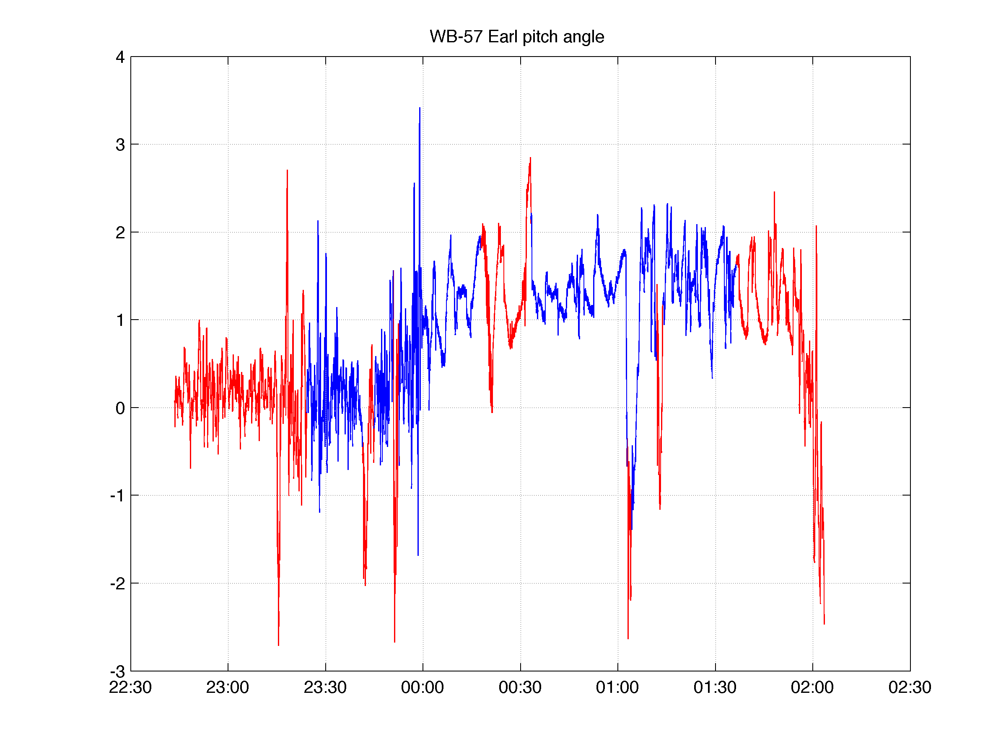
Earl Flight Pitch Angle Blue = Times during which HIRAD data are provided

Slide 4
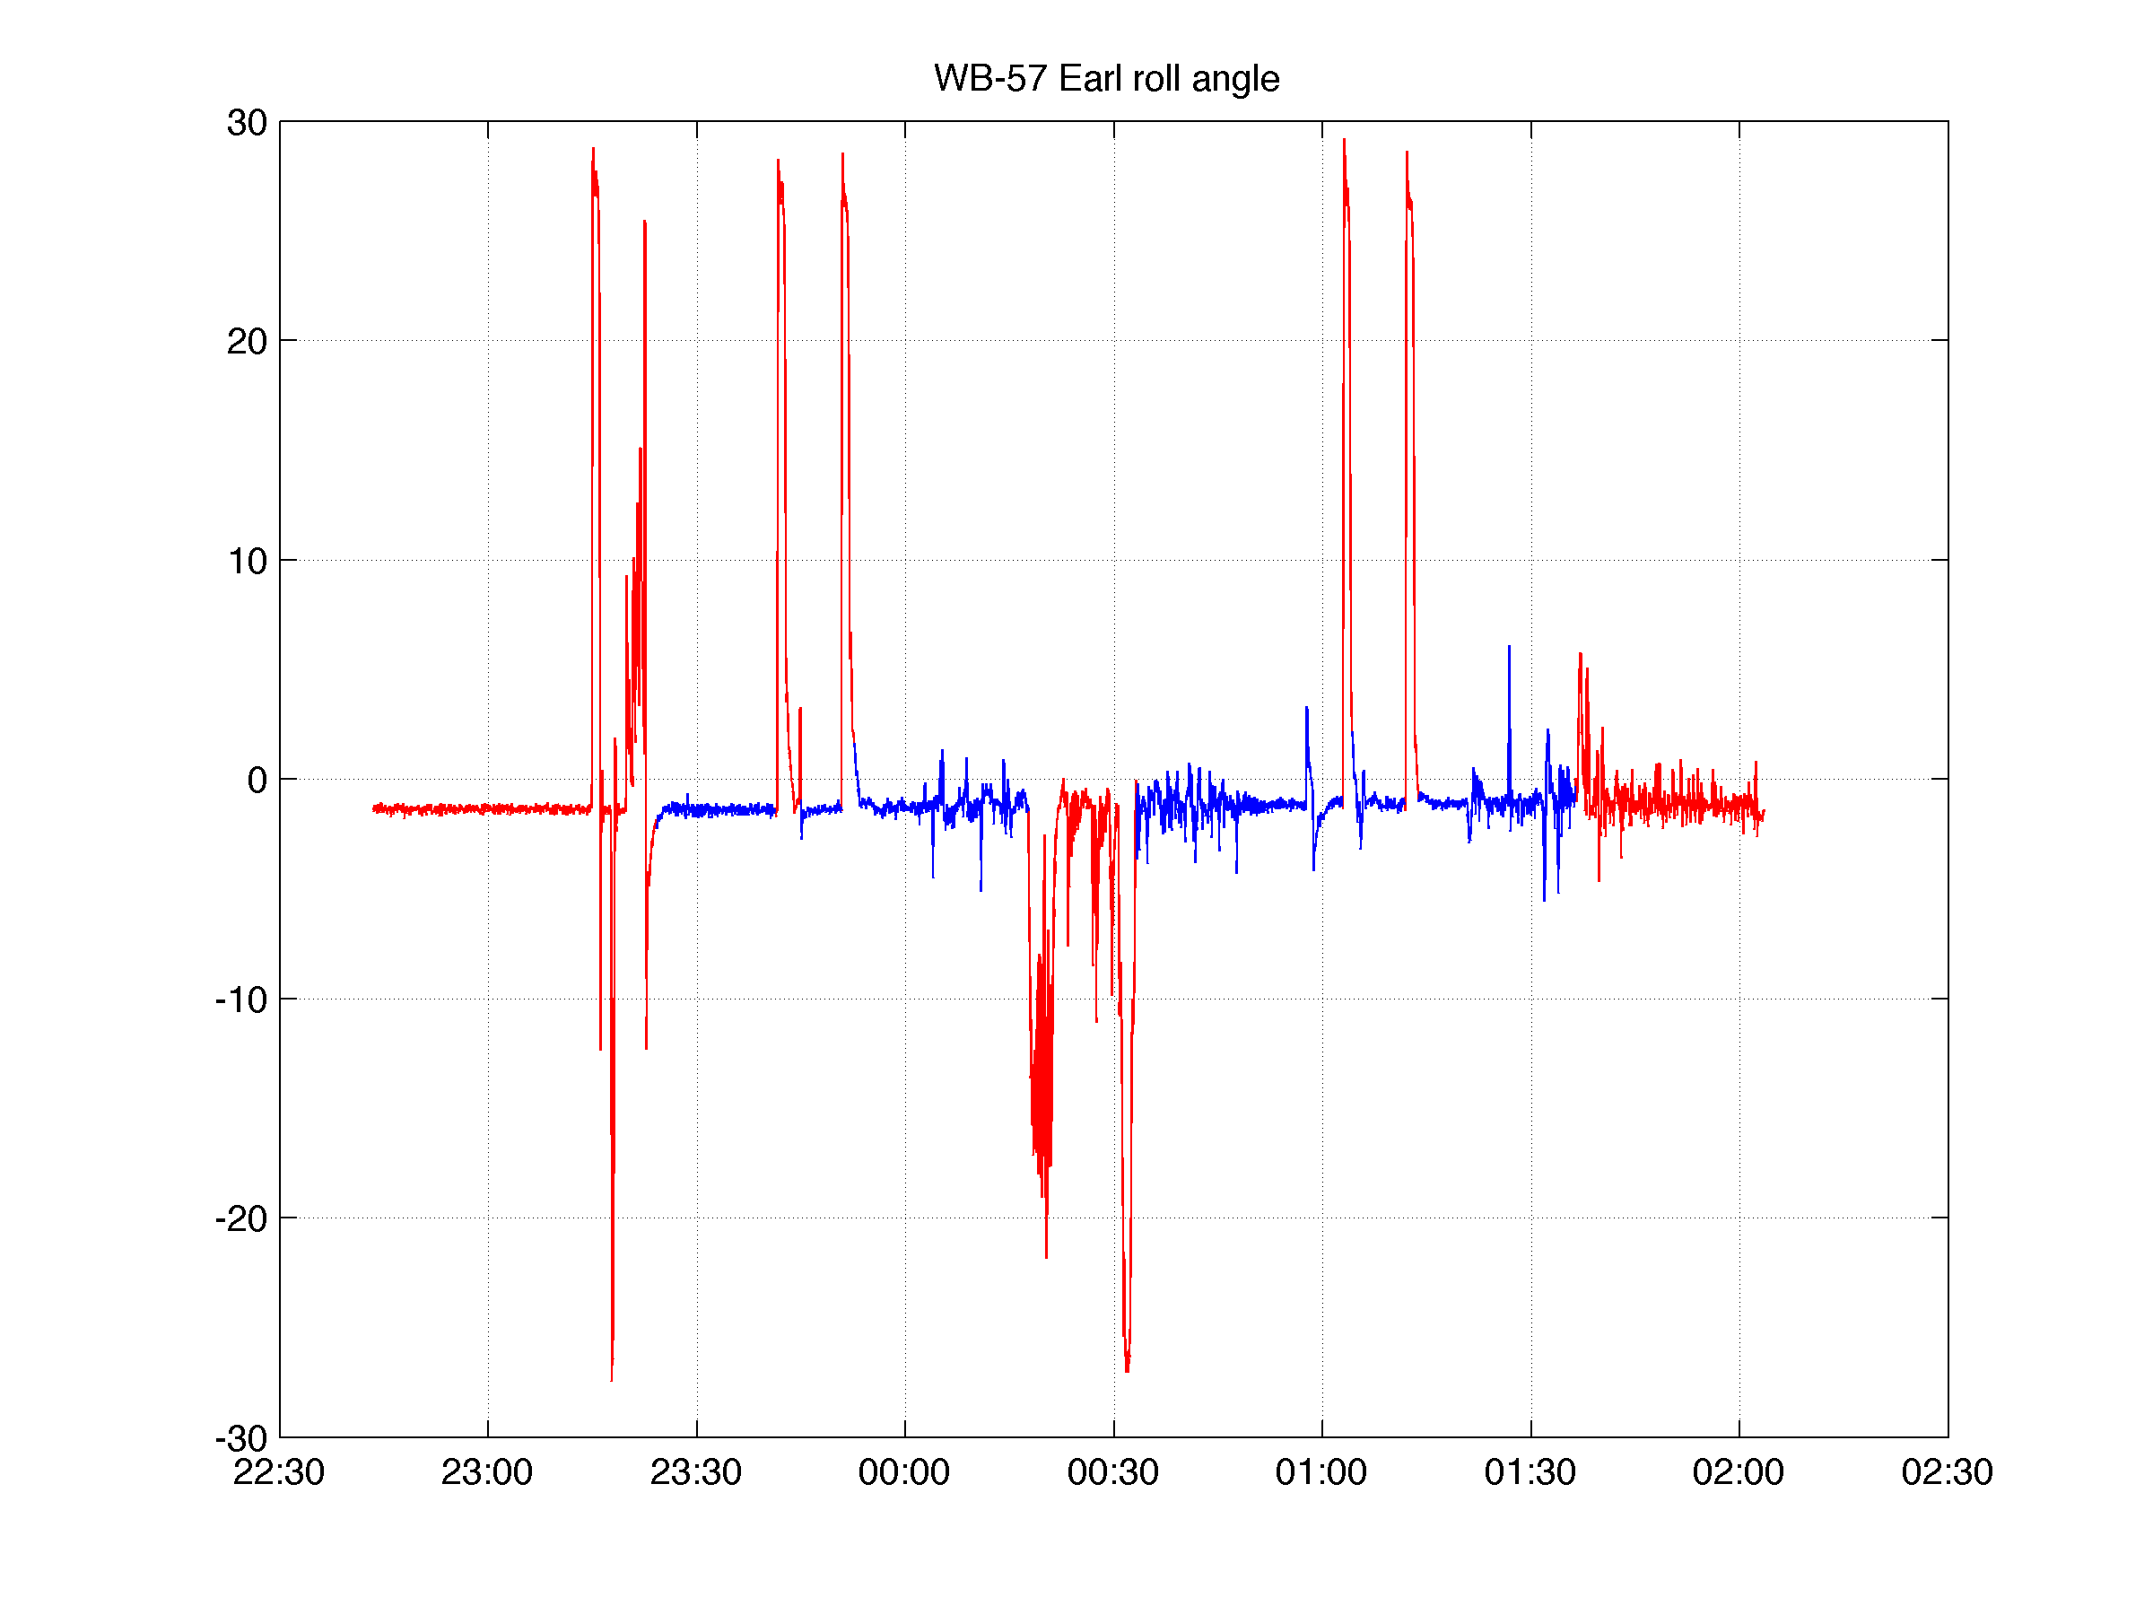
Earl Flight Roll Angle Blue = Times during which HIRAD data are provided

Slide 5
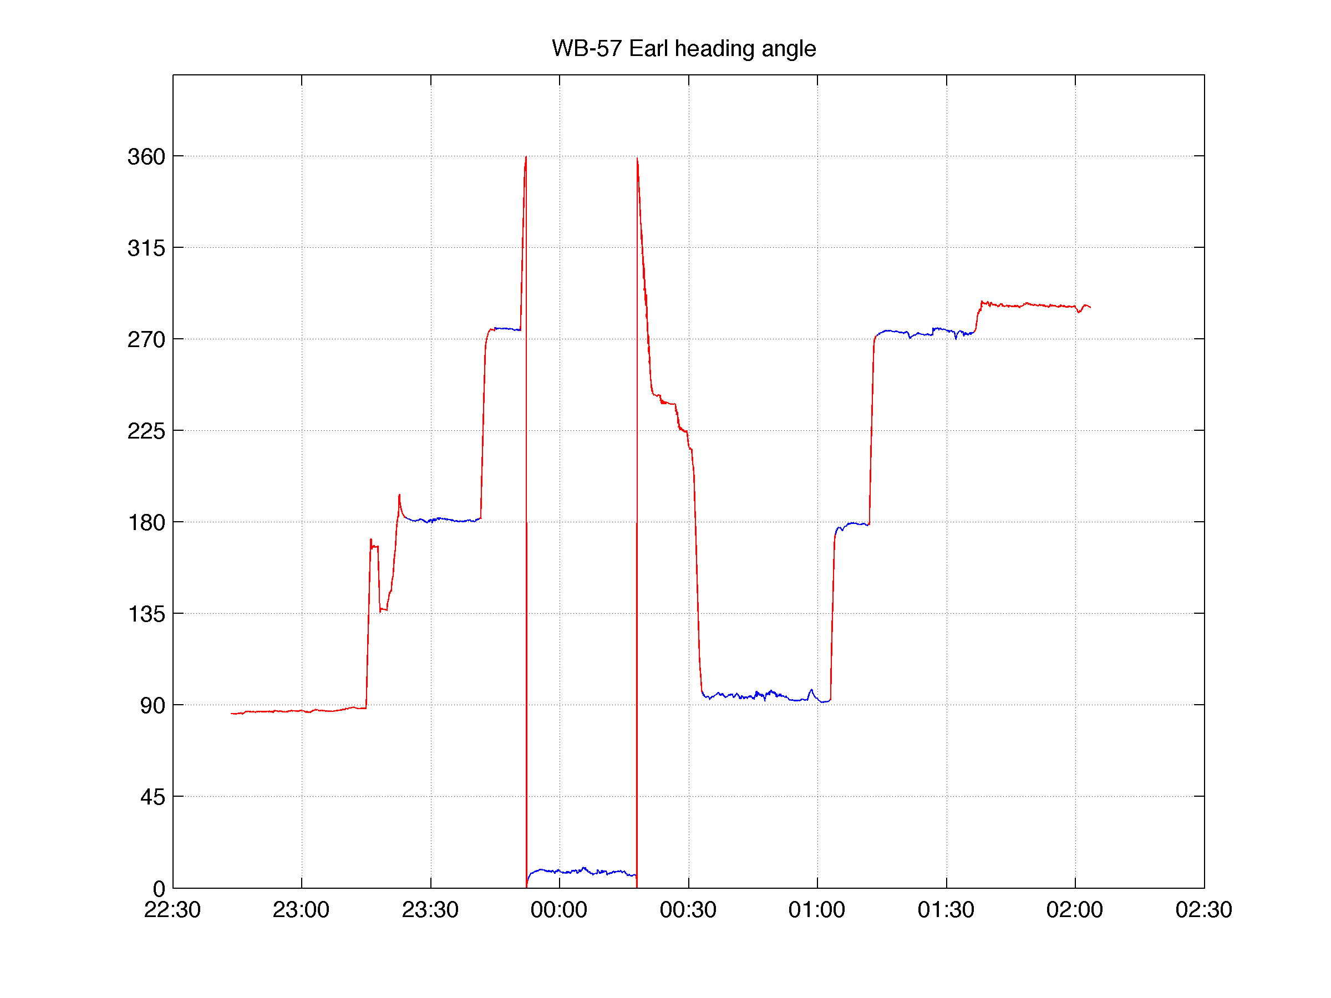
Earl Flight True Heading Angle Blue = Times during which HIRAD data are provided

Slide 6
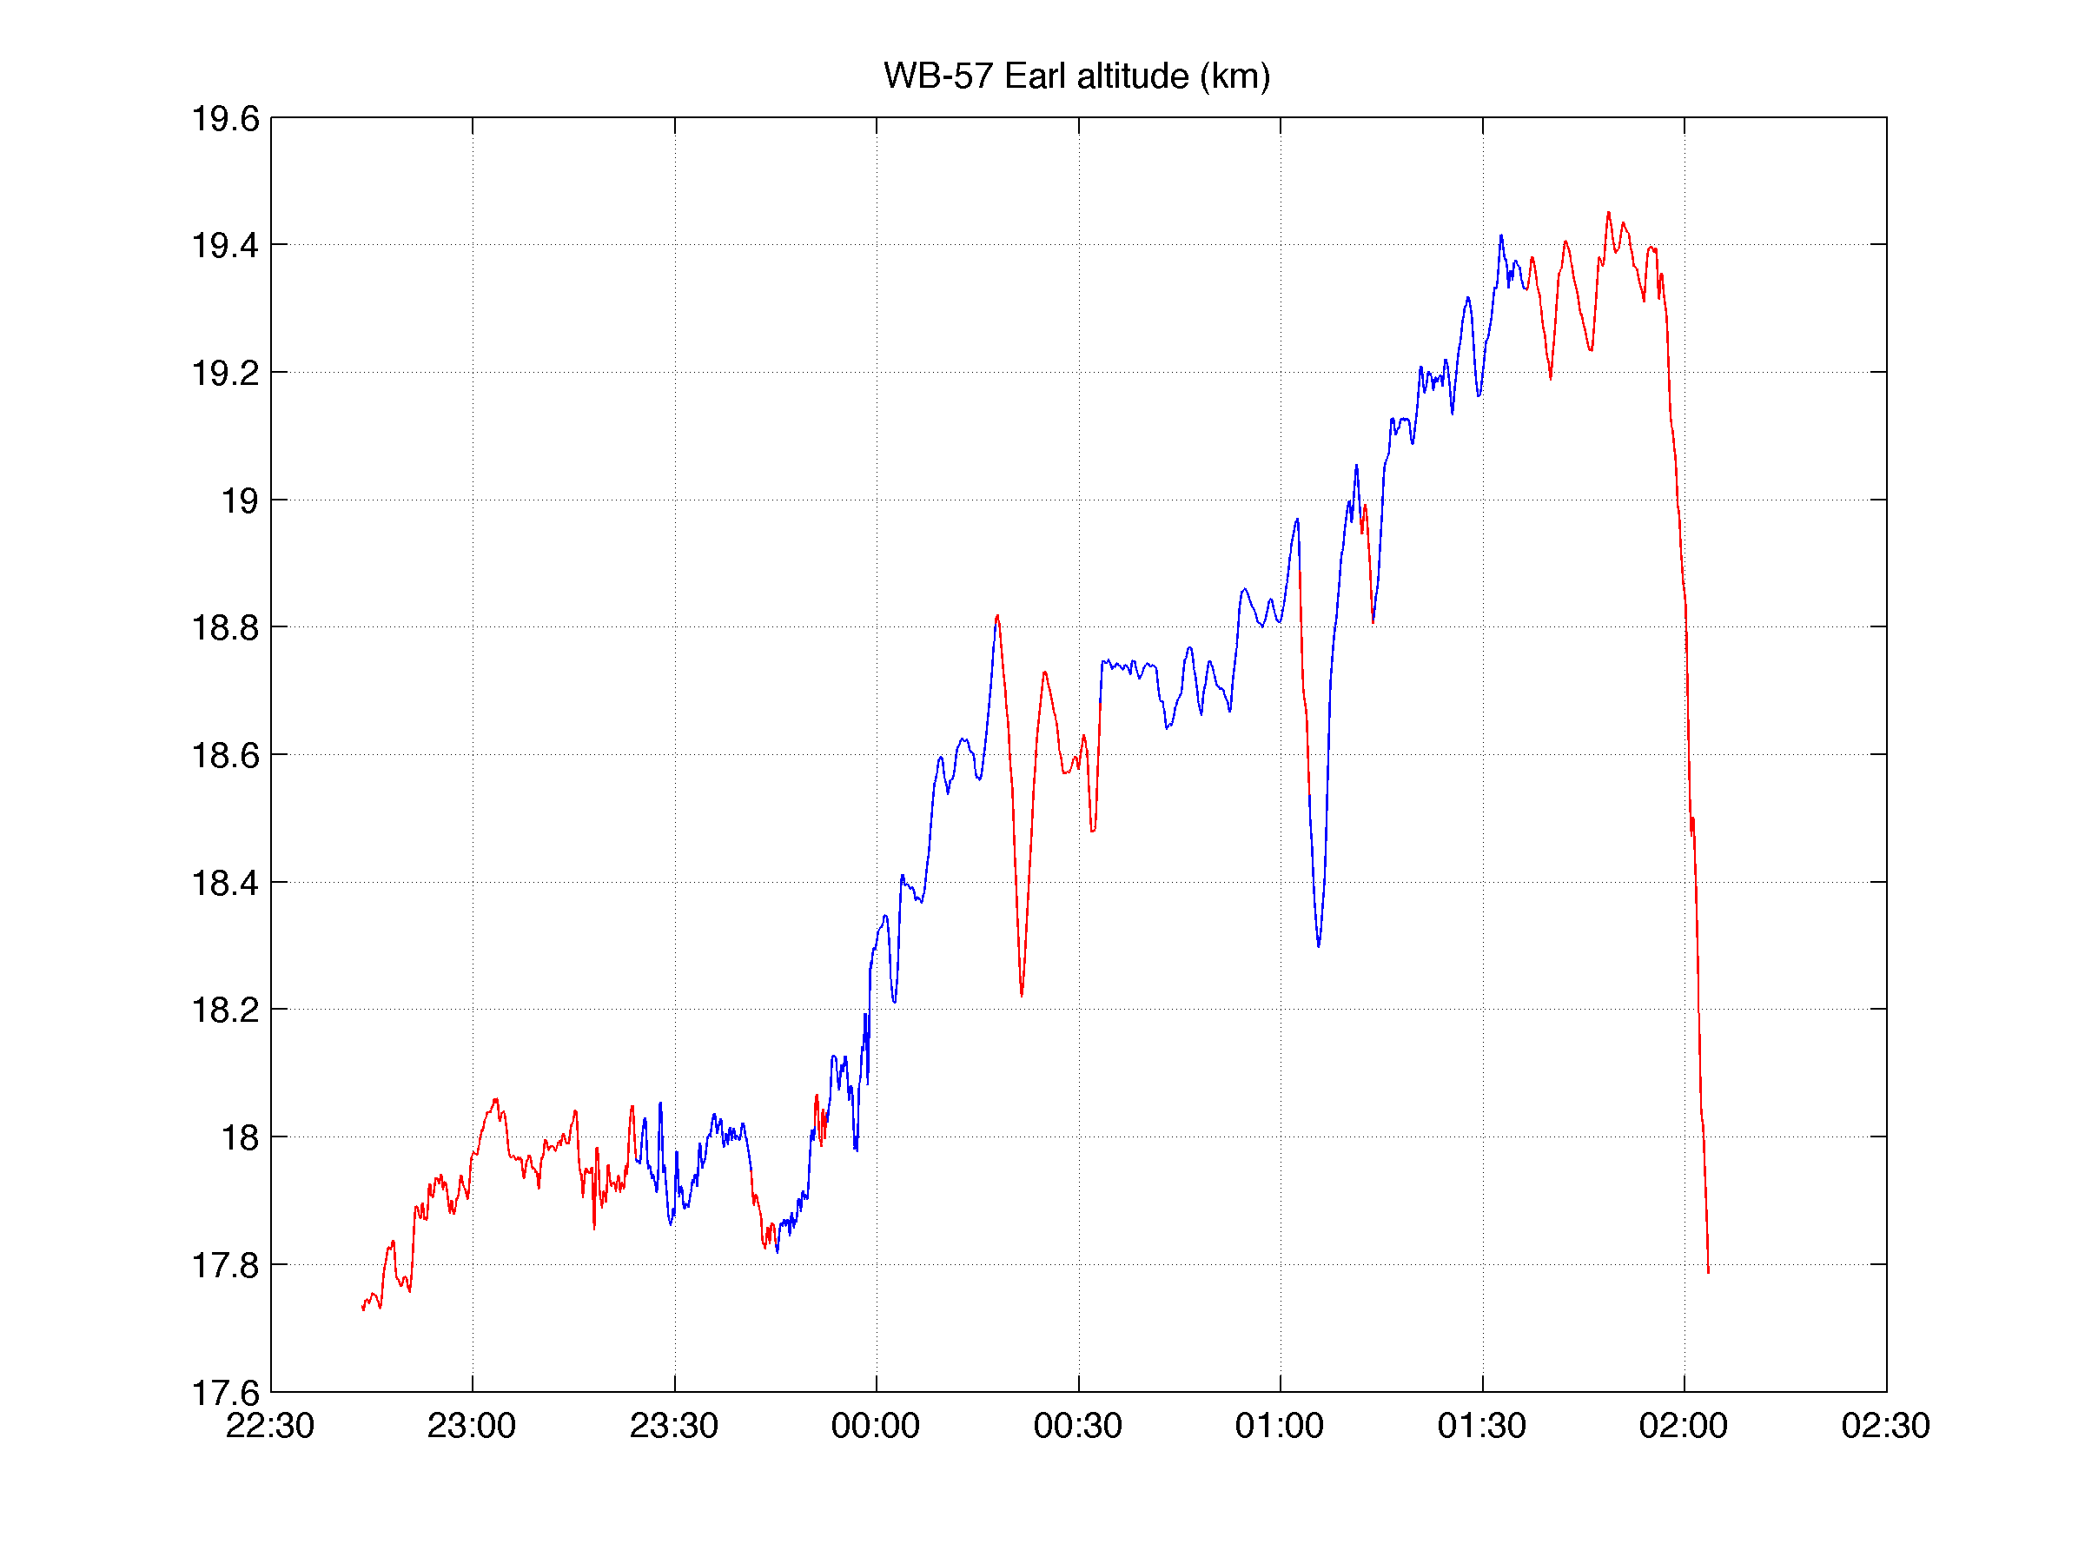
Earl Flight Altitude Blue = Times during which HIRAD data are provided

Slide 7
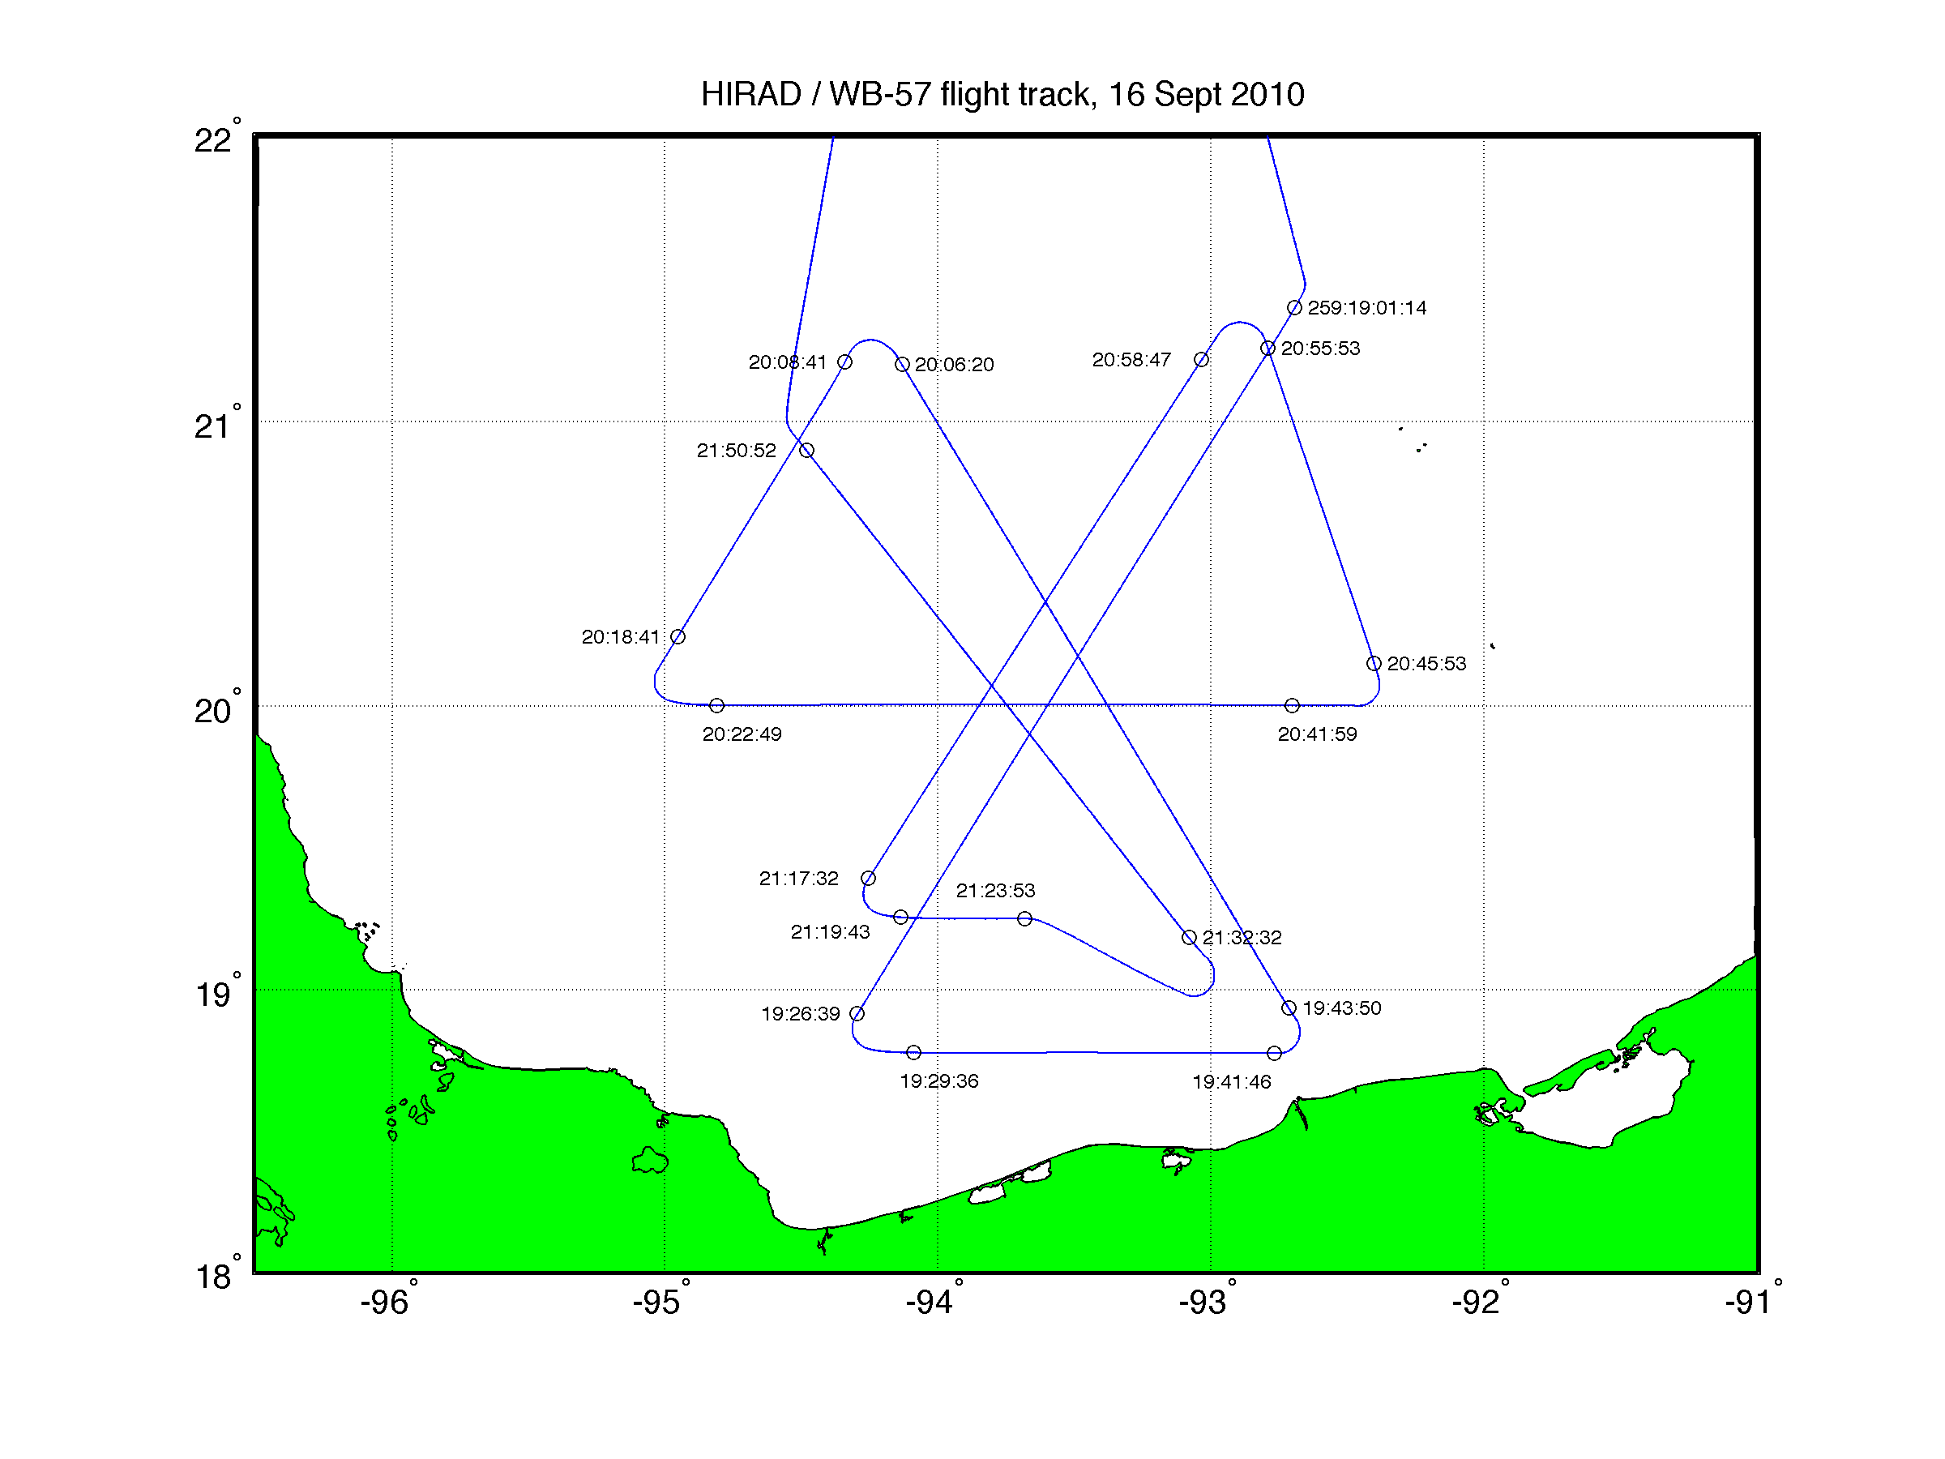
Karl (16 Sept) Flight Track with Times of Start and Finish of Data Provided on GRIP Data Facility (v0)

Slide 8
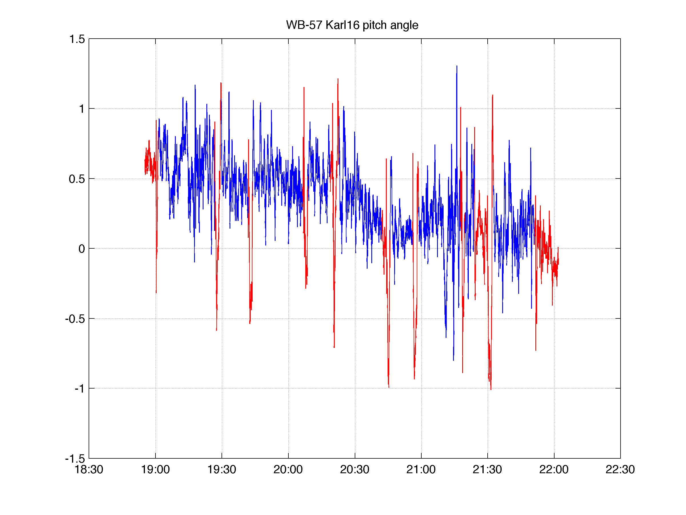
Karl 16 Sept Flight Pitch Angle Blue = Times during which HIRAD data are provided

Slide 9
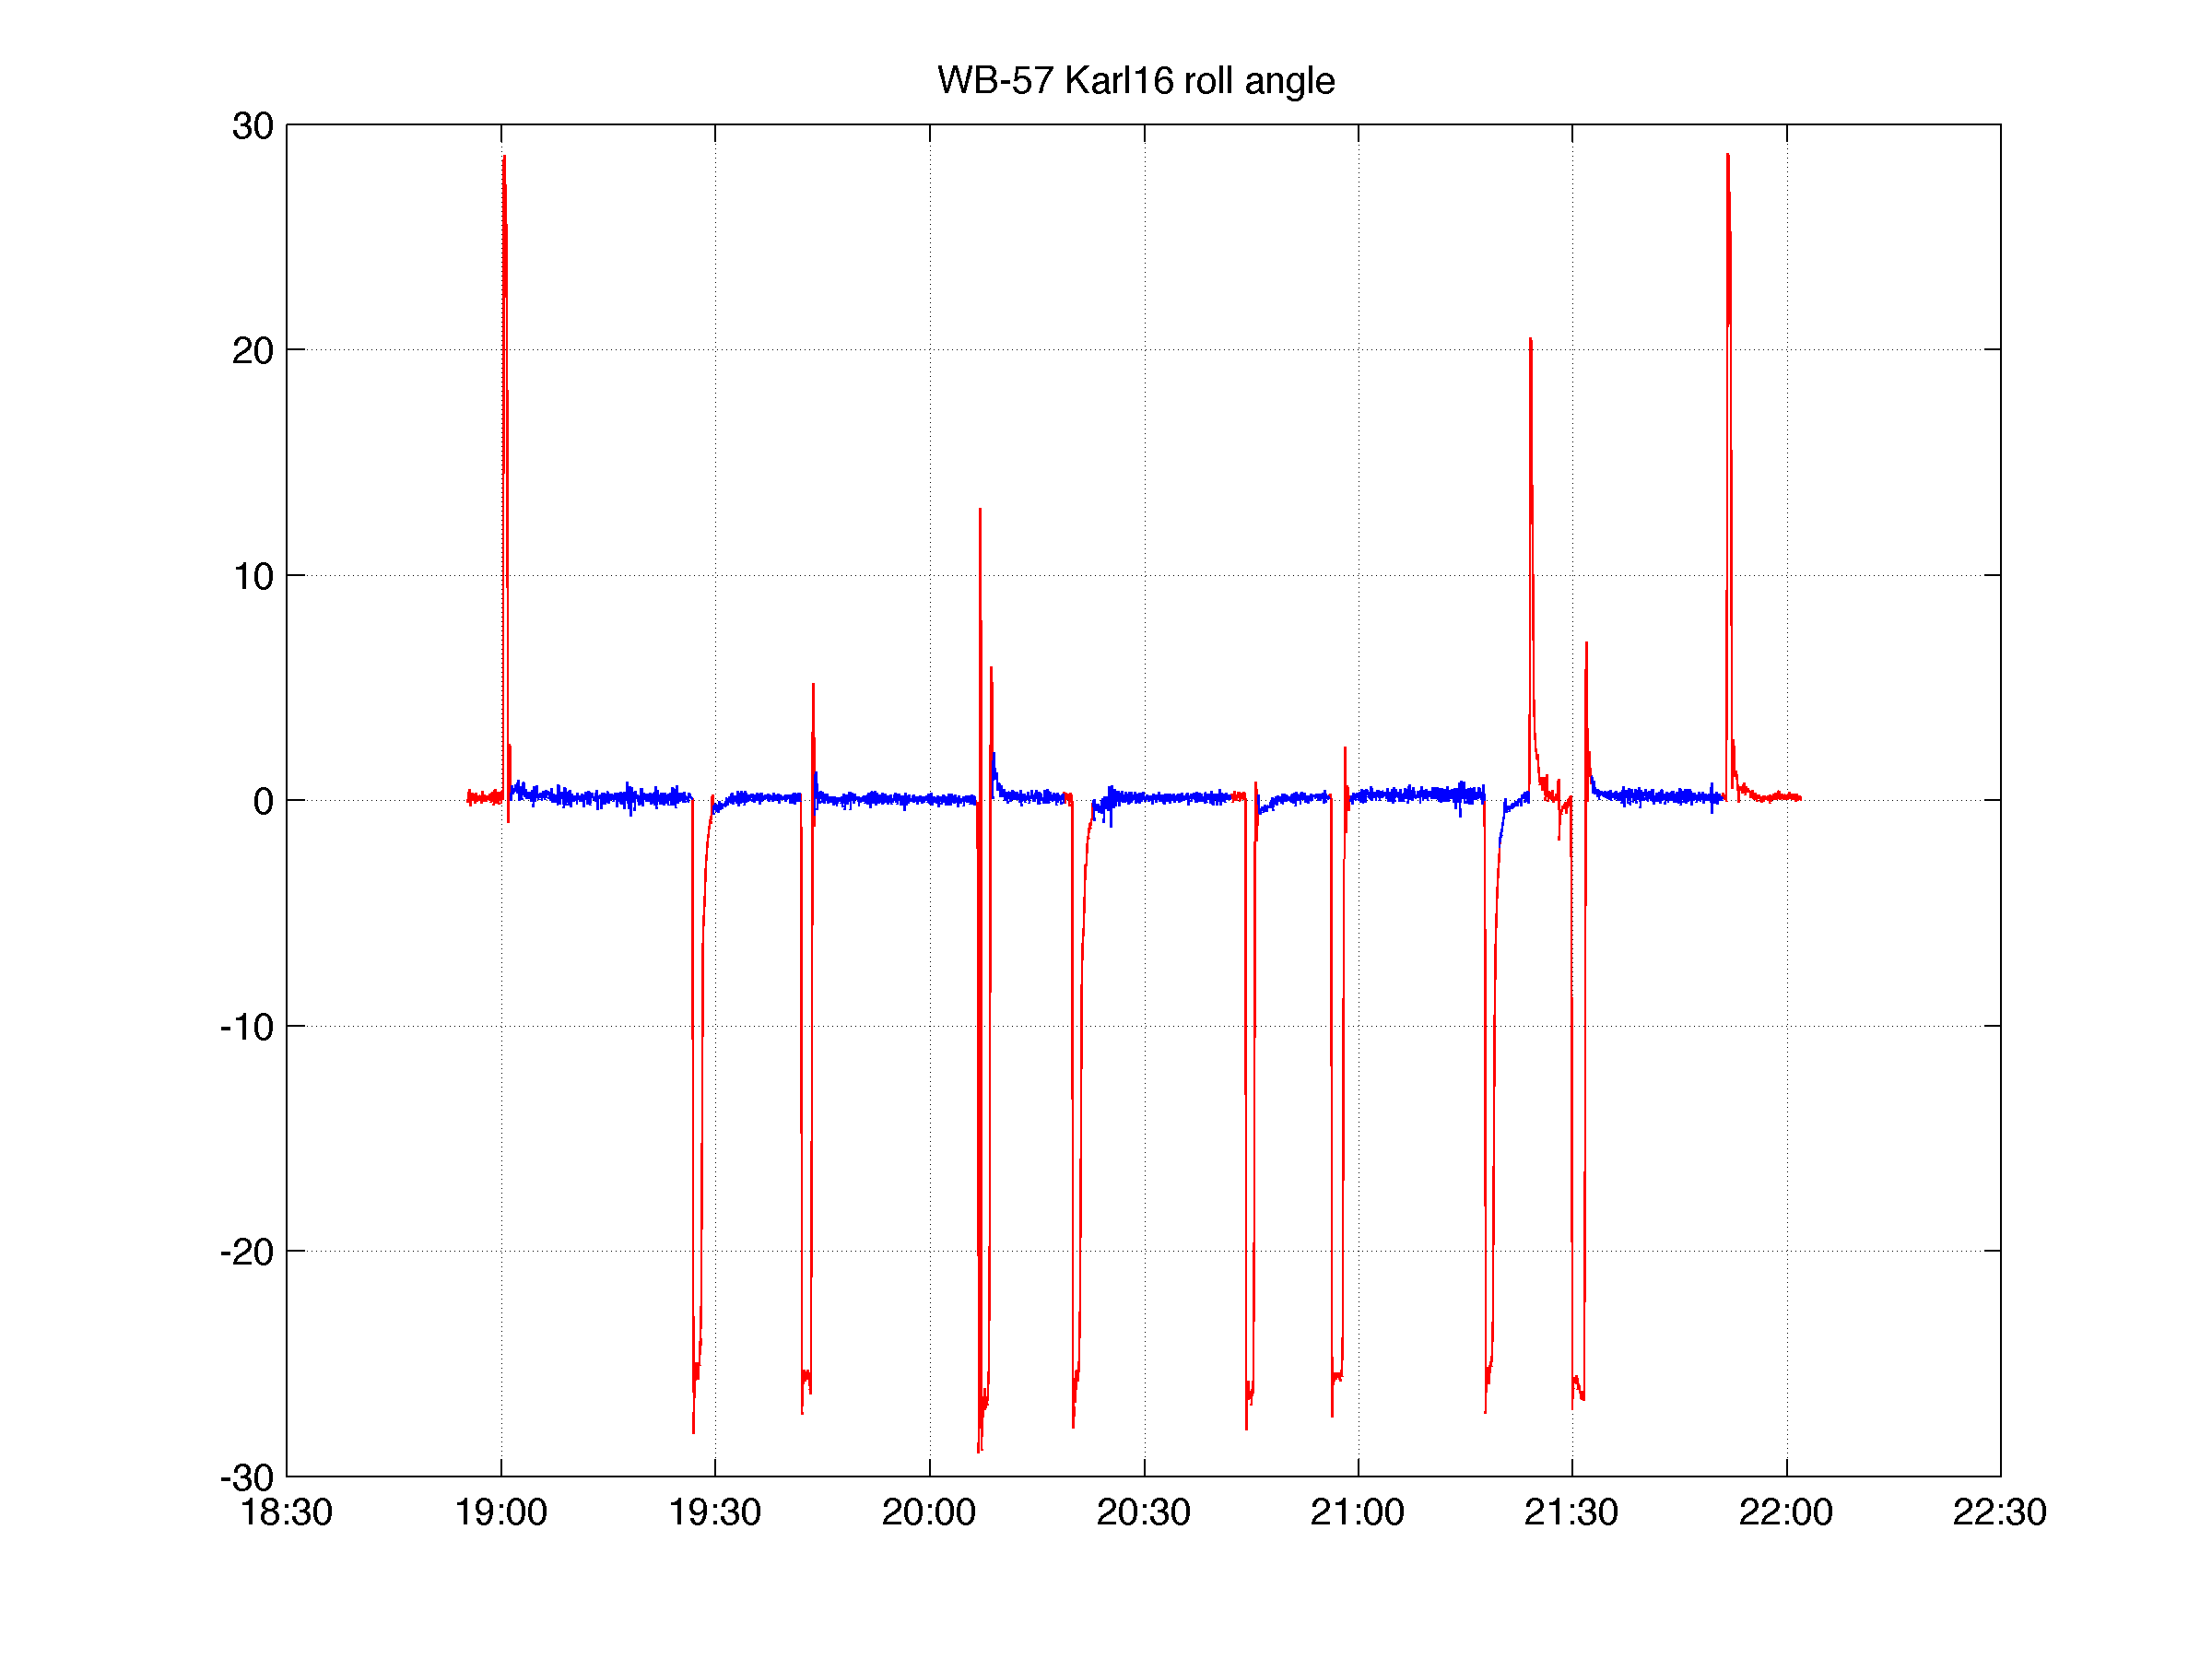
Karl 16 Sept Flight Roll Angle Blue = Times during which HIRAD data are provided

Slide 10
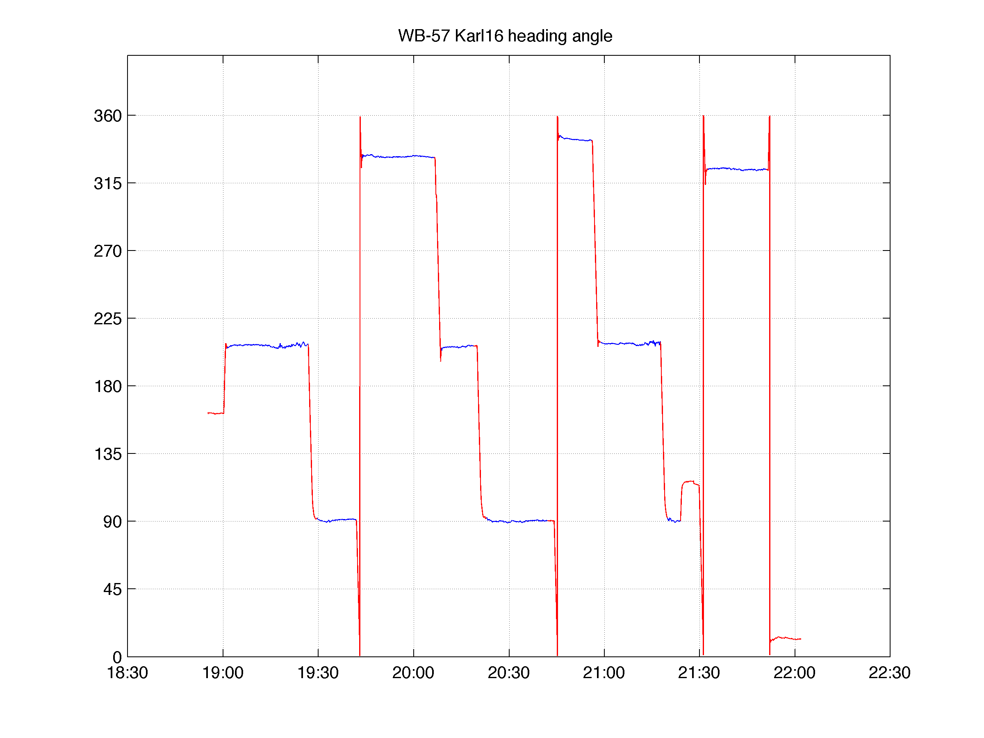
Karl 16 Sept Flight True Heading Angle Blue = Times during which HIRAD data are provided

Slide 11
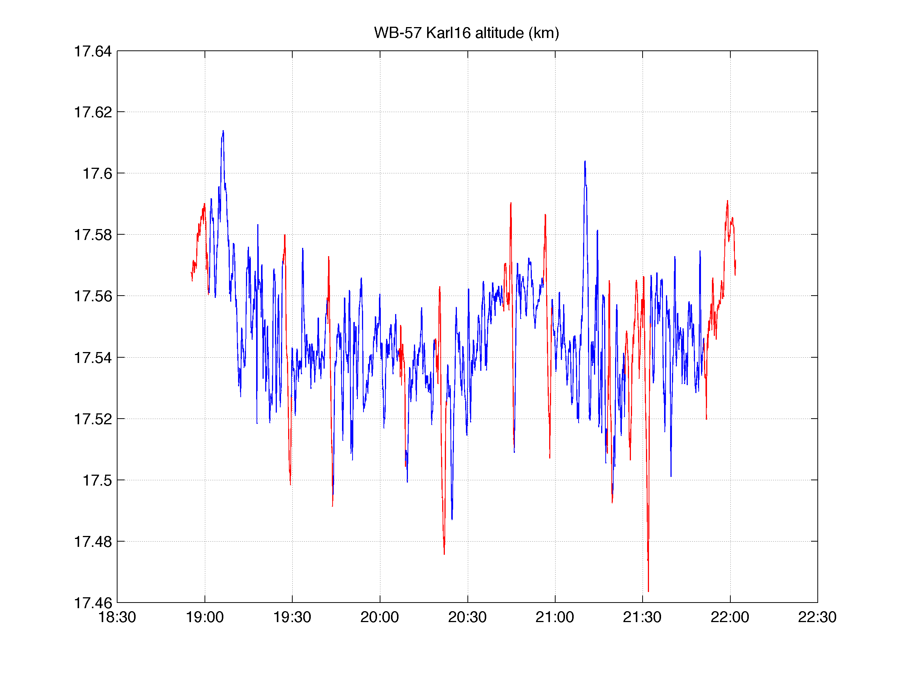
Karl 16 Sept Flight Altitude Blue = Times during which HIRAD data are provided

